Slide 1
AD/AS Framework

Slide 2
Classicals versus Keynesians
There are two key questions in the debate between classical and Keynesian approaches
How rapidly does the economy reach general equilibrium?
What are the effects of monetary policy on the economy?
Price adjustment and the self-correcting economy
The economy is brought into general equilibrium by adjustment of the price level
The speed at which this adjustment occurs is much debated
Classical economists see rapid adjustment of the price level

Slide 3
Classicals versus Keynesians Cont’d.
So the economy returns quickly to full employment after a
If firms change prices instead of output in response to a change in demand, the adjustment process is almost immediate

Slide 4
Keynesian economists see slow adjustment of the price level
It may be several years before prices and wages adjust
When not in general equilibrium, output is determined by aggregate demand at the intersection of the IS and LM curves, and the labor market is not in equilibrium

Slide 5
Monetary Neutrality
Money is neutral if a change in the nominal money supply changes the price level proportionately but has no effect on real variables
The classical view is that a monetary expansion affects prices quickly with at most a transitory effect on real variables
Keynesians think the economy may spend a long time in disequilibrium, so a monetary expansion increases output and employment and causes the real interest rate to fall
Keynesians believe in monetary neutrality in the long run but not the short run, while classicals believe it holds even in the relatively short run

Slide 6
Goals of the lecture
Discuss the role of price adjustment in achieving general equilibrium
Explain the fundamentals and implications of the AD–AS model

Slide 7
Aggregate Demand and Aggregate Supply
AD–AS relates the price level to output
The AD curve is unlike other demand curves, which relate the quantity demanded of a good to its relative price; the AD curve relates the total quantity of goods demanded to the general price level, not a relative price
The AD curve slopes downward because a higher price level is associated with lower real money supply, shifting the LM curve up, raising the real interest rate, and decreasing output demanded

Slide 8
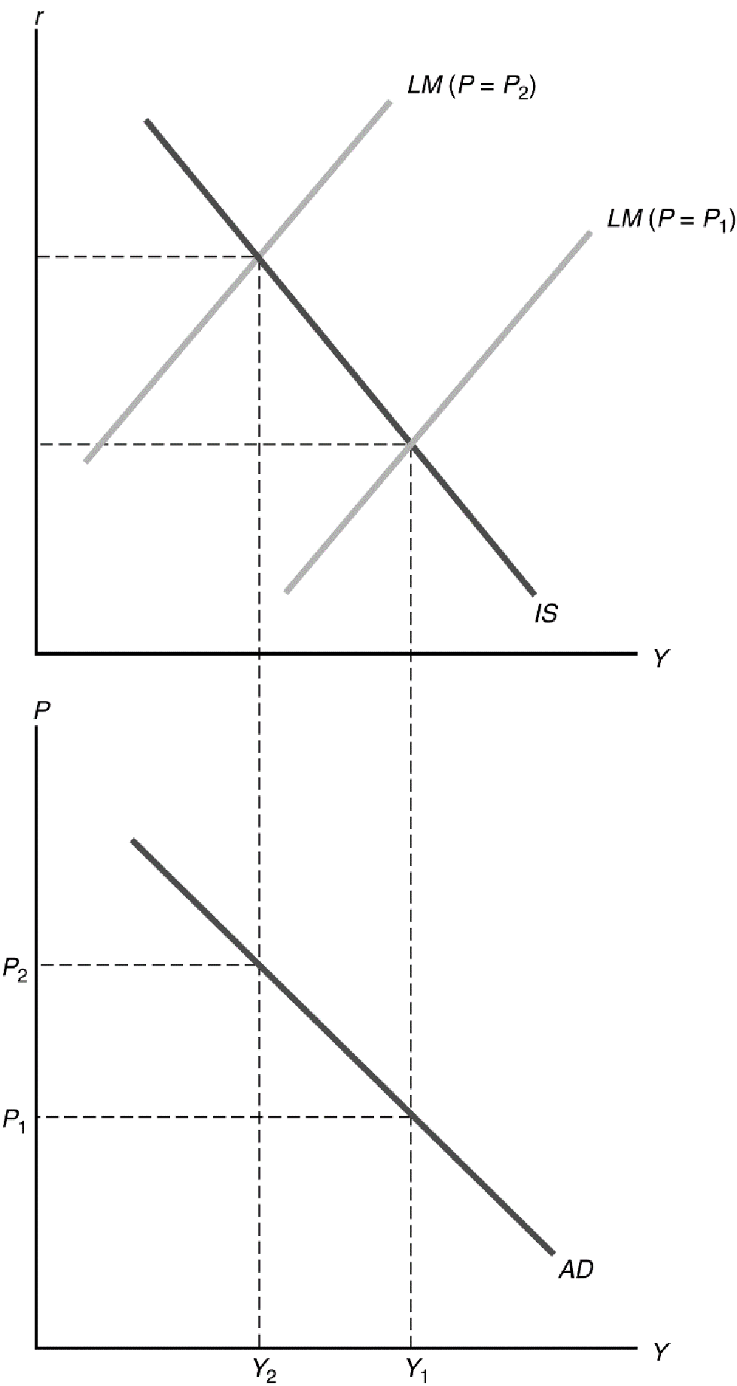
The Aggregate Demand Curve

Slide 9
Factors that shift the AD curve
Any factor that causes the intersection of the IS and LM curves to shift to the left causes the AD curve to shift down and to the left; any factor causing the IS–LM intersection to shift to the right causes the AD curve to shift up and to the right
For example, a temporary increase in government purchases shifts the IS curve up and to the right, so it shifts the AD curve up and to the right as well

Slide 10
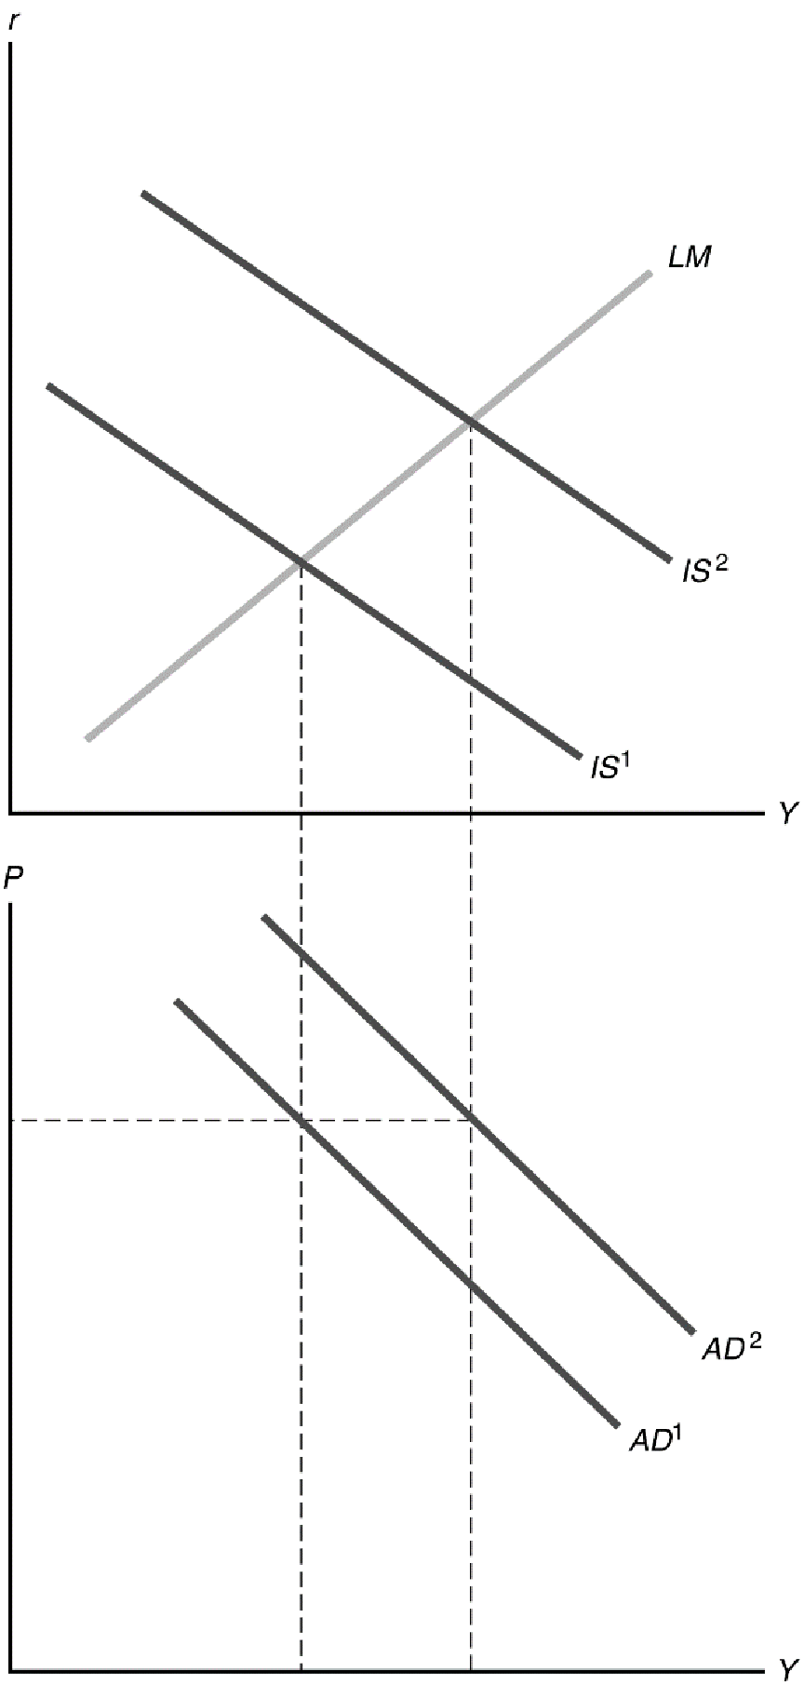
A Shift of the Aggregate Demand Curve

Slide 11
Summary: Factors that shift the AD curve
Factors that shift the IS curve up and to the right and thus the AD curve up and to the right as well
Increases in future output (Y^{f} ), wealth, government purchases (G), or the expected future marginal productivity of capital (MPK^{f} )
Decreases in taxes (T) if Ricardian equivalence doesn’t hold, or the effective tax rate on capital (t)
Factors that shift the LM curve down and to the right and thus the AD curve up and to the right as well
Increases in the nominal money supply (M) or in expected inflation (p^{e})
Decreases in the nominal interest rate on money (i^{m}) or the real demand for money

Slide 12
The Aggregate Supply Curve
The aggregate supply curve shows the relationship between the price level and the aggregate amount of output that firms supply
In the short run, prices remain fixed, so firms supply whatever output is demanded
a. The short-run aggregate supply curve is horizontal

Slide 13
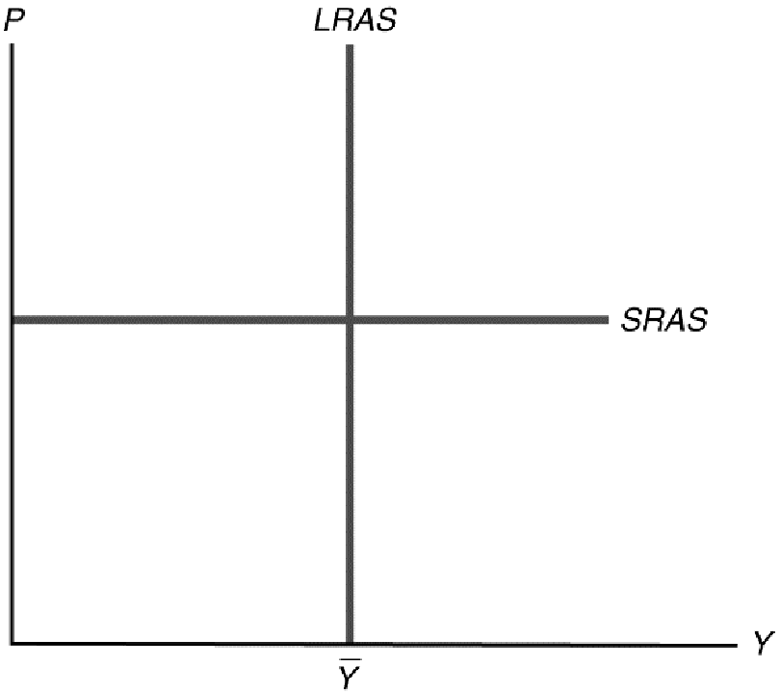
Graph of the Aggregate Supply Curve

Slide 14
The Aggregate Supply Curve Cont’d.
Full-employment output is not affected by the price level, so the long-run aggregate supply curve (LRAS) is a vertical line at Y = Y *

Slide 15
Factors that Shift the Aggregate Supply Curve
The SRAS curve shifts whenever firms change their prices in the short run
Factors like increased costs of producing goods lead firms to increase prices, shifting SRAS up
Factors leading to reduced prices shift SRAS down
Anything that increases Y* shifts the LRAS curve right; anything that decreases Y* shifts the LRAS left.
Examples include changes in the labor force or productivity changes that affect labor demand

Slide 16
Equilibrium in the AD–AS model
Short-run equilibrium: AD intersects SRAS
Long-run equilibrium: AD intersects LRAS
Also called general equilibrium
AD, LRAS, and SRAS all intersect at same point

Slide 17
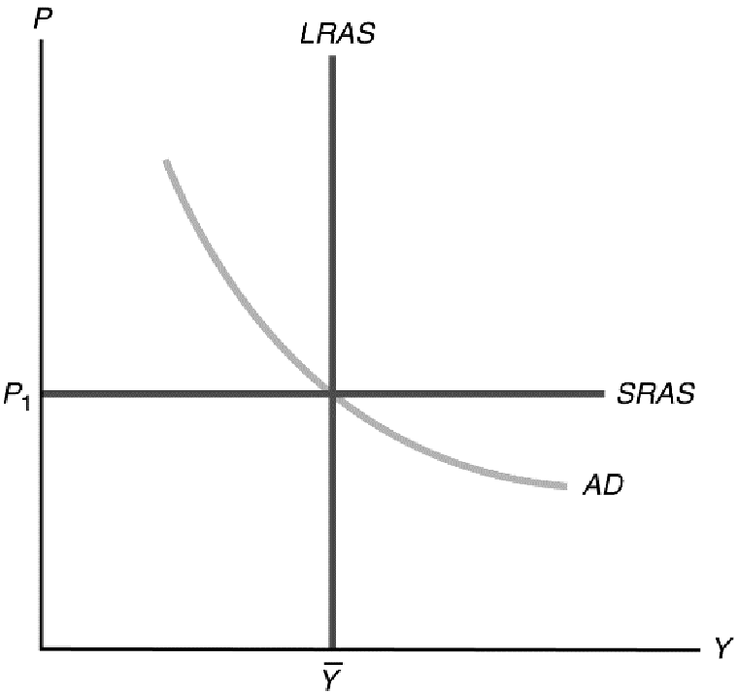
Equilibrium in the AD–AS model Cont’d.

Slide 18
Equilibrium in the AD–AS model Cont’d.
If the economy is not in general equilibrium, economic forces work to restore general equilibrium both in AD–AS diagram and IS–LM diagram

Slide 19
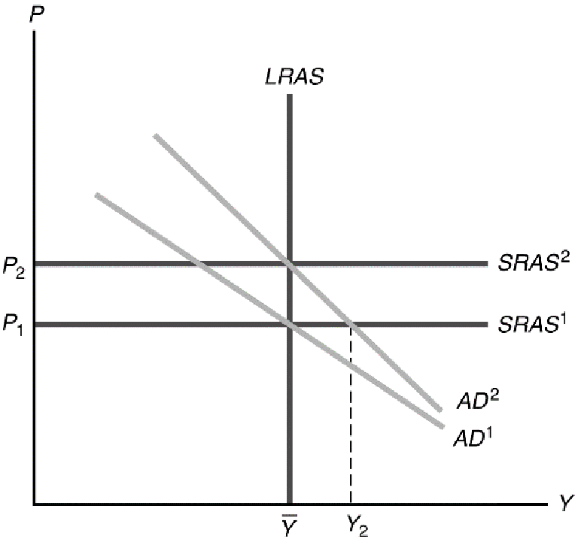
Monetary neutrality in the AD–AS model

Slide 20
Monetary neutrality in the AD–AS model Cont’d.
Suppose the economy begins in general equilibrium, but then the money supply is increased by 10%
This shifts the AD curve upward by 10% (from AD¹ to AD²) because to maintain the aggregate quantity demanded at a given level, the price level would have to rise by 10% so that real money supply would not change and would remain equal to real money demand
In the short run, with the price level fixed, equilibrium occurs where AD² intersects SRAS¹, with a higher level of output

Slide 21
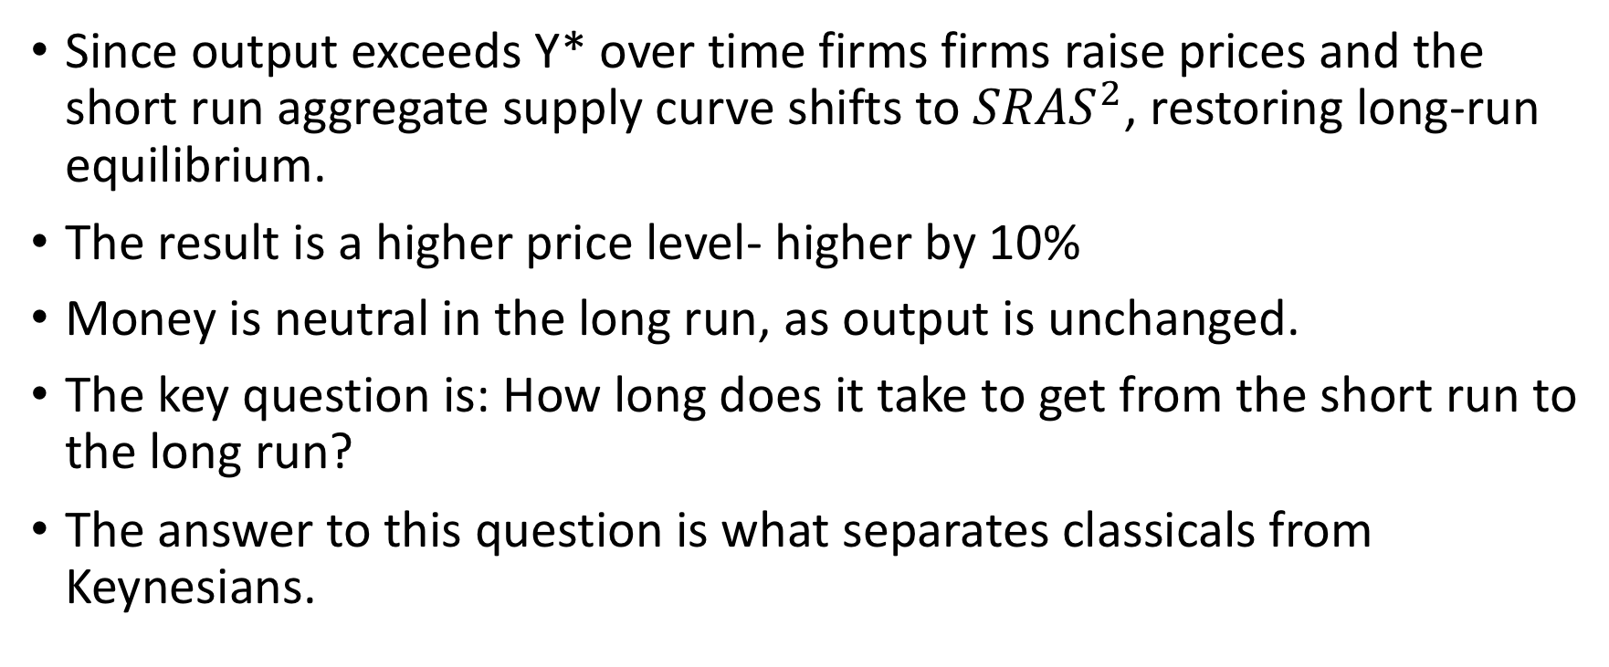
Monetary neutrality in the AD–AS model Cont’d.
Since output exceeds Y* over time firms firms raise prices and the short run aggregate supply curve shifts to ${SRAS}^{2}$, restoring long-run equilibrium.
The result is a higher price level- higher by 10%
Money is neutral in the long run, as output is unchanged.
The key question is: How long does it take to get from the short run to the long run?
The answer to this question is what separates classicals from Keynesians.

