Slide 1


Slide 2

INTRODUCCIÓN

Slide 3
Versiones
PROYECTO COMPRAS | ARCHIVOS
1) Cloud en Fabric con tablas, medidas y calendario en la nube
2) On Premise, con todos los datos en la versión Desktop
Departamento Compras.pbix

Slide 4
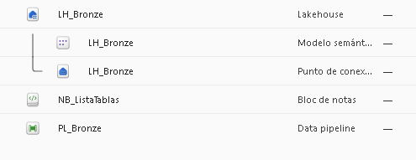
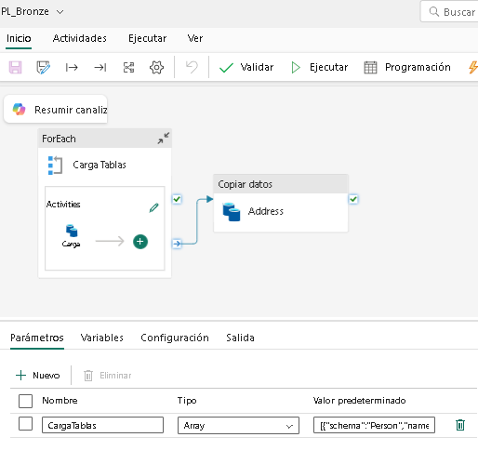
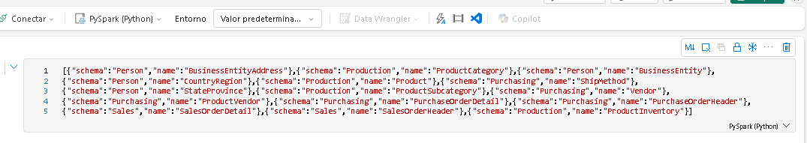
Arquitectura de medallón | Bronze
PROYECTO COMPRAS | CLOUD

Slide 5
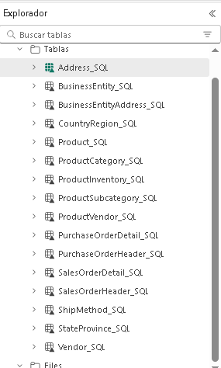
Arquitectura de medallón | Bronze
PROYECTO COMPRAS | CLOUD

Slide 6
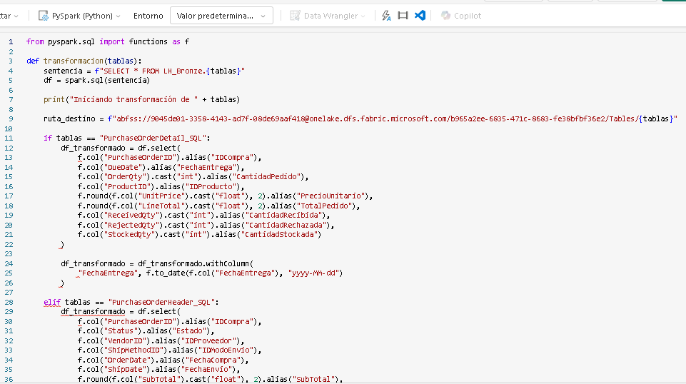
Arquitectura de medallón | Silver
PROYECTO COMPRAS | CLOUD

Slide 7
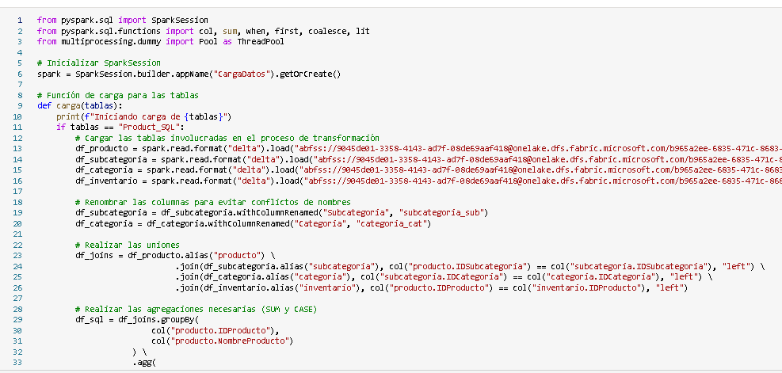
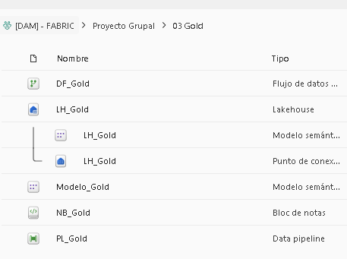
Arquitectura de medallón | Gold
PROYECTO COMPRAS | CLOUD

Slide 8
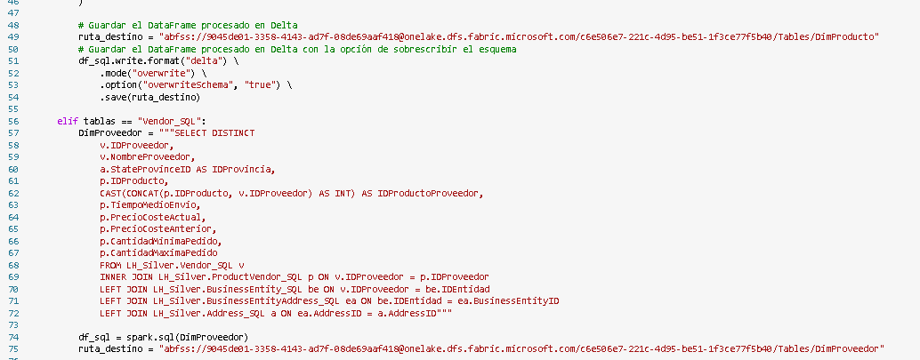
Arquitectura de medallón | Gold
PROYECTO COMPRAS | CLOUD

Slide 9
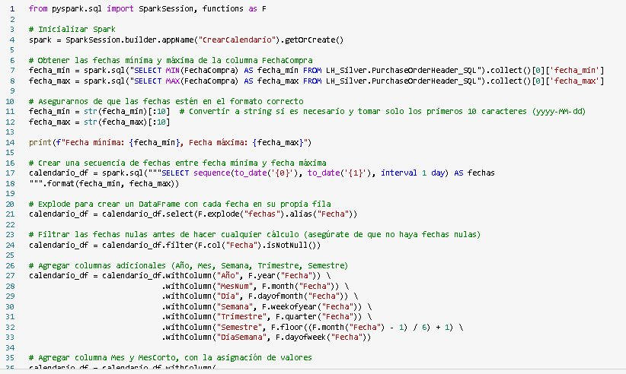
Arquitectura de medallón | Gold
PROYECTO COMPRAS | CLOUD

Slide 10
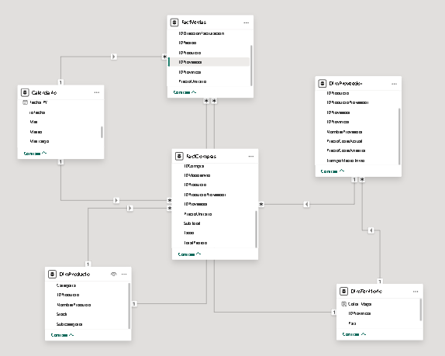
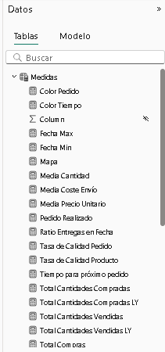
Modelo y medidas
PROYECTO COMPRAS | CLOUD

Slide 11
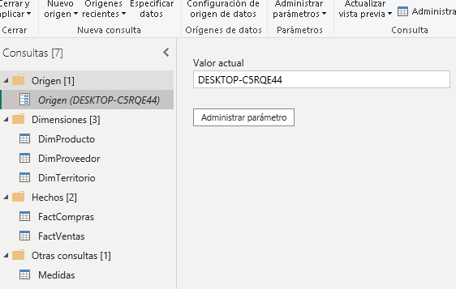
Consultas SQL y parámetro origen
PROYECTO COMPRAS | ON PREMISE

Slide 12
Consultas SQL y parámetro origen
PROYECTO COMPRAS | ON PREMISE
DimProducto
SELECT
p.ProductID AS IDProducto,
p.Name AS NombreProducto,
SUM(pi.Quantity) AS Stock,
CASE
WHEN pc.Name IS NULL THEN 'Sin Categorizar'
ELSE pc.Name
END AS Categoria,
CASE
WHEN psc.Name IS NULL THEN 'Sin Categorizar'
ELSE psc.Name
END AS Subcategoria
FROM Production.Product p
LEFT JOIN Production.ProductSubcategory psc ON p.ProductSubcategoryID = psc.ProductSubcategoryID
LEFT JOIN Production.ProductCategory pc ON psc.ProductCategoryID = pc.ProductCategoryID
LEFT JOIN Production.ProductInventory pi ON p.ProductID = pi.ProductID
GROUP BY p.ProductID, p.Name, pc.Name, psc.Name
---DimProveedor
SELECT DISTINCT
v.BusinessEntityID AS IDProveedor,
v.Name AS NombreProveedor,
a.StateProvinceID AS IDProvincia,
p.ProductID AS IDProducto,
CAST(CONCAT(p.ProductID, v.BusinessEntityID) AS INT) AS IDProductoProveedor,
pv.AverageLeadTime AS TiempoMedioEnvio,
pv.StandardPrice AS PrecioCosteActual,
pv.LastReceiptCost AS PrecioCosteAnterior,
pv.MinOrderQty AS CantidadMinimaPedido,
pv.MaxOrderQty AS CantidadMaximaPedido
FROM Purchasing.Vendor v
INNER JOIN Purchasing.ProductVendor pv ON v.BusinessEntityID = pv.BusinessEntityID
INNER JOIN Production.Product p ON pv.ProductID = p.ProductID
LEFT JOIN Person.BusinessEntity be ON v.BusinessEntityID = be.BusinessEntityID
LEFT JOIN Person.BusinessEntityAddress ea ON be.BusinessEntityID= ea.BusinessEntityID
LEFT JOIN Person.Address a ON ea.AddressID = a.AddressID
---DimTerritorio
SELECT DISTINCT
a.StateProvinceID AS IDProvincia,
c.Name AS Pais,
s.Name AS Provincia
FROM Person.BusinessEntityAddress b
LEFT JOIN Person.Address a ON b.AddressID = a.AddressID
LEFT JOIN Person.StateProvince s ON a.StateProvinceID = s.StateProvinceID
LEFT JOIN Person.CountryRegion c ON s.CountryRegionCode = c.CountryRegionCode
---FactCompras
SELECT
poh.PurchaseOrderID AS IDCompra,
poh.OrderDate AS FechaCompra,
poh.Status AS Estado,
poh.VendorID AS IDProveedor,
pod.OrderQty AS CantidadComprada,
pod.ProductID AS IDProducto,
poh.ShipMethodID AS IDModoenvio,
poh.ShipDate AS FechaEnvio,
poh.SubTotal AS SubTotal,
poh.TaxAmt AS Tasas,
poh.Freight AS CosteEnvio,
poh.Totaldue AS TotalPedido,
pod.DueDate AS FechaEntrega,
pod.UnitPrice AS PrecioUnitario,
pod.LineTotal AS CosteTotal,
pod.ReceivedQty AS CantidadRecibida,
pod.RejectedQty AS CantidadRechazada,
pod.StockedQty AS CantidadStockada,
CONCAT(pod.ProductID,poh.VendorID) AS IDProductoProveedor,
CAST(pod.DueDate - poh.OrderDate AS INT) AS FechaEntregaReal
FROM AdventureWorks2022.Purchasing.PurchaseOrderHeader poh
LEFT JOIN AdventureWorks2022.Purchasing.PurchaseOrderDetail pod ON poh.PurchaseOrderID = pod.PurchaseOrderID

Slide 13
Consultas SQL y parámetro origen
PROYECTO COMPRAS | ON PREMISE
---FactVentas
SELECT DISTINCT
soh.SalesOrderID AS IDPedido,
soh.OrderDate AS FechaVenta,
sod.ProductID AS IDProducto,
v.BusinessEntityID AS IDProveedor,
soh.BillToAddressID AS IDDireccionFacturacion,
sod.OrderQty AS CantidadVendida,
sod.UnitPrice AS PrecioUnitario,
a.StateProvinceID AS IDProvincia
FROM AdventureWorks2022.Sales.SalesOrderHeader soh
LEFT JOIN Sales.SalesOrderDetail sod ON soh.SalesOrderID = sod.SalesOrderID
LEFT JOIN Purchasing.ProductVendor v ON sod.ProductID = v.ProductID
LEFT JOIN Person.Address a ON soh.BillToAddressID = a.AddressID

Slide 14
Cuadro de mando Compras

Slide 15
¡Muchas gracias!

