Slide 1


Slide 2

INTRODUCCIÓN

Slide 3
Versiones
PROYECTO VENTAS | ARCHIVOS
1) Cloud en Fabric con tablas, medidas y calendario en la nube
2) On Premise, con todos los datos en la versión Desktop
Departamento Ventas.pbix

Slide 4
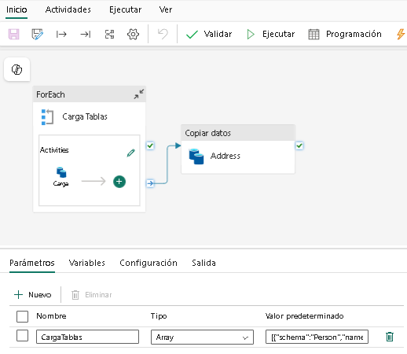
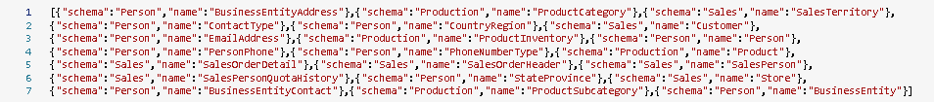
Arquitectura de medallón | Bronze
PROYECTO VENTAS | CLOUD

Slide 5
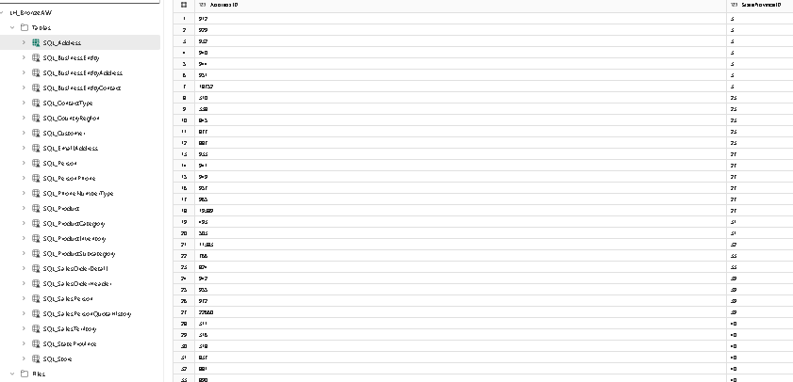
Arquitectura de medallón | Bronze
PROYECTO VENTAS | CLOUD

Slide 6
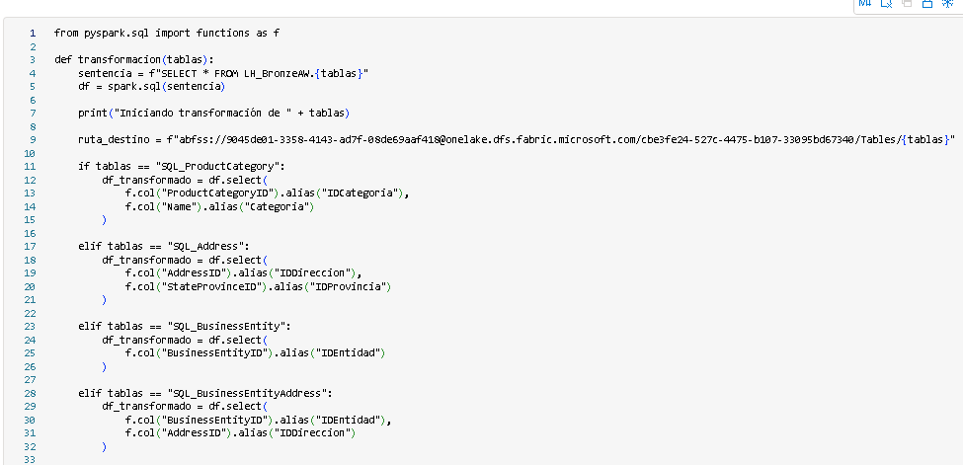
Arquitectura de medallón | Silver
PROYECTO VENTAS | CLOUD

Slide 7
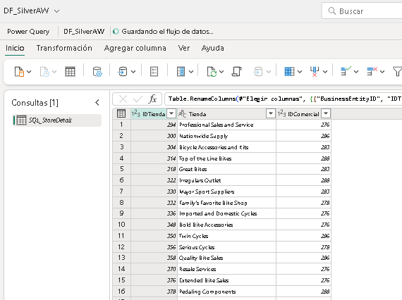
Arquitectura de medallón | Silver
PROYECTO VENTAS | CLOUD

Slide 8
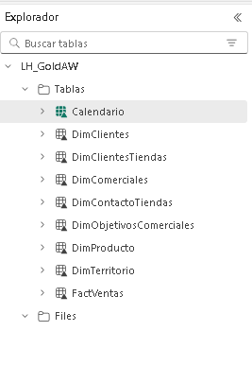
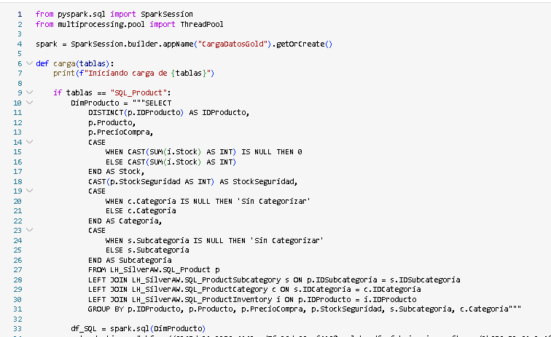
Arquitectura de medallón | Gold
PROYECTO VENTAS | CLOUD

Slide 9
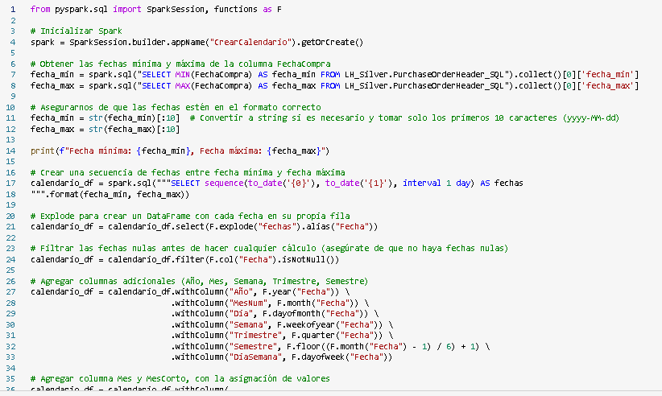
Arquitectura de medallón | Gold
PROYECTO VENTAS | CLOUD

Slide 10
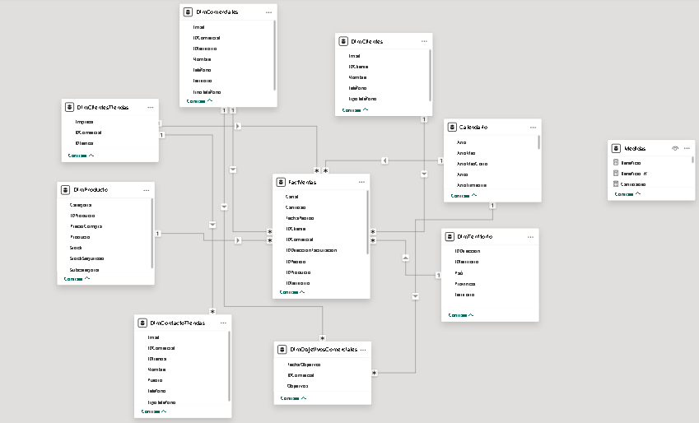
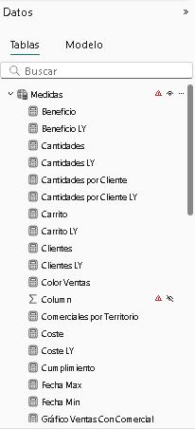
Modelo y medidas
PROYECTO VENTAS | CLOUD

Slide 11
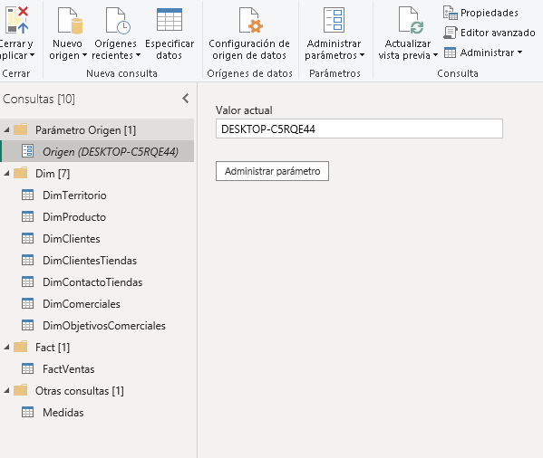
Consultas SQL y parámetro origen
PROYECTO VENTAS | ON PREMISE

Slide 12
Consultas SQL y parámetro origen
PROYECTO VENTAS | ON PREMISE
---DimProducto
SELECT
DISTINCT(p.ProductID) AS IDProducto,
p.Name AS Producto,
p.StandardCost AS PrecioUnitario,
CASE
WHEN CAST(SUM(i.Quantity) AS INT) IS NULL THEN 0
ELSE CAST(SUM(i.Quantity) AS INT)
END AS Stock,
CAST(p.SafetyStockLevel AS INT) AS StockSeguridad,
CASE
WHEN c.Name IS NULL THEN 'Sin Categoria'
ELSE c.Name
END AS Categoria,
CASE
WHEN s.Name IS NULL THEN 'Sin Categoria'
ELSE s.Name
END AS Subcategoria
FROM Production.Product p
LEFT JOIN Production.ProductSubcategory s ON p.ProductSubcategoryID = s.ProductSubcategoryID
LEFT JOIN Production.ProductCategory c ON s.ProductCategoryID = c.ProductCategoryID
LEFT JOIN Production.ProductInventory i ON p.ProductID = i.ProductID
GROUP BY p.ProductID, p.Name, p.StandardCost, p.SafetyStockLevel, s.Name, c.Name;
---DimTerritorio
SELECT DISTINCT
a.AddressID AS IDDireccion,
c.Name AS País,
sp.Name AS Provincia,
st.Name AS Territorio,
st.TerritoryID AS IDTerritorio
FROM Person.BusinessEntityAddress b
LEFT JOIN Person.Address a ON b.AddressID = a.AddressID
LEFT JOIN Person.StateProvince sp ON a.StateProvinceID = sp.StateProvinceID
LEFT JOIN Person.CountryRegion c ON sp.CountryRegionCode = c.CountryRegionCode
LEFT JOIN Sales.SalesTerritory st ON sp.TerritoryID = st.TerritoryID;
---DimClientes
SELECT DISTINCT
c.CustomerID AS IDCliente,
CONCAT(COALESCE(p.FirstName, ''), ' ', COALESCE(p.LastName, '')) AS Nombre,
e.EmailAddress AS Email,
ph.PhoneNumber AS Teléfono,
pt.Name AS TipoTeléfono
FROM Sales.Customer c
RIGHT JOIN Person.Person p ON c.PersonID = p.BusinessEntityID
LEFT JOIN Person.EmailAddress e ON p.BusinessEntityID = e.BusinessEntityID
LEFT JOIN Person.PersonPhone ph ON p.BusinessEntityID = ph.BusinessEntityID
LEFT JOIN Person.PhoneNumberType pt ON ph.PhoneNumberTypeID = pt.PhoneNumberTypeID
INNER JOIN Sales.Store s ON c.StoreID = s.BusinessEntityID
LEFT JOIN Person.BusinessEntityContact sc ON s.BusinessEntityID = sc.Busine2022.Purchasing.PurchaseOrderDetail pod ON poh.PurchaseOrderID = pod.PurchaseOrderID

Slide 13
Consultas SQL y parámetro origen
PROYECTO VENTAS | ON PREMISE
---DimClientesTiendas
SELECT DISTINCT
s.BusinessEntityID AS IDTienda,
s.Name AS Empresa,
s.SalesPersonID AS IDComercial
FROM Sales.Store s;
---DimContactoTiendas
SELECT
s.BusinessEntityID AS IDTienda,
p.FirstName + ' ' + p.LastName AS Nombre,
ea.EmailAddress AS Email,
ph.PhoneNumber AS Telefono,
pt.Name AS TipoTelefono,
ct.Name AS Puesto,
s.SalesPersonID AS IDComercial
FROM Sales.Store s
JOIN Sales.Customer c ON s.BusinessEntityID = c.CustomerID
JOIN Person.BusinessEntity be ON s.BusinessEntityID = be.BusinessEntityID
JOIN Person.BusinessEntityContact bec ON be.BusinessEntityID = bec.BusinessEntityID
JOIN Person.Person p ON bec.PersonID = p.BusinessEntityID
JOIN Person.ContactType ct ON bec.ContactTypeID = ct.ContactTypeID
LEFT JOIN Person.EmailAddress ea ON p.BusinessEntityID = ea.BusinessEntityID
LEFT JOIN Person.PersonPhone ph ON p.BusinessEntityID = ph.BusinessEntityID
LEFT JOIN Person.PhoneNumberType pt ON ph.PhoneNumberTypeID = pt.PhoneNumberTypeID;
---DimComerciales
SELECT DISTINCT
CASE
WHEN soh.SalesPersonID IS NULL THEN 0
ELSE soh.SalesPersonID
END AS IDComercial,
CAST(CASE
WHEN sp.TerritoryID IS NULL THEN 0
ELSE sp.TerritoryID
END AS INT) AS IDTerritorio,
CASE
WHEN st.[Group] IS NULL THEN 'Sin Territorio Asignado'
ELSE st.[Group]
END AS Territorio,
CASE
WHEN p.FirstName IS NULL THEN 'Ventas sin Comercial'
ELSE CONCAT(COALESCE(p.FirstName, ''), ' ', COALESCE(p.LastName, ''))
END AS Nombre,
CASE
WHEN e.EmailAddress IS NULL THEN 'Sin Email Asignado'
ELSE e.EmailAddress
END AS Email,
CASE
WHEN ph.PhoneNumber IS NULL THEN 'Sin Teléfono Asignado'
ELSE ph.PhoneNumber
END AS Teléfono,
CASE
WHEN pt.Name IS NULL THEN 'Sin Tipo Asignado'
ELSE pt.Name
END AS TipoTeléfono
FROM Sales.SalesPerson sp
RIGHT JOIN Sales.SalesOrderHeader soh ON sp.BusinessEntityID = soh.SalesPersonID
LEFT JOIN Person.Person p ON sp.BusinessEntityID = p.BusinessEntityID
LEFT JOIN Person.EmailAddress e ON p.BusinessEntityID = e.BusinessEntityID
LEFT JOIN Person.PersonPhone ph ON p.BusinessEntityID = ph.BusinessEntityID
LEFT JOIN Person.PhoneNumberType pt ON ph.PhoneNumberTypeID = pt.PhoneNumberTypeID
LEFT JOIN Sales.SalesTerritory st ON sp.TerritoryID = st.TerritoryID;

Slide 14
Consultas SQL y parámetro origen
PROYECTO VENTAS | ON PREMISE
---DimObjetivosComerciales
SELECT
BusinessEntityID AS IDComercial,
SalesQuota AS Objetivos,
QuotaDate AS FechaObjetivos
FROM Sales.SalesPersonQuotaHistory
---FactVentas
SELECT DISTINCT
soh.SalesOrderID AS IDPedido,
CAST(soh.OrderDate AS DATE) AS FechaPedido,
soh.OnlineOrderFlag AS VentaOnline,
soh.SalesOrderNumber AS NumeroPedido,
soh.CustomerID AS IDCliente,
CAST(CASE
WHEN soh.SalesPersonID IS NULL THEN 0
ELSE soh.SalesPersonID
END AS INT) AS IDComercial,
soh.BillToAddressID AS IDDireccionFacturacion,
c.StoreID AS IDTienda,
CAST(CASE
WHEN sp.TerritoryID IS NULL THEN 0
ELSE sp.TerritoryID
END AS INT) AS IDTerritorio,
sod.OrderQty AS Cantidad,
sod.ProductID AS IDProducto,
sod.UnitPrice AS PrecioUnitario,
CASE
WHEN soh.OnlineOrderFlag = 1 THEN 'Online'
ELSE 'Offline'
END AS Canal
FROM Sales.SalesOrderHeader soh
RIGHT JOIN Sales.SalesOrderDetail sod ON soh.SalesOrderID = sod.SalesOrderID
LEFT JOIN Sales.Customer c ON soh.CustomerID = c.CustomerID
LEFT JOIN Person.Address a ON soh.BillToAddressID = a.AddressID
LEFT JOIN Sales.SalesPerson sp ON soh.SalesPersonID = sp.BusinessEntityID;
---FactVentas
SELECT DISTINCT
soh.SalesOrderID AS IDPedido,
soh.OrderDate AS FechaVenta,
sod.ProductID AS IDProducto,
v.BusinessEntityID AS IDProveedor,
soh.BillToAddressID AS IDDireccionFacturacion,
sod.OrderQty AS CantidadVendida,
sod.UnitPrice AS PrecioUnitario,
a.StateProvinceID AS IDProvincia
FROM AdventureWorks2022.Sales.SalesOrderHeader soh
LEFT JOIN Sales.SalesOrderDetail sod ON soh.SalesOrderID = sod.SalesOrderID
LEFT JOIN Purchasing.ProductVendor v ON sod.ProductID = v.ProductID
LEFT JOIN Person.Address a ON soh.BillToAddressID = a.AddressID

Slide 15
Cuadro de mando Ventas

Slide 16
¡Muchas gracias!

