Slide 1
Movie Recommendation System
By: Dalya Lami, Ali Alam, Jahn Ferdinandus, Dayana Imanova

Slide 2

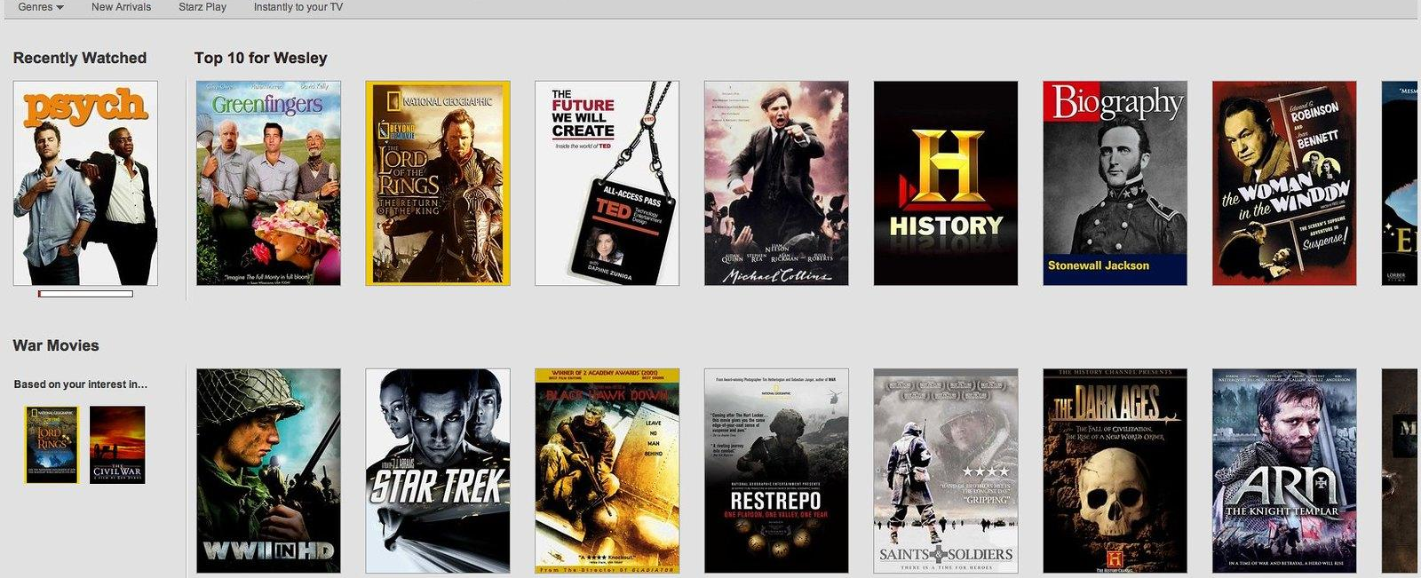
Project Objective:
We are focused on developing a movie recommendation model that incorporates user ratings to provide personalized recommendations. The project involves exploring and analyzing a dataset of user ratings and movie information, Which will allow us to better understand individual preferences and provide tailored recommendations that align with each user's unique taste and interests. As a bonus we also utilized a content and collaborative based filtering to recommend new movies based on the movie of your choice.

Slide 3

Table of Content:
Theory
Overview of the data
Code
Simple Recommenders
Content-based Recommenders
Collaborative Filtering
Examine the dataset using Tableau's graphics and Python libraries.
Content-based & Collaborative Models used to get similar movie recommendations
SVD Model used to predict ratings and get the top 5 movies with highest predicted ratings

Slide 4
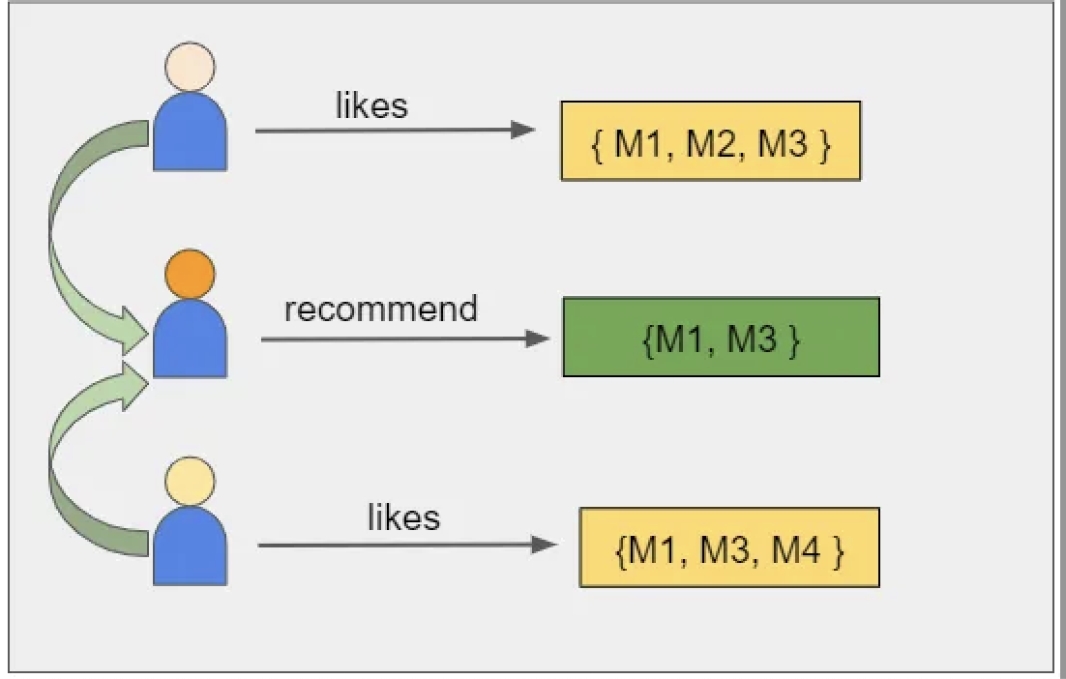
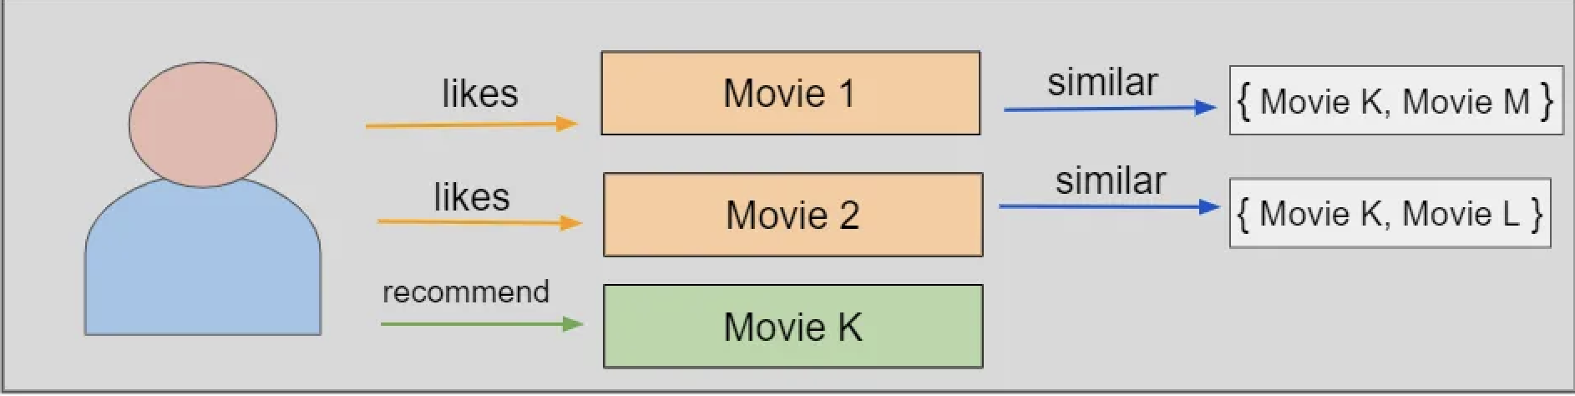
Theory
Simple
Content-based
Collaborative Filtering
It works according on the popularity or rating of a product in our case movie. The underlying theory is that movie with more user ratings and greater popularity tend to be enjoyed by a wider audience.
This uses metadata to suggest similar movies based on a specific criteria, such as director, actors, genre, or description. It assumes that if a user likes a particular criteria, they might also want a similar one, such as a movie of the same genre or director.
The system's collaborative filtering input is derived from past user interactions with movies.

Slide 5

SVD Modeling
Strengths of SVD in Recommendations:
Effective Prediction & Matrix Factorization:
Proficient in accurately predicting user preferences and decomposing the user-item matrix using matrix factorization.
Collaborative Filtering Basis:
Forms the foundation for collaborative filtering algorithms, enhancing collaborative recommendations.
Limitations of SVD:
Scalability Issues:
Challenges with large datasets may impact computational efficiency.
User-Rated Movies as Input:
Relies on user-rated movies for personalized suggestions.

Slide 6
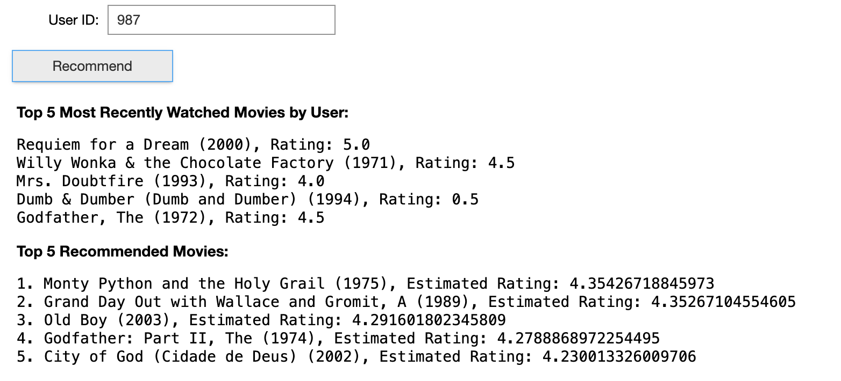
Breakdown of what the code does
User Input Retrieva & Filtering:
Retrieves the user ID for whom recommendations are to be generated
Filters out movies that the user has already rated, preparing a list of potential recommendations.
Generate Movie Recommendations:
It employs a collaborative filtering algorithm, utilizing the Surprise library, to predict ratings for unrated movies for the specified user.
Predicts the user's ratings for each unrated movie, and a list of tuples containing movie IDs and their estimated ratings is created.
It sorts and displays the top 5 recommended movies, including their titles and estimated ratings.

Slide 7
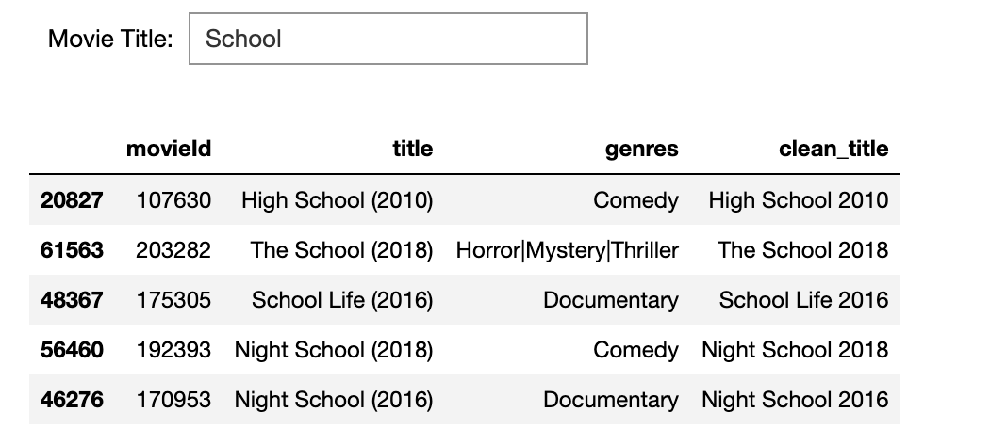
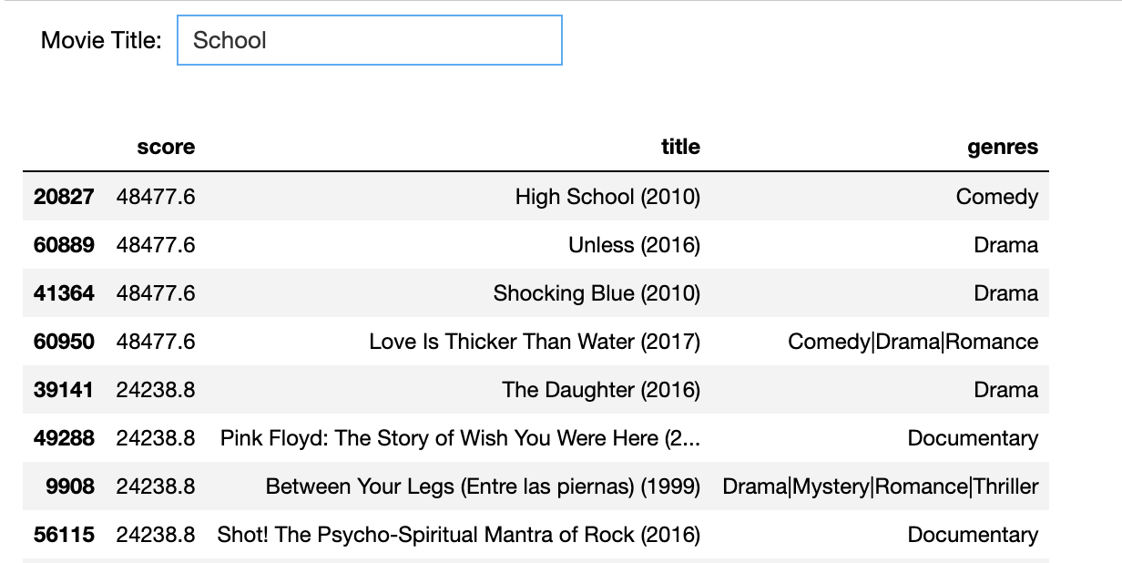
BONUS
Bonus
By entering a movie title, the system utilizes content-based filtering to recommend movies based on similar titles.
By entering a movie title and leveraging collaborative filtering, the system utilizes ratings to assign an overall score and provides quick suggestions for additional movies we might like.

Slide 8
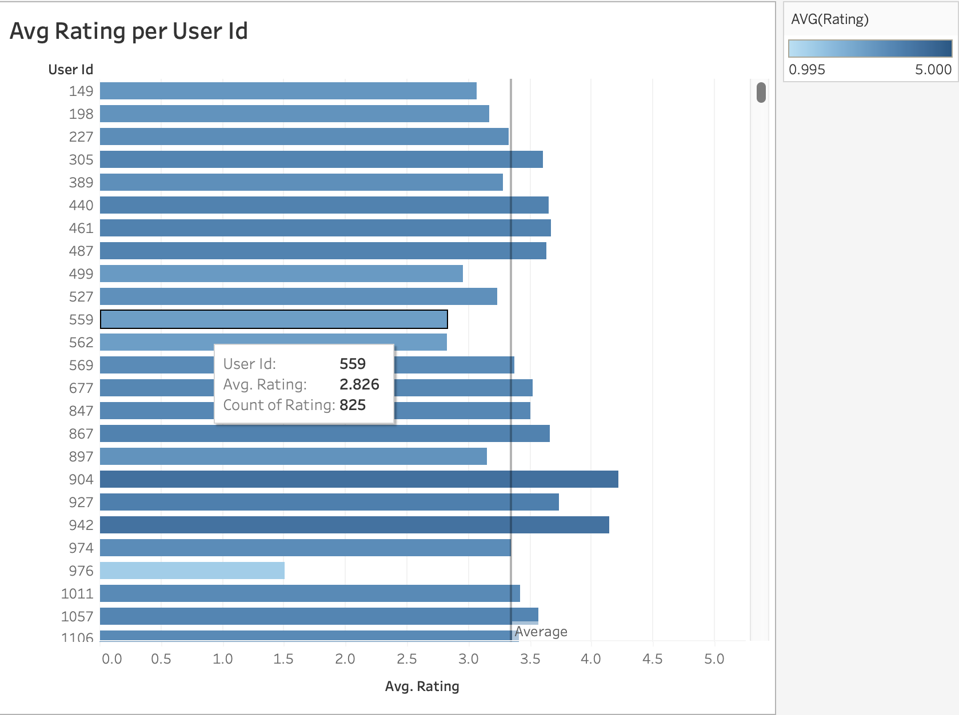
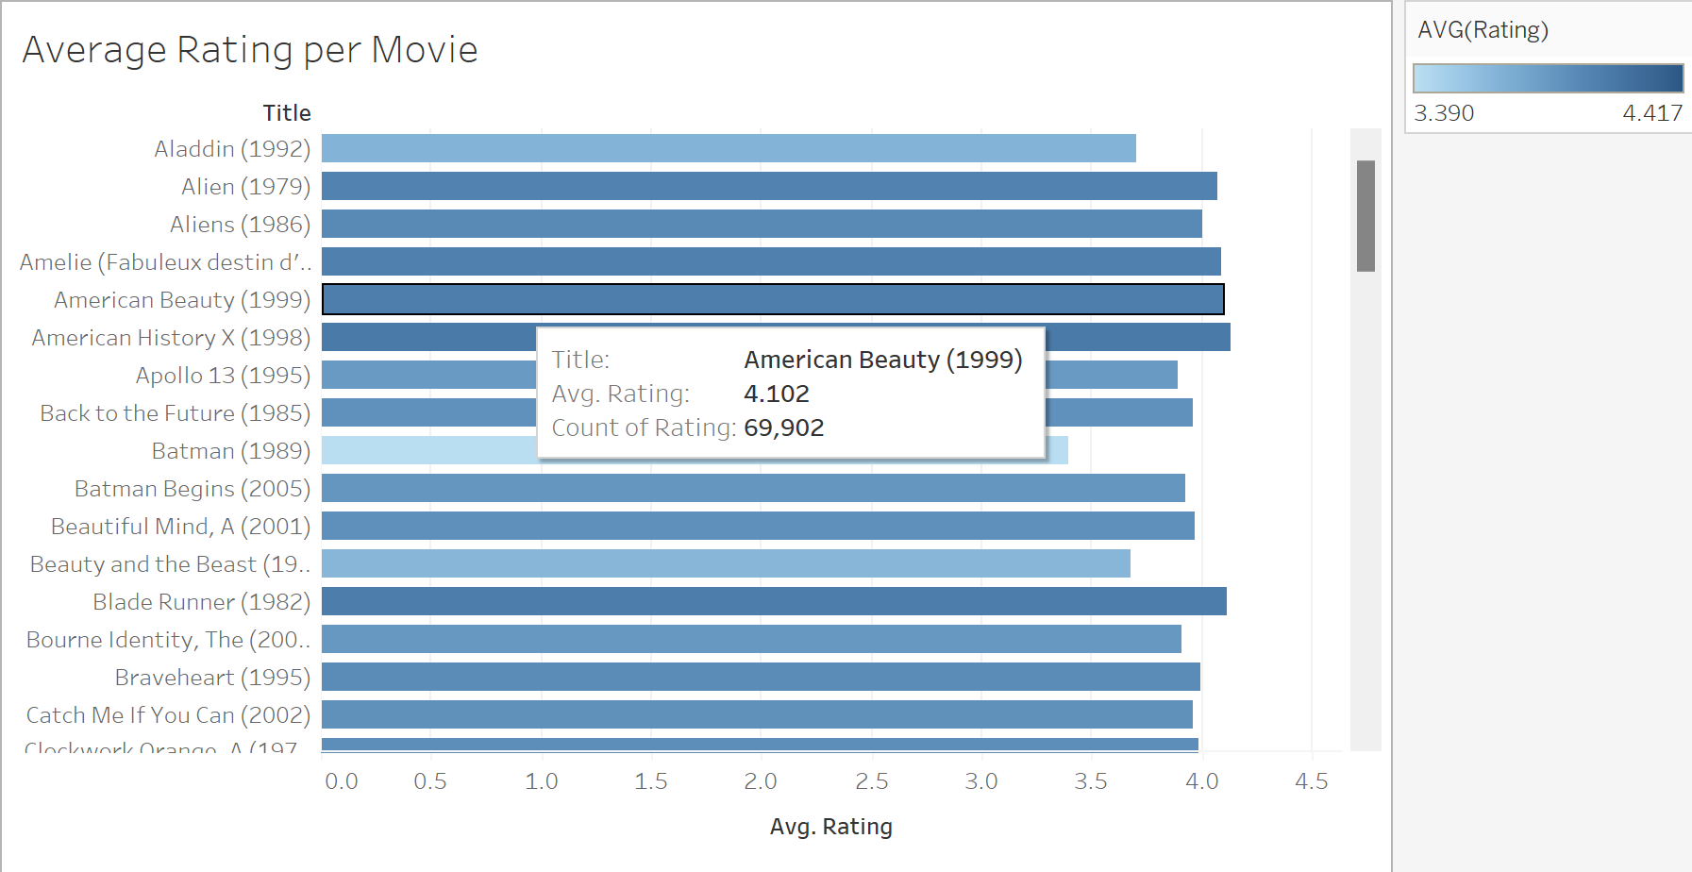
Visual Analysis
This image shows each user with their avg rating total for all the movies, while also showing the total number of movies they’ve rated. The vertical line shows the average total for all the user ratings
This image shows each movie with it’s avg rating total, while also showing the total number of users that have rated the movie.

Slide 9
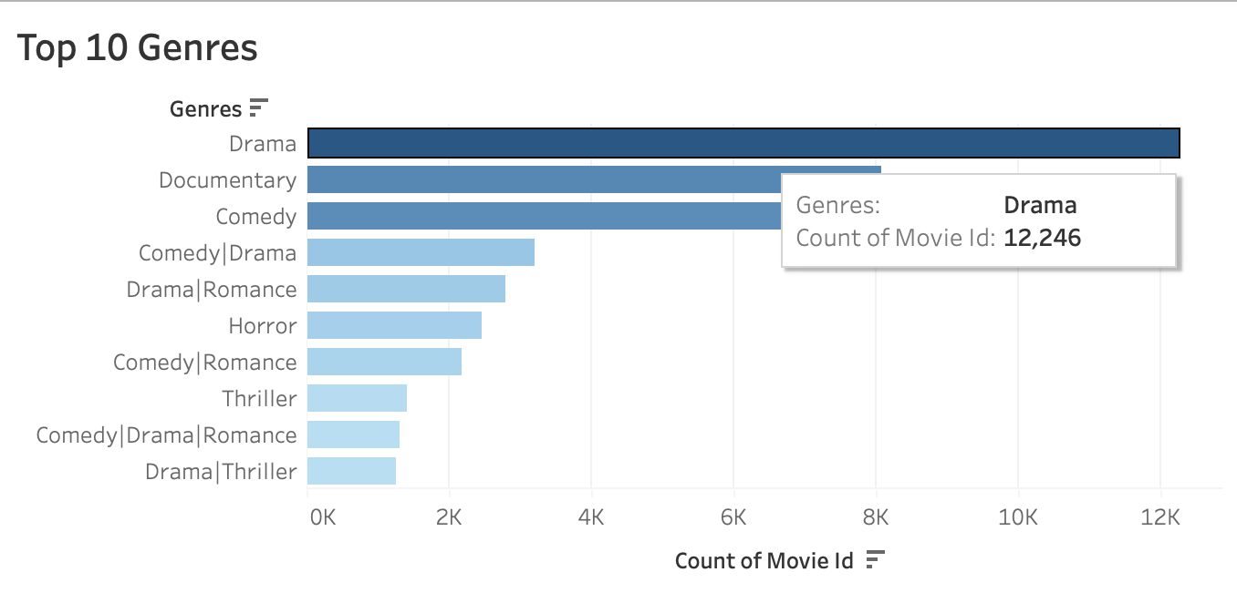
Visual Analysis
Top ten genres with the genres title and the total number of movies in that genres.

Slide 10

Demonstration
Now we are going to go over our code in Jupyter Notebook and we will demonstrate the type of results we can get.
Movie Recommendation Systems

Slide 11
Q & A

