Slide 1
MIE367 Group 3 - Case Study 5
Dalya Mirlas, Taleen Kutob

Slide 2
Case Summary
Acushnet Canada Inc. (ACI) struggled with cash flow because they had to buy golf equipment months in advance and pay high import duties (5% to 19%) when they are cleared by customs. The company had an opportunity to use Canada Customs Bonded Warehouses (CCBW) to delay paying these duties, which could free up cash for other investments. However, CCBW comes with storage costs. The goal with the optimization model is to find the best way to store ACI's imported golf equipment, either offsite with the CCBW or onsite in their own facility, to maximize cash flow savings.

Slide 3
Assumptions - Part 1
The maximum number of pallets stored in the CCBW per month is 200.
According to Perkins, the investment rate will be 13% per year. To find the monthly rate, we simply divide by 12.
Leftover not stored in the CCBW, due to the constraint, will be stored in the ACI.
Storing costs at the CCBW include only the monthly storage costs.
The duty cost is directly applied, not delayed, when storing at the ACI.
Since ACI often had to procure inventory four to six months in advance, we will neglect the four-year storage limit at the CCBW, assuming it will never be reached, and optimize for 12 months.

Slide 4
Assumptions - Part 2
Our goal is to maximize the profit from investments taking into account the monthly costs of storing at CCBW.
Since the duty fee will have to be paid eventually anyway whether it is stored at the ACI warehouses or at the CCBW warehouses, the duty fee is not included in the objective since it will not make a difference to the decision. The duty fee is only useful to calculate how much money you can invest.
The start time is June, since the date of the case study is May, which means that the first month that this initiative can be implemented in is June.

Slide 5
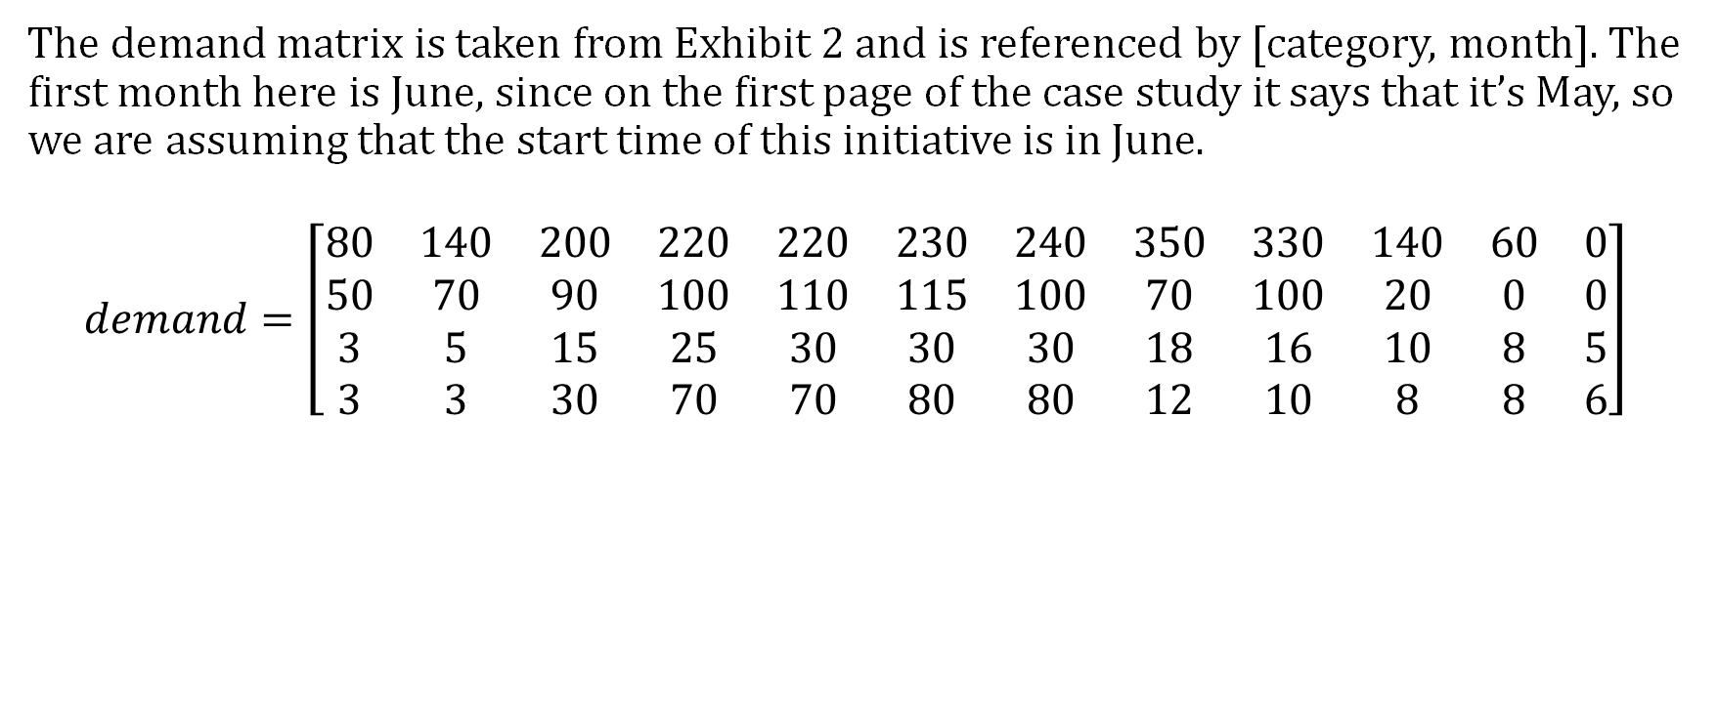
Data - Part 1
The demand matrix is taken from Exhibit 2 and is referenced by [category, month]. The first month here is June, since on the first page of the case study it says that it’s May, so we are assuming that the start time of this initiative is in June.
$$demand=\left[\begin{matrix}80 & 140 & 200 & 220 & 220 & 230 & 240 & 350 & 330 & 140 & 60 & 0 \\ 50 & 70 & 90 & 100 & 110 & 115 & 100 & 70 & 100 & 20 & 0 & 0 \\ 3 & 5 & 15 & 25 & 30 & 30 & 30 & 18 & 16 & 10 & 8 & 5 \\ 3 & 3 & 30 & 70 & 70 & 80 & 80 & 12 & 10 & 8 & 8 & 6\end{matrix}\right]$$

Slide 6
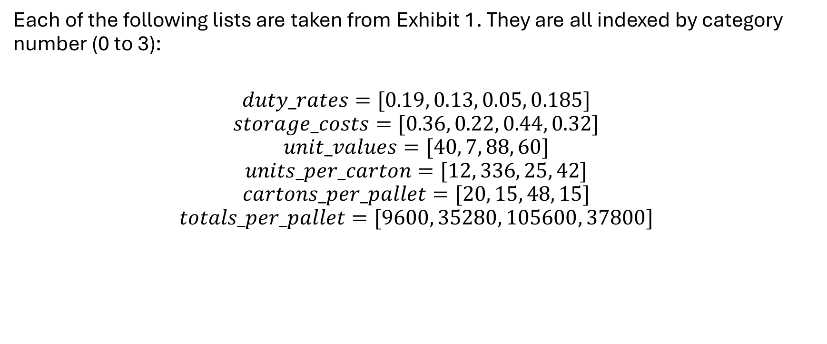
Data - Part 2
Each of the following lists are taken from Exhibit 1. They are all indexed by category number (0 to 3):
$$duty_rates=[0.19, 0.13, 0.05, 0.185]$$
$$storage_costs=[0.36, 0.22, 0.44, 0.32]$$
$$unit_values=[40, 7, 88, 60]$$
$$units_per_carton=[12, 336, 25, 42]$$
$$cartons_per_pallet=[20, 15, 48, 15]$$
$$totals_per_pallet=[9600, 35280, 105600, 37800]$$

Slide 7

Data - Part 3
“Pallets” is a list that has a unique index for each individual pallet in the demand matrix. Therefore, there are 3610 elements in the Pallets list, which is the sum of all pallets in the demand matrix. Each value in the list is either 0, 1, 2, or 3, representing the four categories respectively: “shoes”, “gloves”, “club heads”, “outerwear”. The “pallets” list looks as follows:
The table shows how many of each category number is present in the “pallets” list.
Category | Quantity Across all months
0 | 2210
1 | 825
2 | 195
3 | 380
$$Pallets=$$
$$[0,…,0, \\ 1,…,1 \\ 2,…,2, \\ 3,…,3, ]$$

Slide 8
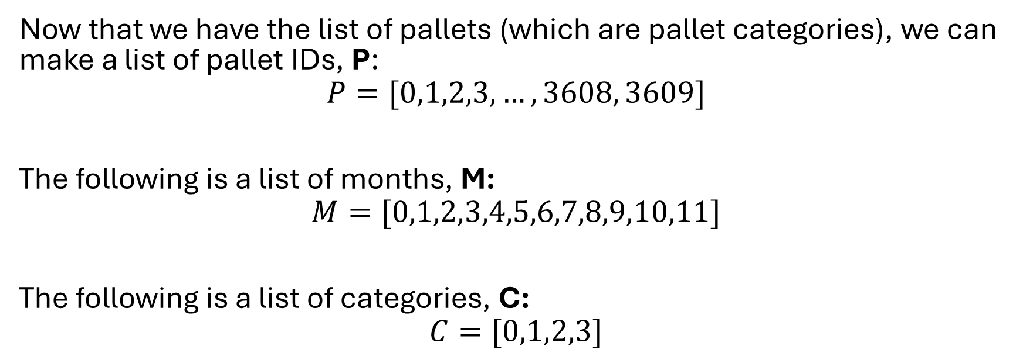
Data - Part 4
Now that we have the list of pallets (which are pallet categories), we can make a list of pallet IDs, P:
$$P=[0,1,2,3,…, 3608, 3609]$$
The following is a list of months, M:
$$M=[0,1,2,3,4,5,6,7,8,9,10,11]$$
The following is a list of categories, C:
$$C=[0,1,2,3]$$

Slide 9
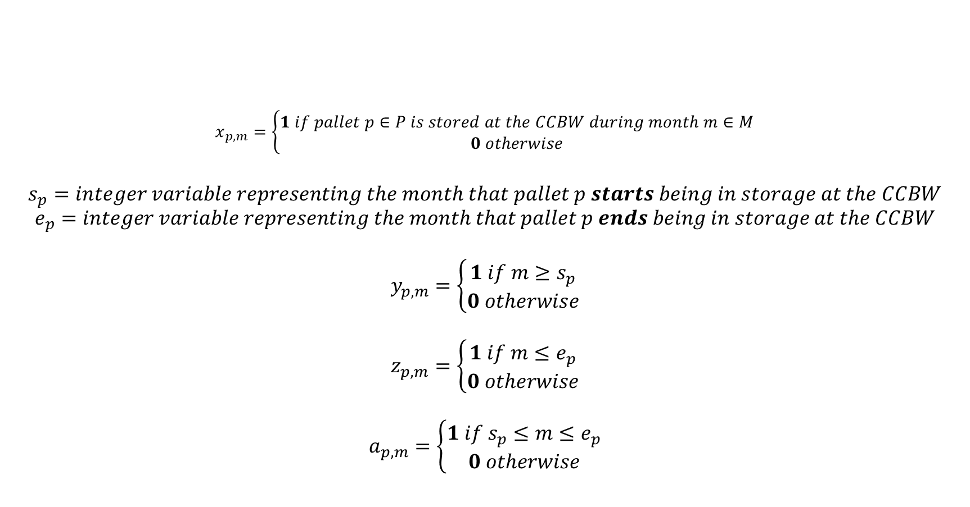
Variables
$$x_{p,m}=\left\{\begin{aligned}1 if pallet p∈P is stored at the CCBW during month m∈M \\ 0 otherwise\end{aligned}\right.$$
$$s_{p}=integer variable representing the month that pallet p starts being in storage at the CCBW$$
$$e_{p}=integer variable representing the month that pallet p ends being in storage at the CCBW$$
$$y_{p,m}=\left\{\begin{aligned}1 if m≥s_{p} \\ 0 otherwise\end{aligned}\right.$$
$$z_{p,m}=\left\{\begin{aligned}1 if m≤e_{p} \\ 0 otherwise\end{aligned}\right.$$
$$a_{p,m}=\left\{\begin{aligned}1 if s_{p}≤m≤e_{p} \\ 0 otherwise\end{aligned}\right.$$

Slide 10
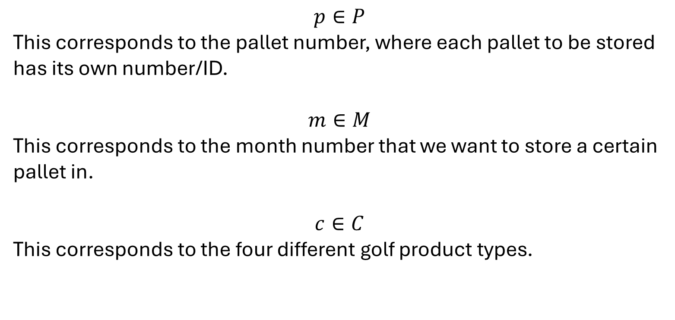
Parameters
$$p∈P$$
This corresponds to the pallet number, where each pallet to be stored has its own number/ID.
$$m∈M$$
This corresponds to the month number that we want to store a certain pallet in.
$$c∈C$$
This corresponds to the four different golf product types.

Slide 11
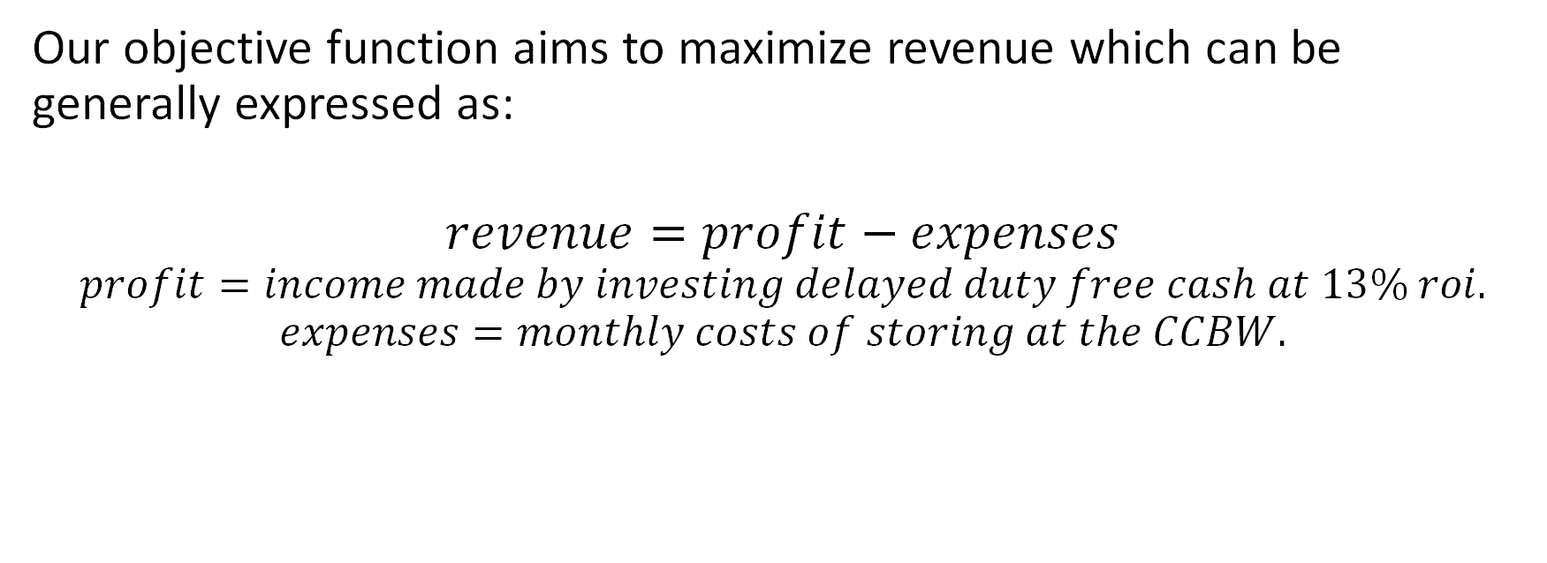
Objective Function – Part 1
Our objective function aims to maximize revenue which can be generally expressed as:
$$revenue=profit−expenses$$
$$profit=income made by investing delayed duty free cash at 13\% roi.$$
$$expenses=monthly costs of storing at the CCBW.$$

Slide 12
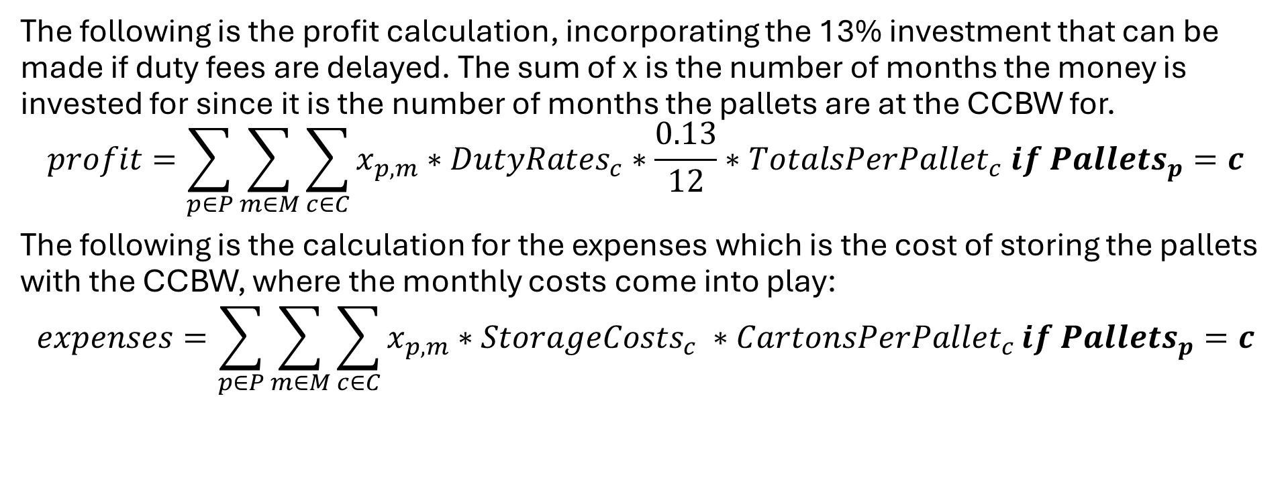
Objective Function – Part 2
The following is the profit calculation, incorporating the 13% investment that can be made if duty fees are delayed. The sum of x is the number of months the money is invested for since it is the number of months the pallets are at the CCBW for.
$$profit=\sum_{p∈P}{\sum_{m∈M}{\sum_{c∈C}{x_{p,m}}}}∗DutyRates_{c}∗\frac{0.13}{12}∗TotalsPerPallet_{c} if {Pallets}_{p}=c$$
The following is the calculation for the expenses which is the cost of storing the pallets with the CCBW, where the monthly costs come into play:
$$expenses=\sum_{p∈P}{\sum_{m∈M}{\sum_{c∈C}{x_{p,m}∗StorageCosts_{c} ∗CartonsPerPallet_{c}}}}if {Pallets}_{p}=c$$

Slide 13

Objective Function - Part 3
Putting it all together, the objective function becomes:
$$Maximize revenue=profit−expenses$$

Slide 14
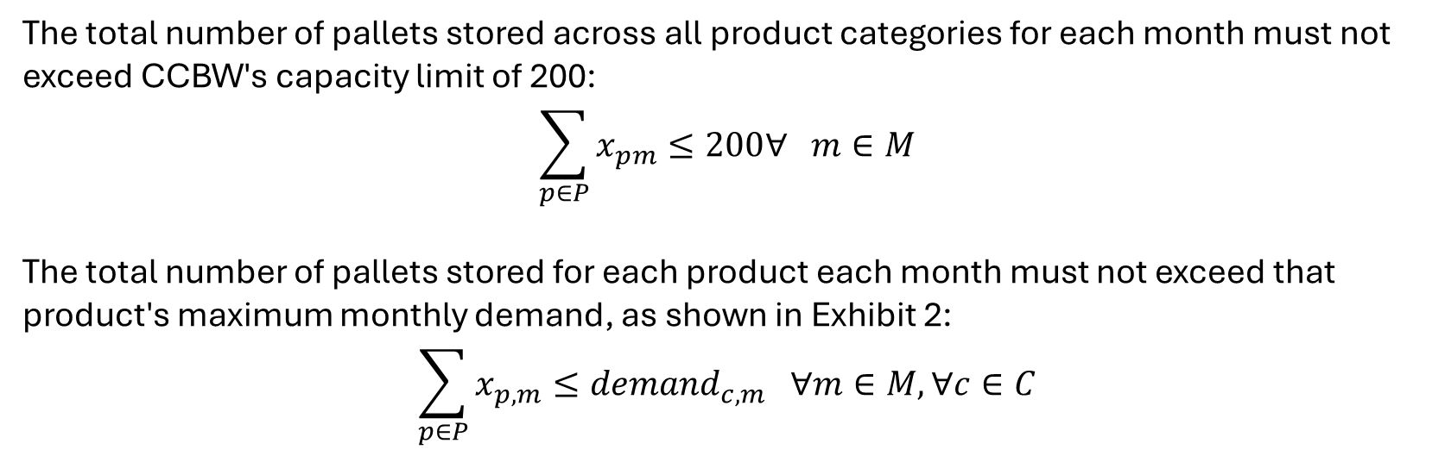
Demand and Capacity Constraints
The total number of pallets stored across all product categories for each month must not exceed CCBW's capacity limit of 200:
$$\sum_{p∈P}{x_{pm}≤200∀ m∈M}$$
The total number of pallets stored for each product each month must not exceed that product's maximum monthly demand, as shown in Exhibit 2:
$$\sum_{p∈P}{x_{p,m}}≤demand_{c,m} ∀m∈M, ∀c∈C$$

Slide 15
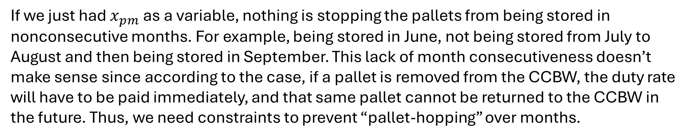
Constraints to Ensure Consecutiveness (Intro)
If we just had $x_{pm}$ as a variable, nothing is stopping the pallets from being stored in nonconsecutive months. For example, being stored in June, not being stored from July to August and then being stored in September. This lack of month consecutiveness doesn’t make sense since according to the case, if a pallet is removed from the CCBW, the duty rate will have to be paid immediately, and that same pallet cannot be returned to the CCBW in the future. Thus, we need constraints to prevent “pallet-hopping” over months.

Slide 16
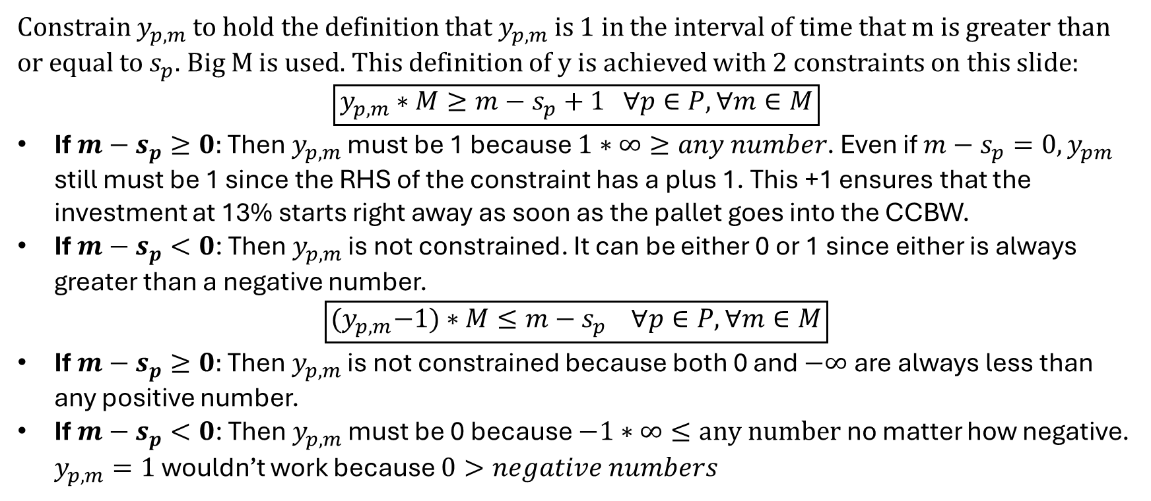
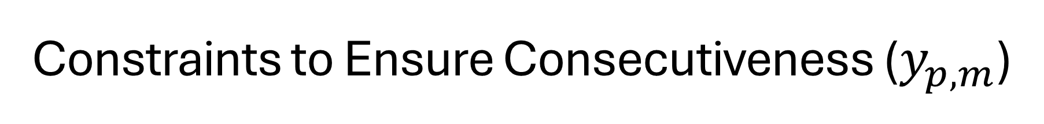
Constraints to Ensure Consecutiveness ($y_{p,m}$)
Constrain $y_{p,m}$to hold the definition that $y_{p,m}$is 1 in the interval of time that m is greater than or equal to $s_{p}$. Big M is used. This definition of y is achieved with 2 constraints on this slide:
$$\boxed{y_{p,m}∗M≥m−s_{p}+1 ∀p∈P, ∀m∈M}$$
If $m−s_{p}≥0:$ Then $y_{p,m}$ must be 1 because $1∗∞≥any number$. Even if $m−s_{p}=0, y_{pm}$ still must be 1 since the RHS of the constraint has a plus 1. This +1 ensures that the investment at 13% starts right away as soon as the pallet goes into the CCBW.
If $m−s_{p}<0$: Then $y_{p,m}$ is not constrained. It can be either 0 or 1 since either is always greater than a negative number.
$$\boxed{{(y}_{p,m}−1)∗M≤m−s_{p} ∀p∈P, ∀m∈M}$$
If $m−s_{p}≥0:$ Then $y_{p,m}$ is not constrained because both 0 and $−∞$ are always less than any positive number.
If $m−s_{p}<0$: Then $y_{p,m}$ must be 0 because $−1∗∞≤any number$ no matter how negative. $y_{p,m}=1$ wouldn’t work because $0>negative numbers$

Slide 17
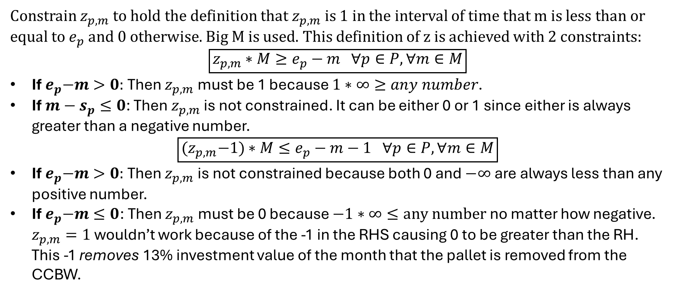
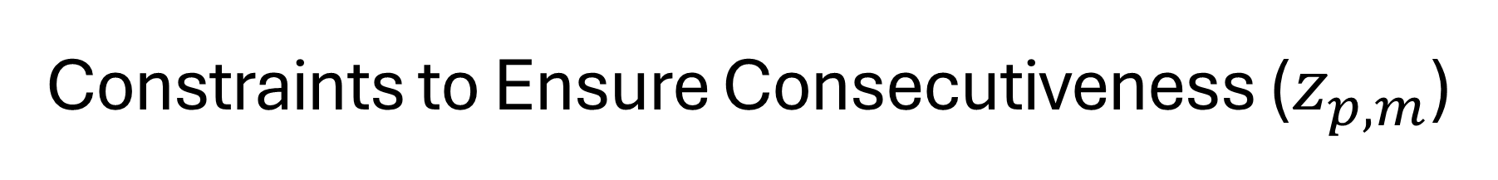
Constraints to Ensure Consecutiveness ($z_{p,m}$)
Constrain $z_{p,m}$to hold the definition that $z_{p,m}$is 1 in the interval of time that m is less than or equal to $e_{p}$ and 0 otherwise. Big M is used. This definition of z is achieved with 2 constraints:
$$\boxed{z_{p,m}∗M≥e_{p}−m ∀p∈P, ∀m∈M}$$
If${ e}_{p}−m>0:$ Then $z_{p,m}$ must be 1 because $1∗∞≥any number$.
If $m−s_{p}≤0$: Then $z_{p,m}$ is not constrained. It can be either 0 or 1 since either is always greater than a negative number.
$$\boxed{{(z}_{p,m}−1)∗M≤e_{p}−m−1 ∀p∈P, ∀m∈M}$$
If${ e}_{p}−m>0:$ Then $z_{p,m}$ is not constrained because both 0 and $−∞$ are always less than any positive number.
If${ e}_{p}−m≤0$: Then $z_{p,m}$ must be 0 because $−1∗∞≤any number$ no matter how negative. $z_{p,m}=1$ wouldn’t work because of the -1 in the RHS causing 0 to be greater than the RH. This -1 removes 13% investment value of the month that the pallet is removed from the CCBW.

Slide 18
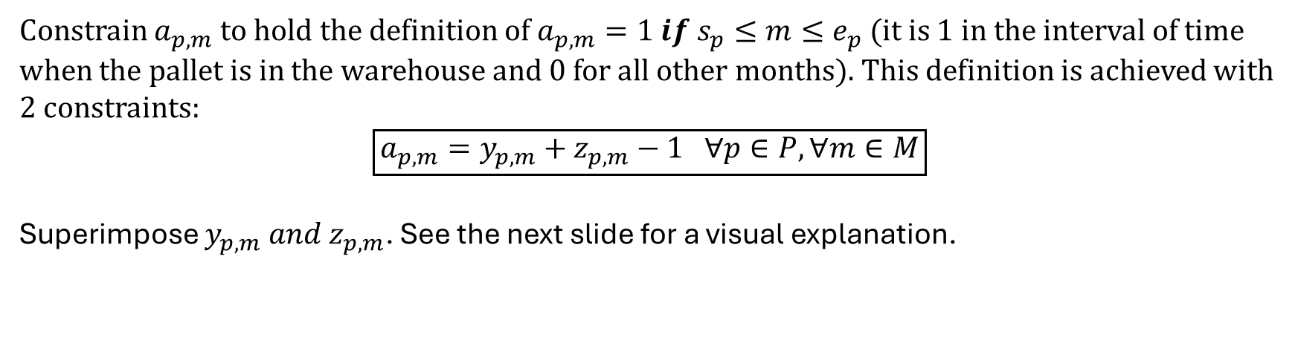
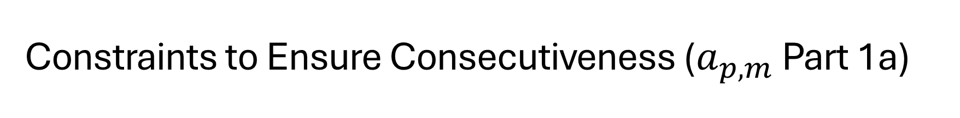
Constraints to Ensure Consecutiveness ($a_{p,m}$ Part 1a)
Constrain $a_{p,m}$to hold the definition of ${a_{p,m}=1 if s}_{p}≤m≤e_{p}$ (it is 1 in the interval of time when the pallet is in the warehouse and 0 for all other months). This definition is achieved with 2 constraints:
$$\boxed{a_{p,m}=y_{p,m}+z_{p,m}−1 ∀p∈P, ∀m∈M}$$
Superimpose $y_{p,m} and z_{p,m}$. See the next slide for a visual explanation.

Slide 19
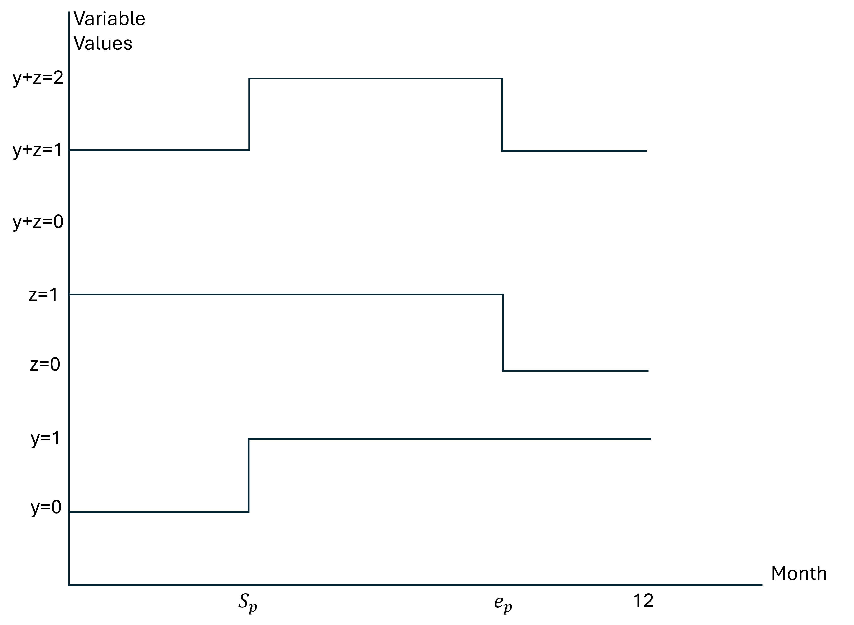
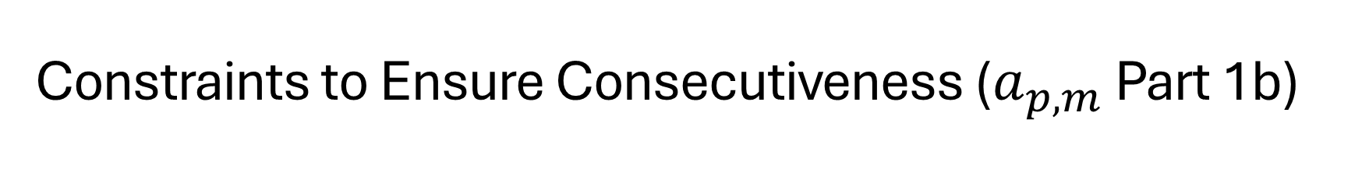
Constraints to Ensure Consecutiveness ($a_{p,m}$ Part 1b)
The elevated area at y+z=2 is the months that the pallet is being stored at.
As can be seen, y+z can either be 1, or 2. The variable “a” is thus y+z-1 so that it is binary.
When the pallet is in the warehouse, “a” will be 1 and when it is not in the warehouse, “a” will be 0.

Slide 20
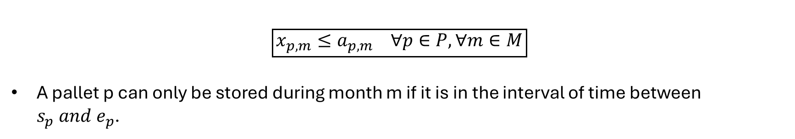
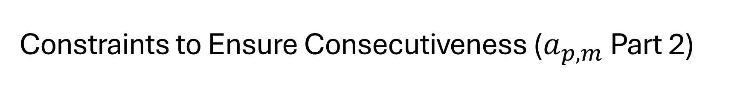
Constraints to Ensure Consecutiveness ($a_{p,m}$ Part 2)
$$\boxed{x_{p,m}≤a_{p,m} ∀p∈P, ∀m∈M}$$
A pallet p can only be stored during month m if it is in the interval of time between $s_{p} and e_{p}$.

Slide 21
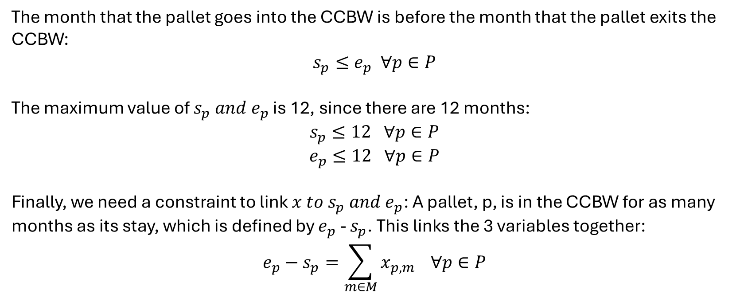
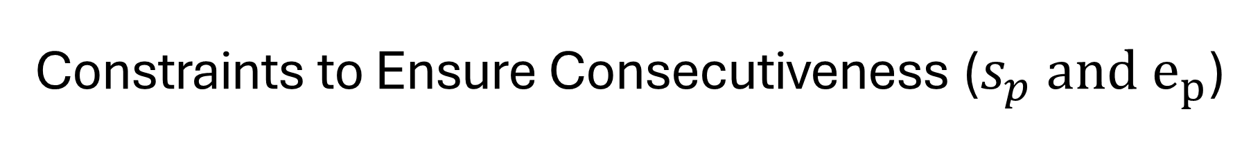
Constraints to Ensure Consecutiveness ($s_{p} and e_{p}$)
The month that the pallet goes into the CCBW is before the month that the pallet exits the CCBW:
$$s_{p}≤e_{p} ∀p∈P$$
The maximum value of $s_{p} and e_{p}$ is 12, since there are 12 months:
$$s_{p}≤12 ∀p∈P$$
$$e_{p}≤12 ∀p∈P$$
Finally, we need a constraint to link $x to s_{p} and e_{p}$: A pallet, p, is in the CCBW for as many months as its stay, which is defined by $e_{p}$- $s_{p}$. This links the 3 variables together:
$$e_{p}−s_{p}=\sum_{m∈M}{x_{p,m}} ∀p∈P$$

Slide 22
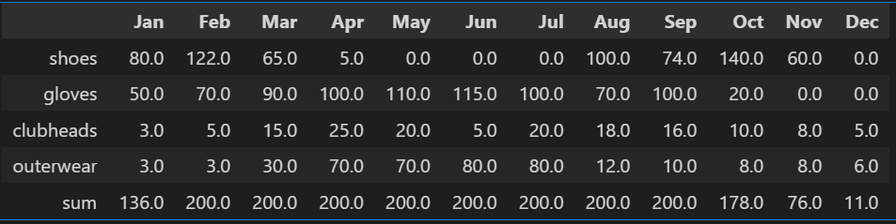
Solution - Part 1
The maximum revenue that can be made from utilizing the option to delay tax by storing at CCBW is: $78,758.06.
The following table shows how much of each category should be stored at each month.

Slide 23
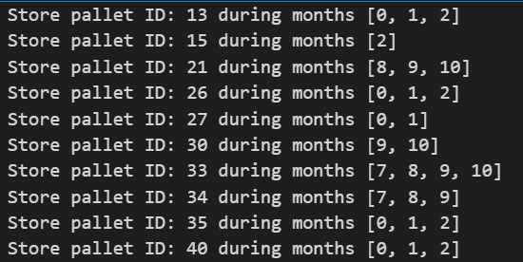
Solution - Part 2
The table from the previous slide doesn’t give exact instructions on how long to hold each specific pallet at the CCBW for. The following shows this for some of the pallets. (See that full solution in the submitted ipynb file).

Slide 24
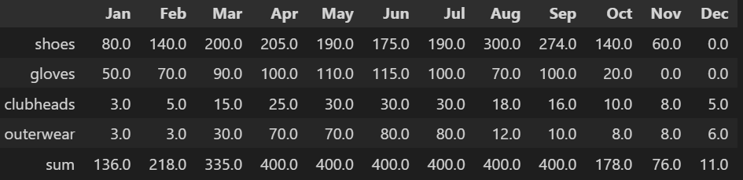
Sensitivity Analysis - Part 1
Increase the CCBW capacity to 400:
These are the marginal pallet storage limits at the CCBW of each month from Exhibit 2: [136, 218, 335, 415, 430, 455, 450, 450, 456, 178, 76, 11]
It was found that when increasing the CCBW capacity to 400, the months that have a sum of pallets at the CCBW being less than 400 (see table below) are constrained not by the CCBW capacity but by the limits from Exhibit 2.
If the ACI allowed more pallets to be sent to the CCBW, the pallets would go there.
On the other hand, the months in the solution-table below that have a sum of 400 are entirely constrained by the CCBW limit since the exhibit 2 marginal sums for those months are greater than 400.
If the CCBW allowed more, then more pallets would go up until the limit of the ACI from exhibit 2 is reached.
Schedule of pallet storage at the CCBW for capacity=400
New objective value: $96,810.14. This makes sense because the more pallets in the CCBW, the more money you delay paying and thus invest.

Slide 25
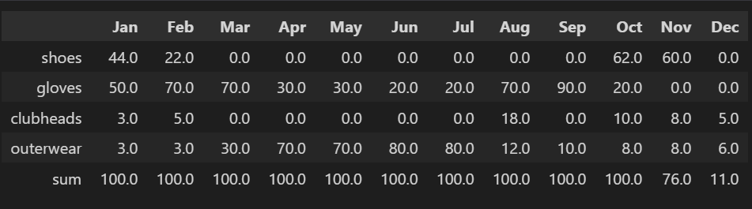
Sensitivity Analysis - Part 2
Decrease the CCBW capacity to 100:
Now the marginal monthly sum of pallets stored at the CCBW is equal to the 100-pallet limit much more often. This is only when the monthly ACI limits on pallet quantity they can store at CCBW is greater than 100: [136, 218, 335, 415, 430, 455, 450, 450, 456, 178, 76, 11].
The last two months have limits less than 100, and those are the only ones in the solution-table below that are less than 100. Once again, this shows that it’s always better to store goods at the CCBW if permitted.
Schedule of pallet storage at the CCBW for capacity=100
New objective value: $52,894.47. This makes sense because the less pallets in the CCBW, the less money can be made from investments.

Slide 26
Conclusion
The sensitivity analysis confirms that storing a pallet at the CCBW is always the optimal choice whenever possible, due to delayed duty fees.
The base case analysis indicates that ACI can achieve maximum savings of $78,758.06 by storing their pallets with the CCBW.
For most products, pallets are stored at the CCBW every month. However, for shoes, no pallets are stored at the CCBW in May due to zero demand, and additionally in July and August.
Given the 200-pallet capacity constraint, a selection of product types will be stored at the CCBW every month, while the remaining pallets must be stored in ACI's facility.
If the CCBW capacity were doubled to 400 pallets, the maximum savings would increase to $96,810.14, a 22.9% increase over the base case. This increase results from greater opportunities for delayed duty fees and investments, leading to higher overall savings.
However, if the CCBW capacity were reduced by half to 100 pallets, the maximum savings would drop to $52,894.47, a 32.9% decrease compared to the base case. This reduction occurs because fewer pallets can be stored at the CCBW, leading to increased immediate duty fees when pallets are cleared, which in turn limits investment opportunities and lowers overall savings.

