Slide 1


Why Program?
Chapter 1
Python for Everybody
www.py4e.com
Notes:
Note from Chuck. If you are using these materials, you can remove the UM logo and replace it with your own, but please retain the CC-BY logo on the first page as well as retain the entire last page.

Slide 2

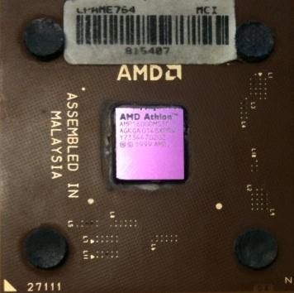
Computers want to be helpful...
Computers are built for one purpose - to do things for us
But we need to speak their language to describe what we want done
Users have it easy - someone already put many different programs (instructions) into the computer and users just pick the ones they want to use
What
Next?
What
Next?
What
Next?
What
Next?
What
Next?
What
Next?
What
Next?

Slide 3
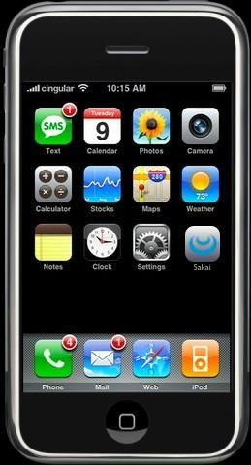
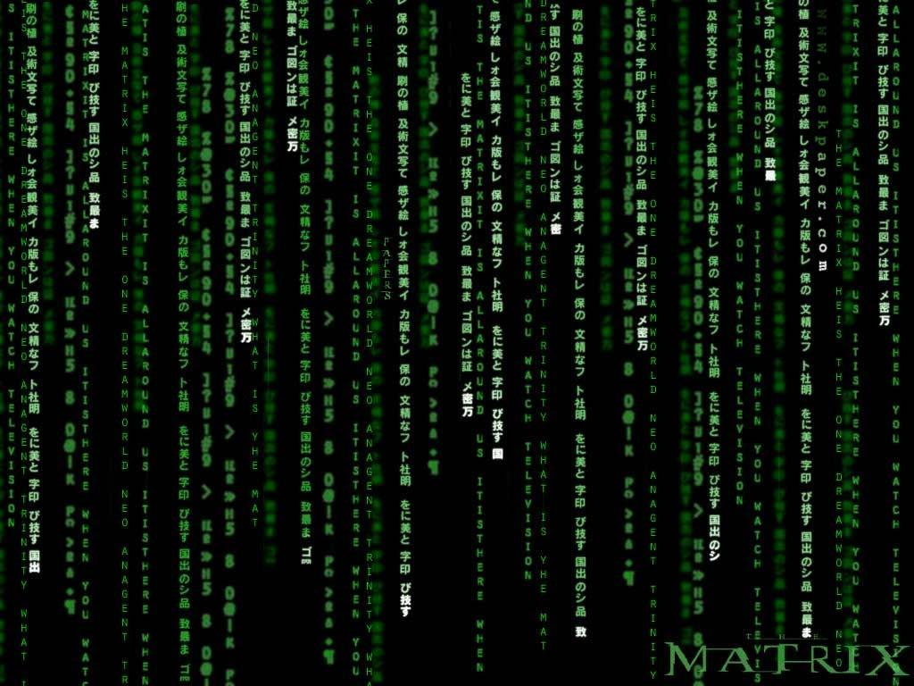
Programmers Anticipate Needs
iPhone Applications are a market
iPhone Applications have over 3 Billion downloads
Programmers have left their jobs to be full-time iPhone developers
Programmers know the ways of the program
Pick
Me!
Pick
Me!
Pick
Me!
Pick
Me!
Pick
Me!
Pay
Me!

Slide 4
Users vs. Programmers
Users see computers as a set of tools - word processor, spreadsheet, map, to-do list, etc.
Programmers learn the computer “ways” and the computer language
Programmers have some tools that allow them to build new tools
Programmers sometimes write tools for lots of users and sometimes programmers write little “helpers” for themselves to automate a task

Slide 5
Why be a programmer?
To get some task done - we are the user and programmer
Clean up survey data
To produce something for others to use - a programming job
Fix a performance problem in the Sakai software
Add a guestbook to a web site

Slide 6
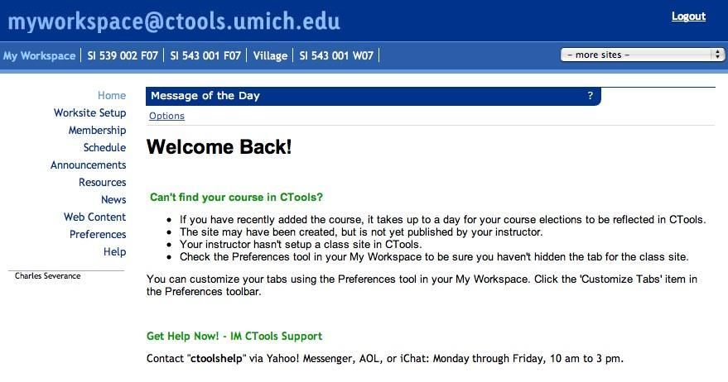

User
Computer
Hardware + Software
Programmer
Data
Information
Networks
....
From a software creator’s point of view, we build the software. The end users (stakeholders/actors) are our masters - who we want to please - often they pay us money when they are pleased. But the data, information, and networks are our problem to solve on their behalf. The hardware and software are our friends and allies in this quest.

Slide 7
What is Code? Software? A Program?
A sequence of stored instructions
It is a little piece of our intelligence in the computer
We figure something out and then we encode it and then give it to someone else to save them the time and energy of figuring it out
A piece of creative art - particularly when we do a good job on user experience

Slide 8
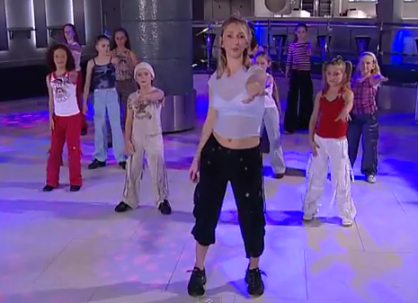
Programs for Humans...
https://www.youtube.com/watch?v=gwWRjvwlLKg

Slide 9
Programs for Humans...
while music is playing:
Left hand out and up
Right hand out and up
Flip Left hand
Flip Right hand
Left hand to right shoulder
Right hand to left shoulder
Left hand to back of head
Right ham to back of head
Left hand to right hit
Right hand to left hit
Left hand on left bottom
Right hand on right bottom
Wiggle
Wiggle
Jump
https://www.youtube.com/watch?v=gwWRjvwlLKg

Slide 10
Programs for Humans...
while music is playing:
Left hand out and up
Right hand out and up
Flip Left hand
Flip Right hand
Left hand to right shoulder
Right hand to left shoulder
Left hand to back of head
Right ham to back of head
Left hand to right hit
Right hand to left hit
Left hand on left bottom
Right hand on right bottom
Wiggle
Wiggle
Jump
https://www.youtube.com/watch?v=gwWRjvwlLKg

Slide 11
Programs for Humans...
while music is playing:
Left hand out and up
Right hand out and up
Flip Left hand
Flip Right hand
Left hand to right shoulder
Right hand to left shoulder
Left hand to back of head
Right hand to back of head
Left hand to right hip
Right hand to left hip
Left hand on left bottom
Right hand on right bottom
Wiggle
Wiggle
Jump
https://www.youtube.com/watch?v=gwWRjvwlLKg

Slide 12
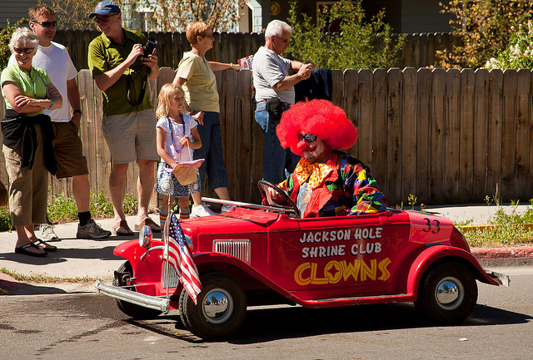
Programs for Python...
the clown ran after the car and the car ran into the tent and the tent fell down on the clown and the car
Image: https://www.flickr.com/photos/allan_harris/4908070612/ Attribution-NoDerivs 2.0 Generic (CC BY-ND 2.0)

Slide 13
Programs for Python...
Image: https://www.flickr.com/photos/allan_harris/4908070612/ Attribution-NoDerivs 2.0 Generic (CC BY-ND 2.0)

Slide 14
name = input('Enter file:')
handle = open(name)
counts = dict()
for line in handle:
words = line.split()
for word in words:
counts[word] = counts.get(word,0) + 1
bigcount = None
bigword = None
for word,count in counts.items():
if bigcount is None or count > bigcount:
bigword = word
bigcount = count
print(bigword, bigcount)
python words.py
Enter file: words.txt
to 16
python words.py
Enter file: clown.txt
the 7

Slide 15
Hardware Architecture

