Slide 1


Networked Programs
Chapter 12
Python for Everybody
www.py4e.com
Notes:
Note from Chuck. If you are using these materials, you can remove the UM logo and replace it with your own, but please retain the CC-BY logo on the first page as well as the acknowledgement page(s) at the end.

Slide 2
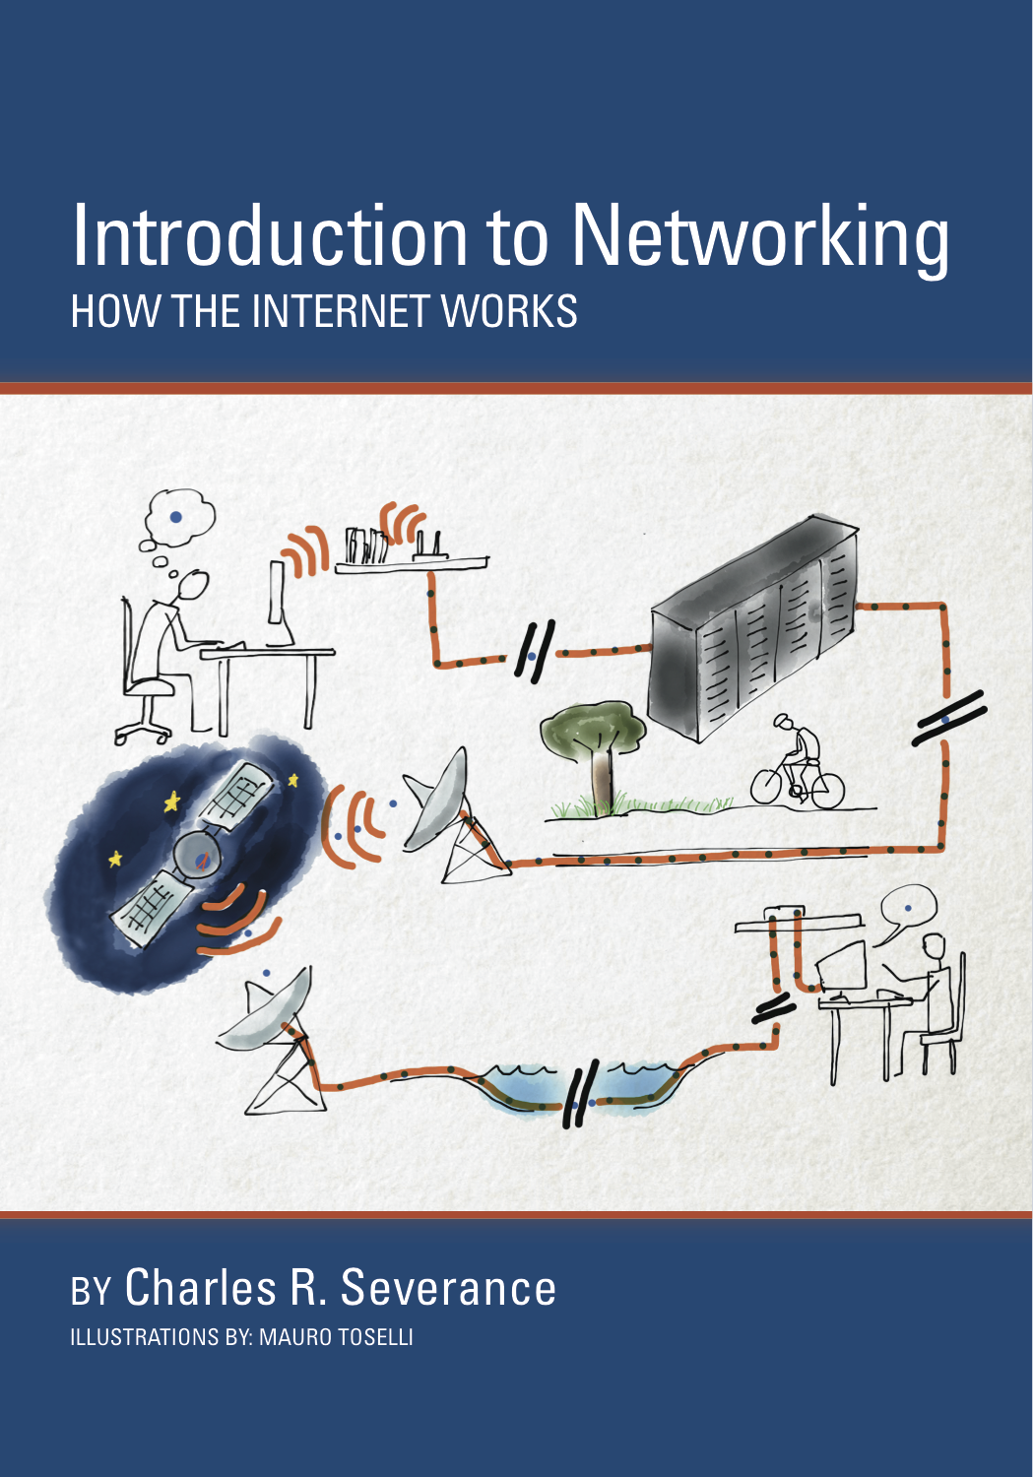
A Free Book on Network Architecture
If you find this topic area interesting and/or need more detail
www.net-intro.com

Slide 3
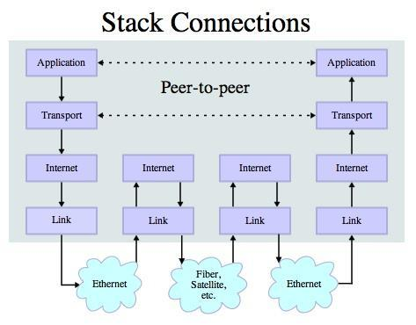
Transport Control Protocol (TCP)
Built on top of IP (Internet Protocol)
Assumes IP might lose some data - stores and retransmits data if it seems to be lost
Handles “flow control” using a transmit window
Provides a nice reliable pipe
Source: http://en.wikipedia.org/wiki/Internet_Protocol_Suite

Slide 4
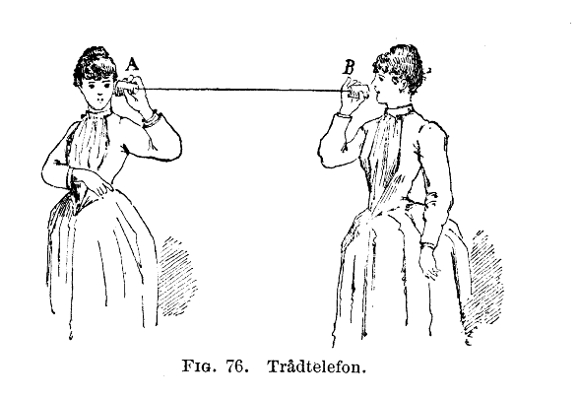
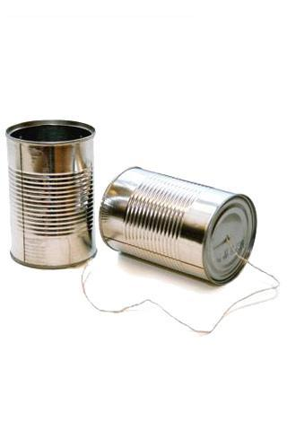
http://en.wikipedia.org/wiki/Tin_can_telephone
http://www.flickr.com/photos/kitcowan/2103850699/

Slide 5

TCP Connections / Sockets
“In computer networking, an Internet socket or network socket is an endpoint of a bidirectional inter-process communication flow across an Internet Protocol-based computer network, such as the Internet.”
Process
Process
Internet
http://en.wikipedia.org/wiki/Internet_socket

Slide 6
TCP Port Numbers
A port is an application-specific or process-specific software communications endpoint
It allows multiple networked applications to coexist on the same server.
There is a list of well-known TCP port numbers
http://en.wikipedia.org/wiki/TCP_and_UDP_port

Slide 7
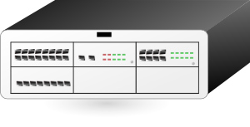

www.umich.edu
Incoming
E-Mail
25
blah blah blah blah
Login
23
74.208.28.177
80
Web Server
443
Personal
Mail Box
109
110
Clipart: http://www.clker.com/search/networksym/1

Slide 8
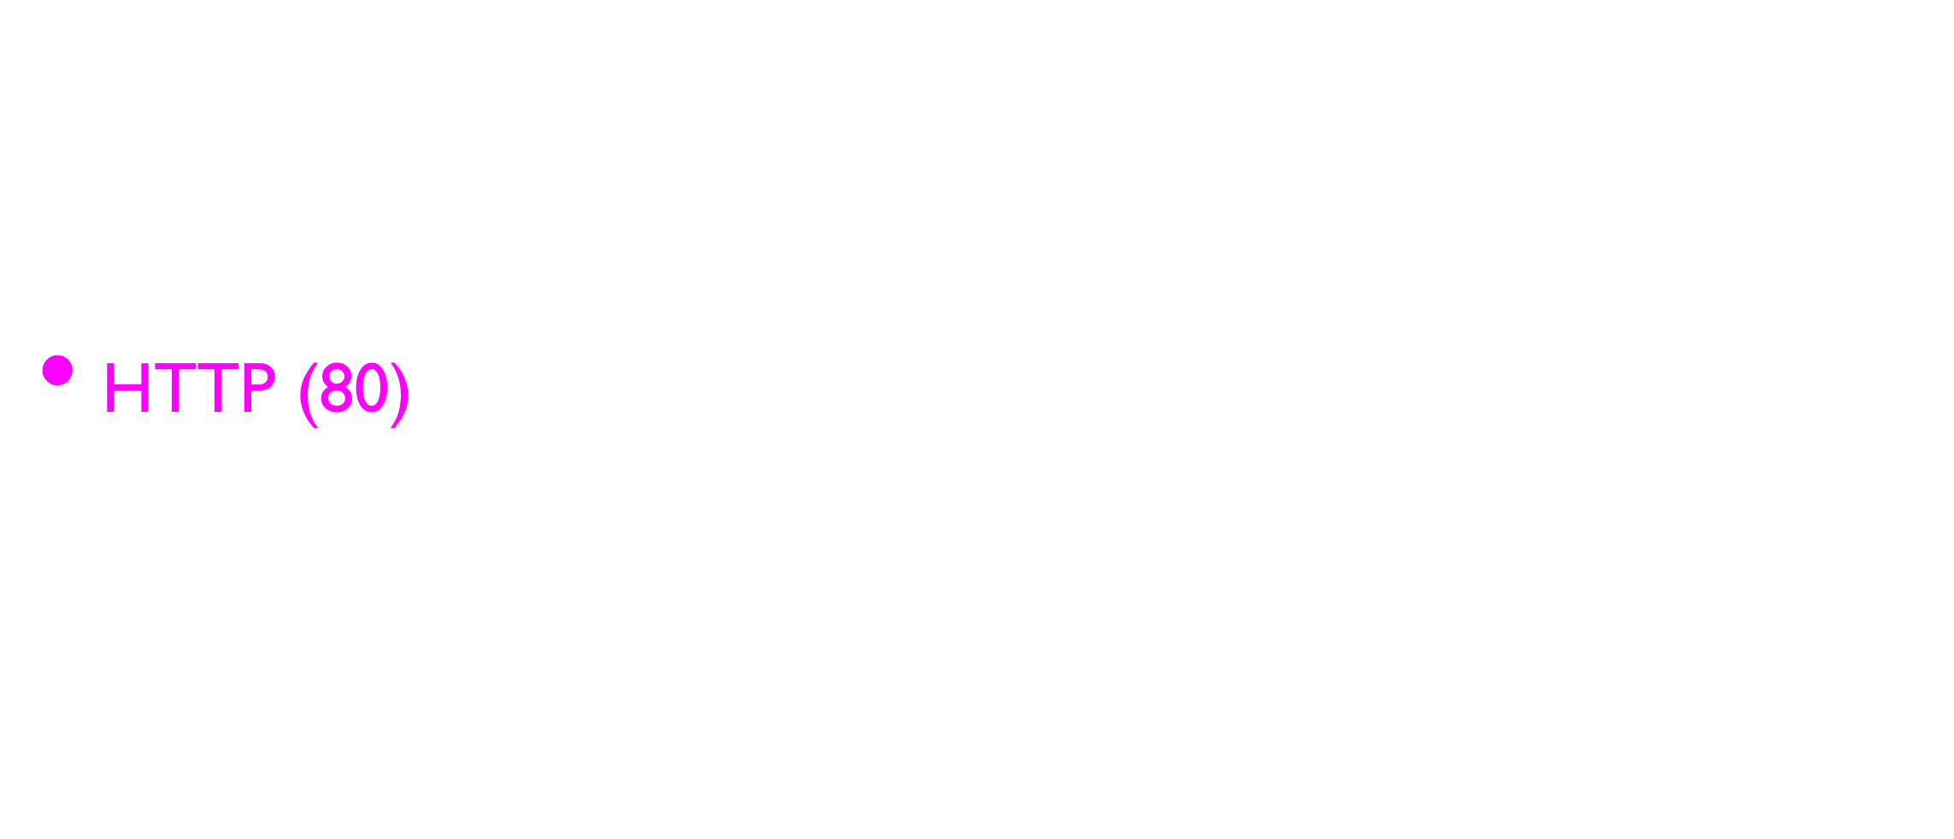
Common TCP Ports
http://en.wikipedia.org/wiki/List_of_TCP_and_UDP_port_numbers

Slide 9
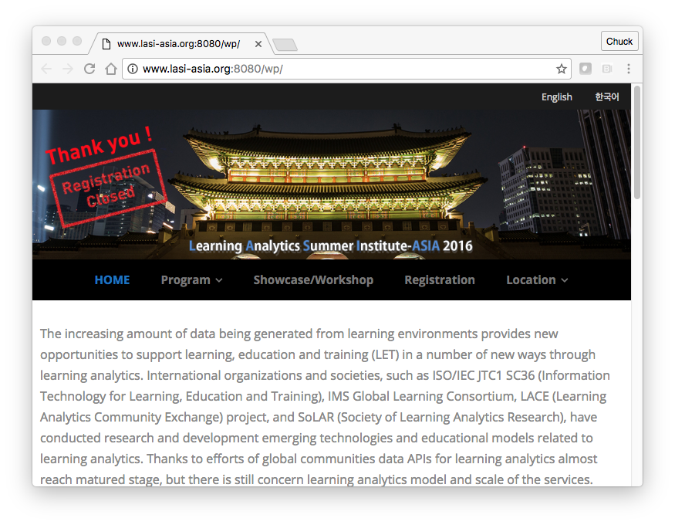
Sometimes we see the port number in the URL if the web server is running on a “non-standard” port.

Slide 10
Sockets in Python
Python has built-in support for TCP Sockets
import socket
mysock = socket.socket(socket.AF_INET, socket.SOCK_STREAM)
mysock.connect( ('data.pr4e.org', 80) )
Host
Port
http://docs.python.org/library/socket.html

Slide 11
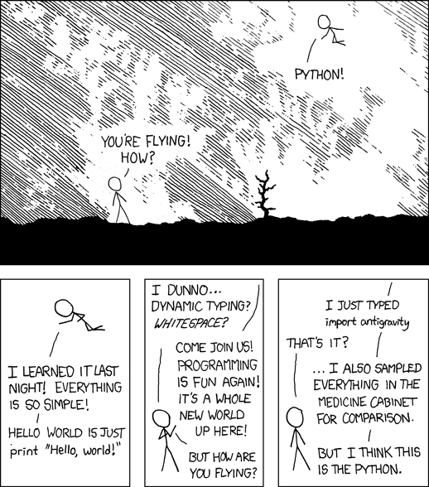
http://xkcd.com/353/

Slide 12
Communicating on Sockets in Python

Slide 13
Acknowledgements / Contributions
Thes slide are Copyright 2010- Charles R. Severance (www.dr-chuck.com) of the University of Michigan School of Information and open.umich.edu and made available under a Creative Commons Attribution 4.0 License. Please maintain this last slide in all copies of the document to comply with the attribution requirements of the license. If you make a change, feel free to add your name and organization to the list of contributors on this page as you republish the materials.
Initial Development: Charles Severance, University of Michigan School of Information
… Insert new Contributors here
...

