Slide 1
Hardware Architecture

Slide 2
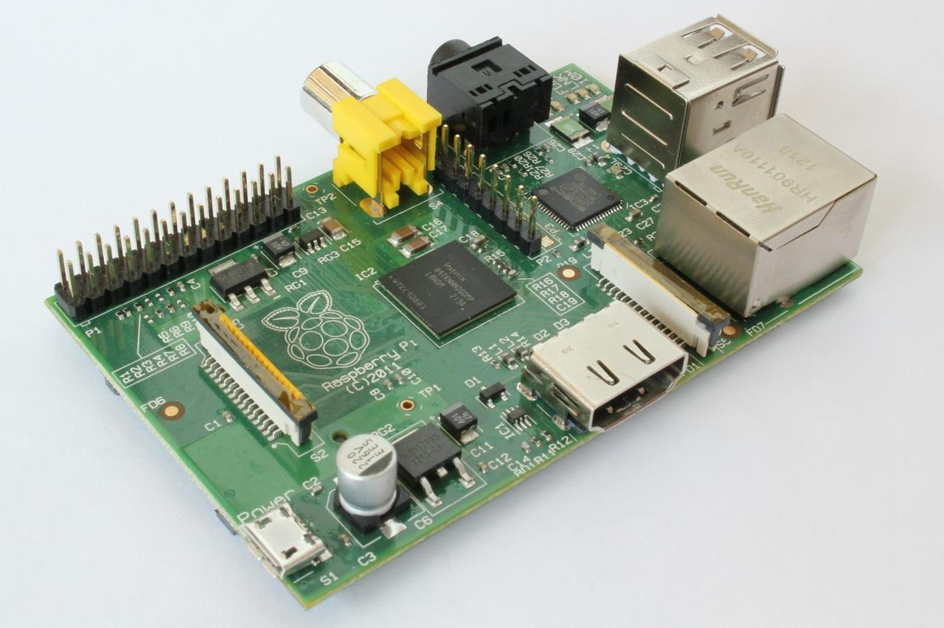
http://upload.wikimedia.org/wikipedia/commons/3/3d/RaspberryPi.jpg

Slide 3

What
Next?
Generic
Computer
Software
Input
and Output
Devices
Central
Processing
Unit
Secondary
Memory
Main
Memory

Slide 4
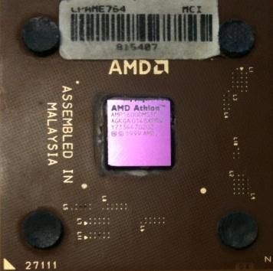
Definitions
What
Next?
Central Processing Unit: Runs the Program - The CPU is always wondering “what to do next”. Not the brains exactly
- very dumb but very very fast
Input Devices: Keyboard, Mouse, Touch Screen
Output Devices: Screen, Speakers, Printer, DVD Burner
Main Memory: Fast small temporary storage - lost on reboot - aka RAM
Secondary Memory: Slower large permanent storage - lasts until deleted - disk drive / memory stick

Slide 5
What
Next?
Generic
Computer
Software
Input
and Output
Devices
Central
Processing
Unit
Secondary
Memory
if x< 3: print
Main
Memory

Slide 6
What
Next?
Generic
Computer
Software
Input
and Output
Devices
Central
Processing
Unit
Secondary
Memory
01001001
00111001
Main
Memory
Machine
Language

Slide 7
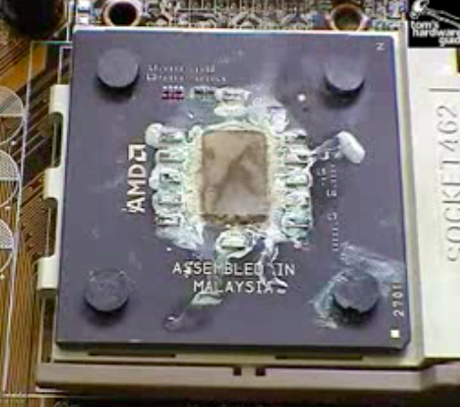
Totally Hot CPU
What
Next?
http://www.youtube.com/watch?v=y39D4529FM4

Slide 8
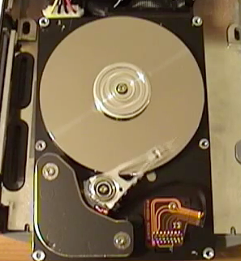
Hard Disk in Action
http://www.youtube.com/watch?v=9eMWG3fwiEU

Slide 9
Python as a Language

