Slide 1
String Concatenation
When the + operator is applied to strings, it means “concatenation”
>>> a = 'Hello'
>>> b = a + 'There'
>>> print(b)
HelloThere
>>> c = a + ' ' + 'There'
>>> print(c)
Hello There
>>>

Slide 2
Using in as a Logical Operator
The in keyword can also be used to check to see if one string is “in” another string
The in expression is a logical expression that returns True or False and can be used in an if statement
>>> fruit = 'banana'
>>> 'n' in fruit
True
>>> 'm' in fruit
False
>>> 'nan' in fruit
True
>>> if 'a' in fruit :
... print('Found it!')
...
Found it!
>>>

Slide 3
String Comparison
if word == 'banana':
print('All right, bananas.')
if word < 'banana':
print('Your word,' + word + ', comes before banana.')
elif word > 'banana':
print('Your word,' + word + ', comes after banana.')
else:
print('All right, bananas.')

Slide 4
String Library
Python has a number of string functions which are in the string library
These functions are already built into every string - we invoke them by appending the function to the string variable
These functions do not modify the original string, instead they return a new string that has been altered
>>> greet = 'Hello Bob'
>>> zap = greet.lower()
>>> print(zap)
hello bob
>>> print(greet)
Hello Bob
>>> print('Hi There'.lower())
hi there
>>>

Slide 5
>>> stuff = 'Hello world'
>>> type(stuff)
<class 'str'>
>>> dir(stuff)
['capitalize', 'casefold', 'center', 'count', 'encode', 'endswith', 'expandtabs', 'find', 'format', 'format_map', 'index', 'isalnum', 'isalpha', 'isdecimal', 'isdigit', 'isidentifier', 'islower', 'isnumeric', 'isprintable', 'isspace', 'istitle', 'isupper', 'join', 'ljust', 'lower', 'lstrip', 'maketrans', 'partition', 'replace', 'rfind', 'rindex', 'rjust', 'rpartition', 'rsplit', 'rstrip', 'split', 'splitlines', 'startswith', 'strip', 'swapcase', 'title', 'translate', 'upper', 'zfill']
https://docs.python.org/3/library/stdtypes.html#string-methods

Slide 6
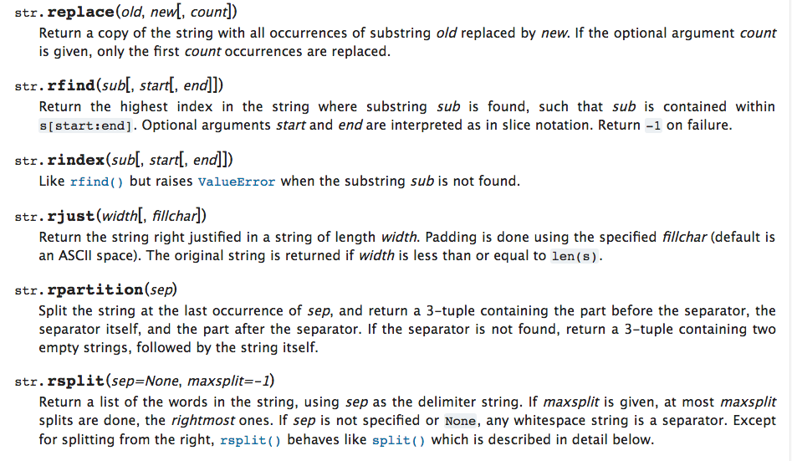

Slide 7
String Library
str.capitalize()
str.center(width[, fillchar])
str.endswith(suffix[, start[, end]])
str.find(sub[, start[, end]])
str.lstrip([chars])
str.replace(old, new[, count])
str.lower()
str.rstrip([chars])
str.strip([chars])
str.upper()

Slide 8
Searching a String
b
a
n
a
n
a
We use the find() function to search for a substring within another string
find() finds the first occurrence of the substring
If the substring is not found, find() returns -1
Remember that string position starts at zero
0
1
2
3
4
5
>>> fruit = 'banana'
>>> pos = fruit.find('na')
>>> print(pos)
2
>>> aa = fruit.find('z')
>>> print(aa)
-1

Slide 9
Making Everything UPPER CASE
You can make a copy of a string in lower case or upper case
Often when we are searching for a string using find() we first convert the string to lower case so we can search a string regardless of case
>>> greet = 'Hello Bob'
>>> nnn = greet.upper()
>>> print(nnn)
HELLO BOB
>>> www = greet.lower()
>>> print(www)
hello bob
>>>

Slide 10
Search and Replace
The replace() function is like a “search and replace” operation in a word processor
It replaces all occurrences of the search string with the replacement string
>>> greet = 'Hello Bob'
>>> nstr = greet.replace('Bob','Jane')
>>> print(nstr)
Hello Jane
>>> nstr = greet.replace('o','X')
>>> print(nstr)
HellX BXb
>>>

Slide 11
Stripping Whitespace
>>> greet = ' Hello Bob '
>>> greet.lstrip()
'Hello Bob '
>>> greet.rstrip()
' Hello Bob'
>>> greet.strip()
'Hello Bob'
>>>
Sometimes we want to take a string and remove whitespace at the beginning and/or end
lstrip() and rstrip() remove whitespace at the left or right
strip() removes both beginning and ending whitespace

Slide 12
Prefixes
>>> line = 'Please have a nice day'
>>> line.startswith('Please')
True
>>> line.startswith('p')
False

Slide 13

Parsing and Extracting
21
31
From stephen.marquard@uct.ac.za Sat Jan 5 09:14:16 2008
>>> data = 'From stephen.marquard@uct.ac.za Sat Jan 5 09:14:16 2008'
>>> atpos = data.find('@')
>>> print(atpos)
21
>>> sppos = data.find(' ',atpos)
>>> print(sppos)
31
>>> host = data[atpos+1 : sppos]
>>> print(host)
uct.ac.za

Slide 14
Strings and Character Sets
Python 2.7.10
>>> x = '이광춘'
>>> type(x)
<type 'str'>
>>> x = u'이광춘'
>>> type(x)
<type 'unicode'>
>>>
Python 3.5.1
>>> x = '이광춘'
>>> type(x)
<class 'str'>
>>> x = u'이광춘'
>>> type(x)
<class 'str'>
>>>
In Python 3, all strings are Unicode

Slide 15
Summary
String type
Read/Convert
Indexing strings []
Slicing strings [2:4]
Looping through strings with for and while
Concatenating strings with +
String operations
String library
String Comparisons
Searching in strings
Replacing text
Stripping white space

Slide 16


Acknowledgements / Contributions
These slides are Copyright 2010- Charles R. Severance (www.dr-chuck.com) of the University of Michigan School of Information and open.umich.edu and made available under a Creative Commons Attribution 4.0 License. Please maintain this last slide in all copies of the document to comply with the attribution requirements of the license. If you make a change, feel free to add your name and organization to the list of contributors on this page as you republish the materials.
Initial Development: Charles Severance, University of Michigan School of Information
… Insert new Contributors and Translators here
...

