Slide 1


Regular Expressions
Chapter 11
Python for Everybody
www.py4e.com
Notes:
Note from Chuck. If you are using these materials, you can remove the UM logo and replace it with your own, but please retain the CC-BY logo on the first page as well as retain the acknowledgement page(s) at the end.

Slide 2
Regular Expressions
In computing, a regular expression, also referred to as “regex” or “regexp”, provides a concise and flexible means for matching strings of text, such as particular characters, words, or patterns of characters. A regular expression is written in a formal language that can be interpreted by a regular expression processor.
http://en.wikipedia.org/wiki/Regular_expression

Slide 3
Regular Expressions
Really clever “wild card” expressions for matching and parsing strings
http://en.wikipedia.org/wiki/Regular_expression

Slide 4
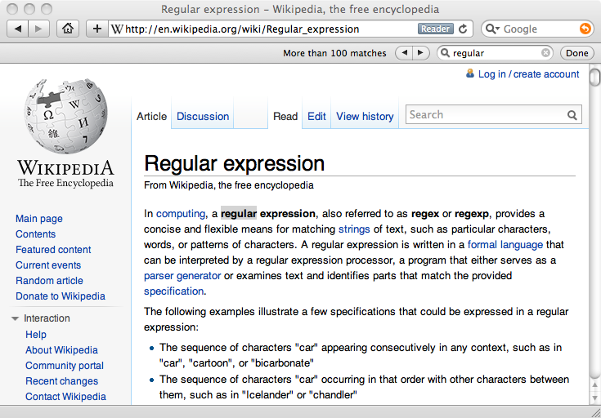
Really smart “Find” or “Search”

Slide 5
Understanding Regular Expressions
Very powerful and quite cryptic
Fun once you understand them
Regular expressions are a language unto themselves
A language of “marker characters” - programming with characters
It is kind of an “old school” language - compact

Slide 6
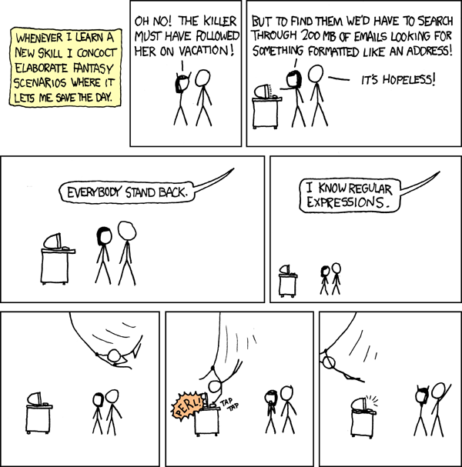
http://xkcd.com/208/

Slide 7
Regular Expression Quick Guide
^ Matches the beginning of a line
$ Matches the end of the line
. Matches any character
\s Matches whitespace
\S Matches any non-whitespace character
* Repeats a character zero or more times
*? Repeats a character zero or more times (non-greedy)
+ Repeats a character one or more times
+? Repeats a character one or more times (non-greedy)
[aeiou] Matches a single character in the listed set
[^XYZ] Matches a single character not in the listed set
[a-z0-9] The set of characters can include a range
( Indicates where string extraction is to start
) Indicates where string extraction is to end
https://www.py4e.com/lectures3/Pythonlearn-11-Regex-Handout.txt

Slide 8
The Regular Expression Module
Before you can use regular expressions in your program, you must import the library using “import re”
You can use re.search() to see if a string matches a regular expression, similar to using the find() method for strings
You can use re.findall() to extract portions of a string that match your regular expression, similar to a combination of find() and slicing: var[5:10]

Slide 9
Using re.search() Like find()
import re
hand = open('mbox-short.txt')
for line in hand:
line = line.rstrip()
if re.search('From:', line) :
print(line)
hand = open('mbox-short.txt')
for line in hand:
line = line.rstrip()
if line.find('From:') >= 0:
print(line)

Slide 10
Using re.search() Like startswith()
import re
hand = open('mbox-short.txt')
for line in hand:
line = line.rstrip()
if re.search('From:', line) :
print(line)
hand = open('mbox-short.txt')
for line in hand:
line = line.rstrip()
if line.find('From:') >= 0:
print(line)
We fine-tune what is matched by adding special characters to the string

Slide 11
Wild-Card Characters
The dot character matches any character
If you add the asterisk character, the character is “any number of times”
X-Sieve: CMU Sieve 2.3
X-DSPAM-Result: Innocent
X-DSPAM-Confidence: 0.8475
X-Content-Type-Message-Body: text/plain
^X.*:

Slide 12
Wild-Card Characters
The dot character matches any character
If you add the asterisk character, the character is “any number of times”
Many times
Match the start of the line
X-Sieve: CMU Sieve 2.3
X-DSPAM-Result: Innocent
X-DSPAM-Confidence: 0.8475
X-Content-Type-Message-Body: text/plain
^X.*:
Match any character

Slide 13
Fine-Tuning Your Match
Depending on how “clean” your data is and the purpose of your application, you may want to narrow your match down a bit
Many times
Match the start of the line
X-Sieve: CMU Sieve 2.3
X-DSPAM-Result: Innocent
X-Plane is behind schedule: two weeks
^X.*:
Match any character

Slide 14
Fine-Tuning Your Match
Depending on how “clean” your data is and the purpose of your application, you may want to narrow your match down a bit
One or more times
Match the start of the line
X-Sieve: CMU Sieve 2.3
X-DSPAM-Result: Innocent
X-Plane is behind schedule: two weeks
^X-\S+:
Match any non-whitespace character

