Slide 1
XML “Elements” (or Nodes)
<people>
<person>
<name>Chuck</name>
<phone>303 4456</phone>
</person>
<person>
<name>Noah</name>
<phone>622 7421</phone>
</person>
</people>
Simple Element
Complex Element

Slide 2
eXtensible Markup Language
Primary purpose is to help information systems share structured data
It started as a simplified subset of the Standard Generalized Markup Language (SGML), and is designed to be relatively human-legible
http://en.wikipedia.org/wiki/XML

Slide 3
XML Basics
Start Tag
End Tag
Text Content
Attribute
Self Closing Tag
<person>
<name>Chuck</name>
<phone type="intl">
+1 734 303 4456
</phone>
<email hide="yes" />
</person>

Slide 4
White Space
<person>
<name>Chuck</name>
<phone type="intl">
+1 734 303 4456
</phone>
<email hide="yes" />
</person>
Line ends do not matter. White space is generally discarded on text elements. We indent only to be readable.
<person>
<name>Chuck</name>
<phone type="intl">+1 734 303 4456</phone>
<email hide="yes" />
</person>

Slide 5
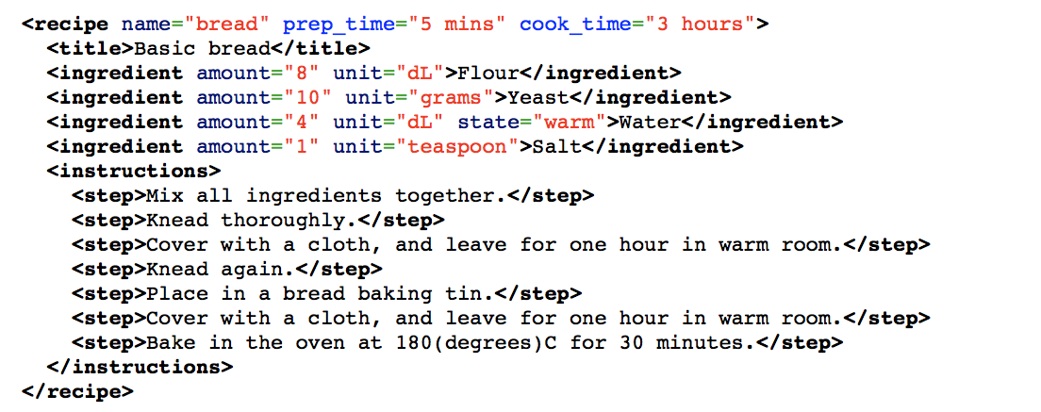
Some XML...
http://en.wikipedia.org/wiki/XML

Slide 6
XML Terminology
Tags indicate the beginning and ending of elements
Attributes - Keyword/value pairs on the opening tag of XML
Serialize / De-Serialize - Convert data in one program into a common format that can be stored and/or transmitted between systems in a programming language-independent manner
http://en.wikipedia.org/wiki/Serialization

Slide 7
XML as a Tree
a
<a>
<b>X</b>
<c>
<d>Y</d>
<e>Z</e>
</c>
</a>
b
c
X
d
e
Elements
Text
Y
Z

Slide 8
XML Text and Attributes
a
<a>
<b w="5">X</b>
<c>
<d>Y</d>
<e>Z</e>
</c>
</a>
b
c
w
attrib
text
node
5
X
d
e
Elements
Text
Y
Z

Slide 9

XML as Paths
a
b
c
<a>
<b>X</b>
<c>
<d>Y</d>
<e>Z</e>
</c>
</a>
/a/b X
/a/c/d Y
/a/c/e Z
X
d
e
Y
Z
Elements
Text

Slide 10
XML Schema
Describing a “contract” as to what is acceptable XML.
http://en.wikipedia.org/wiki/Xml_schema
http://en.wikibooks.org/wiki/XML_Schema

Slide 11


Acknowledgements / Contributions
These slides are Copyright 2010- Charles R. Severance (www.dr-chuck.com) of the University of Michigan School of Information and open.umich.edu and made available under a Creative Commons Attribution 4.0 License. Please maintain this last slide in all copies of the document to comply with the attribution requirements of the license. If you make a change, feel free to add your name and organization to the list of contributors on this page as you republish the materials.
Initial Development: Charles Severance, University of Michigan School of Information
… Insert new Contributors here
...

