Slide 1
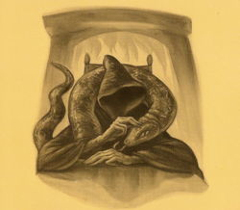
Parseltongue is the language of serpents and those who can converse with them.
An individual who can speak Parseltongue is known as a Parselmouth. It is a very uncommon skill, and may be hereditary. Nearly all known Parselmouths are descended from Salazar Slytherin.
http://harrypotter.wikia.com/wiki/Parseltongue

Slide 2
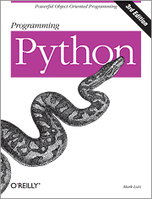
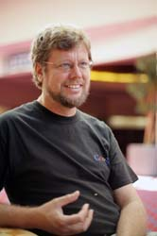
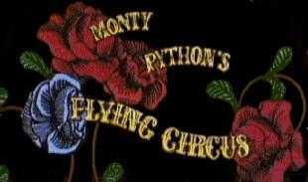
Python is the language of the Python Interpreter and those who can converse with it. An individual who can speak Python is known as a Pythonista. It is a very uncommon skill, and may be hereditary. Nearly all known Pythonistas use software initially developed by Guido van Rossum.

Slide 3
Early Learner: Syntax Errors
We need to learn the Python language so we can communicate our instructions to Python. In the beginning we will make lots of mistakes and speak gibberish like small children.
When you make a mistake, the computer does not think you are “cute”. It says “syntax error” - given that it knows the language and you are just learning it. It seems like Python is cruel and unfeeling.
You must remember that you are intelligent and can learn. The computer is simple and very fast, but cannot learn. So it is easier for you to learn Python than for the computer to learn English...

Slide 4
Talking to Python

