Slide 1
What is Web Scraping?
When a program or script pretends to be a browser and retrieves web pages, looks at those web pages, extracts information, and then looks at more web pages
Search engines scrape web pages - we call this “spidering the web” or “web crawling”
http://en.wikipedia.org/wiki/Web_scraping
http://en.wikipedia.org/wiki/Web_crawler

Slide 2
Why Scrape?
Pull data - particularly social data - who links to who?
Get your own data back out of some system that has no “export capability”
Monitor a site for new information
Spider the web to make a database for a search engine

Slide 3
Scraping Web Pages
There is some controversy about web page scraping and some sites are a bit snippy about it.
Republishing copyrighted information is not allowed
Violating terms of service is not allowed

Slide 4
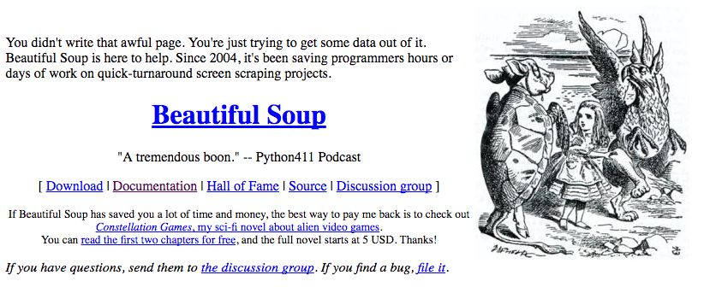
The Easy Way - Beautiful Soup
You could do string searches the hard way
Or use the free software library called BeautifulSoup from www.crummy.com
https://www.crummy.com/software/BeautifulSoup/

Slide 5
BeautifulSoup Installation
# To run this, you can install BeautifulSoup
# https://pypi.python.org/pypi/beautifulsoup4
# Or download the file
# http://www.py4e.com/code3/bs4.zip
# and unzip it in the same directory as this file
import urllib.request, urllib.parse, urllib.error
from bs4 import BeautifulSoup
...
urllinks.py

Slide 6
import urllib.request, urllib.parse, urllib.error
from bs4 import BeautifulSoup
url = input('Enter - ')
html = urllib.request.urlopen(url).read()
soup = BeautifulSoup(html, 'html.parser')
# Retrieve all of the anchor tags
tags = soup('a')
for tag in tags:
print(tag.get('href', None))
python urllinks.py
Enter - http://www.dr-chuck.com/page1.htm
http://www.dr-chuck.com/page2.htm

Slide 7
Summary
The TCP/IP gives us pipes / sockets between applications
We designed application protocols to make use of these pipes
HyperText Transfer Protocol (HTTP) is a simple yet powerful protocol
Python has good support for sockets, HTTP, and HTML parsing

Slide 8


Acknowledgements / Contributions
Thes slide are Copyright 2010- Charles R. Severance (www.dr-chuck.com) of the University of Michigan School of Information and open.umich.edu and made available under a Creative Commons Attribution 4.0 License. Please maintain this last slide in all copies of the document to comply with the attribution requirements of the license. If you make a change, feel free to add your name and organization to the list of contributors on this page as you republish the materials.
Initial Development: Charles Severance, University of Michigan School of Information
… Insert new Contributors here
...

