Slide 1
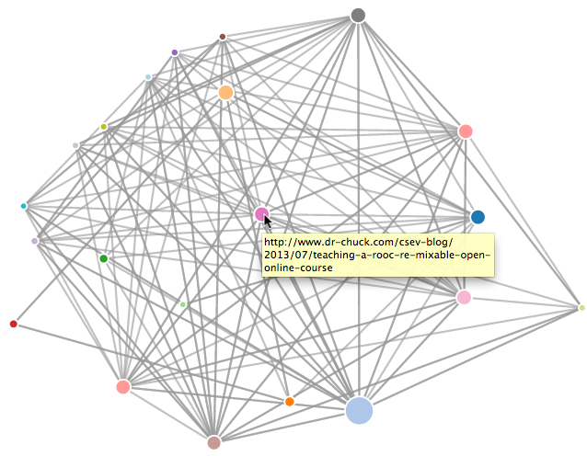
Page Rank
Write a simple web page crawler
Compute a simple version of Google's Page Rank algorithm
Visualize the resulting network
http://www.py4e.com/code3/pagerank.zip

Slide 2
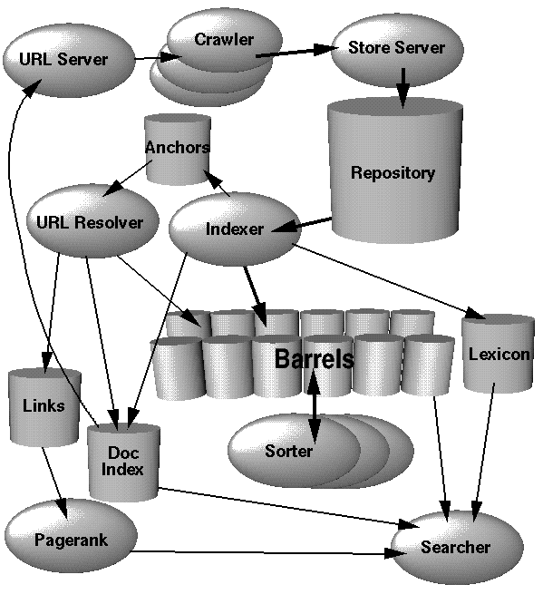
Search Engine Architecture
Web Crawling
Index Building
Searching
http://infolab.stanford.edu/~backrub/google.html

Slide 3
Web Crawler
A Web crawler is a computer program that browses the World Wide Web in a methodical, automated manner. Web crawlers are mainly used to create a copy of all the visited pages for later processing by a search engine that will index the downloaded pages to provide fast searches.
http://en.wikipedia.org/wiki/Web_crawler

Slide 4
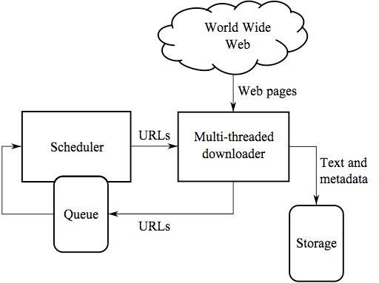
Web Crawler
Retrieve a page
Look through the page for links
Add the links to a list of “to be retrieved” sites
Repeat...
http://en.wikipedia.org/wiki/Web_crawler

Slide 5
Web Crawling Policy
a selection policy that states which pages to download,
a re-visit policy that states when to check for changes to the pages,
a politeness policy that states how to avoid overloading Web sites, and
a parallelization policy that states how to coordinate distributed Web crawlers

Slide 6
robots.txt
A way for a web site to communicate with web crawlers
An informal and voluntary standard
Sometimes folks make a “Spider Trap” to catch “bad” spiders
User-agent: *
Disallow: /cgi-bin/
Disallow: /images/
Disallow: /tmp/
Disallow: /private/
http://www.py4e.com/robots.txt
http://en.wikipedia.org/wiki/Robots_Exclusion_Standard
http://en.wikipedia.org/wiki/Spider_trap

Slide 7
Google Architecture
Web Crawling
Index Building
Searching
http://infolab.stanford.edu/~backrub/google.html

Slide 8
Search Indexing
Search engine indexing collects, parses, and stores data to facilitate fast and accurate information retrieval. The purpose of storing an index is to optimize speed and performance in finding relevant documents for a search query. Without an index, the search engine would scan every document in the corpus, which would require considerable time and computing power.
http://en.wikipedia.org/wiki/Index_(search_engine)

Slide 9


spreset.py
sprank.py
force.html
d3.js
The
Web
spider.py
spider.sqlite
spjson.py
spdump.py
force.js
(5, None, 1.0, 3, u'http://www.dr-chuck.com/csev-blog')
(3, None, 1.0, 4, u'http://www.dr-chuck.com/dr-chuck/resume/speaking.htm')
(1, None, 1.0, 2, u'http://www.dr-chuck.com/csev-blog/')
(1, None, 1.0, 5, u'http://www.dr-chuck.com/dr-chuck/resume/index.htm')
4 rows.
http://www.py4e.com/code3/pagerank.zip

Slide 10
Visualizing Mail Data

Slide 11


Acknowledgements / Contributions
These slides are Copyright 2010- Charles R. Severance (www.dr-chuck.com) of the University of Michigan School of Information and open.umich.edu and made available under a Creative Commons Attribution 4.0 License. Please maintain this last slide in all copies of the document to comply with the attribution requirements of the license. If you make a change, feel free to add your name and organization to the list of contributors on this page as you republish the materials.
Initial Development: Charles Severance, University of Michigan School of Information
… Insert new Contributors here
...

