Slide 1


Service Oriented Approach
Most non-trivial web applications use services
They use services from other applications
Credit Card Charge
Hotel Reservation systems
Services publish the “rules” applications must follow to make use of the service (API)
Application
APIs
Service
Service

Slide 2
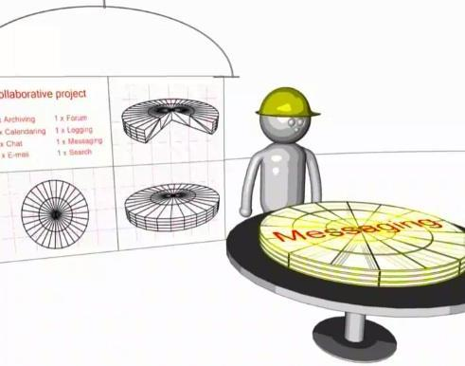
Multiple Systems
Initially - two systems cooperate and split the problem
As the data/service becomes useful - multiple applications want to use the information / application
http://www.youtube.com/watch?v=mj-kCFzF0ME
5:15

Slide 3
Application Program Interfaces
http://en.wikipedia.org/wiki/Web_services

Slide 4


Acknowledgements / Contributions
These slides are Copyright 2010- Charles R. Severance (www.dr-chuck.com) of the University of Michigan School of Information and open.umich.edu and made available under a Creative Commons Attribution 4.0 License. Please maintain this last slide in all copies of the document to comply with the attribution requirements of the license. If you make a change, feel free to add your name and organization to the list of contributors on this page as you republish the materials.
Initial Development: Charles Severance, University of Michigan School of Information
… Insert new Contributors here
...

