Slide 1
Application Program Interface
The API itself is largely abstract in that it specifies an interface and controls the behavior of the objects specified in that interface. The software that provides the functionality described by an API is said to be an “implementation” of the API. An API is typically defined in terms of the programming language used to build an application.
Text
http://en.wikipedia.org/wiki/API

Slide 2
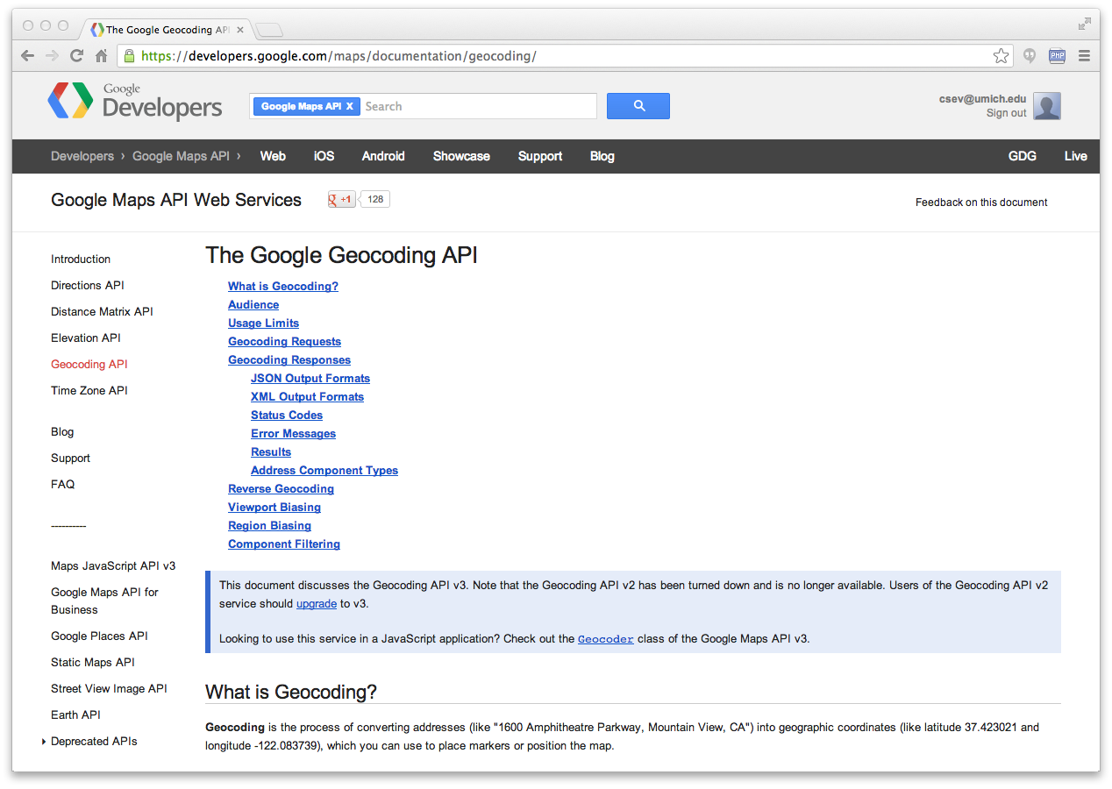
https://developers.google.com/maps/documentation/geocoding/

Slide 3
{
"status": "OK",
"results": [
{
"geometry": {
"location_type": "APPROXIMATE",
"location": {
"lat": 42.2808256,
"lng": -83.7430378
}
},
"address_components": [
{
"long_name": "Ann Arbor",
"types": [
"locality",
"political"
],
"short_name": "Ann Arbor"
}
],
"formatted_address": "Ann Arbor, MI, USA",
"types": [
"locality",
"political"
]
}
]
}
http://maps.googleapis.com/maps/api/geocode/json?address=Ann+Arbor%2C+MI
geojson.py

Slide 4
import urllib.request, urllib.parse, urllib.error
import json
serviceurl = 'http://maps.googleapis.com/maps/api/geocode/json?'
while True:
address = input('Enter location: ')
if len(address) < 1: break
url = serviceurl + urllib.parse.urlencode({'address': address})
print('Retrieving', url)
uh = urllib.request.urlopen(url)
data = uh.read().decode()
print('Retrieved', len(data), 'characters')
try:
js = json.loads(data)
except:
js = None
if not js or 'status' not in js or js['status'] != 'OK':
print('==== Failure To Retrieve ====')
print(data)
continue
lat = js["results"][0]["geometry"]["location"]["lat"]
lng = js["results"][0]["geometry"]["location"]["lng"]
print('lat', lat, 'lng', lng)
location = js['results'][0]['formatted_address']
print(location)
Enter location: Ann Arbor, MI
Retrieving http://maps.googleapis.com/...
Retrieved 1669 characters
lat 42.2808256 lng -83.7430378
Ann Arbor, MI, USA
Enter location:
geojson.py

Slide 5
API Security and Rate Limiting

Slide 6


Acknowledgements / Contributions
These slides are Copyright 2010- Charles R. Severance (www.dr-chuck.com) of the University of Michigan School of Information and open.umich.edu and made available under a Creative Commons Attribution 4.0 License. Please maintain this last slide in all copies of the document to comply with the attribution requirements of the license. If you make a change, feel free to add your name and organization to the list of contributors on this page as you republish the materials.
Initial Development: Charles Severance, University of Michigan School of Information
… Insert new Contributors here
...

