Slide 1


Python Objects
Charles Severance
Python for Everybody
www.py4e.com
Notes:
Note from Chuck. If you are using these materials, you can remove the UM logo and replace it with your own, but please retain the CC-BY logo on the first page as well as the acknowledgement page(s) at the end.

Slide 2
Warning
This lecture is very much about definitions and mechanics for objects
This lecture is a lot more about “how it works” and less about “how you use it”
You won’t get the entire picture until this is all looked at in the context of a real problem
So please suspend disbelief and learn technique for the next 40 or so slides..

Slide 3
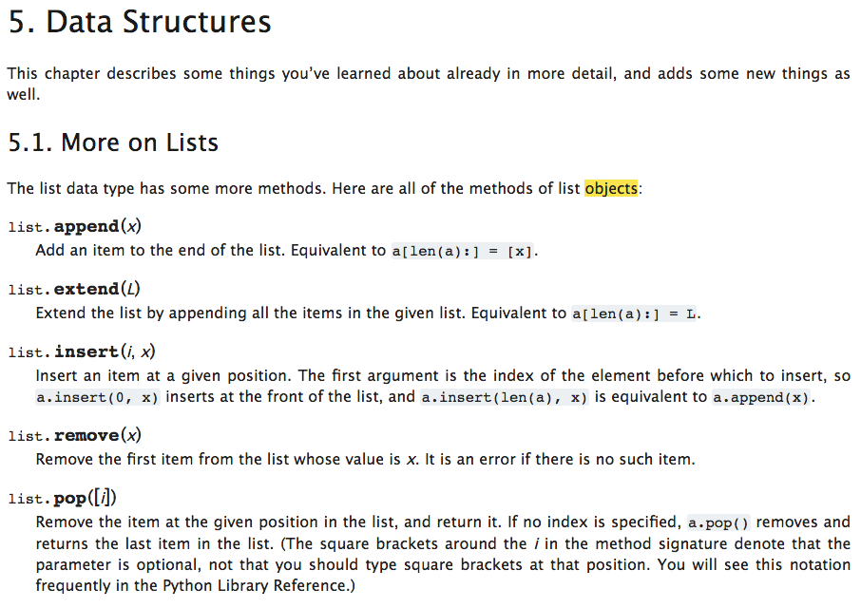
https://docs.python.org/3/tutorial/datastructures.html

Slide 4
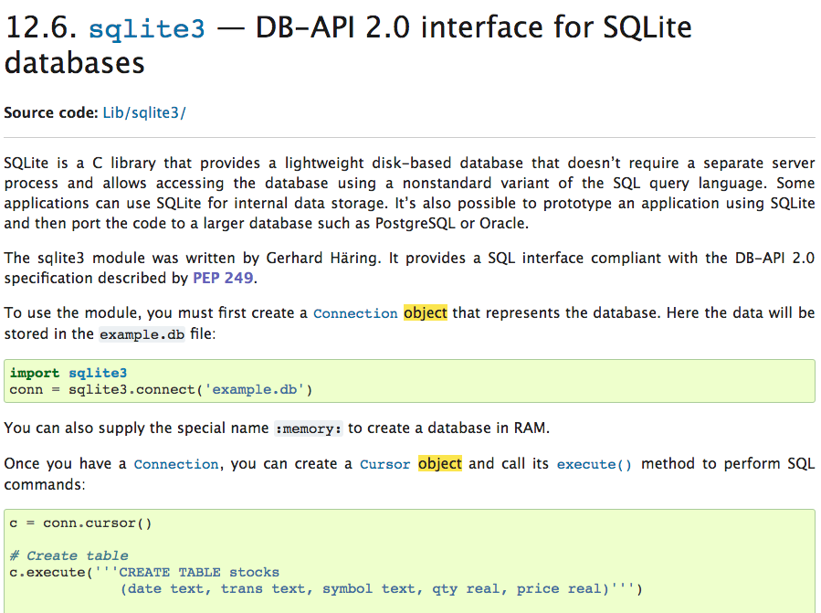
https://docs.python.org/3/library/sqlite3.html

Slide 5
Lets Start with Programs

Slide 6
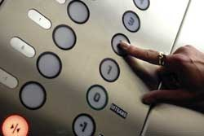
Europe floor? 0
US floor 1
inp = input('Europe floor?')
usf = int(inp) + 1
print('US floor', usf)
Input
Process
Output

Slide 7
Object Oriented
A program is made up of many cooperating objects
Instead of being the “whole program” - each object is a little “island” within the program and cooperatively working with other objects.
A program is made up of one or more objects working together - objects make use of each other’s capabilities

Slide 8
Object
An Object is a bit of self-contained Code and Data
A key aspect of the Object approach is to break the problem into smaller understandable parts (divide and conquer)
Objects have boundaries that allow us to ignore un-needed detail
We have been using objects all along: String Objects, Integer Objects, Dictionary Objects, List Objects...

Slide 9

Input
Dictionary
Object
Object
String
Objects get created and used
Output

Slide 10
Input
Code/Data
Code/Data
Code/Data
Code/Data
Objects are bits of code and data
Output

Slide 11
Input
Code/Data
Code/Data
Code/Data
Code/Data
Objects hide detail - they allow us to ignore the detail of the “rest of the program”.
Output

Slide 12
Input
Code/Data
Code/Data
Code/Data
Code/Data
Objects hide detail - they allow the “rest of the program” to ignore the detail about “us”.
Output

Slide 13
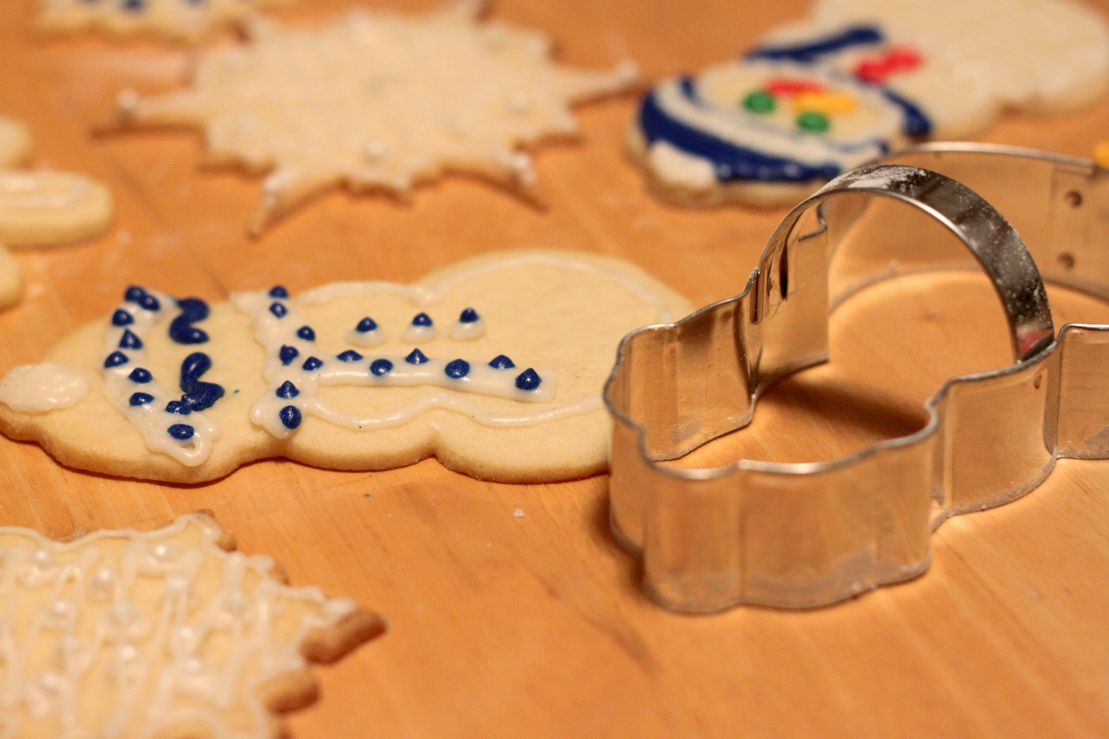
Definitions
Class - a template
Method or Message - A defined capability of a class
Field or attribute- A bit of data in a class
Object or Instance - A particular instance of a class

Slide 14
Terminology: Class
Defines the abstract characteristics of a thing (object), including the thing's characteristics (its attributes, fields or properties) and the thing's behaviors (the things it can do, or methods, operations or features). One might say that a class is a blueprint or factory that describes the nature of something. For example, the class Dog would consist of traits shared by all dogs, such as breed and fur color (characteristics), and the ability to bark and sit (behaviors).
http://en.wikipedia.org/wiki/Object-oriented_programming

Slide 15
Terminology: Instance
One can have an instance of a class or a particular object. The instance is the actual object created at runtime. In programmer jargon, the Lassie object is an instance of the Dog class. The set of values of the attributes of a particular object is called its state. The object consists of state and the behavior that's defined in the object's class.
Object and Instance are often used interchangeably.
http://en.wikipedia.org/wiki/Object-oriented_programming

Slide 16
Terminology: Method
An object's abilities. In language, methods are verbs. Lassie, being a Dog, has the ability to bark. So bark() is one of Lassie's methods. She may have other methods as well, for example sit() or eat() or walk() or save_timmy(). Within the program, using a method usually affects only one particular object; all Dogs can bark, but you need only one particular dog to do the barking
Method and Message are often used interchangeably.
http://en.wikipedia.org/wiki/Object-oriented_programming

Slide 17
Some Python Objects
>>> x = 'abc'
>>> type(x)
<class 'str'>
>>> type(2.5)
<class 'float'>
>>> type(2)
<class 'int'>
>>> y = list()
>>> type(y)
<class 'list'>
>>> z = dict()
>>> type(y)
<class 'list'>
>>> type(z)
<class 'dict'>
>>> dir(x)
[ … 'capitalize', 'casefold', 'center', 'count', 'encode', 'endswith', 'expandtabs', 'find', 'format', … 'lower', 'lstrip', 'maketrans', 'partition', 'replace', 'rfind', 'rindex', 'rjust', 'rpartition', 'rsplit', 'rstrip', 'split', 'splitlines', 'startswith', 'strip', 'swapcase', 'title', 'translate', 'upper', 'zfill']
>>> dir(y)
[… 'append', 'clear', 'copy', 'count', 'extend', 'index', 'insert', 'pop', 'remove', 'reverse', 'sort']
>>> dir(z)
[…, 'clear', 'copy', 'fromkeys', 'get', 'items', 'keys', 'pop', 'popitem', 'setdefault', 'update', 'values']

Slide 18
A Sample Class

Slide 19
Acknowledgements / Contributions
Thes slide are Copyright 2010- Charles R. Severance (www.dr-chuck.com) of the University of Michigan School of Information and made available under a Creative Commons Attribution 4.0 License. Please maintain this last slide in all copies of the document to comply with the attribution requirements of the license. If you make a change, feel free to add your name and organization to the list of contributors on this page as you republish the materials.
Initial Development: Charles Severance, University of Michigan School of Information
… Insert new Contributors here
...

Slide 20
Additional Source Information
Snowman Cookie Cutter" by Didriks is licensed under CC BY https://www.flickr.com/photos/dinnerseries/23570475099
Photo from the television program Lassie. Lassie watches as Jeff (Tommy Rettig) works on his bike is Public Domain https://en.wikipedia.org/wiki/Lassie#/media/File:Lassie_and_Tommy_Rettig_1956.JPG

