Slide 1


Reading Files
Chapter 7
Python for Everybody
www.py4e.com
Notes:
Note from Chuck. If you are using these materials, you can remove the UM logo and replace it with your own, but please retain the CC-BY logo on the first page as well as retain the acknowledgement page(s) at the end.

Slide 2

It is time to go find some Data to mess with!
What
Next?
Software
Input
and Output
Devices
Central
Processing
Unit
Files R Us
Secondary
Memory
if x < 3: print
Main
Memory
From stephen.marquard@uct.ac.za Sat Jan 5 09:14:16 2008
Return-Path: <postmaster@collab.sakaiproject.org>
Date: Sat, 5 Jan 2008 09:12:18 -0500To: source@collab.sakaiproject.orgFrom: stephen.marquard@uct.ac.zaSubject: [sakai] svn commit: r39772 - content/branches/Details: http://source.sakaiproject.org/viewsvn/?view=rev&rev=39772
...

Slide 3
File Processing
A text file can be thought of as a sequence of lines
From stephen.marquard@uct.ac.za Sat Jan 5 09:14:16 2008
Return-Path: <postmaster@collab.sakaiproject.org>
Date: Sat, 5 Jan 2008 09:12:18 -0500
To: source@collab.sakaiproject.org
From: stephen.marquard@uct.ac.za
Subject: [sakai] svn commit: r39772 - content/branches/
Details: http://source.sakaiproject.org/viewsvn/?view=rev&rev=39772
http://www.py4e.com/code/mbox-short.txt

Slide 4
Opening a File
Before we can read the contents of the file, we must tell Python which file we are going to work with and what we will be doing with the file
This is done with the open() function
open() returns a “file handle” - a variable used to perform operations on the file
Similar to “File -> Open” in a Word Processor

Slide 5
Using open()
handle = open(filename, mode)
returns a handle use to manipulate the file
filename is a string
mode is optional and should be 'r' if we are planning to read the file and 'w' if we are going to write to the file
fhand = open('mbox.txt', 'r')

Slide 6
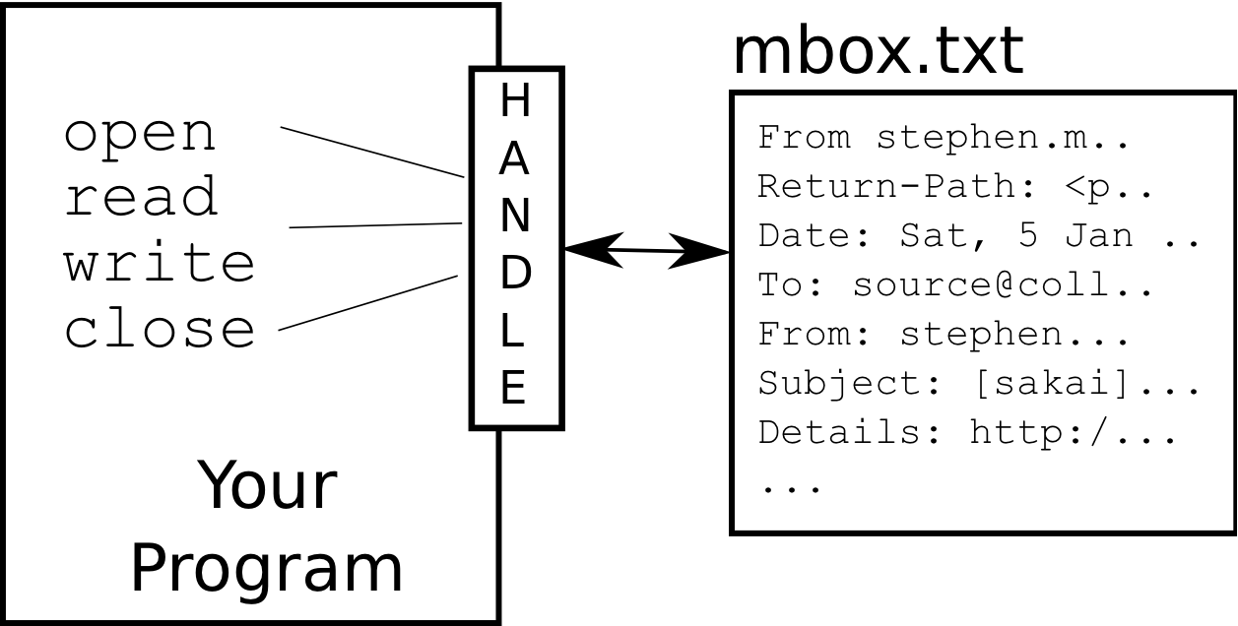
What is a Handle?
>>> fhand = open('mbox.txt')
>>> print(fhand)
<_io.TextIOWrapper name='mbox.txt' mode='r' encoding='UTF-8'>

Slide 7
When Files are Missing
>>> fhand = open('stuff.txt')
Traceback (most recent call last):
File "<stdin>", line 1, in <module>
FileNotFoundError: [Errno 2] No such file or directory: 'stuff.txt'

Slide 8
The newline Character
We use a special character called the “newline” to indicate when a line ends
We represent it as \n in strings
Newline is still one character - not two
>>> stuff = 'Hello\nWorld!'
>>> stuff
'Hello\nWorld!'
>>> print(stuff)
Hello
World!
>>> stuff = 'X\nY'
>>> print(stuff)
X
Y
>>> len(stuff)
3

Slide 9
File Processing
A text file can be thought of as a sequence of lines
From stephen.marquard@uct.ac.za Sat Jan 5 09:14:16 2008
Return-Path: <postmaster@collab.sakaiproject.org>
Date: Sat, 5 Jan 2008 09:12:18 -0500
To: source@collab.sakaiproject.org
From: stephen.marquard@uct.ac.za
Subject: [sakai] svn commit: r39772 - content/branches/
Details: http://source.sakaiproject.org/viewsvn/?view=rev&rev=39772

Slide 10
File Processing
A text file has newlines at the end of each line
From stephen.marquard@uct.ac.za Sat Jan 5 09:14:16 2008\n
Return-Path: <postmaster@collab.sakaiproject.org>\n
Date: Sat, 5 Jan 2008 09:12:18 -0500\n
To: source@collab.sakaiproject.org\n
From: stephen.marquard@uct.ac.za\n
Subject: [sakai] svn commit: r39772 - content/branches/\n
\n
Details: http://source.sakaiproject.org/viewsvn/?view=rev&rev=39772\n

Slide 11
Reading Files in Python…

Slide 12
Acknowledgements / Contributions
These slides are Copyright 2010- Charles R. Severance (www.dr-chuck.com) of the University of Michigan School of Information and open.umich.edu and made available under a Creative Commons Attribution 4.0 License. Please maintain this last slide in all copies of the document to comply with the attribution requirements of the license. If you make a change, feel free to add your name and organization to the list of contributors on this page as you republish the materials.
Initial Development: Charles Severance, University of Michigan School of Information
… Insert new Contributors and Translators here
...

