Slide 1


Python Lists
Chapter 8
Python for Everybody
www.py4e.com
Notes:
Note from Chuck. If you are using these materials, you can remove the UM logo and replace it with your own, but please retain the CC-BY logo on the first page as well as retain the acknowledgement page(s) at the end.

Slide 2
Programming
Algorithms
A set of rules or steps used to solve a problem
Data Structures
A particular way of organizing data in a computer
https://en.wikipedia.org/wiki/Algorithm
https://en.wikipedia.org/wiki/Data_structure

Slide 3
What is Not A “Collection”?
Most of our variables have one value in them - when we put a new value in the variable, the old value is overwritten
$ python
>>> x = 2
>>> x = 4
>>> print(x)
4

Slide 4
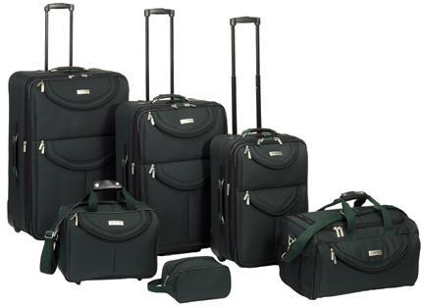
A List Is a Kind of Collection
A collection allows us to put many values in a single “variable”
A collection is nice because we can carry many values around in one convenient package.
friends = [ 'Joseph', 'Glenn', 'Sally' ]
carryon = [ 'socks', 'shirt', 'perfume' ]

Slide 5
List Constants
>>> print([1, 24, 76])
[1, 24, 76]
>>> print(['red', 'yellow', 'blue'])
['red', 'yellow', 'blue']
>>> print(['red', 24, 98.6])
['red', 24, 98.6]
>>> print([ 1, [5, 6], 7])
[1, [5, 6], 7]
>>> print([])
[]
List constants are surrounded by square brackets and the elements in the list are separated by commas
A list element can be any Python object - even another list
A list can be empty

Slide 6
We Already Use Lists!
for i in [5, 4, 3, 2, 1] :
print(i)
print('Blastoff!')
5
4
3
2
1
Blastoff!

Slide 7
Lists and Definite Loops – Best Pals
friends = ['Joseph', 'Glenn', 'Sally']
for friend in friends :
print('Happy New Year:', friend)
print('Done!')
Happy New Year: Joseph
Happy New Year: Glenn
Happy New Year: Sally
Done!
z = ['Joseph', 'Glenn', 'Sally']
for x in z:
print('Happy New Year:', x)
print('Done!')

Slide 8
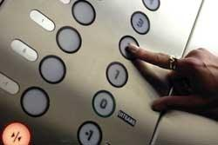
Looking Inside Lists
Just like strings, we can get at any single element in a list using an index specified in square brackets
>>> friends = [ 'Joseph', 'Glenn', 'Sally' ]
>>> print(friends[1])
Glenn
>>>
Joseph
Glenn
Sally
0
1
2

Slide 9
Lists Are Mutable
>>> fruit = 'Banana'
>>> fruit[0] = 'b'
Traceback
TypeError: 'str' object does not
support item assignment
>>> x = fruit.lower()
>>> print(x)
banana
>>> lotto = [2, 14, 26, 41, 63]
>>> print(lotto)
[2, 14, 26, 41, 63]
>>> lotto[2] = 28
>>> print(lotto)
[2, 14, 28, 41, 63]
Strings are “immutable” - we cannot change the contents of a string - we must make a new string to make any change
Lists are “mutable” - we can change an element of a list using the index operator

Slide 10
How Long is a List?
The len() function takes a list as a parameter and returns the number of elements in the list
Actually len() tells us the number of elements of any set or sequence (such as a string...)
>>> greet = 'Hello Bob'
>>> print(len(greet))
9
>>> x = [ 1, 2, 'joe', 99]
>>> print(len(x))
4
>>>

Slide 11
Using the Range Function
The range function returns a list of numbers that range from zero to one less than the parameter
We can construct an index loop using for and an integer iterator
>>> print(range(4))
[0, 1, 2, 3]
>>> friends = ['Joseph', 'Glenn', 'Sally']
>>> print(len(friends))
3
>>> print(range(len(friends)))
[0, 1, 2]
>>>

Slide 12
A Tale of Two Loops...
>>> friends = ['Joseph', 'Glenn', 'Sally']
>>> print(len(friends))
3
>>> print(range(len(friends)))
[0, 1, 2]
>>>
friends = ['Joseph', 'Glenn', 'Sally']
for friend in friends :
print('Happy New Year:', friend)
for i in range(len(friends)) :
friend = friends[i]
print('Happy New Year:', friend)
Happy New Year: Joseph
Happy New Year: Glenn
Happy New Year: Sally

