Slide 1
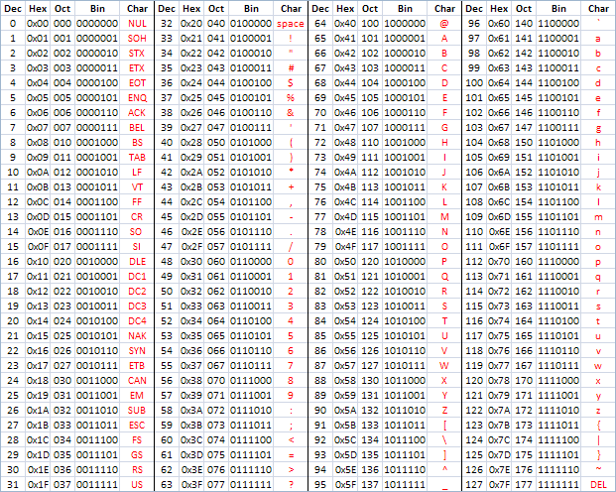
ASCII
American Standard Code for Information Interchange
https://en.wikipedia.org/wiki/ASCII
http://www.catonmat.net/download/ascii-cheat-sheet.png

Slide 2
Representing Simple Strings
Each character is represented by a number between 0 and 256 stored in 8 bits of memory
We refer to "8 bits of memory as a "byte" of memory – (i.e. my disk drive contains 3 Terabytes of memory)
The ord() function tells us the numeric value of a simple ASCII character
>>> print(ord('H'))
72
>>> print(ord('e'))
101
>>> print(ord('\n'))
10
>>>

Slide 3
ASCII
>>> print(ord('H'))
72
>>> print(ord('e'))
101
>>> print(ord('\n'))
10
>>>
In the 1960s and 1970s, we just assumed that one byte was one character

Slide 4
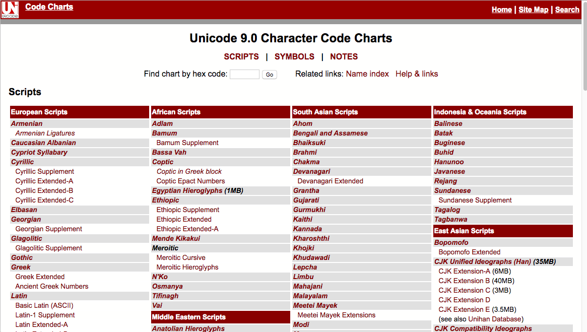
http://unicode.org/charts/

Slide 5
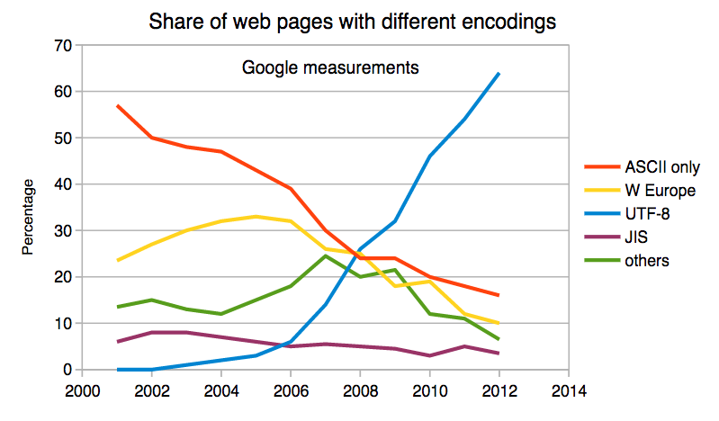
Multi-Byte Characters
To represent the wide range of characters computers must handle we represent characters with more than one byte
UTF-16 – Variable length – Two or Four Bytes
UTF-32 – Fixed Length – Four Bytes
UTF-8 – 1-4 bytes
Upwards compatible with ASCII
Automatic detection between ASCII and UTF-8
UTF-8 is recommended practice for encoding data to be exchanged between systems
https://en.wikipedia.org/wiki/UTF-8

Slide 6
Two Kinds of Strings in Python
Python 2.7.10
>>> x = '이광춘'
>>> type(x)
<type 'str'>
>>> x = u'이광춘'
>>> type(x)
<type 'unicode'>
>>>
Python 3.5.1
>>> x = '이광춘'
>>> type(x)
<class 'str'>
>>> x = u'이광춘'
>>> type(x)
<class 'str'>
>>>
In Python 3, all strings are Unicode

Slide 7
Python 2 Versus Python 3
Python 2.7.10
>>> x = b'abc'
>>> type(x)
<type 'str'>
>>> x = '이광춘'
>>> type(x)
<type 'str'>
>>> x = u'이광춘'
>>> type(x)
<type 'unicode'>
Python 3.5.1
>>> x = b'abc'
>>> type(x)
<class 'bytes'>
>>> x = '이광춘'
>>> type(x)
<class 'str'>
>>> x = u'이광춘'
>>> type(x)
<class 'str'>

Slide 8
Python 3 and Unicode
In Python 3, all strings internally are UNICODE
Working with string variables in Python programs and reading data from files usually "just works"
When we talk to a network resource using sockets or talk to a database we have to encode and decode data (usually to UTF-8)
Python 3.5.1
>>> x = b'abc'
>>> type(x)
<class 'bytes'>
>>> x = '이광춘'
>>> type(x)
<class 'str'>
>>> x = u'이광춘'
>>> type(x)
<class 'str'>

Slide 9
Python Strings to Bytes
When we talk to an external resource like a network socket we sends bytes, so we need to encode Python 3 strings into a given character encoding
When we read data from an external resource, we must decode it based on the character set so it is properly represented in Python 3 as a string
while True:
data = mysock.recv(512)
if ( len(data) < 1 ) :
break
mystring = data.decode()
print(mystring)

Slide 10
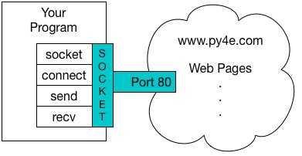
An HTTP Request in Python
import socket
mysock = socket.socket(socket.AF_INET, socket.SOCK_STREAM)
mysock.connect(('data.pr4e.org', 80))
cmd = 'GET http://data.pr4e.org/romeo.txt HTTP/1.0\n\n'.encode()
mysock.send(cmd)
while True:
data = mysock.recv(512)
if (len(data) < 1):
break
print(data.decode())
mysock.close()

Slide 11
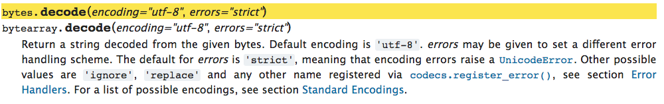
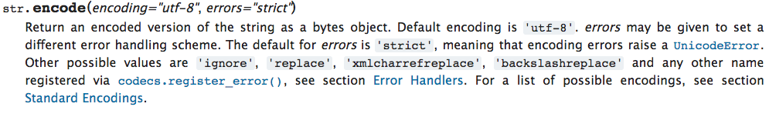
https://docs.python.org/3/library/stdtypes.html#bytes.decode
https://docs.python.org/3/library/stdtypes.html#str.encode

Slide 12
Network
decode()
Bytes
UTF-8
recv()
Socket
String
Unicode
Bytes
UTF-8
encode()
send()
import socket
mysock = socket.socket(socket.AF_INET, socket.SOCK_STREAM)
mysock.connect(('data.pr4e.org', 80))
cmd = 'GET http://data.pr4e.org/romeo.txt HTTP/1.0\n\n'.encode()
mysock.send(cmd)
while True:
data = mysock.recv(512)
if (len(data) < 1):
break
print(data.decode())
mysock.close()

Slide 13
Making HTTP (even) Easier With urllib

Slide 14


Acknowledgements / Contributions
Thes slide are Copyright 2010- Charles R. Severance (www.dr-chuck.com) of the University of Michigan School of Information and open.umich.edu and made available under a Creative Commons Attribution 4.0 License. Please maintain this last slide in all copies of the document to comply with the attribution requirements of the license. If you make a change, feel free to add your name and organization to the list of contributors on this page as you republish the materials.
Initial Development: Charles Severance, University of Michigan School of Information
… Insert new Contributors here
...

