Slide 1
XML Schema
Describing a “contract” as to what is acceptable XML.
http://en.wikipedia.org/wiki/Xml_schema
http://en.wikibooks.org/wiki/XML_Schema

Slide 2
XML Schema
Description of the legal format of an XML document
Expressed in terms of constraints on the structure and content of documents
Often used to specify a “contract” between systems - “My system will only accept XML that conforms to this particular Schema.”
If a particular piece of XML meets the specification of the Schema - it is said to “validate”
http://en.wikipedia.org/wiki/Xml_schema

Slide 3

XML Validation
XML Document
Validator
XML Schema Contract

Slide 4
XML Validation
XML Document
<person>
<lastname>Severance</lastname>
<age>17</age>
<dateborn>2001-04-17</dateborn>
</person>
Validator
XML Schema Contract
<xs:complexType name=”person”>
<xs:sequence>
<xs:element name="lastname" type="xs:string"/>
<xs:element name="age" type="xs:integer"/>
<xs:element name="dateborn" type="xs:date"/>
</xs:sequence>
</xs:complexType>

Slide 5

Many XML Schema Languages
Document Type Definition (DTD)
http://en.wikipedia.org/wiki/Document_Type_Definition
Standard Generalized Markup Language (ISO 8879:1986 SGML)
http://en.wikipedia.org/wiki/SGML
XML Schema from W3C - (XSD)
http://en.wikipedia.org/wiki/XML_Schema_(W3C)
http://en.wikipedia.org/wiki/Xml_schema

Slide 6
XSD XML Schema (W3C spec)
We will focus on the World Wide Web Consortium (W3C) version
It is often called “W3C Schema” because “Schema” is considered generic
More commonly it is called XSD because the file names end in .xsd
http://www.w3.org/XML/Schema
http://en.wikipedia.org/wiki/XML_Schema_(W3C)

Slide 7
XSD Structure
<person>
<lastname>Severance</lastname>
<age>17</age>
<dateborn>2001-04-17</dateborn>
</person>
xs:element
xs:sequence
xs:complexType
<xs:complexType name=”person”>
<xs:sequence>
<xs:element name="lastname" type="xs:string"/>
<xs:element name="age" type="xs:integer"/>
<xs:element name="dateborn" type="xs:date"/>
</xs:sequence>
</xs:complexType>

Slide 8
XSD Constraints
<xs:element name="person">
<xs:complexType>
<xs:sequence>
<xs:element name="full_name" type="xs:string"
minOccurs="1" maxOccurs="1" />
<xs:element name="child_name" type="xs:string"
minOccurs="0" maxOccurs="10" />
</xs:sequence>
</xs:complexType>
</xs:element>
<person>
<full_name>Tove Refsnes</full_name>
<child_name>Hege</child_name>
<child_name>Stale</child_name>
<child_name>Jim</child_name>
<child_name>Borge</child_name>
</person>
http://www.w3schools.com/Schema/schema_complex_indicators.asp

Slide 9
XSD Data Types
<xs:element name="customer" type="xs:string"/>
<xs:element name="start" type="xs:date"/>
<xs:element name="startdate" type="xs:dateTime"/>
<xs:element name="prize" type="xs:decimal"/>
<xs:element name="weeks" type="xs:integer"/>
<customer>John Smith</customer>
<start>2002-09-24</start>
<startdate>2002-05-30T09:30:10Z</startdate>
<prize>999.50</prize>
<weeks>30</weeks>
It is common to represent time in UTC/GMT, given that servers are often scattered around the world.
http://www.w3schools.com/Schema/schema_dtypes_numeric.asp

Slide 10
ISO 8601 Date/Time Format
2002-05-30T09:30:10Z
Year-month-day
Time of day
Timezone - typically specified in UTC / GMT rather than local time zone.
http://en.wikipedia.org/wiki/ISO_8601
http://en.wikipedia.org/wiki/Coordinated_Universal_Time

Slide 11
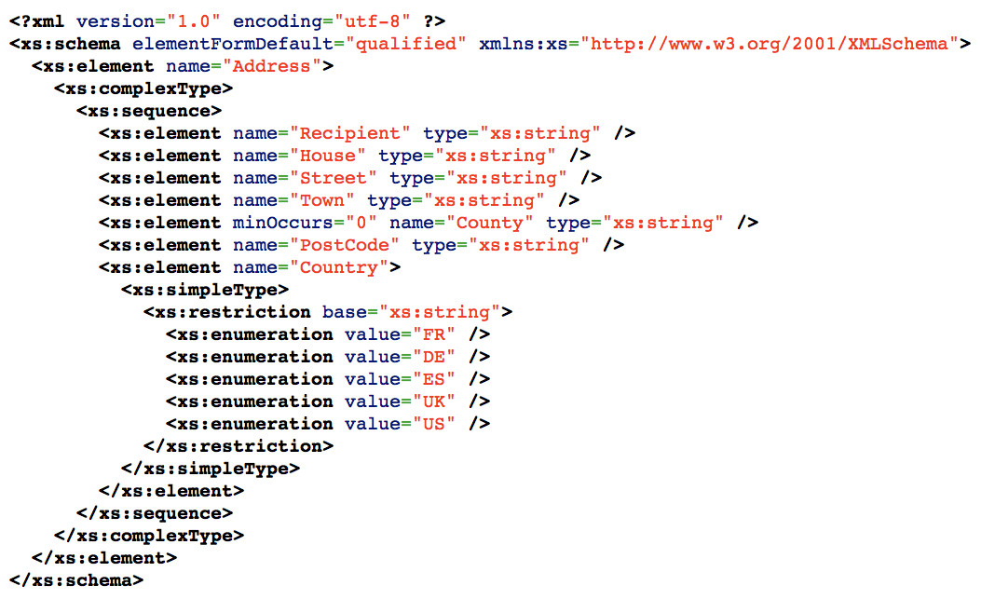
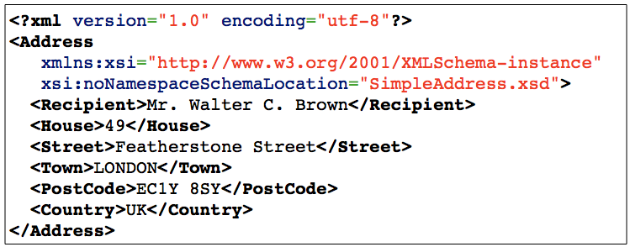

Slide 12
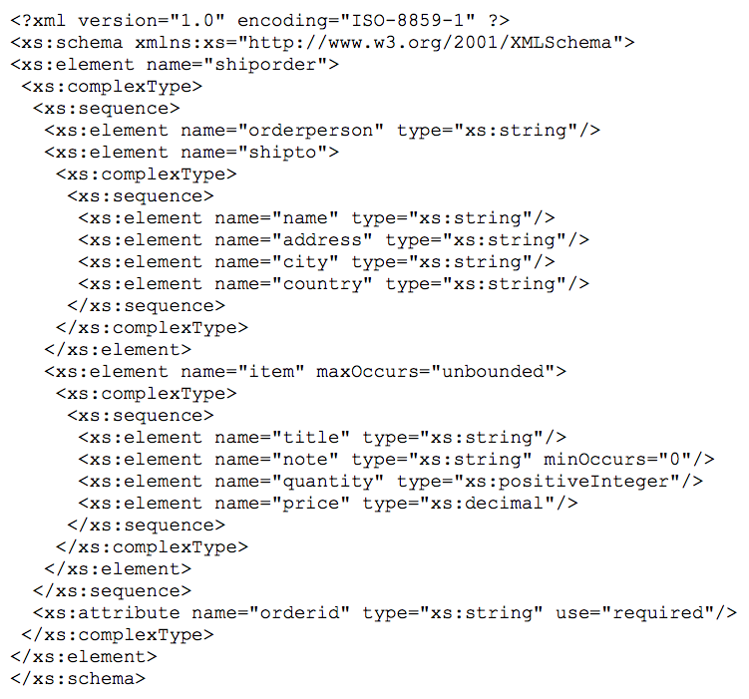
http://www.w3schools.com/Schema/schema_example.asp

Slide 13
Parsing XML in Python

Slide 14


Acknowledgements / Contributions
These slides are Copyright 2010- Charles R. Severance (www.dr-chuck.com) of the University of Michigan School of Information and open.umich.edu and made available under a Creative Commons Attribution 4.0 License. Please maintain this last slide in all copies of the document to comply with the attribution requirements of the license. If you make a change, feel free to add your name and organization to the list of contributors on this page as you republish the materials.
Initial Development: Charles Severance, University of Michigan School of Information
… Insert new Contributors here
...

