Slide 1
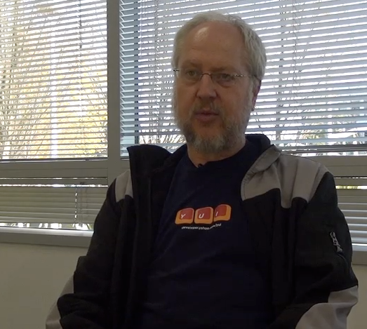
JavaScript Object Notation
Douglas Crockford - “Discovered” JSON
Object literal notation in JavaScript
http://www.youtube.com/watch?v=kc8BAR7SHJI

Slide 2
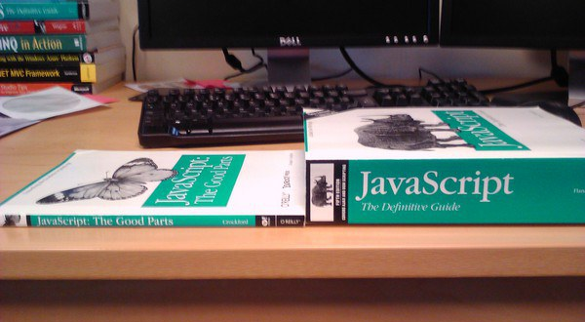

Slide 3
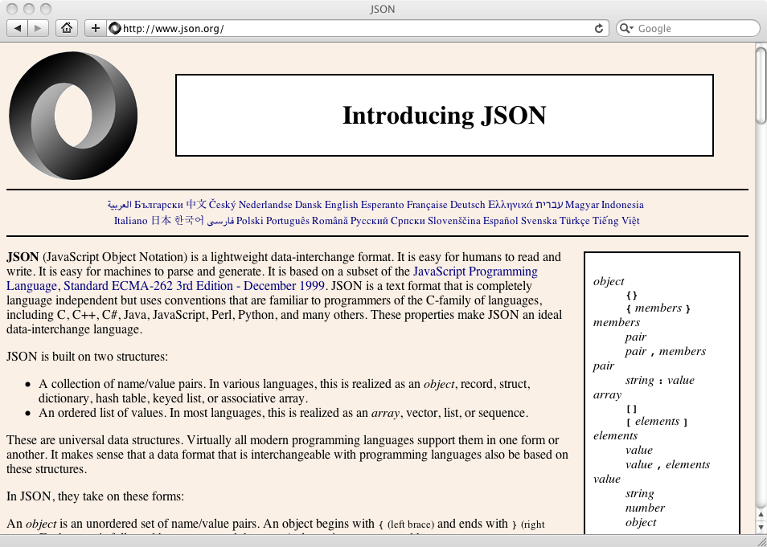

Slide 4
import json
data = '''{
"name" : "Chuck",
"phone" : {
"type" : "intl",
"number" : "+1 734 303 4456"
},
"email" : {
"hide" : "yes"
}
}'''
info = json.loads(data)
print('Name:',info["name"])
print('Hide:',info["email"]["hide"])
json1.py
JSON represents data as nested “lists” and “dictionaries”

Slide 5
import json
input = '''[
{ "id" : "001",
"x" : "2",
"name" : "Chuck"
} ,
{ "id" : "009",
"x" : "7",
"name" : "Chuck"
}
]'''
info = json.loads(input)
print('User count:', len(info))
for item in info:
print('Name', item['name'])
print('Id', item['id'])
print('Attribute', item['x'])
json2.py
JSON represents data as nested “lists” and “dictionaries”

Slide 6
Service Oriented Approach
http://en.wikipedia.org/wiki/Service-oriented_architecture

Slide 7


Acknowledgements / Contributions
These slides are Copyright 2010- Charles R. Severance (www.dr-chuck.com) of the University of Michigan School of Information and open.umich.edu and made available under a Creative Commons Attribution 4.0 License. Please maintain this last slide in all copies of the document to comply with the attribution requirements of the license. If you make a change, feel free to add your name and organization to the list of contributors on this page as you republish the materials.
Initial Development: Charles Severance, University of Michigan School of Information
… Insert new Contributors here
...

