Slide 1
API Security and Rate Limiting
The compute resources to run these APIs are not “free”
The data provided by these APIs is usually valuable
The data providers might limit the number of requests per day, demand an API “key”, or even charge for usage
They might change the rules as things progress...

Slide 2
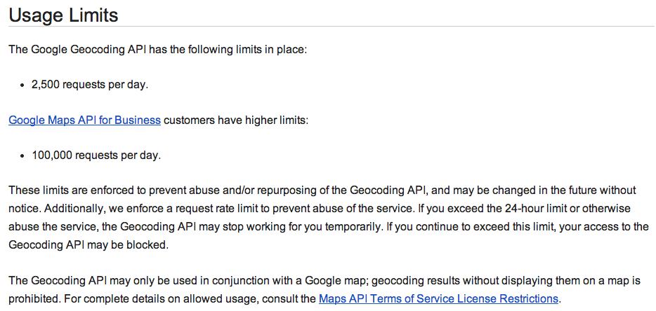

Slide 3
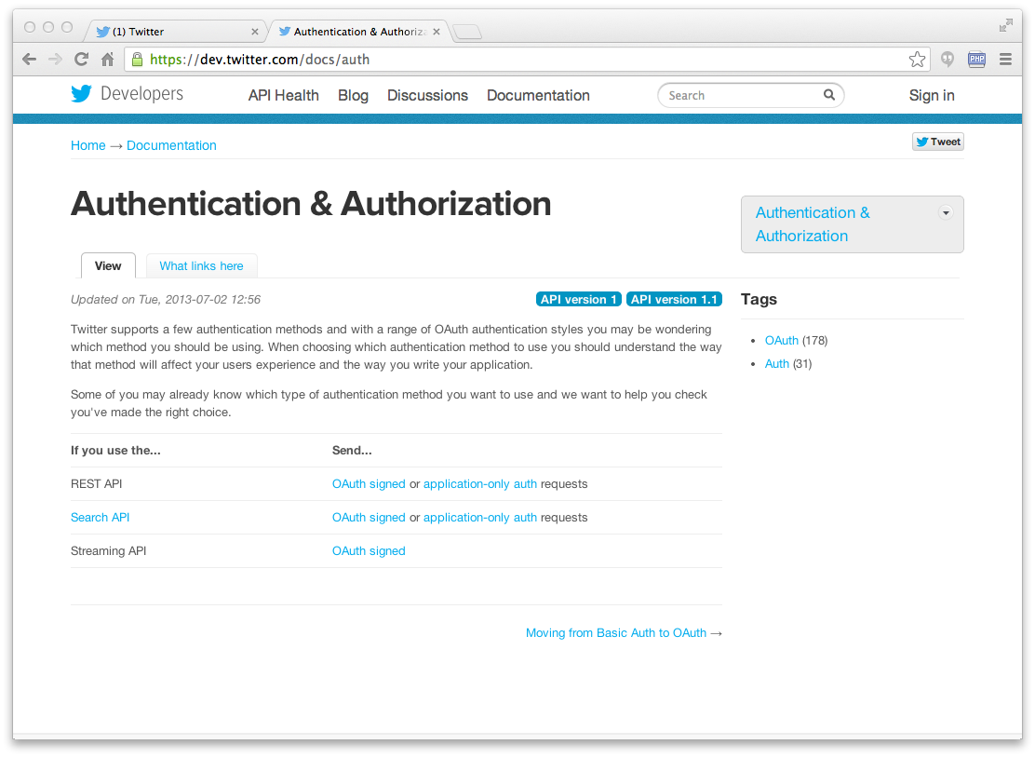

Slide 4
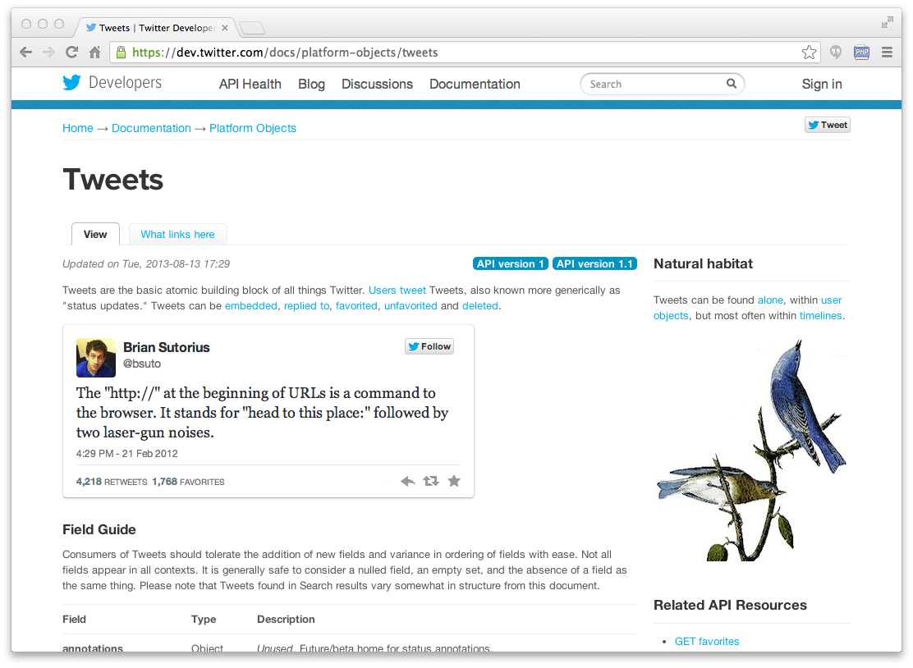

Slide 5
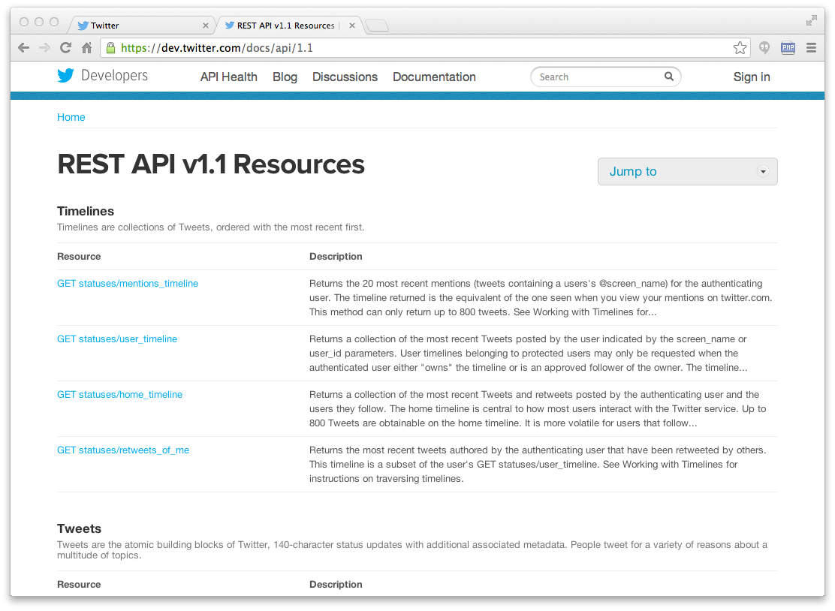

Slide 6
import urllib.request, urllib.parse, urllib.error
import twurl
import json
TWITTER_URL = 'https://api.twitter.com/1.1/friends/list.json'
while True:
print('')
acct = input('Enter Twitter Account:')
if (len(acct) < 1): break
url = twurl.augment(TWITTER_URL,
{'screen_name': acct, 'count': '5'})
print('Retrieving', url)
connection = urllib.request.urlopen(url)
data = connection.read().decode()
headers = dict(connection.getheaders())
print('Remaining', headers['x-rate-limit-remaining'])
js = json.loads(data)
print(json.dumps(js, indent=4))
for u in js['users']:
print(u['screen_name'])
s = u['status']['text']
print(' ', s[:50])
twitter2.py

Slide 7
Enter Twitter Account:drchuck
Retrieving https://api.twitter.com/1.1/friends ...
Remaining 14
{
"users": [
{
"status": {
"text": "@jazzychad I just bought one .__.",
"created_at": "Fri Sep 20 08:36:34 +0000 2013",
},
"location": "San Francisco, California",
"screen_name": "leahculver",
"name": "Leah Culver",
},
{
"status": {
"text": "RT @WSJ: Big employers like Google ...",
"created_at": "Sat Sep 28 19:36:37 +0000 2013",
},
"location": "Victoria Canada",
"screen_name": "_valeriei",
"name": "Valerie Irvine",
],
}
Leahculver
@jazzychad I just bought one .__._
Valeriei
RT @WSJ: Big employers like Google, AT&amp;T are h
Ericbollens
RT @lukew: sneak peek: my LONG take on the good &a
halherzog
Learning Objects is 10. We had a cake with the LO,
twitter2.py

Slide 8
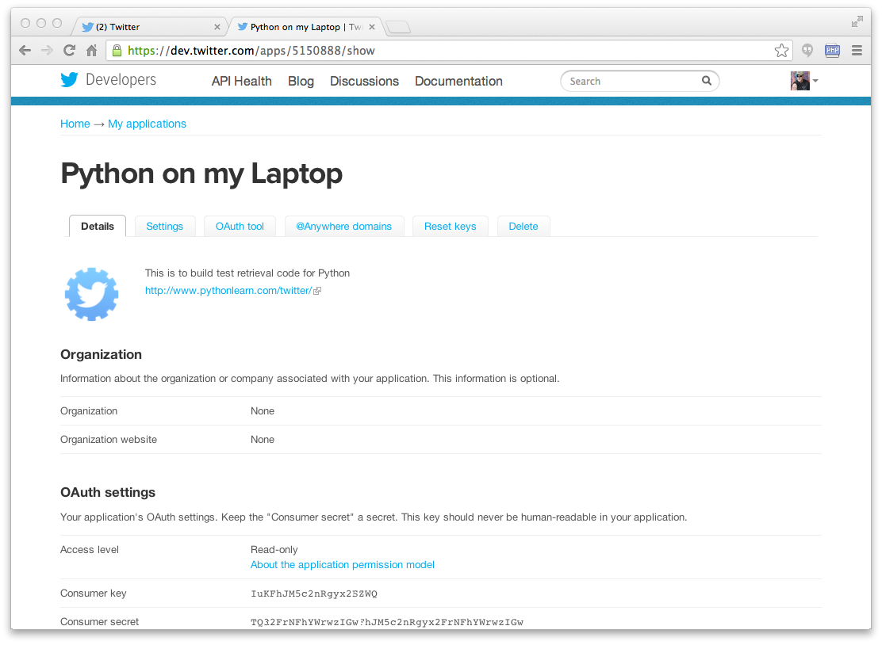

Slide 9
def oauth() :
return { "consumer_key" : "h7Lu...Ng",
"consumer_secret" : "dNKenAC3New...mmn7Q",
"token_key" : "10185562-ein2...P4GEQQOSGI",
"token_secret" : "H0ycCFemmwyf1...qoIpBo" }
hidden.py

Slide 10
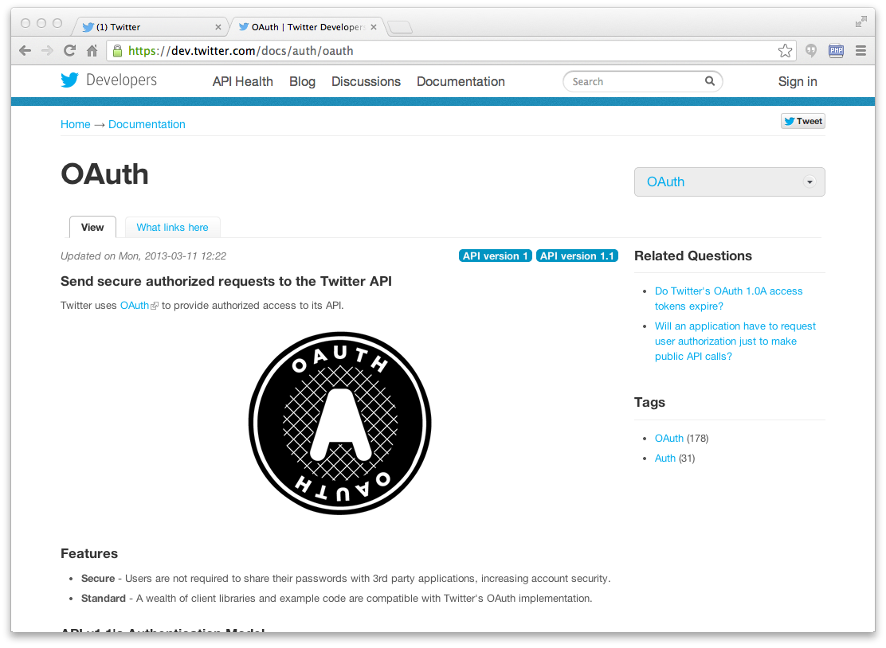

Slide 11
import urllib
import oauth
import hidden
def augment(url, parameters) :
secrets = hidden.oauth()
consumer = oauth.OAuthConsumer(secrets['consumer_key'], secrets['consumer_secret'])
token = oauth.OAuthToken(secrets['token_key'],secrets['token_secret'])
oauth_request = oauth.OAuthRequest.from_consumer_and_token(consumer,
token=token, http_method='GET', http_url=url, parameters=parameters)
oauth_request.sign_request(oauth.OAuthSignatureMethod_HMAC_SHA1(), consumer, token)
return oauth_request.to_url()
twurl.py
https://api.twitter.com/1.1/statuses/user_timeline.json?count=2&oauth_version=1.0&oauth_token=101...SGI&screen_name=drchuck&oauth_nonce=09239679&oauth_timestamp=1380395644&oauth_signature=rLK...BoD&oauth_consumer_key=h7Lu...GNg&oauth_signature_method=HMAC-SHA1

Slide 12
Summary
Service Oriented Architecture - allows an application to be broken into parts and distributed across a network
An Application Program Interface (API) is a contract for interaction
Web Services provide infrastructure for applications cooperating (an API) over a network - SOAP and REST are two styles of web services
XML and JSON are serialization formats

Slide 13


Acknowledgements / Contributions
These slides are Copyright 2010- Charles R. Severance (www.dr-chuck.com) of the University of Michigan School of Information and open.umich.edu and made available under a Creative Commons Attribution 4.0 License. Please maintain this last slide in all copies of the document to comply with the attribution requirements of the license. If you make a change, feel free to add your name and organization to the list of contributors on this page as you republish the materials.
Initial Development: Charles Severance, University of Michigan School of Information
… Insert new Contributors here
...

