Slide 1


Retrieving and Visualizing Data
Charles Severance
Python for Everybody
www.py4e.com
Notes:
Note from Chuck. If you are using these materials, you can remove the UM logo and replace it with your own, but please retain the CC-BY logo on the first page as well as retain the acknowledgement page(s) at the end.

Slide 2
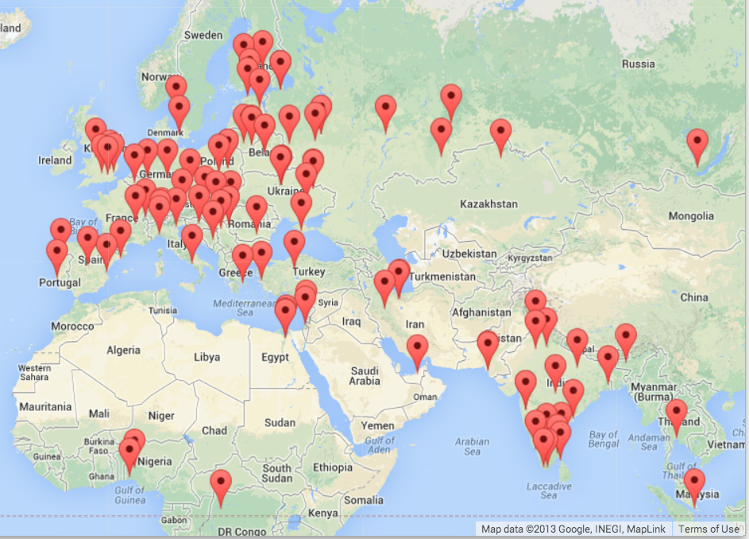


Multi-Step Data Analysis
Data
Source
Gather
Visualize
Clean/Process
(5, 1.0, 0.985, 3, u'http://www.dr..')
(3, 1.0, 2.135, 4, u'http://www.dr..')
(1, 1.0, 0.659, 2, u'http://www.dr..')
(1, 1.0, 0.659, 5, u'http://www.dr..')
....
Analyze

Slide 3
Many Data Mining Technologies
^{https://hadoop.apache.org/}
^{http://spark.apache.org/}
https://aws.amazon.com/redshift/
^{http://community.pentaho.com/}
....
Notes:
We will call my approach "Personal Data Mining" – mostly focused on getting better as Python Programmers.

Slide 4
"Personal Data Mining"
Our goal is to make you better programmers – not to make you data mining experts

Slide 5
GeoData
Makes a Google Map from user entered data
Uses the Google Geodata API
Caches data in a database to avoid rate limiting and allow restarting
Visualized in a browser using the Google Maps API
http://www.py4e.com/code3/geodata.zip

Slide 6
where.data
where.html
Google
geodata
geoload.py
geodata.sqlite
where.js
geodump.py
Northeastern University, ... Boston, MA 02115, USA 42.3396998 -71.08975
Bradley University, 1501 ... Peoria, IL 61625, USA 40.6963857 -89.6160811
...
Technion, Viazman 87, Kesalsaba, 32000, Israel 32.7775 35.0216667
Monash University Clayton ... VIC 3800, Australia -37.9152113 145.134682
Kokshetau, Kazakhstan 53.2833333 69.3833333
...
12 records written to where.js
Open where.html to view the data in a browser
http://www.py4e.com/code3/geodata.zip

Slide 7
Search Engine and PageRank

Slide 8
Acknowledgements / Contributions
These slides are Copyright 2010- Charles R. Severance (www.dr-chuck.com) of the University of Michigan School of Information and open.umich.edu and made available under a Creative Commons Attribution 4.0 License. Please maintain this last slide in all copies of the document to comply with the attribution requirements of the license. If you make a change, feel free to add your name and organization to the list of contributors on this page as you republish the materials.
Initial Development: Charles Severance, University of Michigan School of Information
… Insert new Contributors here
...

