Slide 1
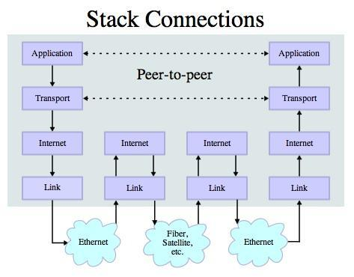
Application Protocol
Since TCP (and Python) gives us a reliable socket, what do we want to do with the socket? What problem do we want to solve?
Application Protocols
Mail
World Wide Web
Source: http://en.wikipedia.org/wiki/Internet_Protocol_Suite

Slide 2
HTTP - Hypertext Transfer Protocol
The dominant Application Layer Protocol on the Internet
Invented for the Web - to Retrieve HTML, Images, Documents, etc
Extended to be data in addition to documents - RSS, Web Services, etc..Basic Concept - Make a Connection - Request a document - Retrieve the Document - Close the Connection
http://en.wikipedia.org/wiki/Http

Slide 3
HTTP
The HyperText Transfer Protocol is the set of rules to allow browsers to retrieve web documents from servers over the Internet

Slide 4
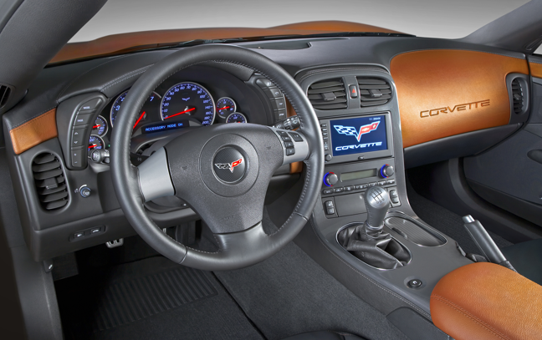
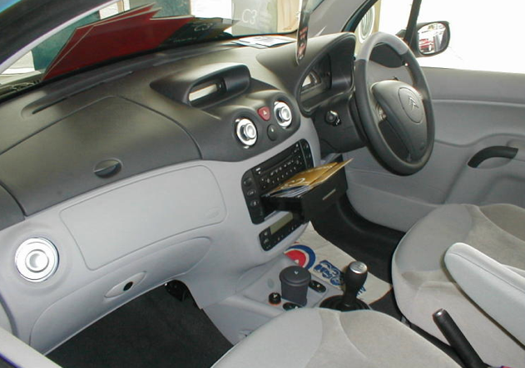
What is a Protocol?
A set of rules that all parties follow so we can predict each other’s behavior
And not bump into each other
On two-way roads in USA, drive on the right-hand side of the road
On two-way roads in the UK, drive on the left-hand side of the road

Slide 5
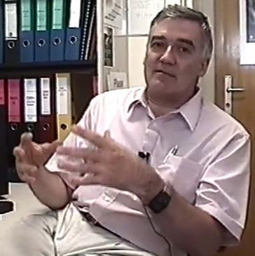
http://www.dr-chuck.com/page1.htm
protocol
host
document
http://www.youtube.com/watch?v=x2GylLq59rI
Robert Cailliau
CERN
1:17 - 2:19

Slide 6
Getting Data From The Server
Each the user clicks on an anchor tag with an href= value to switch to a new page, the browser makes a connection to the web server and issues a “GET” request - to GET the content of the page at the specified URL
The server returns the HTML document to the Browser which formats and displays the document to the user.

Slide 7

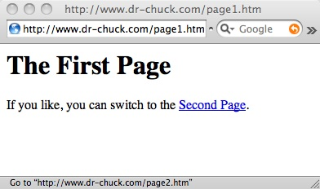
Web Server
80
Browser

Slide 8
Web Server
80
Browser
Click

Slide 9
Request
Web Server
80
GET http://www.dr-chuck.com/page2.htm
Browser
Click

Slide 10
Request
Web Server
80
GET http://www.dr-chuck.com/page2.htm
Browser
Click

Slide 11
Request
Web Server
Response
80
<h1>The Second Page</h1><p>If you like, you can switch back to the <a href="page1.htm">First Page</a>.</p>
GET http://www.dr-chuck.com/page2.htm
Browser
Click

Slide 12
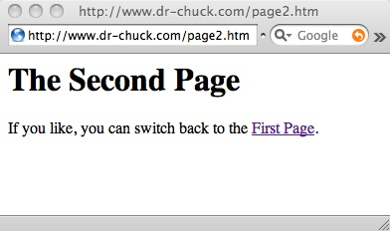
Request
Web Server
Response
80
<h1>The Second Page</h1><p>If you like, you can switch back to the <a href="page1.htm">First Page</a>.</p>
GET http://www.dr-chuck.com/page2.htm
Browser
Click
Parse/
Render

Slide 13
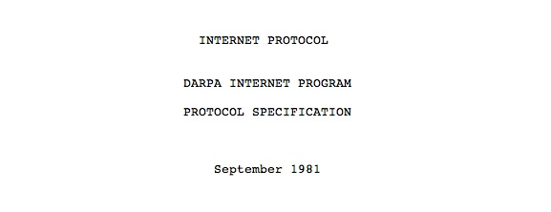
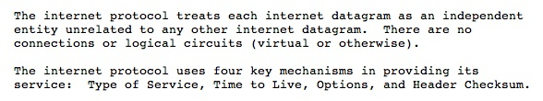
Internet Standards
The standards for all of the Internet protocols (inner workings) are developed by an organization
Internet Engineering Task Force (IETF)
www.ietf.org
Standards are called “RFCs” - “Request for Comments”
Source: http://tools.ietf.org/html/rfc791

Slide 14
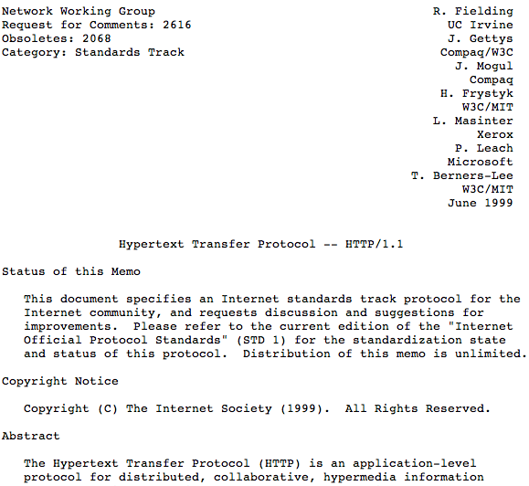
http://www.w3.org/Protocols/rfc2616/rfc2616.txt

Slide 15
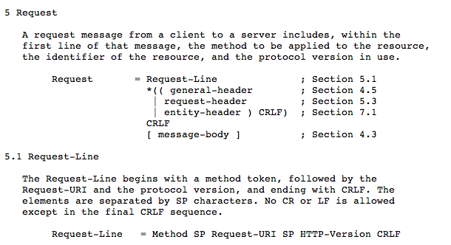

Slide 16
Making an HTTP request
Connect to the server like www.dr-chuck.com"
Request a document (or the default document)
GET http://www.dr-chuck.com/page1.htm HTTP/1.0
GET http://www.mlive.com/ann-arbor/ HTTP/1.0
GET http://www.facebook.com HTTP/1.0

Slide 17
$ telnet data.pr4e.org 80
Trying 74.208.28.177...
Connected to data.pr4e.org.
Escape character is '^]'.
GET http://data.pr4e.org/page1.htm HTTP/1.0
HTTP/1.1 200 OK
Date: Tue, 30 Jan 2024 15:30:13 GMT
Server: Apache/2.4.18 (Ubuntu)
Last-Modified: Mon, 15 May 2017 11:11:47 GMT
Content-Length: 128
Content-Type: text/html
<h1>The First Page</h1>
<p>If you like, you can switch to
the <a href="http://data.pr4e.org/page2.htm">Second Page</a>.</p>
Connection closed by foreign host.
Web Server
Browser

Slide 18

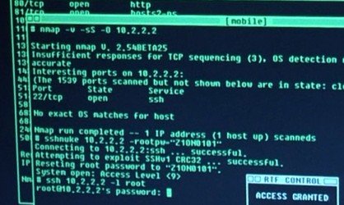
Accurate Hacking in the Movies
Matrix Reloaded
Bourne Ultimatum
Die Hard 4
...
http://nmap.org/movies.html

Slide 19
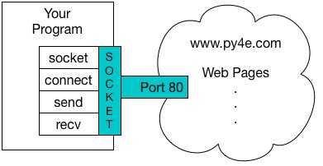
An HTTP Request in Python
import socket
mysock = socket.socket(socket.AF_INET, socket.SOCK_STREAM)
mysock.connect(('data.pr4e.org', 80))
cmd = 'GET http://data.pr4e.org/romeo.txt HTTP/1.0\n\n'.encode()
mysock.send(cmd)
while True:
data = mysock.recv(512)
if (len(data) < 1):
break
print(data.decode())
mysock.close()

Slide 20
HTTP/1.1 200 OK
Date: Sun, 14 Mar 2010 23:52:41 GMT
Server: Apache
Last-Modified: Tue, 29 Dec 2009 01:31:22 GMT
ETag: "143c1b33-a7-4b395bea"
Accept-Ranges: bytes
Content-Length: 167
Connection: close
Content-Type: text/plain
But soft what light through yonder window breaks
It is the east and Juliet is the sun
Arise fair sun and kill the envious moon
Who is already sick and pale with grief
HTTP Header
while True:
data = mysock.recv(512)
if ( len(data) < 1 ) :
break
print(data.decode())
HTTP Body

Slide 21
About Characters and Strings…

Slide 22


Acknowledgements / Contributions
Thes slide are Copyright 2010- Charles R. Severance (www.dr-chuck.com) of the University of Michigan School of Information and open.umich.edu and made available under a Creative Commons Attribution 4.0 License. Please maintain this last slide in all copies of the document to comply with the attribution requirements of the license. If you make a change, feel free to add your name and organization to the list of contributors on this page as you republish the materials.
Initial Development: Charles Severance, University of Michigan School of Information
… Insert new Contributors here
...

