Slide 1


Retrieving and Visualizing Data
Charles Severance
Python for Everybody
www.py4e.com
Notes:
Note from Chuck. If you are using these materials, you can remove the UM logo and replace it with your own, but please retain the CC-BY logo on the first page as well as retain the acknowledgement page(s) at the end.

Slide 2

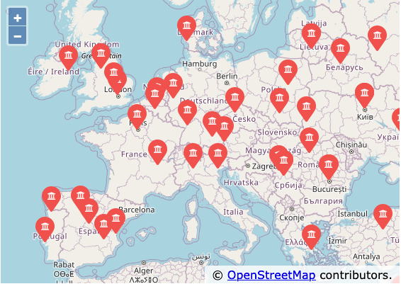

Multi-Step Data Analysis
Data
Source
Gather
Clean/Process
Visualize
(5, 1.0, 0.985, 3, u'http://www.dr..')
(3, 1.0, 2.135, 4, u'http://www.dr..')
(1, 1.0, 0.659, 2, u'http://www.dr..')
(1, 1.0, 0.659, 5, u'http://www.dr..')
....
Analyze

Slide 3
Many Data Mining Technologies
^{https://hadoop.apache.org/}
^{http://spark.apache.org/}
https://aws.amazon.com/redshift/
^{http://community.pentaho.com/}
....
Notes:
We will call my approach "Personal Data Mining" – mostly focused on getting better as Python Programmers.

Slide 4
"Personal Data Mining"
Our goal is to make you better programmers – not to make you data mining experts

Slide 5
OpenGeo
Makes an annotated Open Street Map from user entered data
Uses the proxied GeoAPI API
Caches data in a database to avoid rate limiting and allow restarting
Visualized in a browser using the Open Street Map
http://www.py4e.com/code3/opengeo.zip

Slide 6
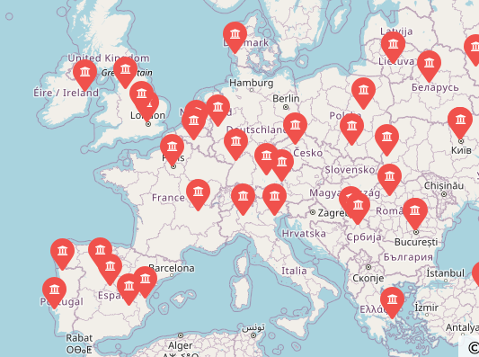
where.html
where.data
Open Street Map data
geoload.py
geodata.sqlite
where.js
geodump.py
Northeastern University, ... Boston, MA 02115, USA 42.3396998 -71.08975
Bradley University, 1501 ... Peoria, IL 61625, USA 40.6963857 -89.6160811
...
Technion, Viazman 87, Kesalsaba, 32000, Israel 32.7775 35.0216667
Kokshetau, Kazakhstan 53.2833333 69.3833333
...
Technical University Munich 48.14907275 11.567444920339295
178 records written to where.js
Open where.html to view the data in a browser
http://www.py4e.com/code3/opengeo.zip

Slide 7
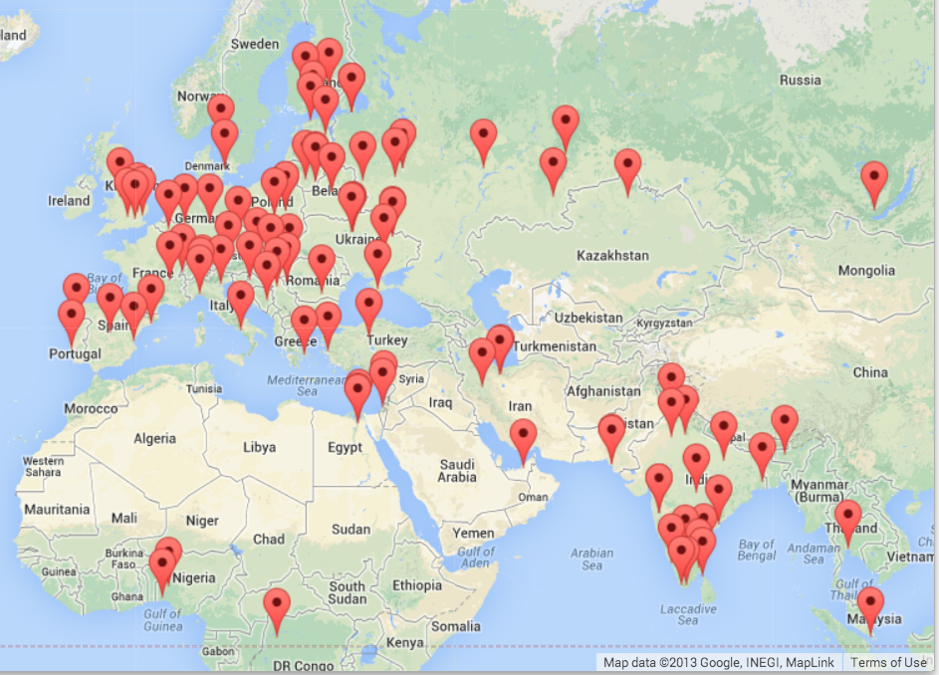
GeoData
Makes a Google Map from user entered data
Uses the Google Geodata API
Caches data in a database to avoid rate limiting and allow restarting
Visualized in a browser using the Google Maps API
http://www.py4e.com/code3/geodata.zip

Slide 8
where.data
where.html
Google
geodata
geoload.py
geodata.sqlite
where.js
geodump.py
Northeastern University, ... Boston, MA 02115, USA 42.3396998 -71.08975
Bradley University, 1501 ... Peoria, IL 61625, USA 40.6963857 -89.6160811
...
Technion, Viazman 87, Kesalsaba, 32000, Israel 32.7775 35.0216667
Monash University Clayton ... VIC 3800, Australia -37.9152113 145.134682
Kokshetau, Kazakhstan 53.2833333 69.3833333
...
12 records written to where.js
Open where.html to view the data in a browser
http://www.py4e.com/code3/geodata.zip

Slide 9
Search Engine and PageRank

Slide 10
Acknowledgements / Contributions
These slides are Copyright 2010- Charles R. Severance (www.dr-chuck.com) of the University of Michigan School of Information and open.umich.edu and made available under a Creative Commons Attribution 4.0 License. Please maintain this last slide in all copies of the document to comply with the attribution requirements of the license. If you make a change, feel free to add your name and organization to the list of contributors on this page as you republish the materials.
Initial Development: Charles Severance, University of Michigan School of Information
… Insert new Contributors here
...

