Slide 1
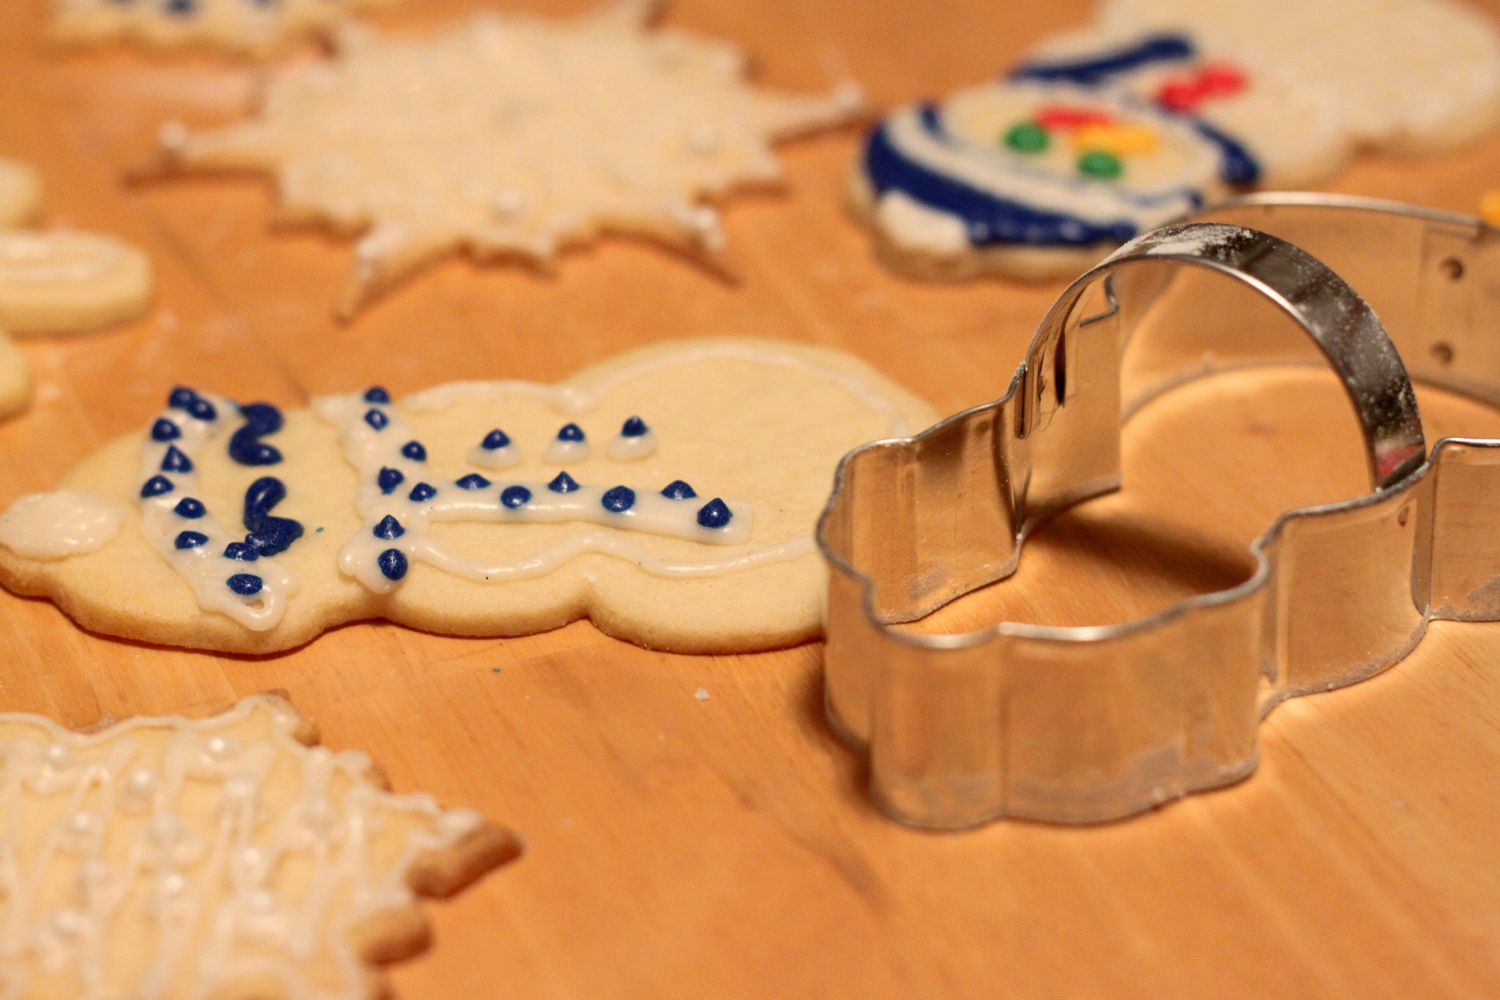
A Sample Class

Slide 2
class is a reserved word that defines a template for making objects
class PartyAnimal:
def __init(self)__:
self.x = 0
def party(self) :
self.x = self.x + 1
print("So far",self.x)
an = PartyAnimal()
an.party()
an.party()
an.party()
When the object is constructed, a specially named method is called to allocate and initialize attributes.
Each PartyAnimal object has a bit of code
Construct a PartyAnimal object and store in an
Tell the an object to run the party() code within it
PartyAnimal.party(an)

Slide 3
class PartyAnimal:
def __init(self)__:
self.x = 0
def party(self) :
self.x = self.x + 1
print("So far",self.x)
an = PartyAnimal()
an.party()
an.party()
an.party()
$ python party2.py

Slide 4
class PartyAnimal:
def __init(self)__:
self.x = 0
def party(self) :
self.x = self.x + 1
print("So far",self.x)
an = PartyAnimal()
an.party()
an.party()
an.party()
$ python party2.py
an
x
0
party()

Slide 5
class PartyAnimal:
def __init(self)__:
self.x = 0
def party(self) :
self.x = self.x + 1
print("So far",self.x)
an = PartyAnimal()
an.party()
an.party()
an.party()
$ python party2.py
So far 1
So far 2
So far 3
an self
x
party()
PartyAnimal.party(an)

Slide 6
Playing with dir() and type()

Slide 7
A Nerdy Way to Find Capabilities
The dir() command lists capabilities
Ignore the ones with underscores - these are used by Python itself
The rest are real operations that the object can perform
It is like type() - it tells us something *about* a variable
>>> y = list()
>>> type(y)
<class 'list'>
>>> dir(y)
['__add__', '__class__', '__class_getitem__', '__contains__', '__delattr__', '__delitem__', '__dir__', '__doc__', '__eq__', ... 'append', 'clear', 'copy', 'count', 'extend', 'index', 'insert', 'pop', 'remove', 'reverse', 'sort']
>>>

Slide 8
class PartyAnimal:
def __init__(self):
self.x = 0
def party(self) :
self.x = self.x + 1
print("So far",self.x)
an = PartyAnimal()
print("Type", type(an))
print("Dir ", dir(an))
print ("Type", type(an.x))
print ("Type", type(an.party))
We can use dir() to find the “capabilities” of our newly created class.
$ python party3.py
Type <class '__main__.PartyAnimal'>
Dir ['__class__', ... 'party', 'x']
Type <class 'int'>
Type <class 'method'>
party3.py

Slide 9
Try dir() with a String
>>> x = 'Hello there'
>>> dir(x)
['__add__', '__class__', '__contains__', '__delattr__', '__dir__', '__doc__', '__eq__', '__format__', '__ge__', '__getattribute__', '__getitem__', '__getnewargs__', '__gt__', '__hash__', '__init__', '__iter__', '__le__', '__len__', '__lt__', '__mod__', '__mul__', '__ne__', '__new__', '__reduce__', '__reduce_ex__', '__repr__', '__rmod__', '__rmul__', '__setattr__', '__sizeof__', '__str__', '__subclasshook__', 'capitalize', 'casefold', 'center', 'count', 'encode', 'endswith', 'expandtabs', 'find', 'format', 'format_map', 'index', 'isalnum', 'isalpha', 'isdecimal', 'isdigit', 'isidentifier', 'islower', 'isnumeric', 'isprintable', 'isspace', 'istitle', 'isupper', 'join', 'ljust', 'lower', 'lstrip', 'maketrans', 'partition', 'replace', 'rfind', 'rindex', 'rjust', 'rpartition', 'rsplit', 'rstrip', 'split', 'splitlines', 'startswith', 'strip', 'swapcase', 'title', 'translate', 'upper', 'zfill']

Slide 10
Object Lifecycle
http://en.wikipedia.org/wiki/Constructor_(computer_science)

Slide 11


Acknowledgements / Contributions
Thes slide are Copyright 2010- Charles R. Severance (www.dr-chuck.com) of the University of Michigan School of Information and made available under a Creative Commons Attribution 4.0 License. Please maintain this last slide in all copies of the document to comply with the attribution requirements of the license. If you make a change, feel free to add your name and organization to the list of contributors on this page as you republish the materials.
Initial Development: Charles Severance, University of Michigan School of Information
… Insert new Contributors here
...

Slide 12
Additional Source Information
Snowman Cookie Cutter" by Didriks is licensed under CC BY https://www.flickr.com/photos/dinnerseries/23570475099
Photo from the television program Lassie. Lassie watches as Jeff (Tommy Rettig) works on his bike is Public Domain https://en.wikipedia.org/wiki/Lassie#/media/File:Lassie_and_Tommy_Rettig_1956.JPG

