Slide 1
Object Lifecycle
http://en.wikipedia.org/wiki/Constructor_(computer_science)

Slide 2
Object Lifecycle
Objects are created, used and discarded
We have special blocks of code (methods) that get called
At the moment of creation (constructor)
At the moment of destruction (destructor)
Constructors are used a lot
Destructors are seldom used

Slide 3
Constructor
The primary purpose of the constructor is to set up some instance variables to have the proper initial values when the object is created

Slide 4
class PartyAnimal:
def __init__(self):
self.x = 0
print('I am constructed')
def party(self) :
self.x = self.x + 1
print('So far',self.x)
def __del__(self):
print('I am destructed', self.x)
an = PartyAnimal()
an.party()
an.party()
an = 42
print('an contains',an)
$ python party4.py
I am constructed
So far 1
So far 2
I am destructed 2
an contains 42
The constructor and destructor are optional. The constructor is typically used to set up variables. The destructor is seldom used.

Slide 5
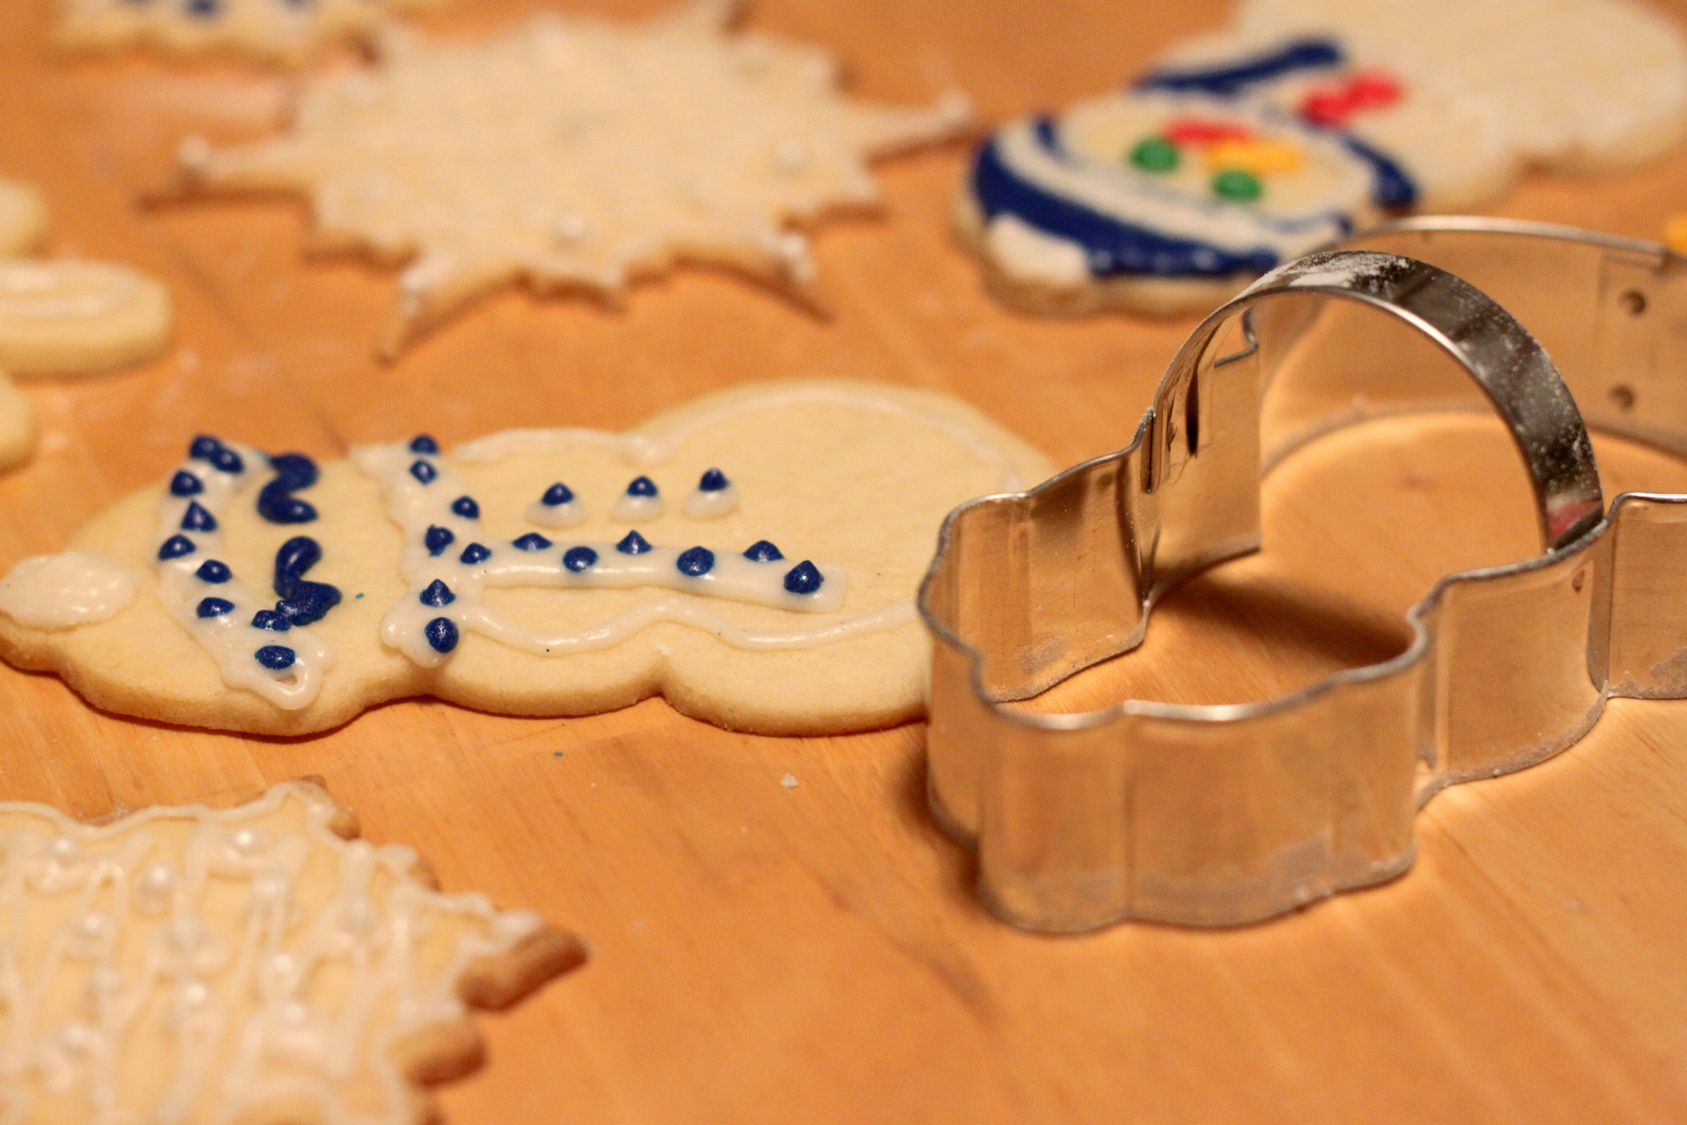
Constructor
In object oriented programming, a constructor in a class is a special block of statements called when an object is created
http://en.wikipedia.org/wiki/Constructor_(computer_science)

Slide 6
Many Instances
We can create lots of objects - the class is the template for the object
We can store each distinct object in its own variable
We call this having multiple instances of the same class
Each instance has its own copy of the instance variables

Slide 7
class PartyAnimal:
def __init__(self, z):
self.x = 0
self.name = z
print(self.name,"constructed")
def party(self) :
self.x = self.x + 1
print(self.name,"party count",self.x)
s = PartyAnimal("Sally")
s.party()
j = PartyAnimal("Jim")
j.party()
s.party()
Constructors can have additional parameters. These can be used to set up instance variables for the particular instance of the class (i.e., for the particular object).
party5.py

Slide 8
class PartyAnimal:
def __init__(self, z):
self.x = 0
self.name = z
print(self.name,"constructed")
def party(self) :
self.x = self.x + 1
print(self.name,"party count",self.x)
s = PartyAnimal("Sally")
s.party()
j = PartyAnimal("Jim")
j.party()
s.party()

Slide 9
class PartyAnimal:
def __init__(self, z):
self.x = 0
self.name = z
print(self.name,"constructed")
def party(self) :
self.x = self.x + 1
print(self.name,"party count",self.x)
s = PartyAnimal("Sally")
s.party()
j = PartyAnimal("Jim")
j.party()
s.party()
s
X: 0
name: Sally

Slide 10
class PartyAnimal:
def __init__(self, z):
self.x = 0
self.name = z
print(self.name,"constructed")
def party(self) :
self.x = self.x + 1
print(self.name,"party count",self.x)
s = PartyAnimal("Sally")
s.party()
j = PartyAnimal("Jim")
j.party()
s.party()
s
X: 1
name: Sally

Slide 11
class PartyAnimal:
def __init__(self, z):
self.x = 0
self.name = z
print(self.name,"constructed")
def party(self) :
self.x = self.x + 1
print(self.name,"party count",self.x)
s = PartyAnimal("Sally")
s.party()
j = PartyAnimal("Jim")
j.party()
s.party()
s
X: 1
name: Sally
j
X: 0
name: Jim

Slide 12
class PartyAnimal:
def __init__(self, z):
self.x = 0
self.name = z
print(self.name,"constructed")
def party(self) :
self.x = self.x + 1
print(self.name,"party count",self.x)
s = PartyAnimal("Sally")
s.party()
j = PartyAnimal("Jim")
j.party()
s.party()
s
X: 1
name: Sally
j
X: 1
name: Jim

Slide 13
class PartyAnimal:
def __init__(self, z):
self.x = 0
self.name = z
print(self.name,"constructed")
def party(self) :
self.x = self.x + 1
print(self.name,"party count",self.x)
s = PartyAnimal("Sally")
s.party()
j = PartyAnimal("Jim")
j.party()
s.party()
s
X: 2
name: Sally
j
X: 1
name: Jim

Slide 14
Inheritance
http://www.ibiblio.org/g2swap/byteofpython/read/inheritance.html

Slide 15


Acknowledgements / Contributions
Thes slide are Copyright 2010- Charles R. Severance (www.dr-chuck.com) of the University of Michigan School of Information and made available under a Creative Commons Attribution 4.0 License. Please maintain this last slide in all copies of the document to comply with the attribution requirements of the license. If you make a change, feel free to add your name and organization to the list of contributors on this page as you republish the materials.
Initial Development: Charles Severance, University of Michigan School of Information
… Insert new Contributors here
...

Slide 16
Additional Source Information
Snowman Cookie Cutter" by Didriks is licensed under CC BY https://www.flickr.com/photos/dinnerseries/23570475099
Photo from the television program Lassie. Lassie watches as Jeff (Tommy Rettig) works on his bike is Public Domain https://en.wikipedia.org/wiki/Lassie#/media/File:Lassie_and_Tommy_Rettig_1956.JPG

