Slide 1


Python Dictionaries
Chapter 9
Python for Everybody
www.py4e.com
Notes:
Note from Chuck. If you are using these materials, you can remove the UM logo and replace it with your own, but please retain the CC-BY logo on the first page as well as retain the entire last page.

Slide 2
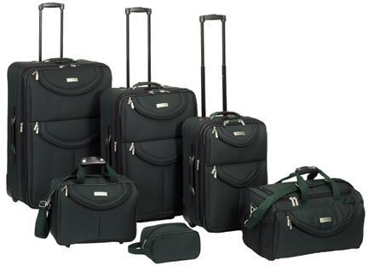
What is a Collection?
A collection is nice because we can put more than one value in it and carry them all around in one convenient package
We have a bunch of values in a single “variable”
We do this by having more than one place “in” the variable
We have ways of finding the different places in the variable

Slide 3
What Is Not A “Collection”?
Most of our variables have one value in them - when we put a new value in the variable - the old value is overwritten
$ python
>>> x = 2
>>> x = 4
>>> print(x)
4

Slide 4
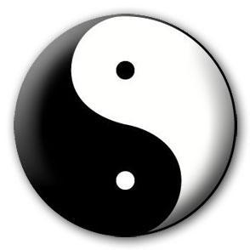
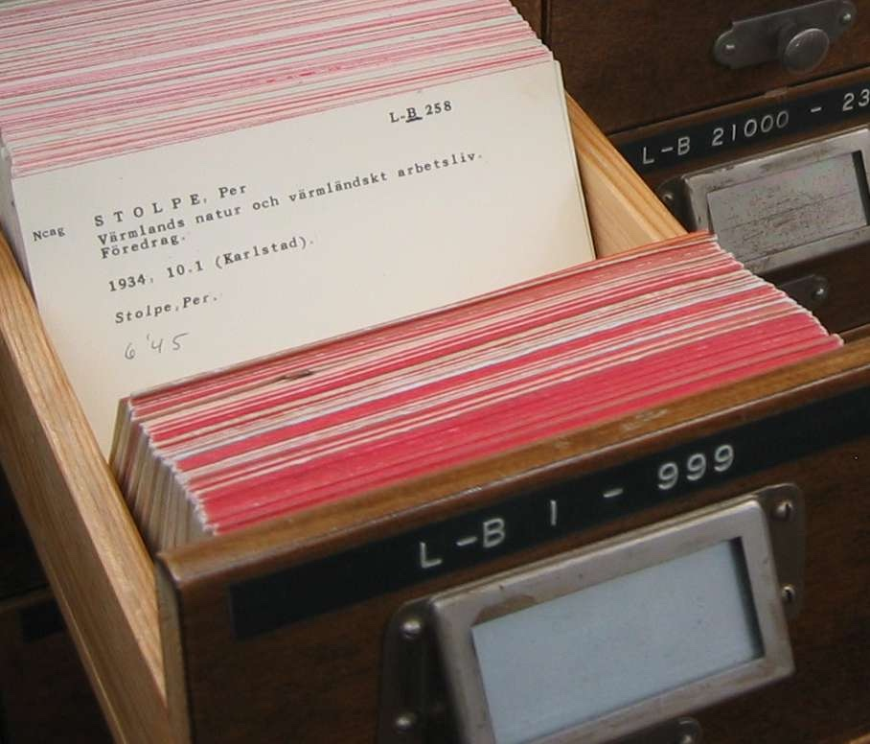
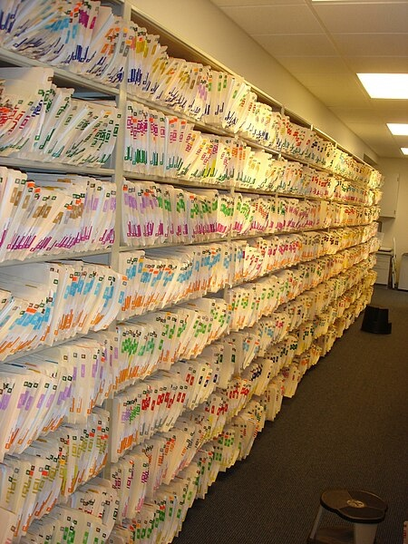
A Story of Two Collections..
List
A linear collection of values Lookup by position 0 .. length-1
Dictionary
A linear collection of key-value pairs Lookup by "tag" or "key"
https://en.wikipedia.org/wiki/Index_card#/media/File:LA2-katalogkort.jpg
https://commons.wikimedia.org/wiki/File:Shelves-of-file-folders.jpg

Slide 5
Dictionaries
Dictionaries are Python’s most powerful data collection
Dictionaries allow us to do fast database-like operations in Python
Similar concepts in different programming languages
- Associative Arrays - Perl / PHP
- Properties or Map or HashMap - Java
- Property Bag - C# / .Net

Slide 6
Dictionaries over time in Python
Prior to Python 3.7 dictionaries did not keep entries in the order of insertion
Python 3.7 (2018) and later dictionaries keep entries in the order they were inserted
"insertion order" is not "always sorted order"

Slide 7
Below the Abstraction
Python lists, dictionaries, and tuples are "abstract objects" designed to be easy to use
For now we will just understand them and use them and thank the creators of Python for making them easy for us
Using Python collections is easy. Creating the code to support them is tricky and uses Computer Science concepts like dynamic memory, arrays, linked lists, hash maps and trees.
But that implementation detail is for another course…

Slide 8
Lists (Review)
>>> cards = list()
>>> cards.append(12)
>>> cards.append(3)
>>> cards.append(75)
>>> print(cards)
[12, 3, 75]
>>> print(cards[1])
3
>>> cards[1] = cards[1] + 2
>>> print(cards)
[12, 5, 75]
We append values to the end of a List and look them up by position
We insert values into a Dictionary using a key and retrieve them using a key

Slide 9
Dictionaries
We append values to the end of a List and look them up by position
We insert values into a Dictionary using a key and retrieve them using a key
>>> cabinet = dict()
>>> cabinet['summer'] = 12
>>> cabinet['fall'] = 3
>>> cabinet['spring'] = 75
>>> print(cabinet)
{'summer': 12, fall': 3, spring': 75}
>>> print(cabinet['fall'])
3
>>> cabinet['fall'] = cabinet['fall'] + 2
>>> print(cabinet)
{'summer': 12, 'fall': 5, 'spring': 75}

Slide 10
Comparing Lists and Dictionaries
Dictionaries are like lists except that they use keys instead of numbers to look up values
>>> ddd = dict()
>>> ddd['age'] = 21
>>> ddd['course'] = 182
>>> print(ddd)
{'age': 21, 'course': 182}
>>> ddd['age'] = 23
>>> print(ddd)
{'age': 23, 'course': 182}
>>> lst = list()
>>> lst.append(21)
>>> lst.append(183)
>>> print(lst)
[21, 183]
>>> lst[0] = 23
>>> print(lst)
[23, 183]

Slide 11
>>> lst = list()
>>> lst.append(21)
>>> lst.append(183)
>>> print(lst)
[21, 183]
>>> lst[0] = 23
>>> print(lst)
[23, 183]
List
Key
Value
[0]
21
lst
[1]
183
>>> ddd = dict()
>>> ddd['age'] = 21
>>> ddd['course'] = 182
>>> print(ddd)
{'age': 21, 'course': 182}
>>> ddd['age'] = 23
>>> print(ddd)
{'age': 23, 'course': 182}
Dictionary
Key
Value
['course']
182
ddd
['age']
21

Slide 12
>>> lst = list()
>>> lst.append(21)
>>> lst.append(183)
>>> print(lst)
[21, 183]
>>> lst[0] = 23
>>> print(lst)
[23, 183]
List
Key
Value
[0]
23
lst
[1]
183
>>> ddd = dict()
>>> ddd['age'] = 21
>>> ddd['course'] = 182
>>> print(ddd)
{'age': 21, 'course': 182}
>>> ddd['age'] = 23
>>> print(ddd)
{'age': 23, 'course': 182}
Dictionary
Key
Value
['course']
182
ddd
['age']
23

Slide 13
Dictionary Literals (Constants)
Dictionary literals use curly braces and have a list of key : value pairs
You can make an empty dictionary using empty curly braces
>>> jjj = { 'chuck' : 1 , 'fred' : 42, 'jan': 100}
>>> print(jjj)
{'chuck': 1, 'fred': 42, 'jan': 100}
>>> ooo = { }
>>> print(ooo)
{}
>>>

