Slide 1
Inheritance
When we make a new class - we can reuse an existing class and inherit all the capabilities of an existing class and then add our own little bit to make our new class
Another form of store and reuse
Write once - reuse many times
The new class (child) has all the capabilities of the old class (parent) - and then some more

Slide 2
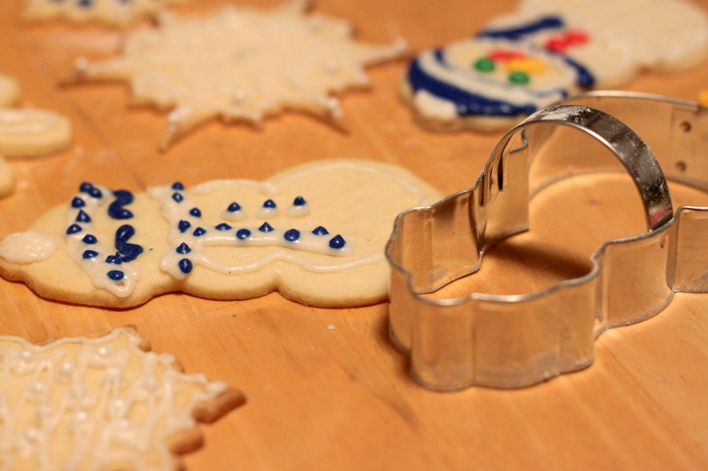
Terminology: Inheritance
‘Subclasses’ are more specialized versions of a class, which inherit attributes and behaviors from their parent classes, and can introduce their own.
http://en.wikipedia.org/wiki/Object-oriented_programming

Slide 3
class PartyAnimal:
def __init__(self, nam):
self.x = 0
self.name = nam
print(self.name,"constructed")
def party(self) :
self.x = self.x + 1
print(self.name,"party count",self.x)
class FootballFan(PartyAnimal):
def __init__(self, nam) :
super().__init__(nam)
self.points = 0
def touchdown(self):
self.points = self.points + 7
self.party()
print(self.name,"points",self.points)
s = PartyAnimal("Sally")
s.party()
j = FootballFan("Jim")
j.party()
j.touchdown()
FootballFan is a class which extends PartyAnimal. It has all the capabilities of PartyAnimal and more.
party7.py

Slide 4
class PartyAnimal:
def __init__(self, nam):
self.x = 0
self.name = nam
print(self.name,"constructed")
def party(self) :
self.x = self.x + 1
print(self.name,"party count",self.x)
class FootballFan(PartyAnimal):
def __init__(self, nam) :
super().__init__(nam)
self.points = 0
def touchdown(self):
self.points = self.points + 7
self.party()
print(self.name,"points",self.points)
s = PartyAnimal("Sally")
s.party()
j = FootballFan("Jim")
j.party()
j.touchdown()
s
x: 0
name: Sally

Slide 5
class PartyAnimal:
def __init__(self, nam):
self.x = 0
self.name = nam
print(self.name,"constructed")
def party(self) :
self.x = self.x + 1
print(self.name,"party count",self.x)
class FootballFan(PartyAnimal):
def __init__(self, nam) :
super().__init__(nam)
self.points = 0
def touchdown(self):
self.points = self.points + 7
self.party()
print(self.name,"points",self.points)
s = PartyAnimal("Sally")
s.party()
j = FootballFan("Jim")
j.party()
j.touchdown()
s
x: 1
name: Sally

Slide 6
class PartyAnimal:
def __init__(self, nam):
self.x = 0
self.name = nam
print(self.name,"constructed")
def party(self) :
self.x = self.x + 1
print(self.name,"party count",self.x)
class FootballFan(PartyAnimal):
def __init__(self, nam) :
super().__init__(nam)
self.points = 0
def touchdown(self):
self.points = self.points + 7
self.party()
print(self.name,"points",self.points)
s = PartyAnimal("Sally")
s.party()
j = FootballFan("Jim")
j.party()
j.touchdown()
j
x: 0
name: Jim
points: 0

Slide 7
class PartyAnimal:
def __init__(self, nam):
self.x = 0
self.name = nam
print(self.name,"constructed")
def party(self) :
self.x = self.x + 1
print(self.name,"party count",self.x)
class FootballFan(PartyAnimal):
def __init__(self, nam) :
super().__init__(nam)
self.points = 0
def touchdown(self):
self.points = self.points + 7
self.party()
print(self.name,"points",self.points)
s = PartyAnimal("Sally")
s.party()
j = FootballFan("Jim")
j.party()
j.touchdown()
j
x: 1
name: Jim
points: 0

Slide 8
class PartyAnimal:
def __init__(self, nam):
self.x = 0
self.name = nam
print(self.name,"constructed")
def party(self) :
self.x = self.x + 1
print(self.name,"party count",self.x)
class FootballFan(PartyAnimal):
def __init__(self, nam) :
super().__init__(nam)
self.points = 0
def touchdown(self):
self.points = self.points + 7
self.party()
print(self.name,"points",self.points)
s = PartyAnimal("Sally")
s.party()
j = FootballFan("Jim")
j.party()
j.touchdown()
j
x: 1
name: Jim
points: 7

Slide 9
Definitions
Class - a template
Attribute – A variable within a class
Method - A function within a class
Object - A particular instance of a class
Constructor – Code that runs when an object is created
Inheritance - The ability to extend a class to make a new class.

Slide 10
Summary
Object Oriented programming is a very structured approach to code reuse.
We can group data and functionality together and create many independent instances of a class

Slide 11


Acknowledgements / Contributions
Thes slide are Copyright 2010- Charles R. Severance (www.dr-chuck.com) of the University of Michigan School of Information and made available under a Creative Commons Attribution 4.0 License. Please maintain this last slide in all copies of the document to comply with the attribution requirements of the license. If you make a change, feel free to add your name and organization to the list of contributors on this page as you republish the materials.
Initial Development: Charles Severance, University of Michigan School of Information
… Insert new Contributors here
...

Slide 12
Additional Source Information
Snowman Cookie Cutter" by Didriks is licensed under CC BY https://www.flickr.com/photos/dinnerseries/23570475099
Photo from the television program Lassie. Lassie watches as Jeff (Tommy Rettig) works on his bike is Public Domain https://en.wikipedia.org/wiki/Lassie#/media/File:Lassie_and_Tommy_Rettig_1956.JPG

