Slide 1
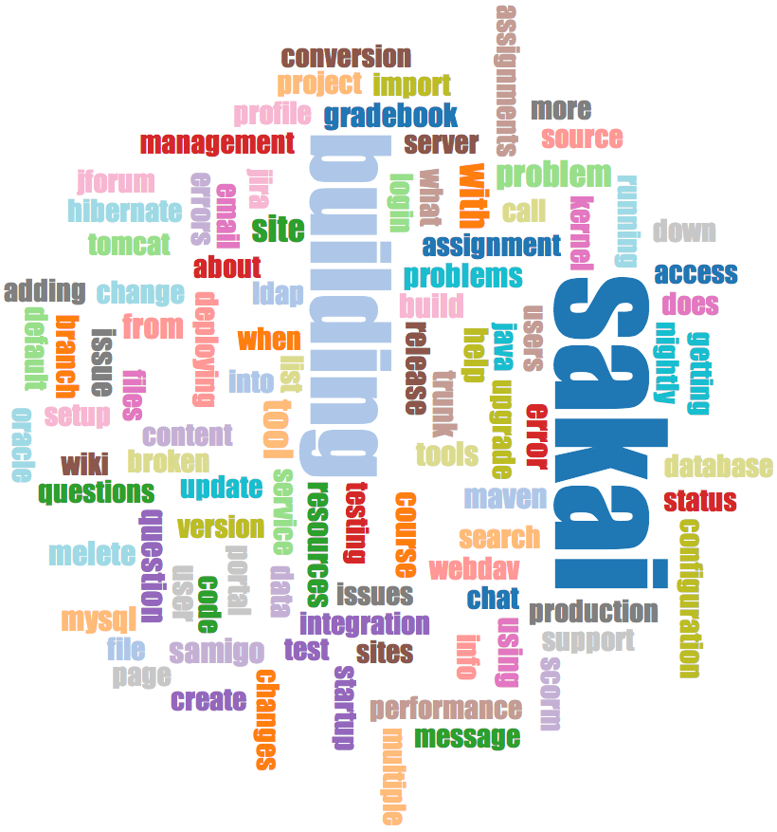
Mailing Lists - Gmane
Crawl the archive of a mailing list
Do some analysis / cleanup
Visualize the data as word cloud and lines
http://www.py4e.com/code3/gmane.zip

Slide 2
Warning: This Dataset is > 1GB
Sadly the original source of this data (gmane.org) has shut down
We made a copy of a subset of the data before it was shut down
Use this for your testing:
https://mbox.dr-chuck.net/sakai.devel/4/5

Slide 3


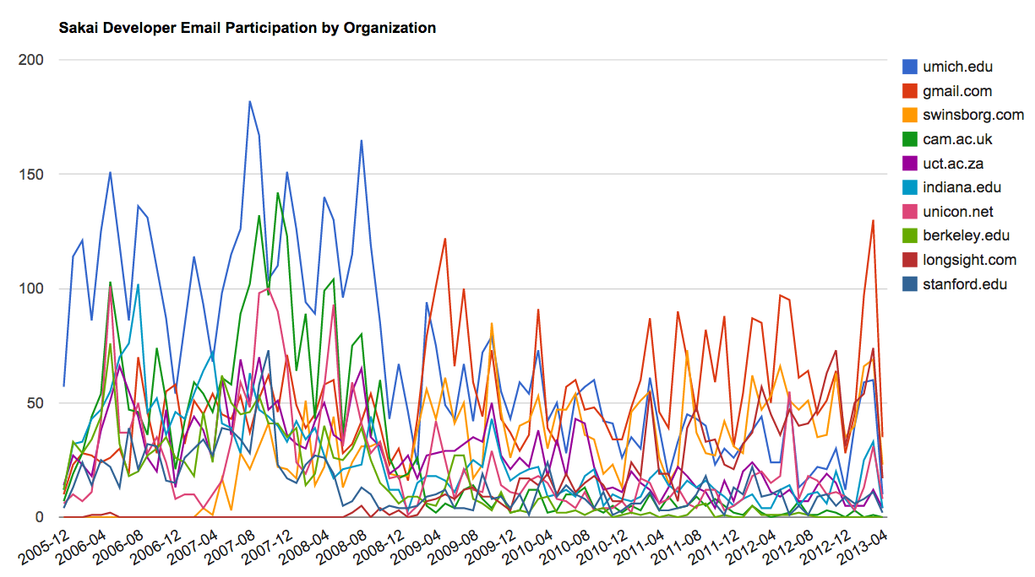
gword.htm
d3.js
mbox.dr-chuck.net
gmane.py
content.sqlite
gmodel.py
gword.js
content.sqlite
gword.py
gbasic.py
gline.py
How many to dump? 5
Loaded messages= 51330 subjects= 25033 senders= 1584
Top 5 Email list participants
steve.swinsburg@gmail.com 2657
azeckoski@unicon.net 1742
ieb@tfd.co.uk 1591
csev@umich.edu 1304
david.horwitz@uct.ac.za 1184
...
gline.js
gline.htm
d3.js
http://www.py4e.com/code3/gmane.zip

Slide 4
Summary
Combining all of the techniques in the class, we can make data management system that can pull data (restarting as necessary), clean it up, and visualize it

Slide 5


Acknowledgements / Contributions
These slides are Copyright 2010- Charles R. Severance (www.dr-chuck.com) of the University of Michigan School of Information and open.umich.edu and made available under a Creative Commons Attribution 4.0 License. Please maintain this last slide in all copies of the document to comply with the attribution requirements of the license. If you make a change, feel free to add your name and organization to the list of contributors on this page as you republish the materials.
Initial Development: Charles Severance, University of Michigan School of Information
… Insert new Contributors here
...

