Slide 1
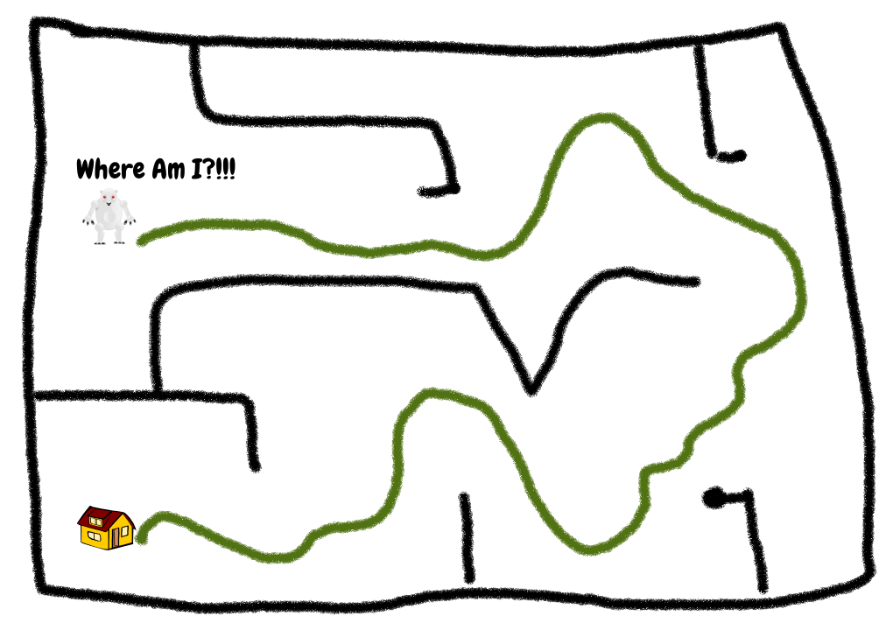
ACTIVE SLAM AND PATH PLANNING FOR ROBOT NAVIGATION
Notes:
1

Slide 2
ACTIVE SLAM
General SLAM methods are passive.
Active slam deliberately sets goal points to gather more sensor data.
This is an offline mapping technique
Uses the online SLAM techniques along with a strategy to select goal positions.
Improves coverage and reduces uncertainty in maps.
Applications: Exploration robots, rescue robots and survey/monitoring robots.
Notes:
2

Slide 3
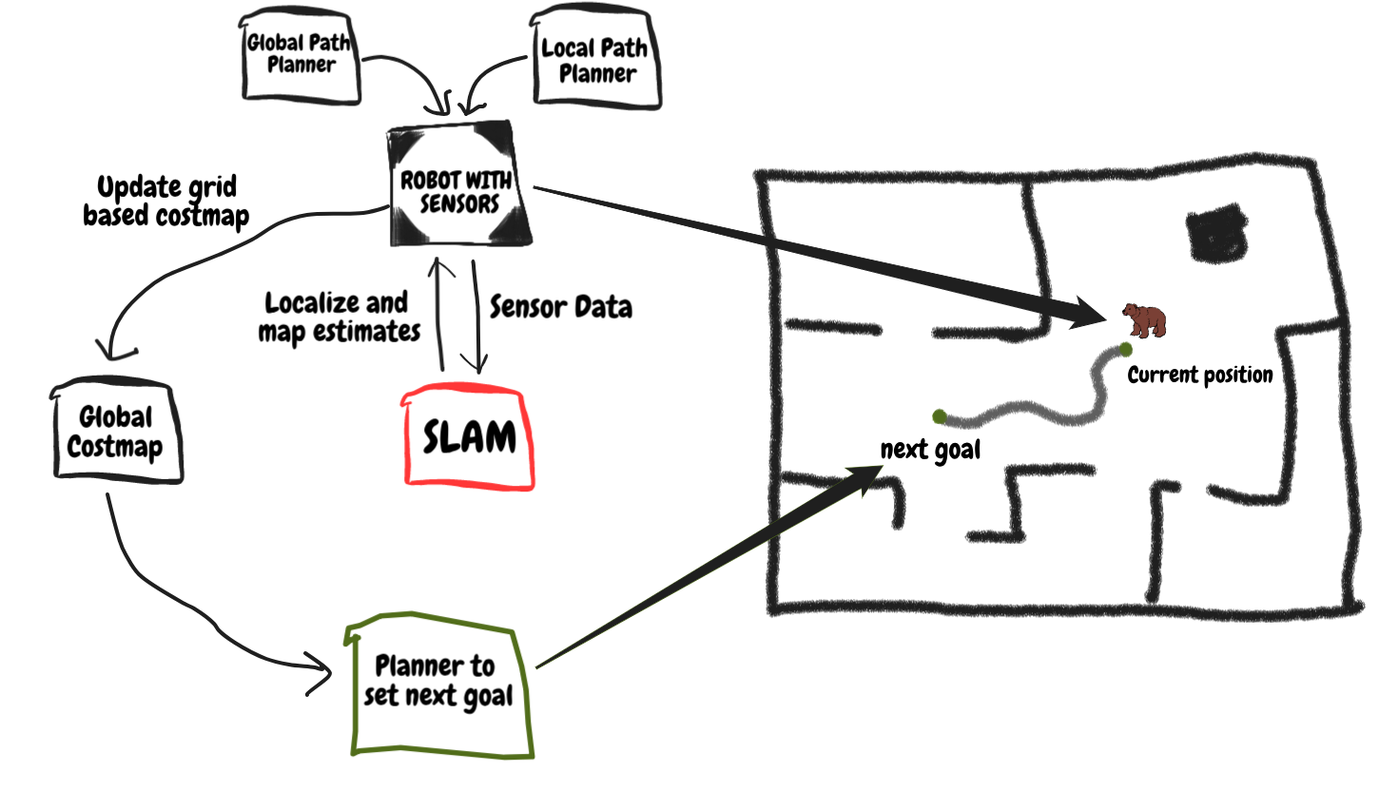
FLOW DIAGRAM
Notes:
3

Slide 4
Simulation Environment
Robotic Operating System (ROS)
ROS uses a modular approach by dividing the complex problem into nodes.
Nodes communicate with each other using publisher and subscriber mechanism.
Easy to switch between simulation and real world environments.
Ex: one node is used in path planning, one is used gather sensor data, one to monitor the odometry ...
Gazebo Simulator
A 3D world simulator which has proper integration packages with ros.
Turtlebot3 Simulated Robot
Directly available open source robot model for gazebo and well documented ROS packages to control the robot.
All the testing is done on Google cloud virtual machine instance.
Notes:
4

Slide 5
High Level working of algorithm
Sense the environment
Run SLAM iteration and build global map
Scan global map to update the hidden and frontier states
Search among hidden states (if set not empty) otherwise search among frontier states
Choose the state which has optimal cost and good correlation
Move to that location and repeat the process until no unexplored space is left
Few important aspects of the algorithm:
If the robot is not able to move to a specific location twice, it is removed from stack.
If the coverage is not good after moving to a specific location, it tries again and then removes from stack
A global planner (A*) is used to plan the motion to the goal and local planner (dynamic window approach) is used to avoid local obstacles.
Notes:
5

Slide 6
Experimented Methods
Global Planner:
A *
Dijkstra's
Coverage assignment: Defined metrics for low and high coverage classification
Tested with different map resolutions and the optimal found to be 0.075m/grid
Used random frontier goal selection for reducing computation time.
Used threshold method to select goal from hidden states.
Included a mechanism to first check if the paths are feasible without having to physically move the robot.
Additionally had to finetune other ros package parameters like the global planner’s cost factor, simulation time for local planner, obstacle avoidance factor and many others.
Notes:
6

Slide 7
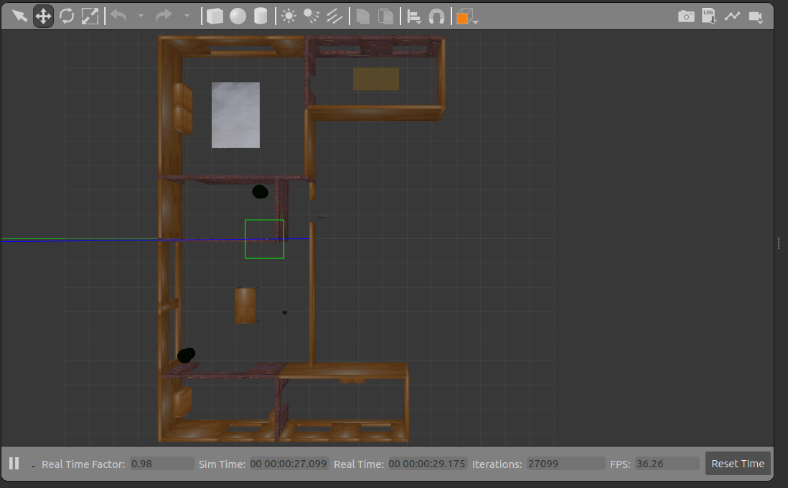
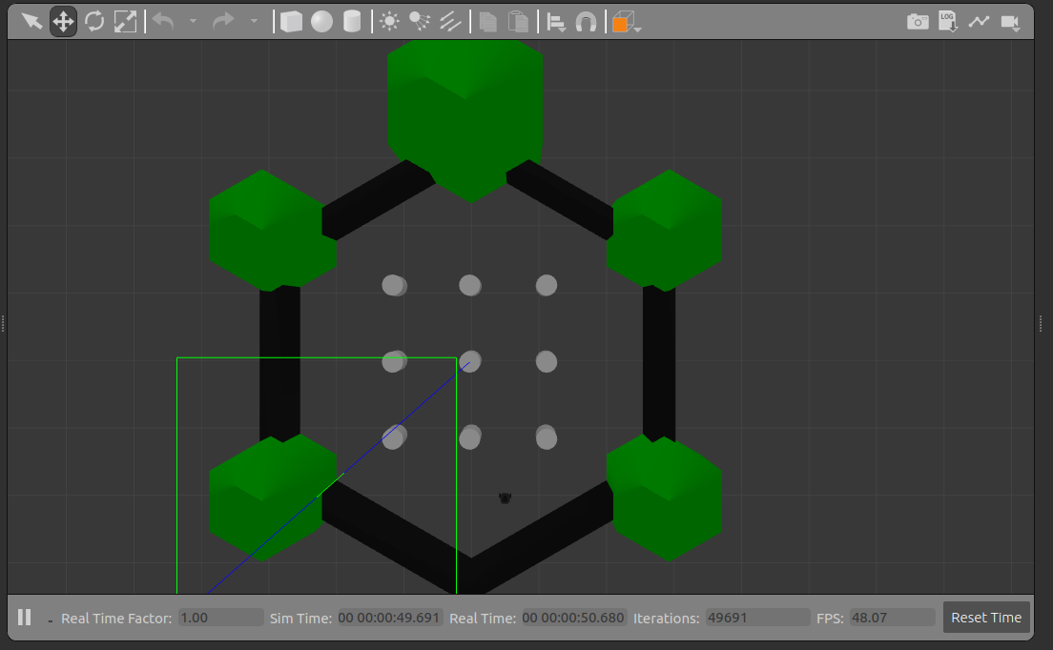
Results
Notes:
7

Slide 8
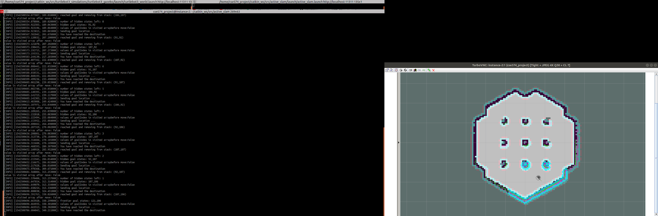
Results
Notes:
8

Slide 9
References
https://ieeexplore.ieee.org/document/7125079/citations?tabFilter=papers#citations
https://ieeexplore-ieee-org.ezproxy1.lib.asu.edu/stamp/stamp.jsp?tp=&arnumber=5509725https://answers.ros.org/question/205521/robot-coordinates-in-map/
https://ieeexplore.ieee.org/stamp/stamp.jsp?tp=&arnumber=5876943
https://pdfs.semanticscholar.org/9afb/8b6ee449e1ddf1268ace8efb4b69578b94f6.pdf
https://ieeexplore.ieee.org/document/7125079/metrics#metrics
https://lamor.fer.hr/images/50020776/Maurovic2017.pdf
http://msl.cs.illinois.edu/~lavalle/papers/TovGuiLav04.pdf
https://www.robots.ox.ac.uk/~mobile/Theses/rjs_thesis.pdf
Notes:
9

