Slide 1







EXTRACTION &
LOAD
TRANSFORM
ON
READ
ERP
CRM
OLTP
NOSQL
S3 Storage
Amazon Athena
Amazon EMR
MEDIA SOURCES
AWS Glue
Glue Catalog
LOGS
CLOUD DBS
Searchable Catalog
Amazon Redshift* Spectrum
Amazon QuickSight
Data Sources
Data Lake
Extraction & Load
Realtime data ingestion using Kinesis and EMR
Transform On Read
Batch and real-time transform using EMR.
Data migration from RDBMS to Data lake using database migration service.
Batch ELT using AWS Glue
Data Analytics using Amazon Athena and Amazon Redshift spectrum
Visualization using AWS Quicksight
Transformation using Glue ETL
Minimal/no transformation is done.

Slide 2



AWS Cloud
EMR
S3
Glue Crawler
Glue Catalog
Athena
Redshift Spectrum

Slide 3









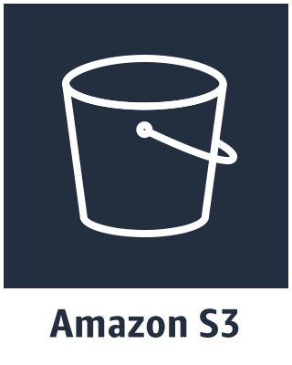



AWS Cloud
Principals
Request
Actions/Operations
-------------
Resources
-------------
Information
------
-----
User
Role
Application
Authentication
Authorization
Effect
-------------
Action
-------------
Resource
Condition
-----
Effect
-------------
Action
-------------
Principal
Condition
-----
Identity Based
Resource/Tag Based
Data Lake Operations
Data Lake Resources
PutObject
GetObject
ListBucket
…….
…….
…….
EnableKey
DisableKey
ListKeys
…….
…….
…….
Bucket
Bucket & objects
Object
Encrypted data
Data encryption key

Slide 4



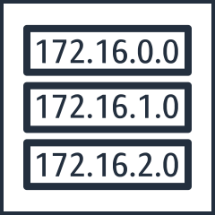




AWS Cloud
VPC
Availability zone
Availability zone
Subnet
Subnet
Route table
Security Group
Security Group
1
2
3
4
Instances With KPL
Kinesis VPC Endpoints
Data Lake

Slide 5





On-Premise
AWS Cloud
Region
5
Glue Crawler
Glue Catalog
1
2
3
4
TLS
Network Attached
Storage
AWS DataSync
Agent

Slide 6



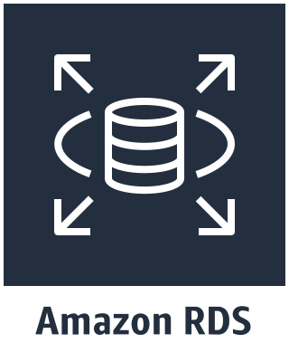
AWS Cloud
VPC
Availability zone
Availability zone
Subnet
Subnet
JDBC Sources
1
Route table
3
Security Group
IAM Role
2
4
5
Elastic network interface
Data Lake

Slide 7



AWS Cloud
VPC
Availability zone
Availability zone
Subnet
Subnet
Data Sources
Security Group
1
Route table
Security Group
3
DB Instance
2
Elastic network interface
5
IAM Role
6
Data Lake

Slide 8


AWS Cloud
VPC
Availability zone
Subnet
Subnet
3
2
1
Data Lake
Internet gateway
3

Slide 9
AWS Cloud
VPC
Availability zone
Subnet
2
Glue Crawler
3
1
Data Lake
Glue Catalog

Slide 10

AWS Cloud
VPC
Availability zone
2
1
Subnet
Glue Crawler
Glue Catalog
3
Data Lake
Redshift Spectrum

Slide 11

AWS Cloud
2
Glue Crawler
1
3
Data Lake
Glue Catalog

