Slide 1
Interactive Object Segmentation

Slide 2
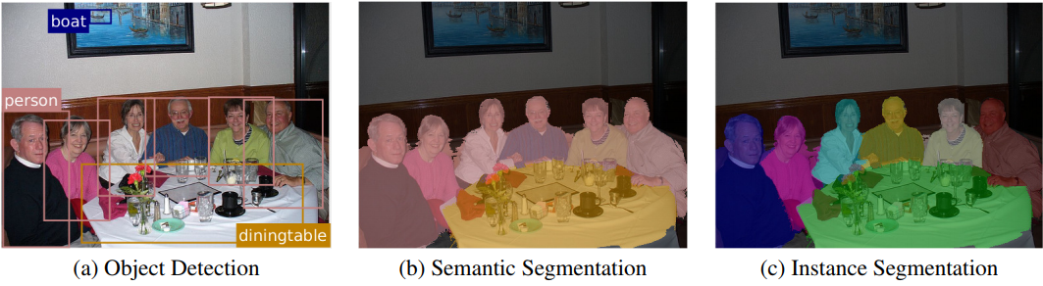
Object Detection, Semantic Segmentation, Instance Segmentation
Notes:
Semantic segmentation – labels every pixel in an image with its object class – has no notion of different instances of an object.
Object detection - localise different object instances, but does so at a very coarse, bounding-box level.
Instance segmentation localises objects at a pixel level, and can be thought of being at the intersection of these two scene understanding tasks. Unlike the former, it knows about different instances of the same object, and unlike the latter, it operates at a pixel level.

Slide 3
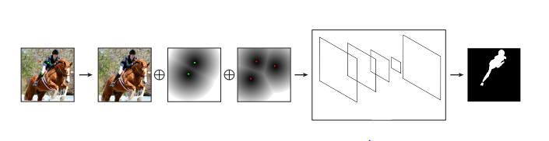
Previous Architecture
Given an input image and user interactions, our algorithm first transforms positive and negative clicks (denoted as green dots and red crosses respectively) into two separate channels, which are then concatenated (denoted as ⊕) with the image’s RGB channels to compose an input pair to the DeepMask model. The corresponding output is the ground truth mask of the selected object.

Slide 4
Problem Statement
Leverage Semantic Segmentation to obtain better results for instance segmentation which in turn will reduce the number of user clicks required.
Note:
Instance segmentation can be viewed as a more complex form of semantic segmentation, since we are not only required to label the object class of each pixel, but also its instance identity.

Slide 5
BiSeg: Simultaneous Instance Segmentation and Semantic Segmentation with Fully Convolutional Networks

Slide 6
Proposed Methodology
Early methods address instance segmentation using convolutional neural networks (CNNs), but require mask proposals from external modules.
This paper presents a simple and effective framework for simultaneous semantic segmentation and instance segmentation with FCNs.
They predict the instance segmentation mask as a posterior probability in Bayesian inference, where the semantic segmentation result is treated as prior, and fusion of multiple position-sensitive score maps at different scales and partition modes as likelihood.

Slide 7
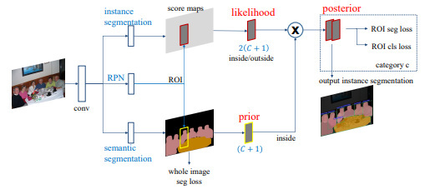
Network Architecture
Network architecture of BiSeg. It takes an image of arbitrary size as input and outputs both semantic segmentation and instance segmentation results. RPN, semantic segmentation and instance segmentation sub-networks share the convolutional feature maps. The learnable weight layers are fully convolutional and computed on the whole image.

Slide 8


Bayesian Inference
Let P(Ick|X) be the posterior probability of instance segmentation for category c and ROI k, given the input image X. It can be expressed as:
As P(Ick, j) = 0 for j 6= c, we can rewrite that

Slide 9
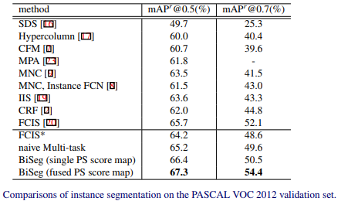
Results

Slide 10
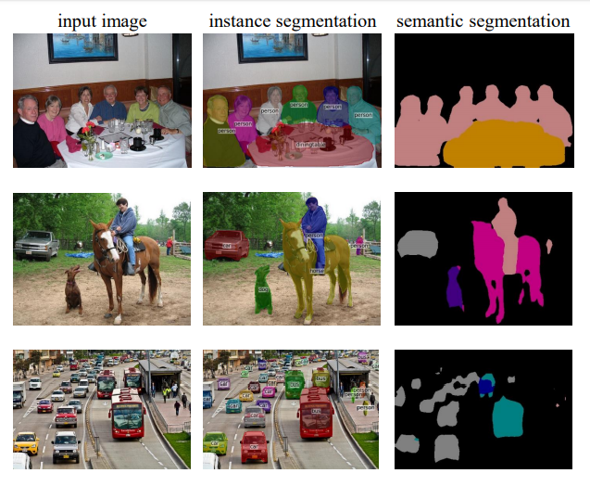
Notes:
Results of BiSeg. Their method produces high segmentation quality at borderlines without using CRF. For instance segmentation, they show all detected instances whose classification scores are larger than 0.5. They confirm good results of instance segmentation even for heavily occluded scenes (the last two rows).

Slide 11
Takeaway
Performing instance segmentation as a posterior in the Bayesian inference where semantic segmentation can be used as a prior.

Slide 12
Semantic Segmentation from Limited Training data

Slide 13
Proposed Methodology
Bypass the need for data collection and model training for new categories.
They first learn a feature embedding which transforms image patches of the same object into low-dimensional points that are close-by, and patches of different objects into points that a far apart in the feature space. Classification can then be performed by a simple nearest neighbour look up. The patches are generated by a class-agnostic RGB-D segmentation to obtain the final segmentation map, a pixel-wise voting scheme is performed on all segments.

Slide 14
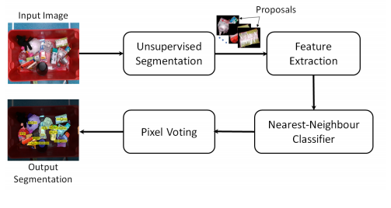
Overview of Deep Metric Learning Approach

Slide 15


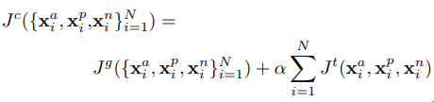
Training
The network is trained using a triplet loss Jt that aims to separate the similar pairs (xa, xp) from the dissimilar pairs (xa,xn) by a margin m.
It assumes that the distances between the similar pairs di+ and dis-similar pairs di- follow a distribution and the objective is to minimise the overlap Jg between the two distributions:
Weighted combination of the triplet and the global loss defined as:

Slide 16

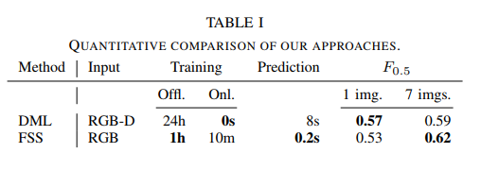
Results
F0.5 measure:

Slide 17
Takeaway
Deep metric approach to perform semantic segmentation for the unknown categories.

Slide 18
References
Pham, V.-Q.; Ito, S.; Kozakaya, T. BiSeg: Simultaneous Instance Segmentation and Semantic Segmentation with Fully Convolutional Networks. In Proceedings of the British Machine Vision Conference (BMVC), London, UK, 4–7 September 2017
A. Milan, T. Pham, K. Vijay, D. Morrison, A. Tow, L. Liu, J. Erskine, R. Grinover, A. Gurman, T. Hunn, et al. Semantic segmentation from limited training data. arXiv preprint arXiv:1709.07665, 2017.
A. Arnab and P. H. S. Torr. Pixelwise instance segmentation with a dynamically instantiated network. In CVPR, 2017

Slide 19
Thank you!

