Slide 1
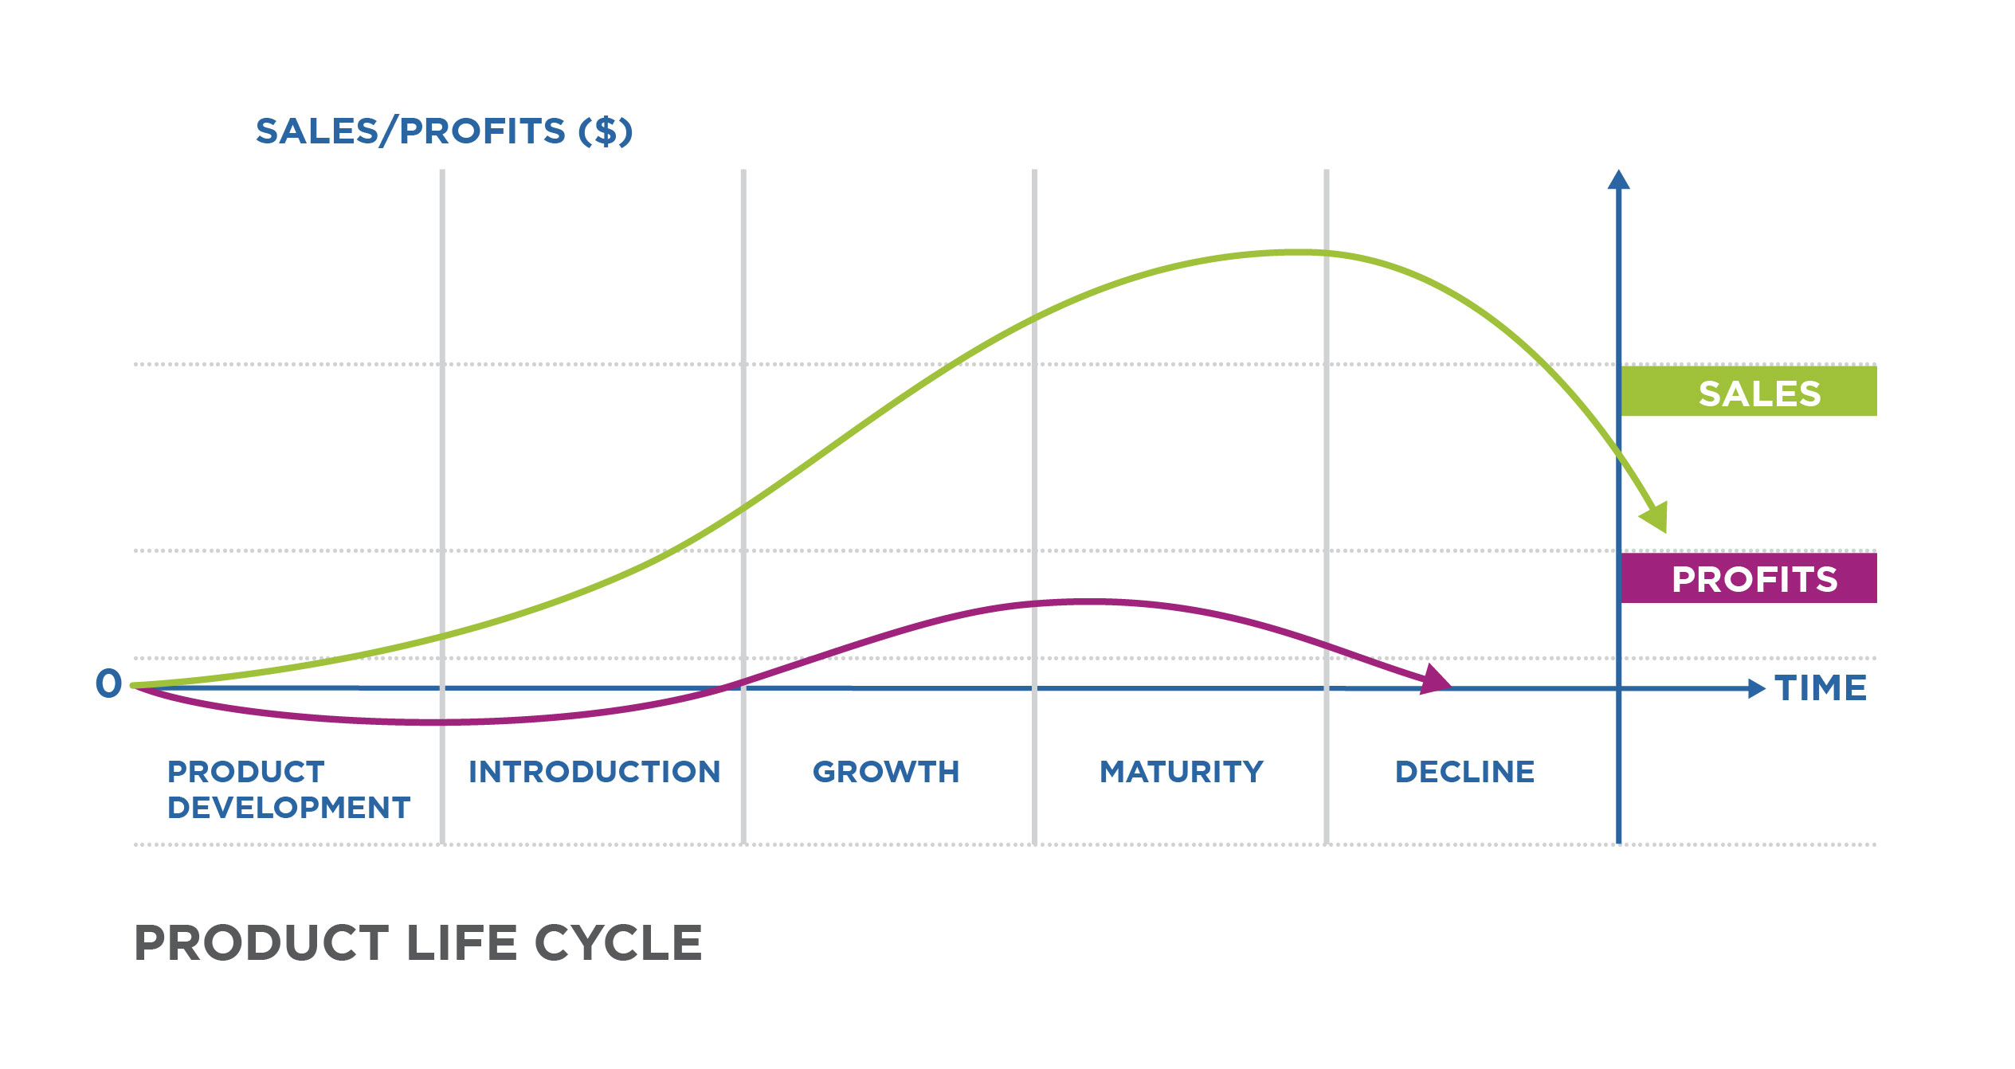
Title:-Sales prediction analysis using ensemble learning over walmart
Name:- DAMAN RAKWAL
ROLL NO. :- 25
SEC :- C
MENTOR:- DR. ANKIT TOMAR, ASSISTANT PROFESSOR

Slide 2
Introduction to Sales Prediction Analysis:- >Sales Prediction Analysis involves utilizing data and analytical methods to forecast future sales performance. >Crucial for businesses to plan efficiently, allocate resources effectively, and formulate impactful marketing strategies. Problem Statement:- > Inefficient Sales Planning: 1 Current sales planning processes lack precision. 2 Resulting in suboptimal strategies and missed revenue opportunities. >Resource Allocation Challenges: 1 Inability to allocate resources effectively based on accurate sales forecasts. 2 Leads to excess inventory costs and inefficient use of resources. >Importance of Accurate Sales Prediction: 1 Accurate predictions are vital for adapting to market dynamics. 2 Facilitates proactive decision-making, ensuring a competitive edge in the industry. Key Objectives:- >Develop a robust sales prediction system to address these challenges. >Enhance decision-making processes and resource optimization within the business.

Slide 3
Benefits of the Sales Prediction Analysis :-
Enhanced Decision-Making:
Accurate sales predictions empower decision-makers with insights to formulate informed strategies.
Enables proactive decision-making based on real-time market trends.
2. Optimal Resource Allocation:
Efficiently allocate resources by aligning them with forecasted sales demand.
Reduces excess inventory costs and ensures resources are utilized effectively.
3. Improved Planning and Strategy:
Facilitates better business planning by providing foresight into future sales trends.
Allows for the development of strategic initiatives tailored to market dynamics.
4. Competitive Edge:
Maintains a competitive edge by responding promptly to market changes.
Enables the organization to adapt and stay ahead of competitors.
Ensemble learning:-
Ensemble learning is a powerful machine learning paradigm that involves combining predictions from multiple models to enhance overall accuracy and robustness. By leveraging diverse models and aggregating their outputs through methods like voting or averaging, ensemble learning mitigates the weaknesses of individual models and improves generalization to new data. The technique is renowned for reducing overfitting, increasing stability, and consistently delivering superior performance across various machine learning tasks. Ensemble learning, encompassing techniques like Bagging, Boosting, and Stacking, has become a cornerstone in machine learning applications, demonstrating its efficacy in achieving higher predictive accuracy and reliability.

Slide 4
Methodology:-
1. Data Preprocessing:
>Handle Missing Values: Identify and address any missing data in the dataset.
>Descriptive Statistics: Utilize statistical measures to gain insights into the dataset's characteristics.
2. Data Visualization:
>Distribution Plots: Visualize the distribution of 'Weekly_Sales' for overall insights.
>Feature Distribution: Explore the distribution of relevant columns ('Temperature', 'Fuel_Price', 'CPI', 'Unemployment') for individual insights.
3. Feature Engineering:
>Date Feature Extraction: Convert the 'Date' column to datetime and extract relevant features like year, month, and day.
>Label Encoding: Encode categorical columns ('Store', 'Holiday_Flag') using label encoding.
4. Data Splitting:
>Split the dataset into features (X) and the target variable (Y) - 'Weekly_Sales’.
>Further split the data into training and testing sets using a random seed for reproducibility.

Slide 5
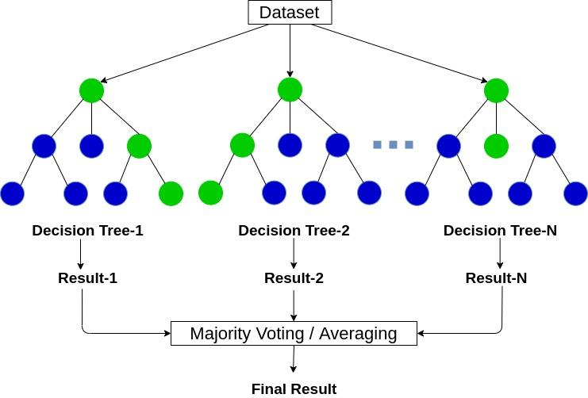
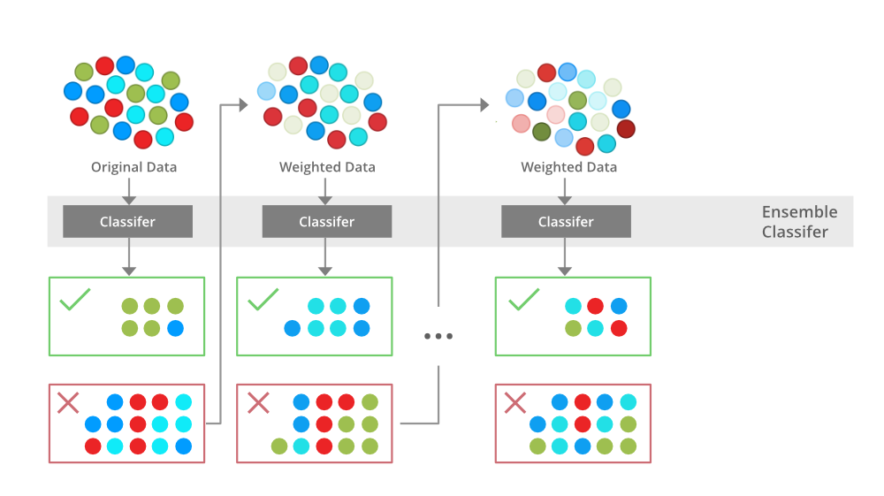
RandomForest XGBoost
5. Model Training:
>XGBoost Regressor: Implement XGBoost, a powerful regression algorithm, for sales prediction.
>RandomForest Regressor: Utilize the RandomForest algorithm for an ensemble approach.

Slide 6
6. Model Evaluation:
>R Squared Metric: Evaluate model performance using the R squared metric on the test dataset.
>Assess individual models (XGBoost and RandomForest) and the ensemble method.
7. Ensemble Learning:
>Averaging Predictions: Combine predictions from XGBoost and RandomForest to create an ensemble model.
>Evaluate the performance of the ensemble model using the R squared metric.
8. Model Comparison and Analysis:
>Compare the performance of individual models and the ensemble method.
>Analyze insights gained from each model's predictions and identify strengths and weaknesses.

Slide 7
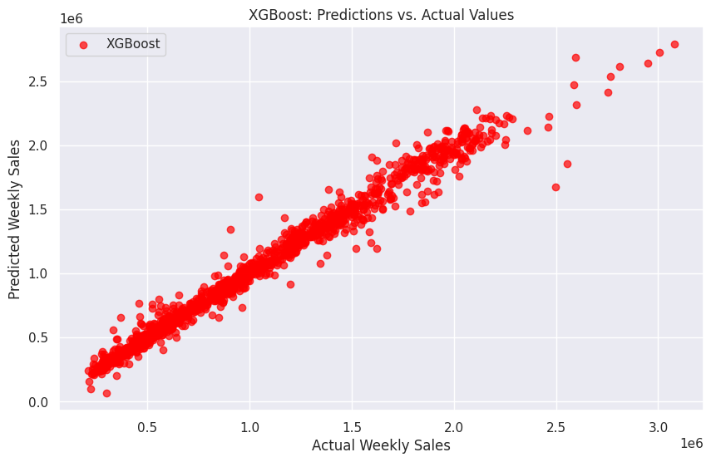
Result and Discussion:-
XGBoost Model Performance:
>The XGBoost model demonstrated strong predictive capabilities for Walmart weekly sales. The R-squared value for the training data was found to be 0.99698(as per Kaggle dataset) , indicating a high level of explained variance. However, the model's performance on the test data yielded an R-squared value of 0.97786(as per Kaggle dataset).

Slide 8
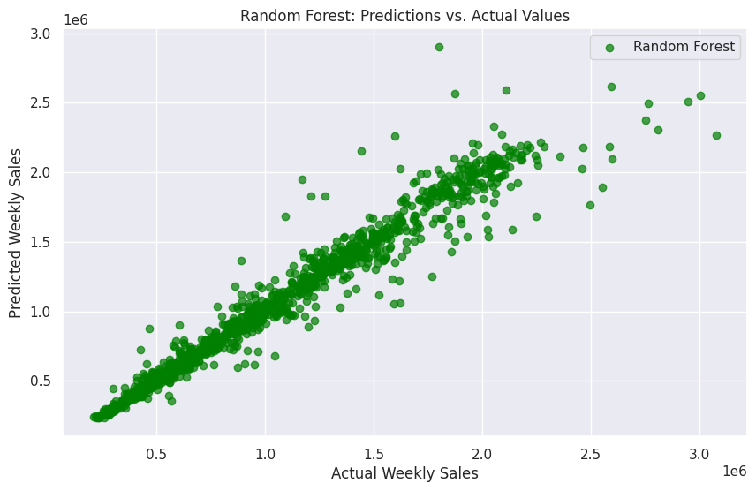
Random Forest Model Performance:
>The Random Forest model, another powerful regression algorithm, exhibited promising results. The R-squared value for the training data was 0.99381(as per Kaggle dataset), demonstrating effective learning on the training set. On the test data, the R-squared value was 0.95430(as per Kaggle dataset). While the model generally generalizes well, further exploration is needed to optimize its parameters.

Slide 9
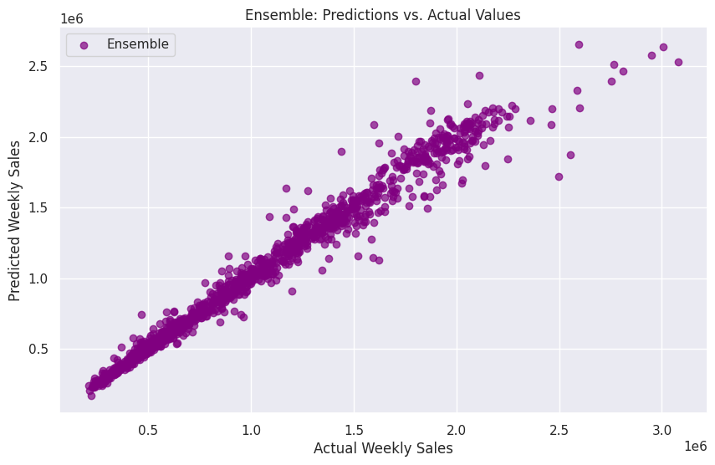
Averaging Predictions:
The ensemble model, created by averaging predictions from XGBoost and Random Forest, aimed to leverage the strengths of both algorithms. The resulting R-squared value for the test data was 0.97257 (as per Kaggle dataset), showcasing a potentially improved overall performance compared to individual models.

Slide 10
Conclusion:
For future enhancements, I plan to incorporate additional algorithms into the sales prediction analysis, broadening the model diversity and potentially improving predictive accuracy. Furthermore, I aim to extract insights that may have been overlooked in the current analysis, expanding the depth of understanding regarding the underlying patterns in the dataset.
Additionally, my next focus will be on developing a comprehensive frontend for the project. A user-friendly interface will facilitate seamless interaction with the sales prediction system, enabling stakeholders to derive valuable insights intuitively. This step will enhance the project's accessibility and usability, making it more practical for business applications.

Slide 11
THANK YOU

