Slide 1

Title:- “Signature verification system”
Name:- daman Rakwal
University roll no.:-2018772
Mentor’s name:-mS. Meenakshi maindola , assistant professor

Slide 2
INTRODUCTION:-
In order to analyse and verify handwritten signatures for security and legal reasons, the Signature Verification System was created. It compares two signature images and determines how similar they are using image processing techniques or algorithms. In Addition, the system has an intuitive user interface that enables users to capture or browse signature images. The system determines the similarity percentage between the images after receiving the images.
FUNCTIONALITY:-
The signature verification system provides the following main functions:
1. Capture and browse signature images: Users can capture signature images using their webcam or browse and select images available on their computer. There are separate options for selecting signature 1 and signature 2 images, allowing the user to compare two different signatures.

Slide 3
2. Signature comparison: The system draws or selects signatures to calculate their similarity.
It uses an image matching algorithm to characterize signatures and compare them to determine similarity.
3. Similarity Threshold: Use a threshold to determine whether the signature matches. In this project, Percent Threshold is set to 85% as a measure of accuracy. If the number of matches is below the threshold, an error message is displayed stating that the signatures do not match.
4. User interface (UI): The system uses the Tkinter library in Python to create a user-friendly Graphical User Interface (GUI). The GUI allows users to interact with the system by clicking the capture, browse and compare buttons. It also provides the user with information showing the results of the signature comparison.
The signature verification system integrates these functions, allowing users to easily capture, browse and compare signature images. The system interface and underlying algorithms work together to determine the similarity of signatures, helping security and legal applications where signature verification is important.

Slide 4
BENEFITS AND PRACTICAL IMPLEMENTATIONS:-
The signature verification system has many advantages and features that help increase security, efficiency and customer satisfaction.
1. Enhanced Security: The authenticity check system of written signatures prevents illegal use and forged signatures. Ensure only real signatures are accepted by comparing signature images.
2. Legal and Financial Applications: The system has important applications in areas where signature verification is important, such as legal and financial.
It provides a reliable way to verify the signatures of contracts, agreements and financial transactions, thus ensuring their authenticity and validity.
3. User-Friendly Interface: The system is designed with a user-friendly interface suitable for inexperienced people. This easy access allows many users to easily interact with the system, capture or browse signature images and get similar percentages of them.

Slide 5
4. Time and Cost Savings: The system completes the signature verification process, reducing the time and costs associated with the manual verification process. It increases efficiency and productivity by eliminating the need to manually check and compare signatures.
5. Improved efficiency and productivity: The automatic signature certificate generator simplifies the verification process, leading to fast and accurate results. This performance improves efficiency as the system handles audit tasks quickly and reliably.
Overall, the signature verification system provides an effective solution for domain verification, providing better security, efficiency, and a better customer experience. Its applications have spread to many sectors, especially law and finance, where signature recognition is required.

Slide 6
METHODOLOGY:-
Procedure :
In this project, process goes as follows, This code is a Graphical User Interface (GUI) for comparing two signatures. It utilizes the Tkinter library. There are buttons to capture and browse signature images, and a "verify" button to perform the comparison. The "Capture" button can be pressed to capture signature images. The paths of the signature images can be entered in the entry fields or selected using the browse button.
The “checkSimilarity” function calls the match function, which compares the signature images and calculates the similarity percentage. If the similarity percentage is lower than the THRESHOLD, an error message is displayed indicating that the signatures do not match. If the similarity percentage is higher than the THRESHOLD, a success message is displayed indicating that the signatures match.

Slide 7
Requirements:-
Programming Language:
Python programming language is used to make this signature verification system. Python is a versatile programming language known for its simplicity and readability, making it an excellent choice for beginners and experienced developers alike.
Modules:
The External modules/libraries which are used in code to build the project of signature verification system are as follows:
Tkinter
OS
CV2
Numpy
skimage.metrics

Slide 8
How it works:-
User Interface:
The Tkinter library is utilized to create a graphical user interface (GUI) for the signature verification system. The GUI consists of elements such as labels, buttons, and entry fields to facilitate user interaction.
Signature Capture:
The system provides options for capturing signature images. The “captureImage” function enables users to capture images either by pressing a designated key (space bar) or by clicking a "Capture" button. The OpenCV library is used to access the webcam and display the live video feed. The captured images are saved in a temporary directory.
Signature Selection:
The system allows users to select signature images by either browsing their computer files or using the captured images. The “browsefunc” function provides a file dialog for browsing and selecting signature images. The selected image paths are displayed in the respective entry fields.

Slide 9
Signature Comparison:
The “checkSimilarity” function is called when the "verify" button is pressed. The match function is used to compare the similarity between the two selected signature images. The similarity percentage is calculated and compared against a predefined threshold ie.85%. If the similarity percentage is below the threshold, an error message is displayed indicating that the signatures do not match. Otherwise, a success message is displayed indicating a match.
Match Function:
def match(path1, path2):
img1 = cv2.imread(path1)
img2 = cv2.imread(path2)
img1 = cv2.cvtColor(img1, cv2.COLOR_BGR2GRAY)
img2 = cv2.cvtColor(img2, cv2.COLOR_BGR2GRAY)
img1 = cv2.resize(img1, (300, 300))
img2 = cv2.resize(img2, (300, 300))
cv2.imshow("One", img1)
cv2.imshow("Two", img2)
cv2.waitKey(0)
cv2.destroyAllWindows()
similarity_value = "{:.2f}".format(ssim(img1, img2)*100)
return float(similarity_value)

Slide 10
ssim (structure similarity index metric):-
The Structural Similarity Index (SSIM) is a measure of similarity between two images that takes into account the structural information and perceived quality. It compares the local patterns of pixel intensities in the images to evaluate their similarity.
The formula for calculating SSIM between two images, x and y, is as follows:
SSIM(x, y) = (2 * μ_x * μ_y + C1) * (2 * σ_xy + C2) / (μ_x^2 + μ_y^2 + C1) * (σ_x^2 + σ_y^2 + C2)
Where:
μ_x and μ_y are the average pixel intensities of images x and y, respectively.
σ_x^2 and σ_y^2 are the variance of pixel intensities of images x and y, respectively.
σ_xy is the covariance of pixel intensities between images x and y.
C1 and C2 are small constants added to avoid division by zero and stabilize the division.
Here's a step-by-step explanation of how to compute the SSIM between two images:
Convert both images x and y to grayscale if they are in color. Grayscale images are typically used for SSIM calculations.
Compute the average pixel intensities (μ_x and μ_y) and variances (σ_x^2 and σ_y^2) of images x and y, respectively.
Compute the covariance of pixel intensities (σ_xy) between images x and y.
Calculate the SSIM using the formula mentioned above.
The resulting SSIM value will lie in the range [-1, 1], where 1 indicates perfect similarity, 0 means the images are completely dissimilar, and -1 indicates perfect dissimilarity with the images having opposite pixel intensities.

Slide 11
User Feedback:
Tkinter's “messagebox” module is employed to display informative messages to the user, indicating the result of the signature comparison.
Graphical Interface:
The GUI elements, such as labels, buttons, and entry fields, are positioned using the “place” method to create an organized layout.
Execution:
The “root.mainloop()” function runs an event loop allowing the GUI to be displayed and interacted with by the user.
Overall, the methodology involves capturing or selecting signature images, comparing them using the “match” function, and providing feedback to the user regarding the similarity between the signatures. The GUI created using Tkinter facilitates user interaction, making the signature verification process more accessible and user-friendly.

Slide 12
Result and Discussion:-
This code implements a signature verification system with a user friendly Graphical User Interface (GUI) using the Tkinter library in Python.
The GUI allows users to capture signature images or browse existing images. Once the signatures are selected the system compares them using the match function.
If the similarity percentage between the signatures is below the defined threshold an error message is displayed indicating that the signatures do not match.
Conversely if the similarity percentage exceeds the threshold a success message is shown indicating a match.
The code leverages OpenCV for image capture and processing and utilizes the signature module for the signature comparison.
Overall, it provides an interactive and efficient solution for signature verification in a visually appealing manner.

Slide 13
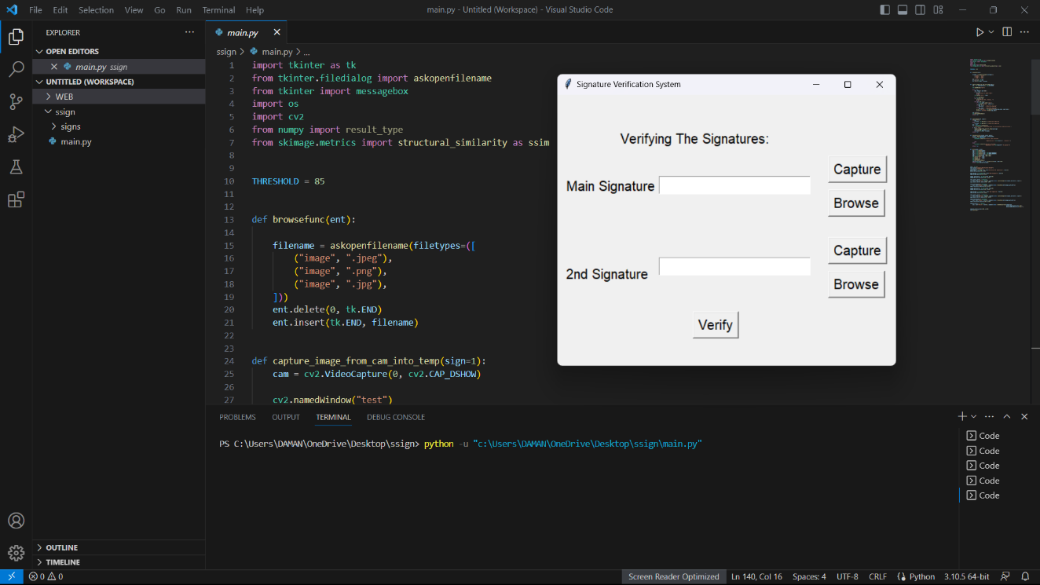
Screenshots of result:-

Slide 14
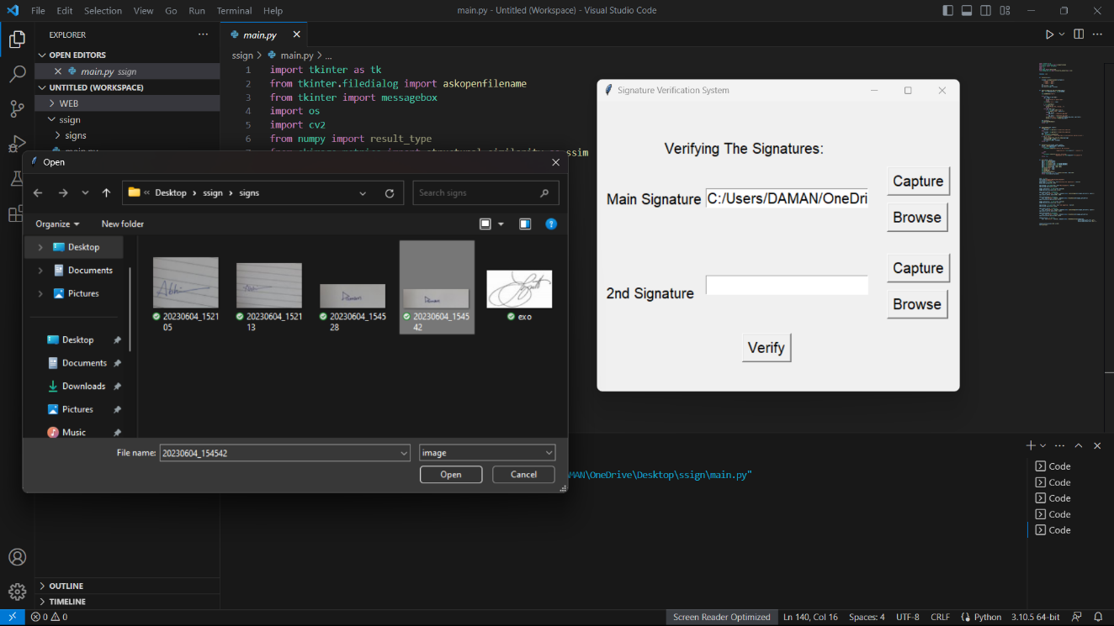

Slide 15
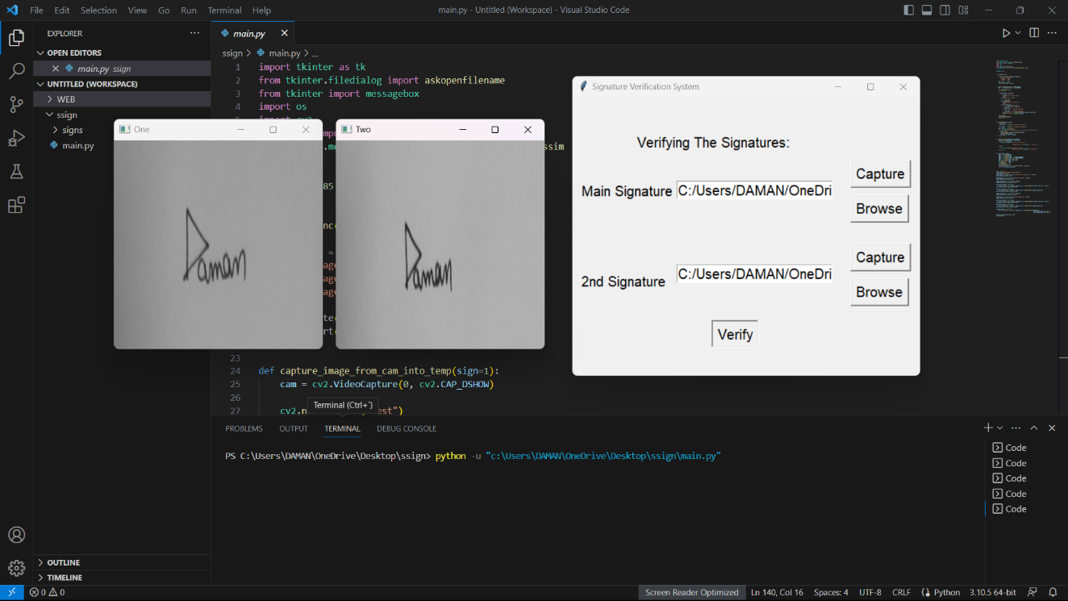

Slide 16
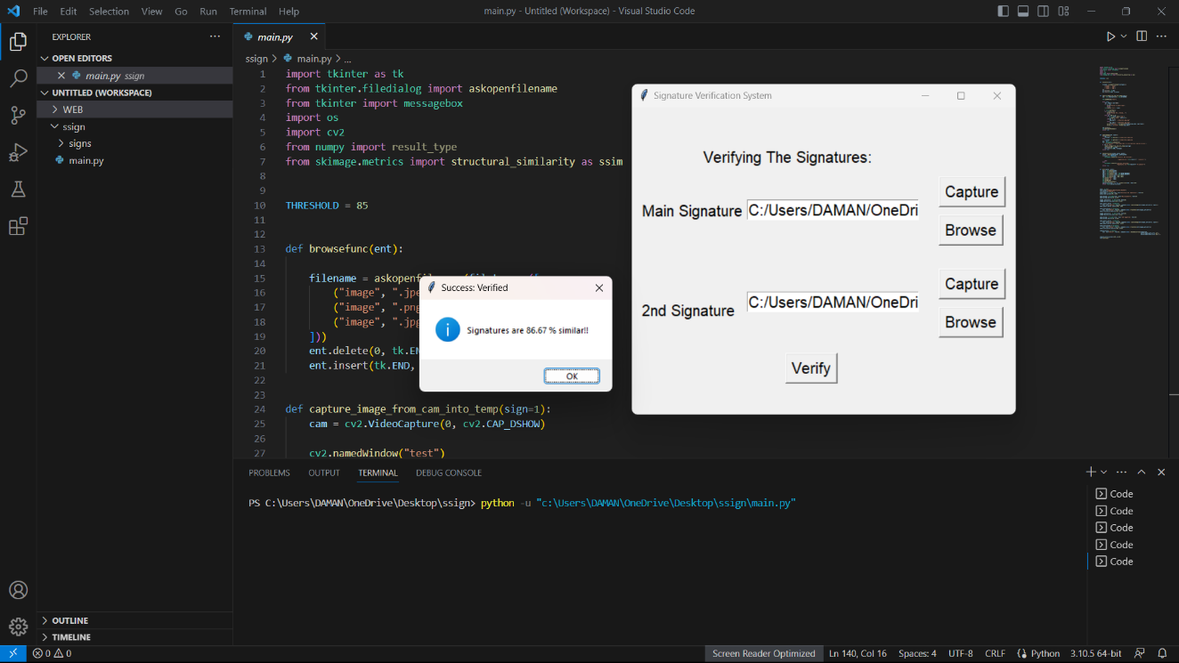

Slide 17
THANK YOU

