Slide 1
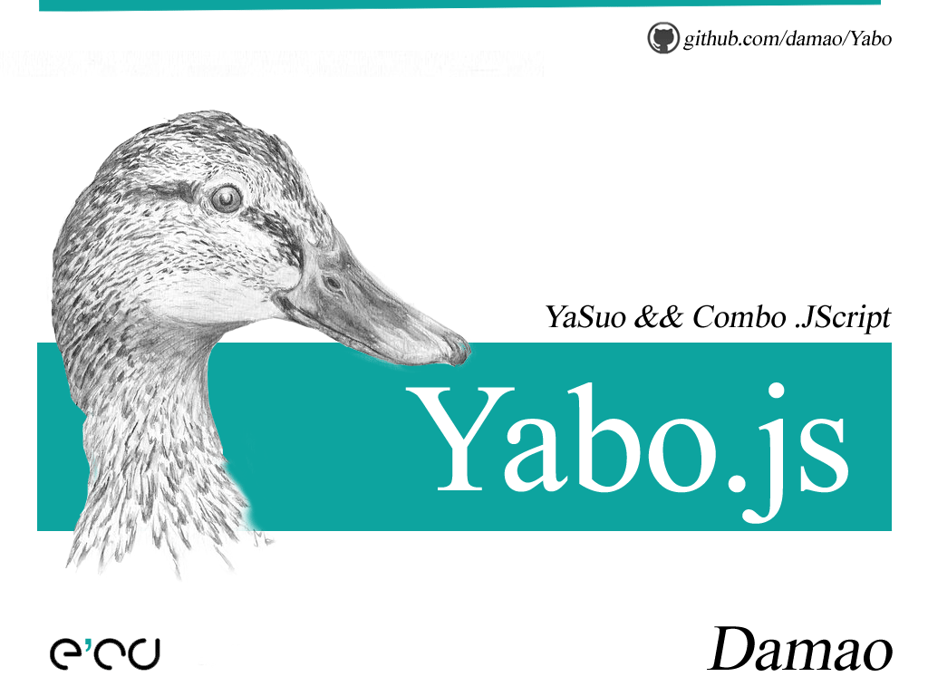

Slide 2


Slide 3
站在巨人的肩膀上 Standing on shoulders of Gients

Slide 4
YUI Compressor
The Yahoo!
JavaScript and CSS
Compressor

Slide 5
YUI Compressor
java -jar "yuicompressor.jar"
-o yui.min.css
yui.css

Slide 6
YUI Compressor
java -jar "yuicompressor.jar"
-o $FileNameWithoutExtension$.min.css
$FileName$

Slide 7
Ycombo
The Alibaba
JavaScript and CSS
Combinator

Slide 8
Ycombo
java -jar “ycombo.jar"
-o ycombo.min.css
ycombo.seed

Slide 9
Ycombo
java -jar “ycombo.jar"
-o $FileNameWithoutExtension$.min.css
$FileNameWithoutExtension$.seed

Slide 10
Ycombo.seed
// #require <PATH>
// #require "PATH“
/* #require <PATH> */
/* #require "PATH" */

Slide 11
Yabo.seed
SEED
/\
A B / /\
C C D
/ / / \
E E F G
E > C > A > F > G > D > B > SEED

Slide 12
Yabo.js
The Damao!
CSS
Yasuo && Combo

Slide 13
Yabo.js
wscript E:\Yabo.js Yabo.css
Yabo.css > Yabo.min.css
Yabo.source.css > Yabo.css

Slide 14
Yabo.js
wscript E:\Yabo.js $FilePath$

Slide 15


Slide 16
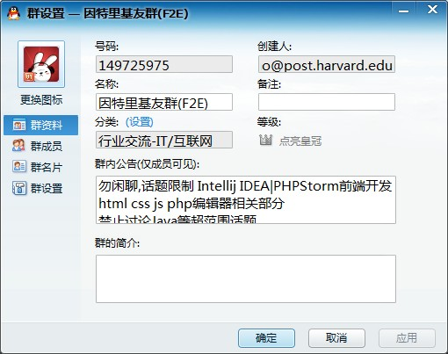

Slide 17
https://github.com/damao/Intellij-IDEA-F2E

Slide 18
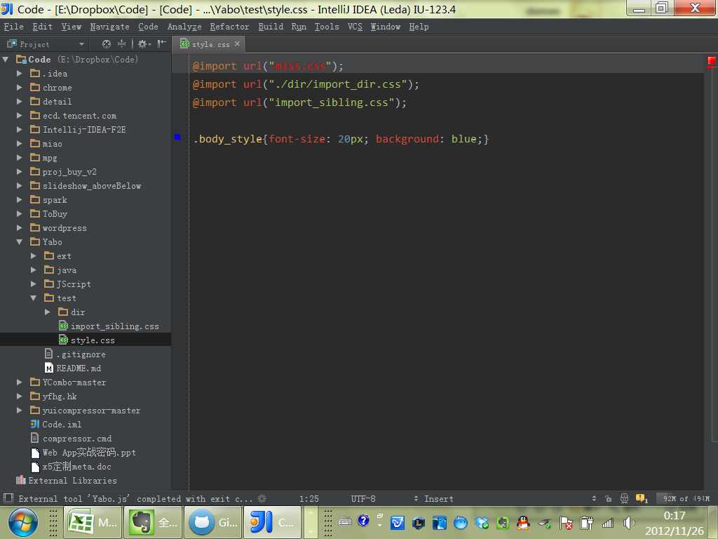

Slide 19
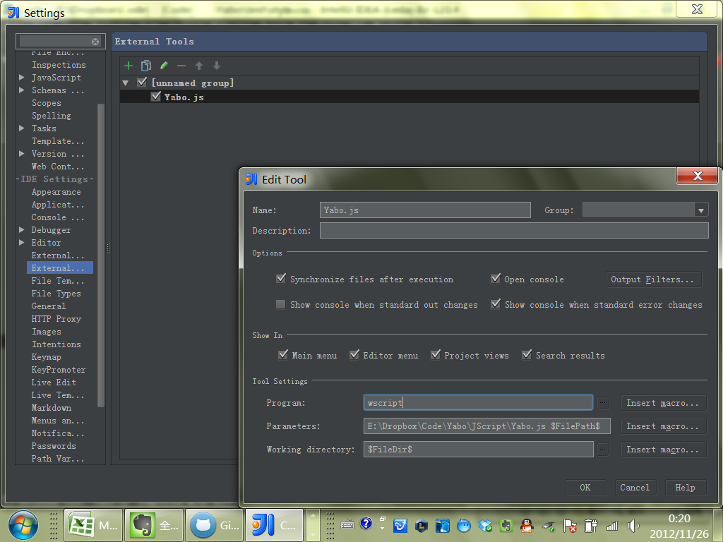

Slide 20
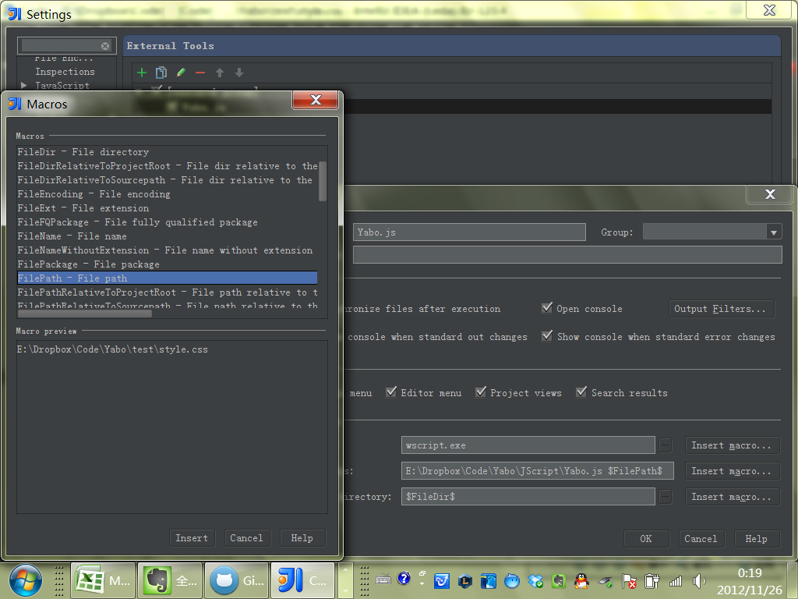

Slide 22
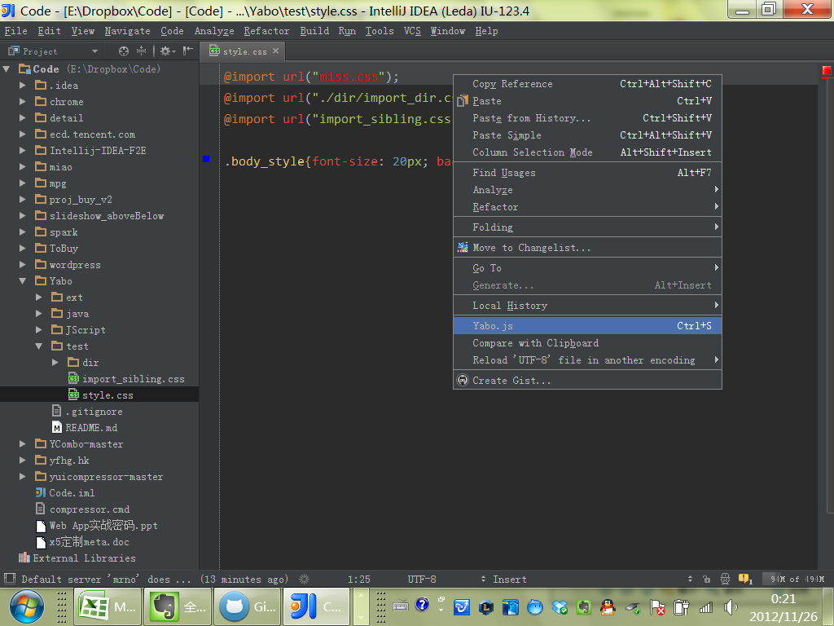

Slide 23
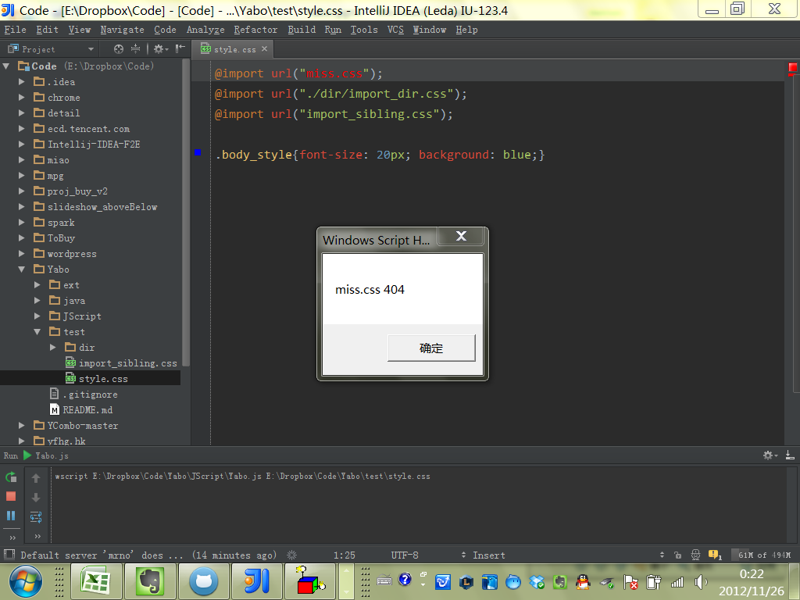

Slide 24
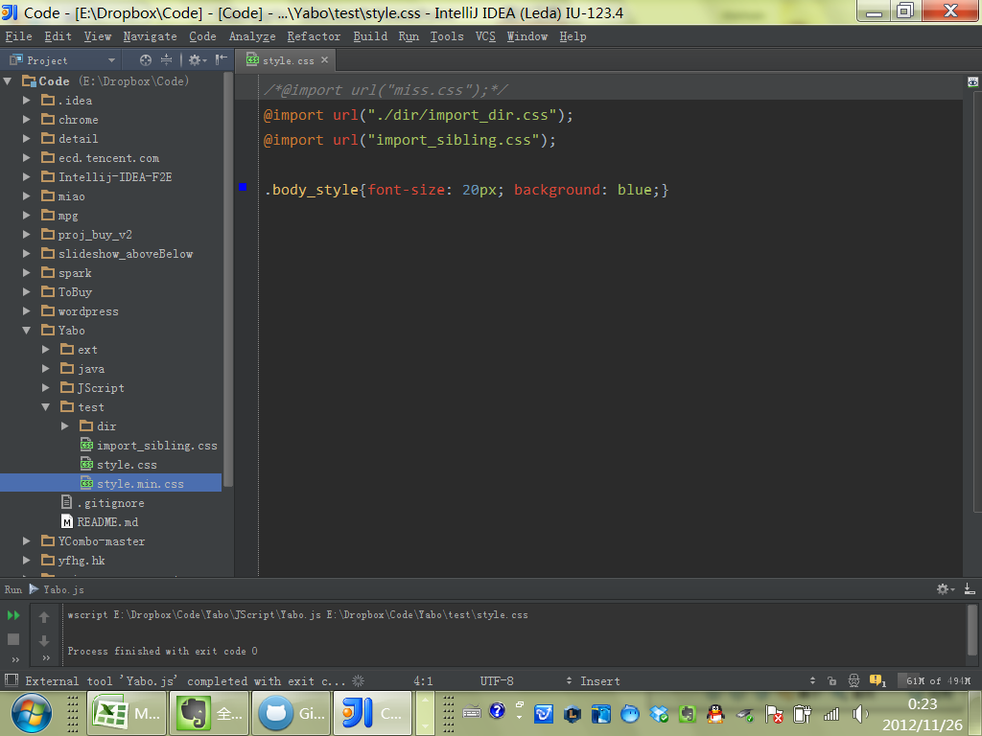

Slide 25
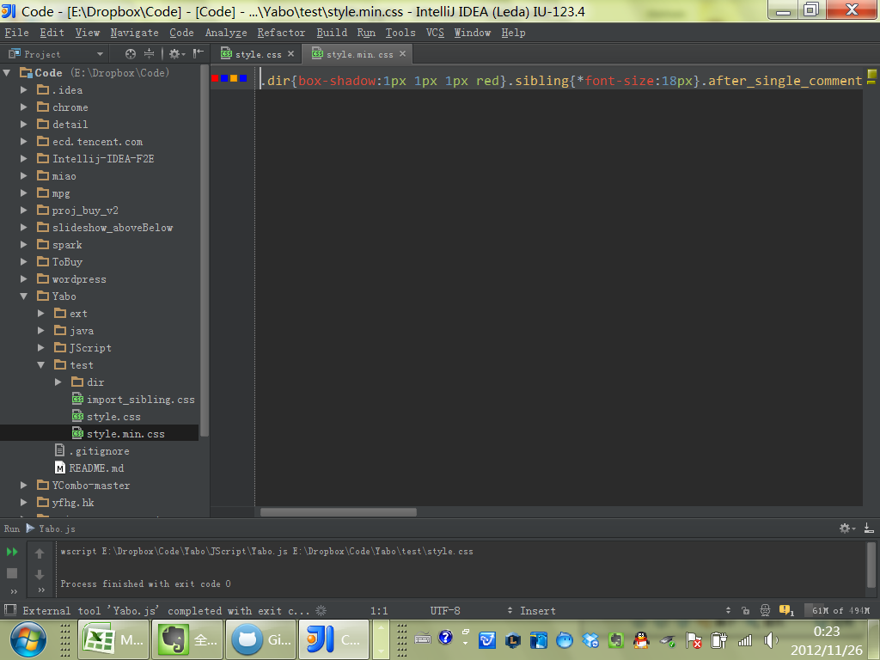

Slide 26
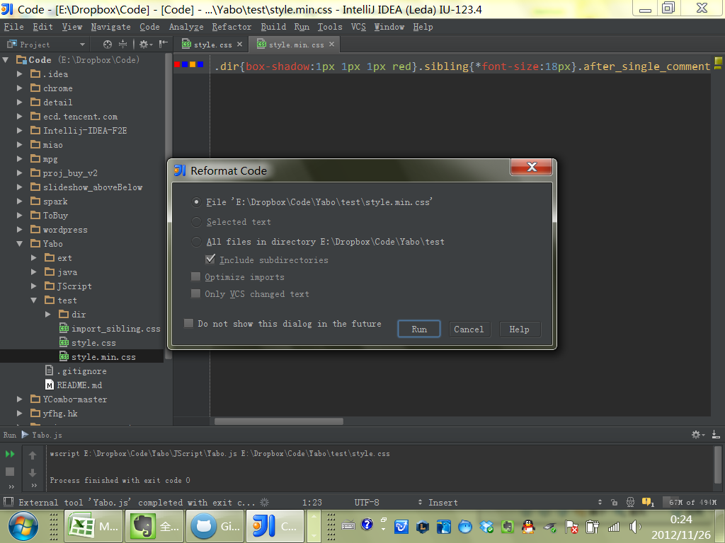

Slide 27
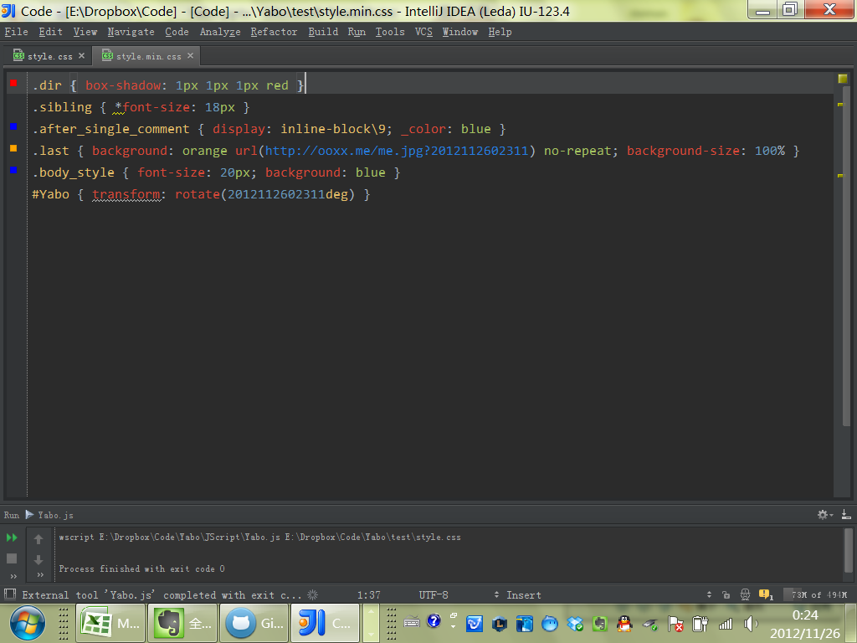

Slide 28
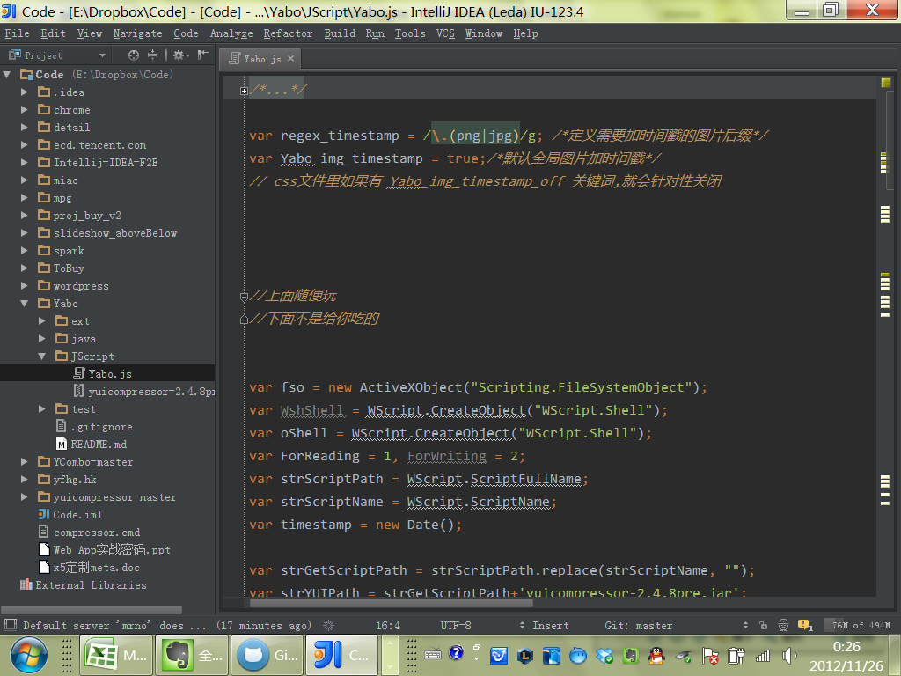

Slide 29
JScript
The Microsoft
ECMAScript
Dialect

Slide 30
FileSystemObject (FSO)
HTML
来创建 Web 页
Windows Scripting Host *
来为 Microsoft Windows 创建批文件
Script Control
来对用其他语言开发的应用程序提供编辑脚本的能力

Slide 31
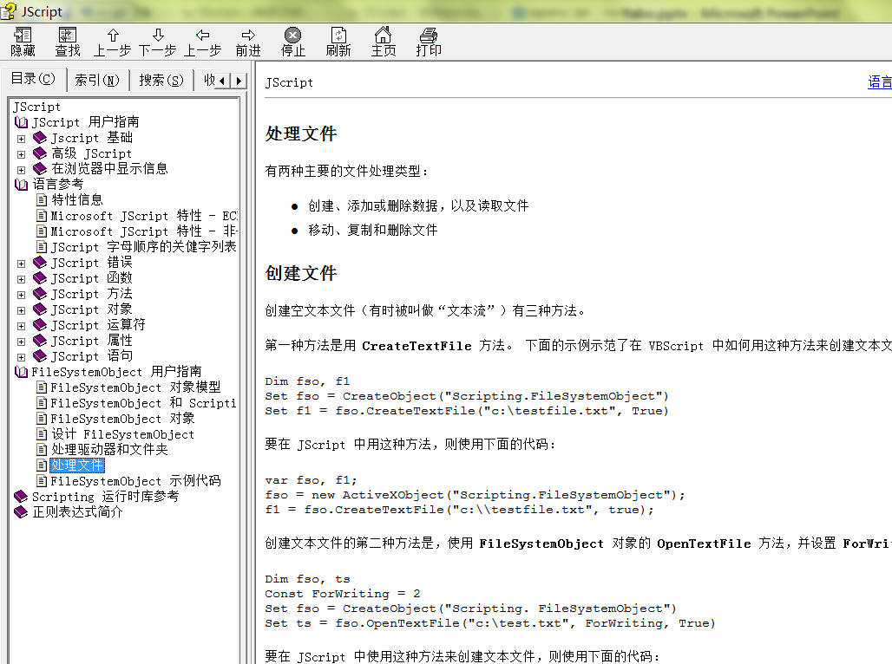

Slide 32
fso.CreateTextFile
var fso, f1;
fso = new ActiveXObject("Scripting.FileSystemObject");
f1 = fso.CreateTextFile("c:\\testfile.txt", true);

Slide 33
Node.js
The Joyent
V8 JavaScript Runtime
Platform

Slide 34
Node.js
var http = require('http');
http.createServer(function (req, res) {
res.writeHead(200, {'Content-Type': 'text/plain'});
res.end('Hello World\n');
}).listen(1337, "127.0.0.1");
console.log('Server running at http://127.0.0.1:1337/');

Slide 35
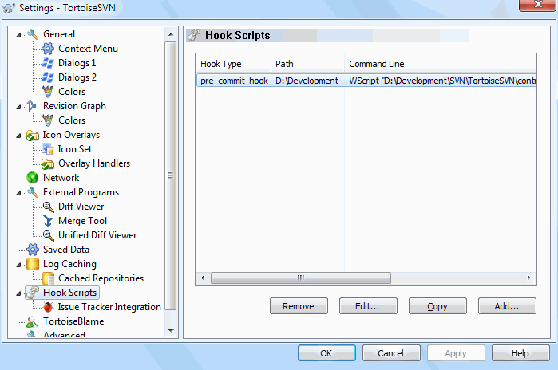

Slide 36
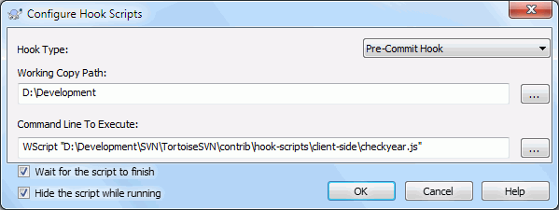

Slide 37
http://tortoisesvn.net/docs/release/TortoiseSVN_en/tsvn-dug-settings.html#tsvn-dug-settings-hooks

Slide 38
TortoiseSVN
Start-commit
PATH MESSAGEFILE CWD
Pre-commit
PATH DEPTH MESSAGEFILE CWD
Post-commit
PATH DEPTH MESSAGEFILE REVISION ERROR CWD
Start-update
PATH CWD
Pre-update
PATH DEPTH REVISION CWD
Post-update
PATH DEPTH REVISION ERROR CWD
Pre-connect
no parameters are passed to this script. You can pass a custom parameter by appending it to the script path.

Slide 39



Slide 40


Slide 41
