Slide 1

Marconi law, LLC
Network System Implementation
Admin: Damarkus Harris

Slide 2

Overview
Project Scope
Network Objectives/Benefits
Network Infrastructure Requirements
Network Topology Diagram
Capital & Operating Requirements
HW/SW Specification & Cabling type
Lessons Learned

Slide 3

Project scope
Provided Equipment for all employees including workstations, mobile devices, a printer & VoIP phones.
Annual on-going network maintenance & Support.
Server Room – includes a switch, router and a database server.
WAP and TV’s throughout the building.
Networking cabling throughout the building for ethernet connections.

Slide 4

Network objectives/benefits
Cloud Security
Windows Server 2016 comes with enhanced security that meet regulatory and compliance objectives and protects your business
Scalability
24 ports on Switch that can connect to new workstations or any capable device.
Customizable Switch
Customize to tailor your network
Most flexibility and scalability
Guest VLANs
WAP (Cisco Business 145AC)
Cisco Business Mobile App
Monitor network traffic and usage
Provide real time snapshots

Slide 5

Network infrastructure requirements
3 – OptiPlex 7470 All in one (WorkStation)
10 – Surface Book 2 (Mobile Laptop)
1 – Brother MFC-L8900 Printer All in one
3 – Cisco Business 145AC WAP
1 – PowerEdge T40 Tower Server / Dell Monitor & Windows Server 2016 Standard
4 – Poly VVX 601 VoIP + NeuPo 48 Bolt Power Supply
1 – Cisco RV160 VPN Router
1 – Cisco SG350X-24 Stackable Managed Switch
10 – Apple iPhone 11
4 – Sony 32-inch TV
Cat5 Ethernet Cabling

Slide 6
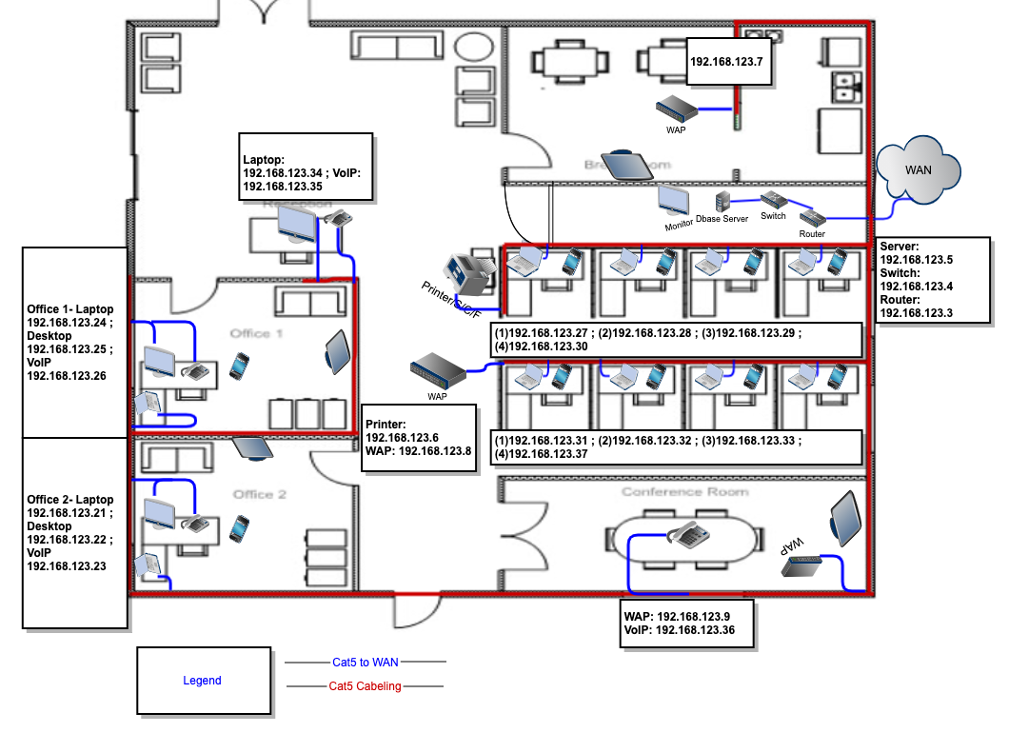
Network topology diagram
A network topology is the arrangement of the elements of a communication network.

Slide 7
Capital & operating Requirements
Hardware | Per Unit Cost | Quantity | Total Cost
OptiPlex 7470 All in one | $929.00 | 3 | $2787
Surface Book 2 | $1,150.00 | 10 | $11,500
Brother MFC-L8900CDW | $524.99 | 1 | $524.99
Cisco Business 145AC Series Access Point | $165.00 | 3 | $495
PowerEdge T40 Tower Server / Dell Monitor & Windows Server 2016 Standard | $1368.98 | 1 | $1368.98
Poly VVX 601 VoIP phone + NeuPo 48 Volt Power Supply | $179.99 | 4 | 719.96
Cisco RV160 VPN Router | $149.00 | 1 | $149
Cisco SG350X-24 Stackable Managed Switch | $490.37 | 1 | $490.37
Apple iPhone 11 | $749.00 | 10 | $7490
Sony 32 inch TV | $299.00 | 4 | $1196
Labor (@ $75/hr.) | $75 | 10hrs 46 mins | $784.50
Annual on-going network maintenance & support | $12,000 | 1 | $12,000
TOTAL COST *All prices are before any taxes and fees. |  |  | $39,505.80

Slide 8
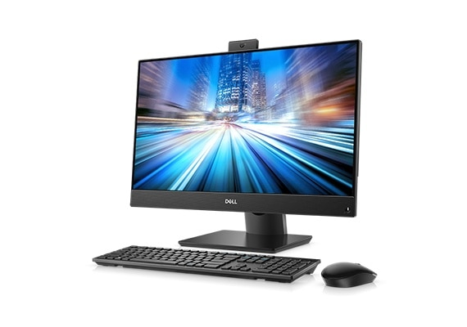
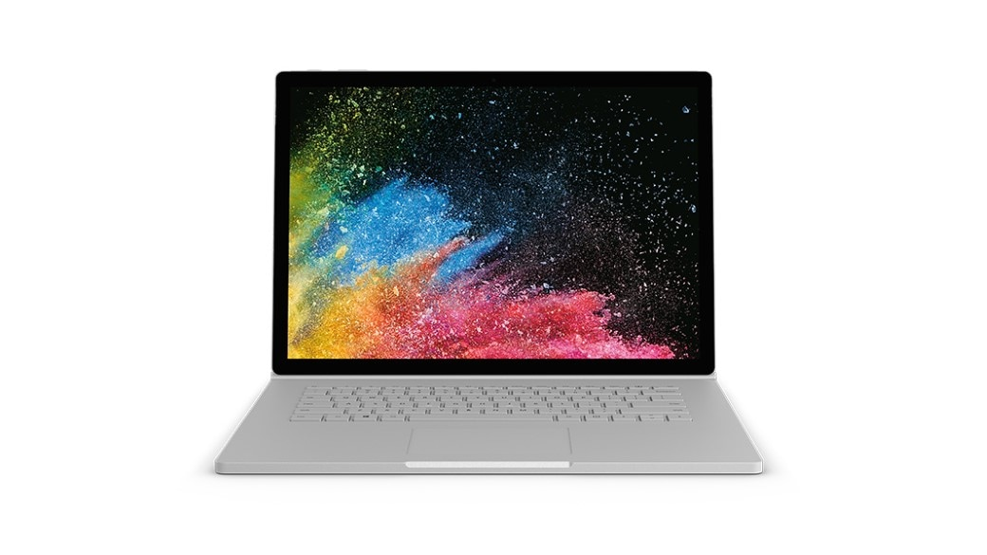
HW/SW specification & cabling type
Brand/Manufacturer | Dell
Model | OptiPlex 7470
Processor | Intel ® Core ™ i5-9500 6 Cores
Memory | 8GB
Storage/Hard Drive | 500GB SATA
Monitor | H: 13.54” W: 21.26” D: 2.07”
Ethernet | RJ-45
Operating System | Windows 10 Pro
Features | Wireless HDMI USB 3.1 SD Card Reader Headset Port
Brand/Manufacturer | Microsoft
Model | Surface Book 2
Processor | 7th Gen Intel Core i5
Memory | 8GB
Storage/Hard Drive | 256GB
Monitor | 13.5 inches (Touch)
Battery | Up to 17 hours
Operating System | Windows
Weight | Total: 4.20 lbs. Tablet: 1.80 lbs.

Slide 9
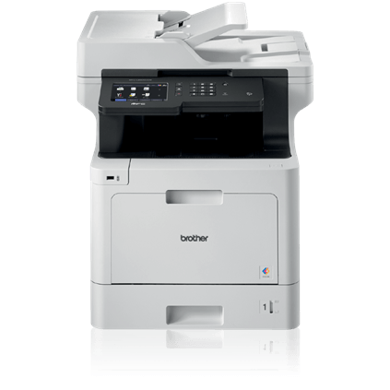
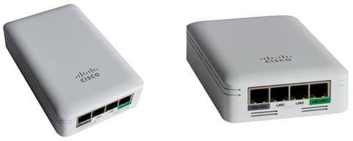
HW/SW specification & cabling type
Brand/Manufacturer | Brother
Model | MFC-L8900CDW
Functions | Scan, Copy & Fax
Weight | 63.1 lbs.
Max Paper Capacity | 1,300
Duty Cycle | 60,000 pages per month
Memory | 512 MB
Wireless | Standard
Platform Supported | PC, Mac
Physical Dimensions | 19.5” x 20.7” x 21.6”
Manufacturer Warranty | One Year
Brand/Manufacturer | Cisco
Model | Business 145AC Access Point
Features | Increased wireless performance Cisco Business Mobile App Wired access Mounting
Maximum Clients | 200 per Wi-fi radio, total of 400 clients per access point
Data Rates Supported | 802.11a, b/g, n and ac
System | 1GB DRAM 256 MB flash 710-MHz quad-core processor

Slide 10
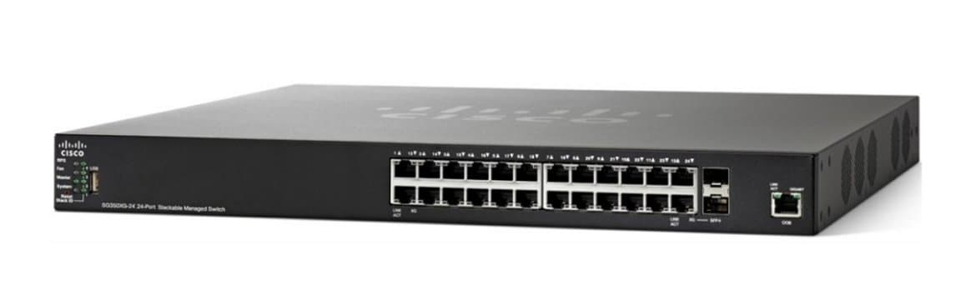
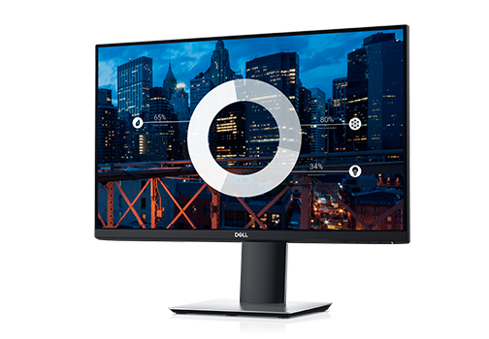
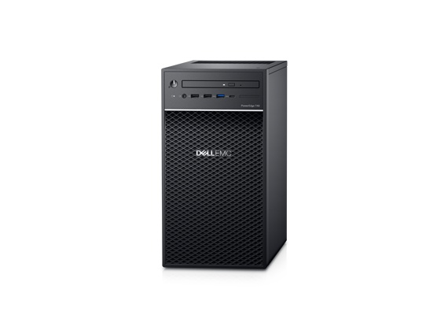
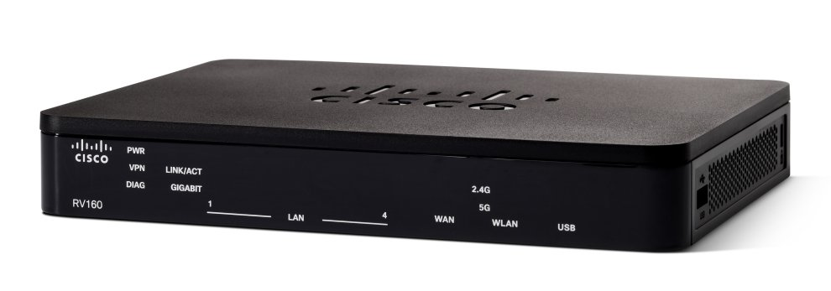
HW/SW specification & cabling type
Brand/Manufacturer | Cisco
Model | SG350X-24
No of Ports | 24
Port speed | 24x 10/100/1000 ports
CPU memory | 512 MB
Power | 100 to 240V
Encryption | SSL SSH
Dimensions/Features | Weight: 9.52 lbs. Height: 1.73 in. Operating Temp 32° - 122° F Storage Temp -4° - 158° F DoS Prevention Private VLAN DHCP snooping
Brand/Manufacturer | Dell
Model | PowerEdge T40
Processor | Intel Xeon E-2224G 3.5GHz
Memory | 8GB
Storage/Hard Drive | 1TB
Monitor | Dell 24” Full HD LED
Ethernet | RJ-45
Operating System | Windows Server 2019
Brand/Manufacturer | Cisco
Model | RV160
Speed | 600 Mbps
Ethernet | RJ-45
Operating System | Linux
CPU | Dual-Core
Port | 4

Slide 11
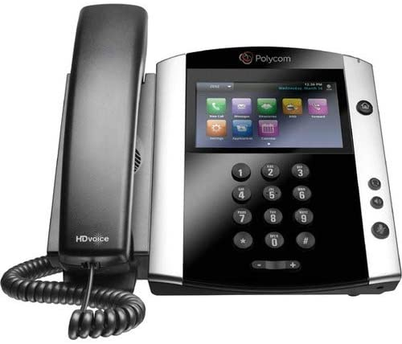
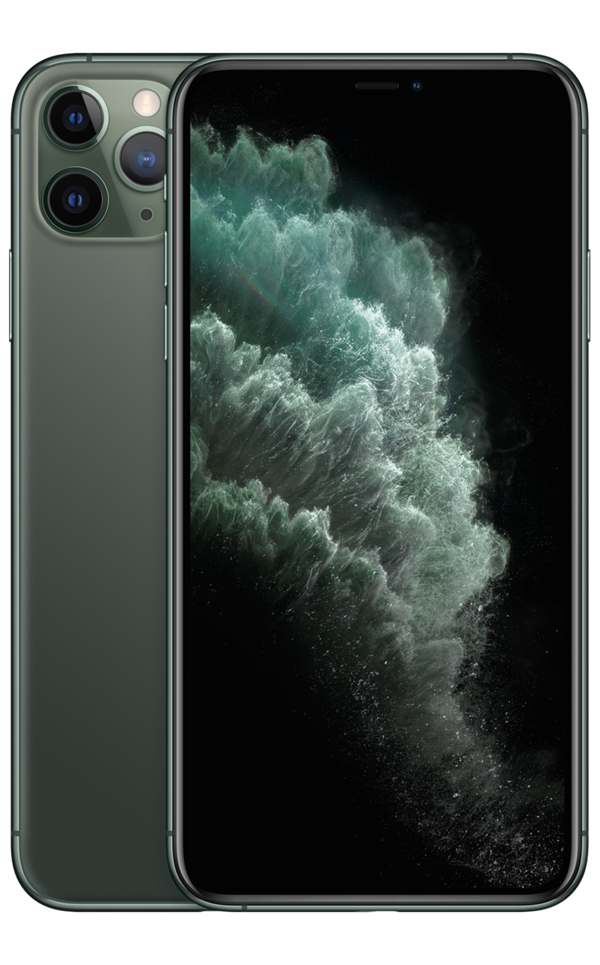
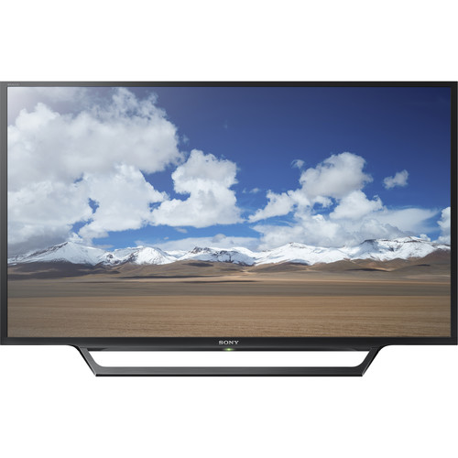
HW/SW specification & cabling type
Brand/Manufacturer | Poly
Model | VVX 601
Features | 4 soft keys to easy find transfer, conference and call park.
Specifications | LCD Screen saver/digital picture frame mode On-screen virtual keyboard Voicemail Dual USB Bluetooth Weight 2.0 lbs.
Warranty | 1 Year
Brand/Manufacturer | Apple
Model | Iphone 11
Storage | 128GB
Size and Weight | H: 5.94 inches W: 2.98 inches D: 0.33 inch Weight: 6.84 ounces
Display | 6.1”
Processor | A13 Bionic chip
Camera | Dual 12MP Ultra-Wide and Wide cameras
Brand/Manufacturer | Sony
Model | W600D
Size and Weight | S: 28.9 in x 3.5 in x 17.6 in W: 10.8 lbs.
Display | 1366 x 768

Slide 12
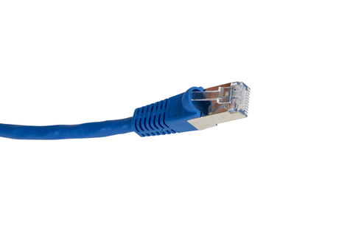
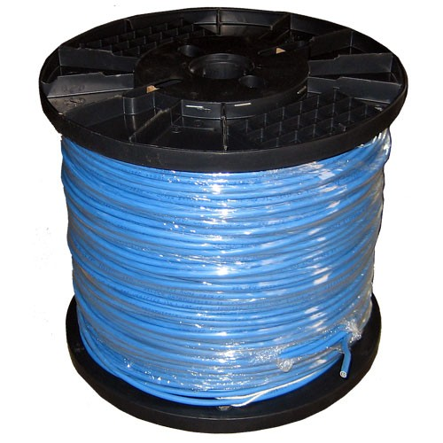
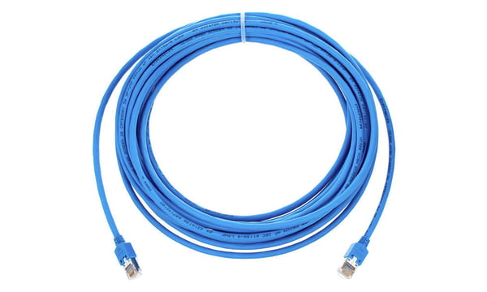
HW/SW specification & cabling type
CAT type | Cat5
Features | 100MHz
Length | Max Length 100 meters

Slide 13

Closeout/lessons learned
Project Management
Scope
Stakeholders
Triple Constraints
Cost
Time
Agreed Scope

