Slide 1
Fuel Cost Optimization in Freight Logistics
A Data-Driven Approach using Python, SQL, and Power BI

Slide 2
Objective
A logistics company aimed to reduce rising fuel costs by understanding truck-level inefficiencies.
This project explores how data from freight, fuel consumption, and driver performance can lead to actionable insights.

Slide 3
Tech Stack Used
Python – Data cleaning, transformation, analysis
MySQL – Structured querying, joins, aggregations
Power BI – Dashboards, KPI visualizations, slicing

Slide 4
Key Insights
- Identified trucks with low fuel efficiency
- City-wise revenue patterns visualized
- Maintenance & fixed costs correlation with revenue
- Up to 15% fuel cost can be saved through optimization

Slide 5
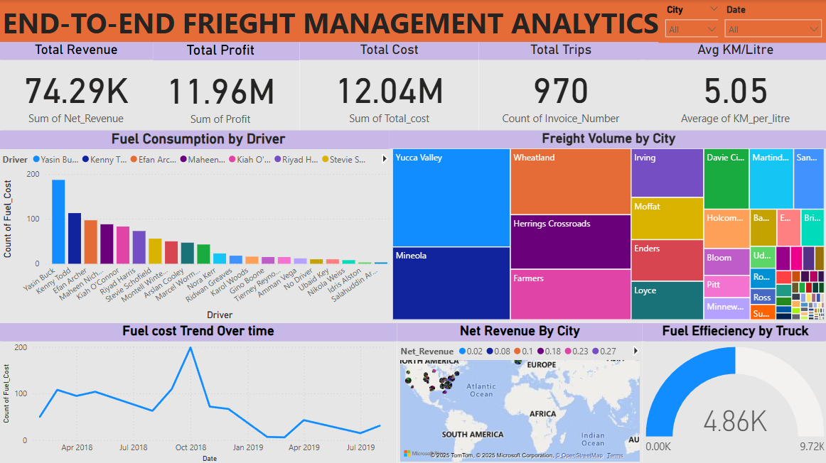
Freight Management Dashboard Overview

