Slide 1
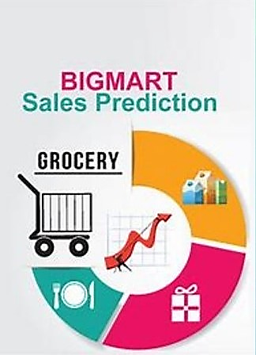
BIGMART SALES PREDICTION
ANALYZING BIGMART SALES TRENDS AND PREDICTIVE MODELS USING MACHINE LEARNING
Our Project Guide:
Mrs.G.V Leela Kumari
D.Supraja (Y20ADS406)
G.Bhavani (Y20ADS407)
B.Hrithik (Y20ADS402)
P.RaghuGopi (L21ADS404)

Slide 2
CONTENTS
Title
Contents
Abstract
Literature Survey
Existing System
Disadvantages
Proposed System
Advantages
Block Diagram
Software Requirements
Hardware Requirements
Algorithms
Applications
References
Conclusion….

Slide 3
ABSTRACT
Now a days shopping malls and Big Marts keep the track of their sales data of each and every individual item for predicting future demand of the customer and update the inventory management as well. These data stores basically contain a large number of customer data and individual item attributes in a data warehouse.
In this , we propose a predictive model using Machine learning Regression techniques Linear Regression, random Forest Regressor, Gradient Boost Algo’s LightGBM, CatBoost , Lasso and ridge re for predicting the sales of a company like Big Mart and that the model may produce better performance as compared to existing model XGBoost algorithm.

Slide 4
LITERATURE SURVEY
A Forecast for Big Mart Sales Based on Random Forests and Multiple Linear Regression (2018) Kadam, H., Shevade, R., Ketkar, P. and Rajguru. A Forecast for Big Mart Sales Based on Random Forests and Multiple Linear Regression used Random Forest and Linear Regression for prediction analysis which gives less accuracy. To overcome this, we can use XG boost Algorithm which will give more accuracy and will be more efficient.
Forecasting methods and applications (2008) Makridakis, S., Wheelwrigh. S. C., Hyndman. R.J. Forecasting methods and applications contain a Lack of Data and short life cycles. So some of the datalike historical data, and consumeroriented markets face uncertain demands and can be predicted for accurate results.
By Das, P., Chaudhury. Prediction of retail sales of footwear using feed-forward and recurrent neural networks used neural networks for prediction of sales. Using a neural network for predicting weekly retail sales, is not efficient, So XG boost can work efficiently.

Slide 5
EXISTING SYSTEM
Objective: In Existing system they aimed to develop a reliable sales forecasting model for Bigmart stores.
Method Exploration: Various predictive techniques were investigated, including decision trees, linear regression, Ridge Regression and others.
Performance Evaluation: Each method was rigorously evaluated for its predictive accuracy using established metrics.
XGBoost Superiority: Following the evaluation, the XGBoost algorithm emerged as the most effective, demonstrating superior performance compared to other methods.
Accuracy Metrics: Evaluation metrics, such as Mean Absolute Error (MAE) and Root Mean Square Error (RMSE), indicated that XGBoost achieved an error of approximately 1052 for RMSE and 739.03 for MAE.

Slide 6
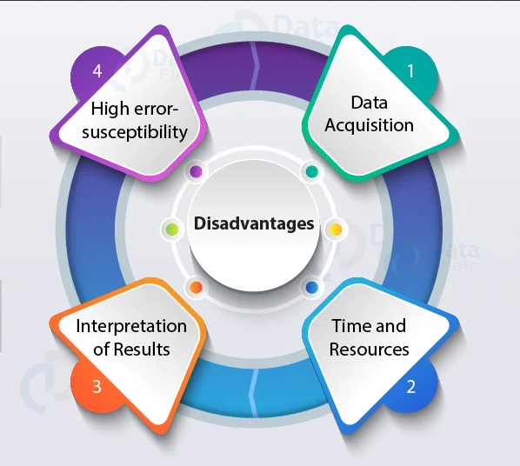
DISADVANTAGES
While XGBoost is known for its performance on structured/tabular data, it may not be as suitable for unstructured data types or extremely large datasets.
Optimizing the performance of an ensemble classifier involves tuning numerous hyperparameters across multiple algorithms, which can be time-consuming and require expertise.
XGBoost relies on certain assumptions about the data. If these assumptions are violated, it can lead to inaccurate predictions or biased estimates.
There's a risk of overfitting, especially when dealing with relatively small datasets.

Slide 7
PROPOSED SYSTEM
Objective: The primary aim of the proposed system is to determine the most effective regression technique for predicting accurate results in Bigmart sales forecasting.
Regressor Techniques Testing: The system explores a range of regression techniques, including:
LGBMRegressor
CatBoost Regressor
Linear Regression
Random Forest Regressor
Lasso Regression and Ridge
Sequence of Steps: The dataset of Bigmart sales undergoes a series of sequential steps for model development and evaluation, Model Training etc..
Results: We got LightGBMRegressor is best algorithm having low RMSE as 1018 and MAE as 728 than existing model XGBoost algorithm

Slide 8

ADVANTAGES
Comprehensive Evaluation: By testing multiple regression techniques, the proposed model allowing for a comprehensive comparison of their strengths and weaknesses.
Robustness: The proposed model's evaluation of various regression techniques enhances predictive robustness, mitigating reliance on any single method and improving adaptability to diverse datasets and scenarios.
Adaptability to various Domains:The model's versatility extends its applicability beyond Bigmart sales, allowing adaptation to diverse industries and prediction tasks.
Its methodology enables broader usage and knowledge transfer across domains, fostering adaptability and utility in varied contexts.

Slide 9
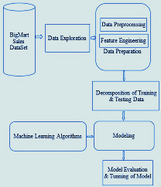
BLOCK DIAGRAM
Data Collection: This initial stage involves gathering relevant data from historical sales data, customer demographics, product information, store details, promotional activities and seasonal trends.
Data Preprocessing: In this,the collected data undergoes preprocessing involves tasks such as handling missing values, encoding categorical variables, scaling numerical features.
Training And Testing: During the training phase, machine learning models learn patterns and relationships from the training dataset to make predictions. In testing, these models are evaluated on a separate dataset to assess their performance and generalization ability.
Model Evaluation: Model evaluation is a critical stage in the machine learning pipeline, where the performance of trained models is assessed to gauge their effectiveness in making prediction

Slide 10
SYSTEM REQUIREMENTS
SOFTWARE REQUIREMENTS
Programming Language: Python
Front-end : HTML,CSS
Operating System: Windows 10
Packages: Pandas, numpy, matplotlib
Workspace: Jupyter notebook
Hardware Requirements
RAM: 8GB
Storage: 5l2
Processor: Ryzen5

Slide 11
ALGORITHMS
These are the Regression Techniques that we are using…….
LightGBM Regressor
Lasso Regression
CatBoost Regressor
Ridge Regression
Linear Regression
RandomForest regressor

Slide 12
Comparision Of Accuracy Of All Models
ALGORITHM | RMSE | MAE | ACCURACY
Linear Regression | 1071 | 830 | 49.65
RandomForestRegressor | 979 | 719 | 59.65
LighGBMRegressor | 1018 | 728 | 84.95
CatBoostRegressor | 1035 | 796 | 53.88
LassoRegressor | 1071 | 830 | 49.65
RidgeRegressor | 1071 | 830 | 49.65

Slide 13
APPLICATIONS
Market Basket Analysis: Understand the relationships between different products and customer purchasing behaviour.This knowledge can be used to optimize product placement, bundle related items, and improve overall shopping experience.
Customer Satisfaction Improvement: Ensure product availability by accurately predicting sales, reducing instances of out-of-stock items. This enhances customer satisfaction and loyalty, as customers can consistently find the products they need.
Seasonal Demand Planning: Identify and prepare for seasonal variations in demand. This allows retailers to adjust inventory, marketing, and staffing levels to meet the unique challenges of each season.

Slide 14
REFERENCES
Beheshti-Kashi, S., Karimi, H.R., Thoben, K.D., L¨utjen, M., Teucke, M.: A survey on retail sales forecasting and prediction in fashion markets. Systems Science & Control Engineering 3(1), 154–161 (2015)
Bose, I., Mahapatra, R.K.: Business data mining machine learning perspective. Information & management 39(3), 211–225 (2001)
Chu, C.W., Zhang, G.P.: A comparative study of linear and nonlinear models for aggregate retail sales forecasting. International Journal of production economics 86(3), 217–231 (2003)
Claypool, M., Gokhale, A., Miranda, T., Murnikov, P., Netes, D., Sartin, M.: Combing content-based and collaborative filters in an online newspaper (1999)

Slide 15
CONCLUSION
In present era of digitally connected world every shopping mall desires to know the customer demands beforehand to avoid the shortfall of sale items in all seasons.
Using machine learning to predict Big mart sales can help stores forecast better ,manage inventory smarter and grow their business . By looking at past sales data in detail , we can understand what customers want and when helping stores avoid running out of popular items all year round.
Finally a comparison of different models is summarized . It is also concluded that our model with lowest MAE and RMSE performs better compared to existing models.

Slide 16


