Slide 1


CONCURRENCY IN PYTHON

Slide 2
WHAT IS CONCURRENCY?
Concurrency is a concept where multiple tasks appear to run simultaneously, but not necessarily in parallel. Basically, concurrency means managing access to shared resources, ensuring that data remains consistent, and tasks are executed in an optimized manner. Concurrency also implies faster execution time.
Concurrency in Python can be achieved in various ways like parallelism (using multiprocessing), multithreading and asynchronous programming.

Slide 3
USE CASES OF CONCURRENCY IN REAL WORLD APPLICATIONS
WEB SERVERS AND APPLICATION SERVERS
REAL-TIME SYSTEMS
FINANCIAL TRADING SYSTEMS
Used in e-commerce applications and social media sites to handle multiple requests simultaneously.
Used in automotive control systems, medical monitoring devices, and industrial automation for critical tasks.
High-frequency trading platforms use concurrency to process and analyze vast amounts of market data in real time, execute trades at high speeds, and monitor multiple financial markets simultaneously.
SCIENTIFIC COMPUTING AND SIMULATIONS
MOBILE APPLICATIONS
Used in apps where they perform network requests, data processing, and UI updates without blocking user interactions.
Used to simulate complex phenomena that involve numerous interacting elements.

Slide 4
THREADS
A thread is a separate flow of execution, independent of other sub-programs. Multiple threads within the same process can share memory with each other.
THREADS AND PROCESSES
PROCESS
A process contains data, files, registers, stacks and code which is executed using threads. Multiple processes can’t share memory as they are isolated. A process can have multiple threads.

Slide 5
WHAT IS GIL IN PYTHON?
The Python Global Interpreter Lock or GIL, in simple words, is a mutex (or a lock) that allows only one thread to hold the control of the Python interpreter.
GLOBAL INTERPRETER LOCK
THE PROBLEM WITH GIL
Due to GIL, only one thread can be executed at a time. Other threads are blocked until the locked thread which is running, unlocks the interpreter. This creates problems when multiple tasks are to be executed considering the time complexity.

Slide 6
MULTITHREADING
Multithreading is defined as the ability of a processor to execute multiple threads concurrently. In a simple, single-core CPU, it is achieved using frequent switching between threads. This is termed context switching. In context switching, the state of a thread is saved and the state of another thread is loaded whenever any interrupt (due to I/O or manually set) takes place.

Slide 7
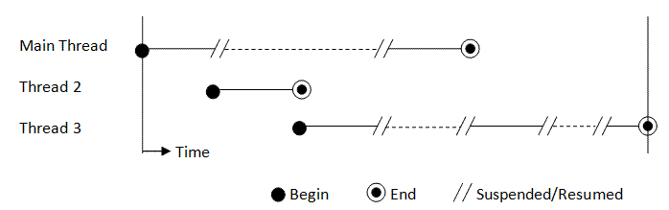
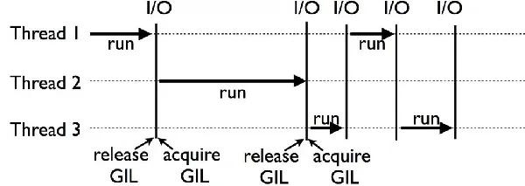

Slide 8
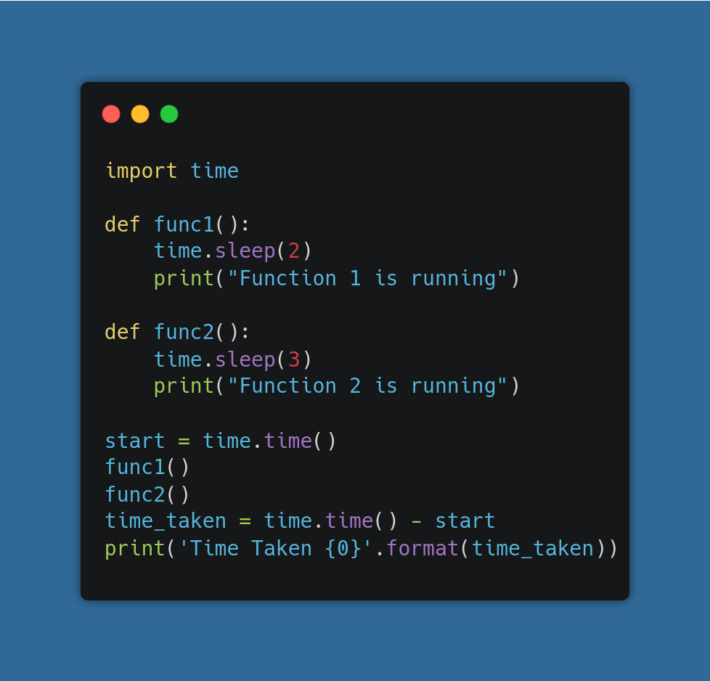
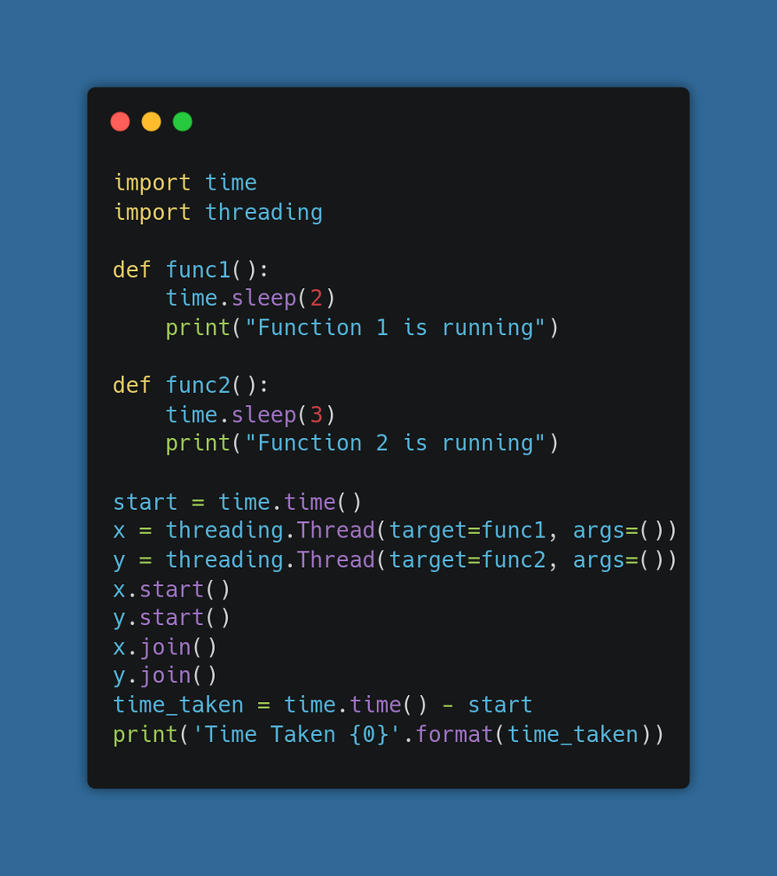
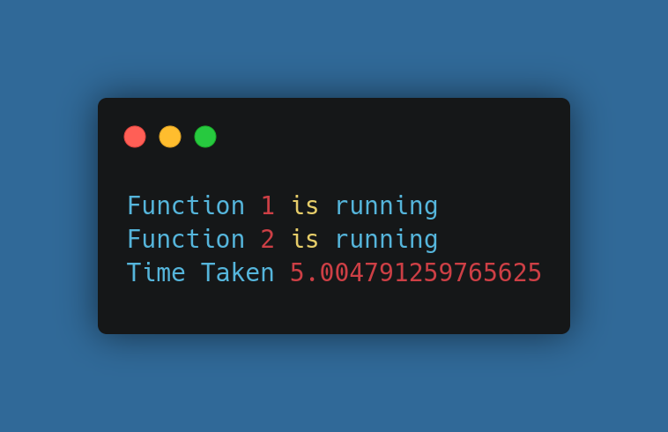
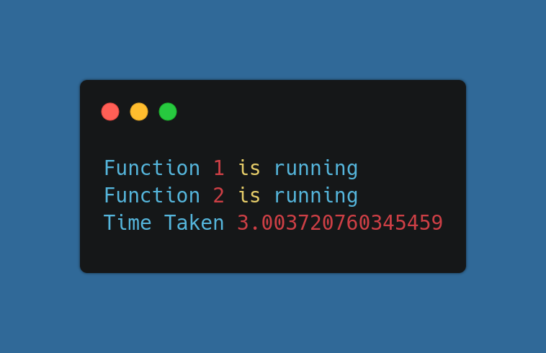

Slide 9
ASYNCHRONOUS PROGRAMMING
Asynchronous programming is a form of concurrency where tasks start and then move on without waiting for the previous task to finish.
It is useful in I/O bound operations (like file reading, making requests) where tasks don’t need to wait for other tasks to be completed.
It is achieved using Asyncio package and Aiohttp package for requests.

Slide 10
TASKS
SUBROUTINES
Tasks are a convenient way to manage multiple coroutines running concurrently, allowing us to track their progress and handle errors.
A subroutine is a reusable block of code which performs a specific task. It is also called function or method.
COROUTINES
EVENT LOOP
Used in asynchronous programming
Give away control when idle in order to enable multiple tasks to run simultaneously.
It manages and distributes the execution of multiple tasks. It runs continuously to check and execute tasks or events concurrently.

Slide 11
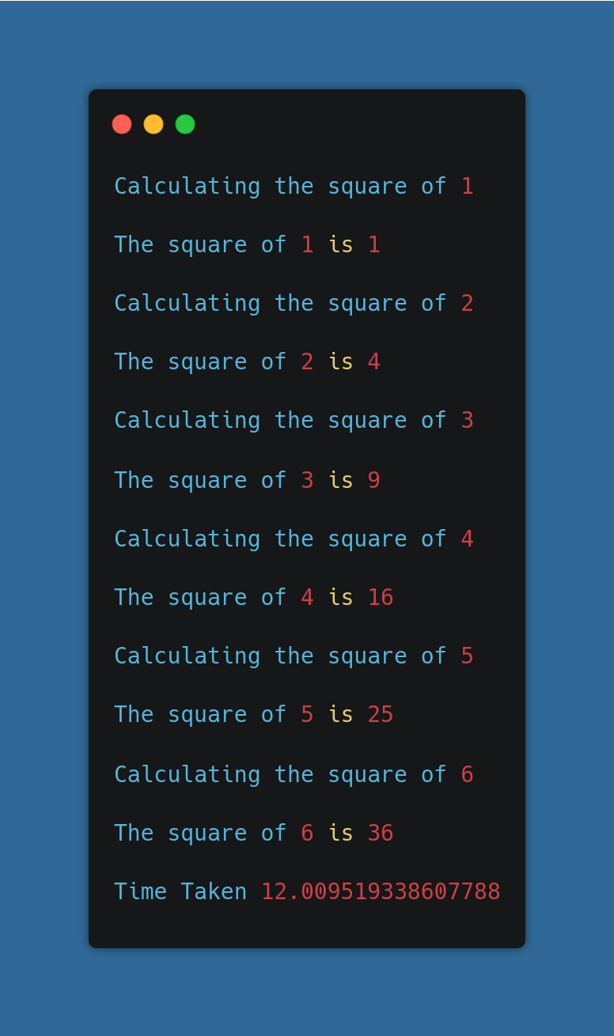
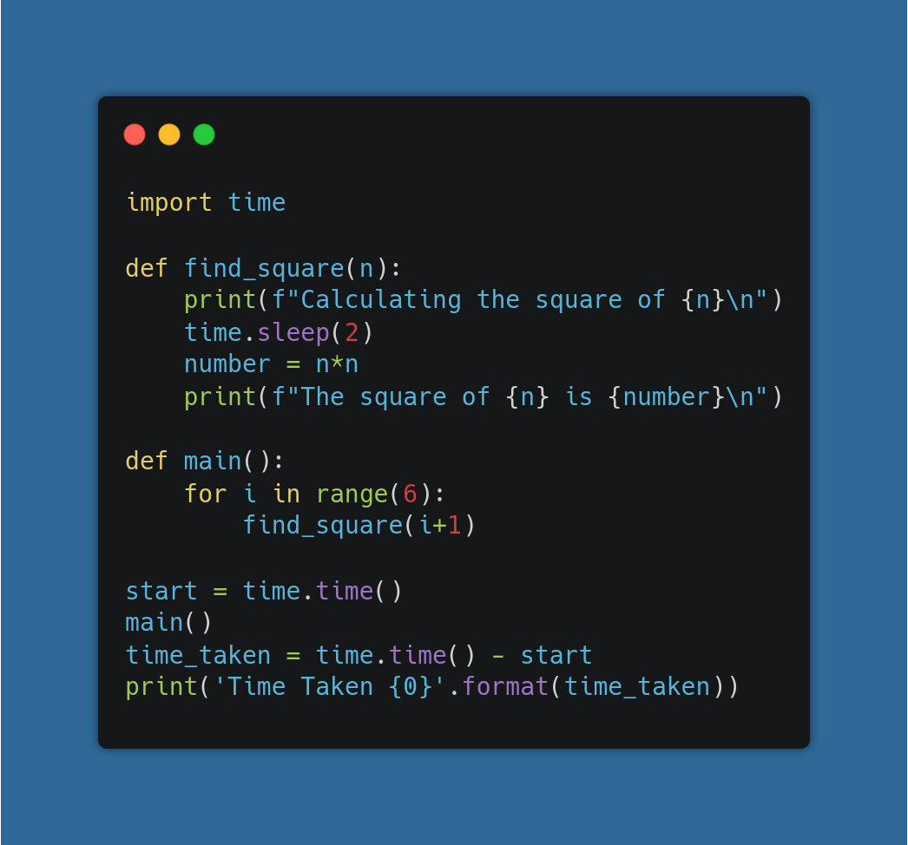

Slide 12
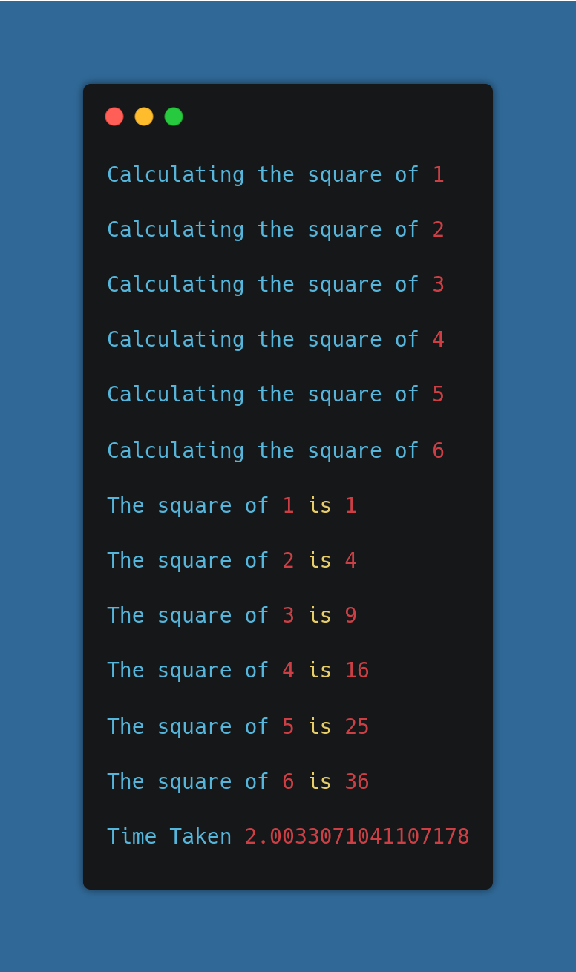
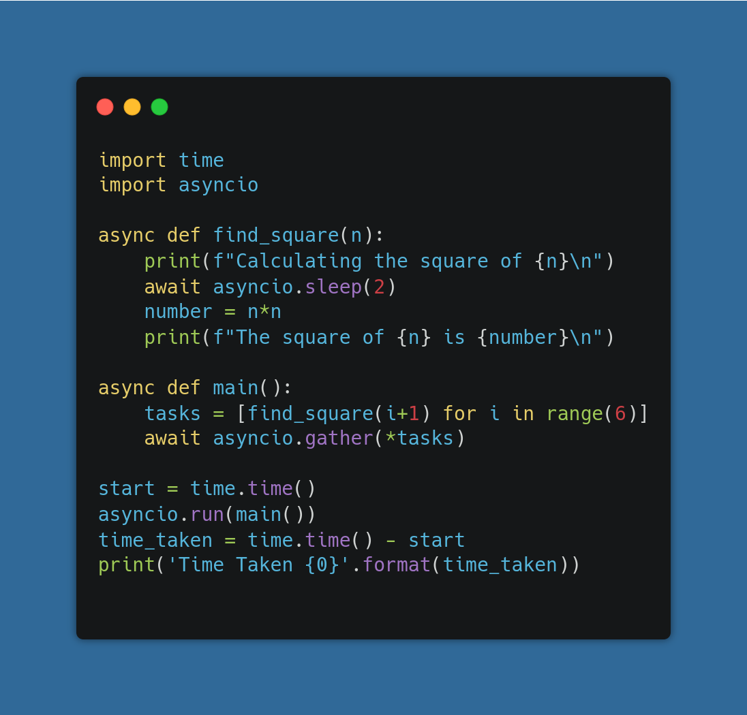

Slide 13
MULTITHREADING VS. ASYNCIO
MULTITHREADING
ASYNCIO
It uses multiple threads
In threading, we can’t determine when to run which code in which thread
Operating system decides when to run which thread
So, multithreading sometimes gives random results
It uses single thread
Asyncio achieves concurrency by cooperative multitasking
We decide which part of the code can be awaited, which then switches the control to run other parts of the code

Slide 14

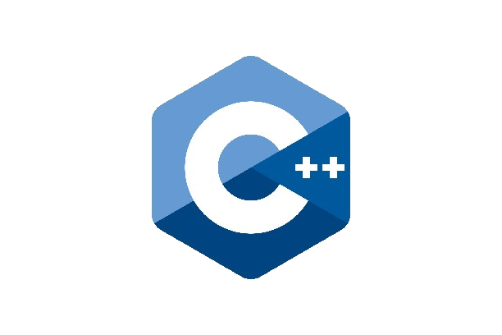

CONCURRENCY IN GOLANG VS. PYTHON VS. C++
UNDERSTANDING DIFFERENCES BETWEEN CONCURRENCY PARADIGMS IN PYTHON, GOLANG AND C++

Slide 15
Go has in-built concurrency and no GIL like in Python.
Go uses Goroutines, Waitgroups and channels to achieve concurrency.
Go routines are managed by the Go runtime while Python uses OS threads.
Due to GIL in Python, effectiveness of threading is limited in Python in CPU bound tasks, while Goroutines are effective in both CPU bound as well as I/O bound tasks.
Goroutines are lightweight and have lower overhead. So large number of goroutines can be created.
Python being OS threads, have higher overhead costs.

Slide 16
Also, efficient communication between goroutines is possible using channels.
Using mutexes, we can achieve partial synchronization in concurrent programs in Go and C++ to prevent data races and make sure that no two goroutines can access a variable at a given time.
C++ also does not have GIL.
In C++, the std::atomic library provides support for atomic operations. This library is primarily used for ensuring safe access and modification of shared variables in multithreaded programs without the need for explicit locking mechanisms such as mutexes.

Slide 17
REFERENCES:
https://medium.com/@suryanshshrivastava_75738/concurrency-asynchronous-programming-and-multithreading-724340dec4df#:~:text=Concurrency%20vs.,is%20waiting%20for%20some%20resource
https://www.analyticsvidhya.com/blog/2023/08/exploring-multithreading-concurrency-and-parallel-execution-in-python/
https://www.geeksforgeeks.org/multithreading-python-set-1/
https://www.educative.io/answers/how-to-create-an-asyncio-task
https://www.scaler.com/topics/golang/mutex-in-golang/
https://medium.com/@mansha99/concurrency-in-python-threads-and-locks-8daed86e92e6#:~:text=Concurrency%20is%20a%20mechanism%20that,Task1%20has%20completed%20its%20execution

Slide 18
THANK YOU

