Slide 1
What predicts a customer paying their first monthly fee?
DATA ANALYST TAKE-HOME · 09/10/2026
First-30-day behaviour of 5,000 customers who signed up in 2024
Damian Adamski · For the Head of Product and the Head of Data
Notes:
Thank the panel. The Product team asked which early behaviours predict whether a customer pays their first monthly fee. I'll give the answer first, then the evidence, then three recommendations and how to measure them. About 18 minutes, then questions.

Slide 2
Activation, allowance and family login drive first-fee collection
THE ANSWER UP FRONT
Q1 · BEHAVIOURS
Q2 · SEGMENTS
Q3 · RECOMMENDATIONS
Allowance and family login
Channel and platform, not plan tier
Three changes to test
Setting up an allowance (+25pp) and parent and child logging in together (+20pp) are the strongest signals. A declined card payment is the main warning sign (−12pp).
Referral customers pay most (77%), TikTok least (54%), and Web trails iOS by 8pp. The gaps hold after accounting for behaviour. Plan tier makes no difference.
Activation nudges, allowance and family login built into onboarding, and a top-up prompt after a declined payment, each run as an A/B test.
pp = percentage points. Behaviour figures use activated customers (n = 4,236), holding other factors equal.
Notes:
If you remember one slide, this is it. Q1: allowance and family login are the strongest behaviours, and a declined card payment is the main warning sign. Q2: where a customer comes from and which platform they use matter; the plan they choose does not. Q3: three changes, each tested properly before rollout. pp means percentage points: the straight difference between two percentages.

Slide 3
15% never activate their card, and none of them pay
THE FUNNEL
5,000 signed up
34%
84.7% activate their card
4,236 activated · 84.7%
of customers who didn't pay never activated their card (764 of 2,243).
65.1% of activated customers pay
Activation is its own lever. The behaviour analysis that follows uses the 4,236 activated customers.
2,757 paid · 55.1%
Data checked with 22 quality rules: clean apart from 4 inconsistent rows, kept and flagged (no effect on results).
Notes:
Before looking at behaviours, the funnel. 85% activate their card; of those, 65% pay. Nobody who failed to activate paid, so activation is a gate. That's why I analyse behaviours on activated customers only; otherwise every behaviour looks predictive just because it means the card was activated. It also means activation alone accounts for a third of all non-payers. On data quality: I ran 22 checks; everything passed except 4 rows where a family login was recorded without a parent login. I kept and flagged them; removing them changes nothing.

Slide 4
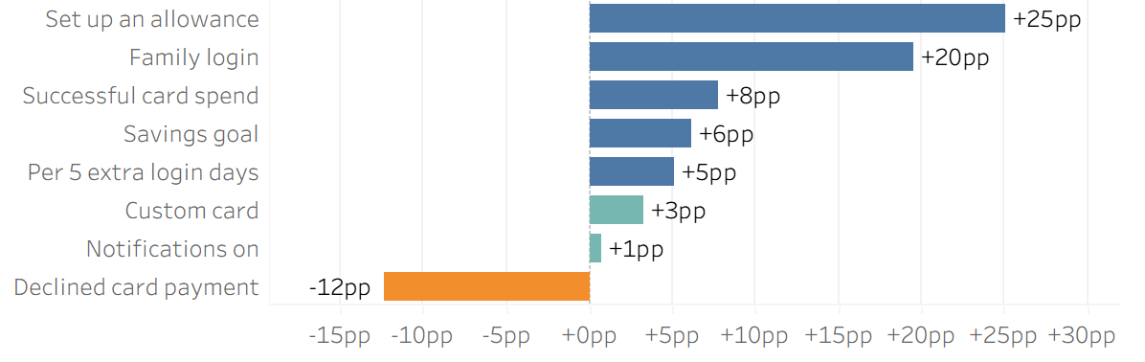
Allowance and family login matter most; declined payments hurt
BEHAVIOURS
Less likely to pay
More likely to pay
The amount of allowance doesn't matter, only having one.
could be chance
could be chance
Change in the chance of paying the first fee, holding the other behaviours, platform, tier and channel equal (logistic regression, activated customers, n = 4,236). Family login = parent and child both log in. Teal = not statistically significant.
Notes:
This is the main answer to question 1. Each bar shows how much more or less likely a customer is to pay when they do this behaviour, comparing customers who are otherwise alike. Setting up an allowance is linked to a 25 point higher chance of paying; parent and child logging in together, 20 points. A declined card payment is linked to 12 points lower. Two things don't matter: custom cards and notifications are grey because the difference could be chance. So turning on notifications is not a lever. If asked how: logistic regression with average marginal effects; the raw gaps tell the same story (allowance +27pp before adjusting).

Slide 5
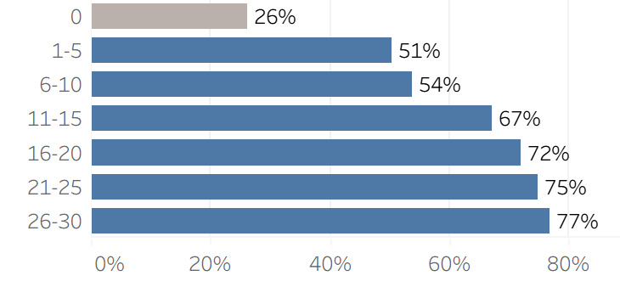
Families with both habits almost always pay
HABITS
Fee rate by allowance and family login
Fee rate by login days (first 30 days)
Family login
No family login
Only 46 users
94%
77%
Allowance
n = 419
n = 1,227
73%
49%
No allowance
n = 612
n = 1,978
Activated customers, n = 4,236. The two habits mostly add up rather than multiply.
Login days = the number of different days the parent logged into the app during their first 30 days.
Notes:
Two views of the same idea: habits build on each other. Left: families with both an allowance and a family login pay 94% of the time; with neither, 49%. That's the gap onboarding should close. Right: the more days a parent logs in during the first month, the more likely they pay, rising steadily from 50% to 77%. The 0-day group is only 46 people, so I don't read much into it. If asked about the interaction: the test was borderline (p = 0.05), so I describe the effects as adding up.

Slide 6
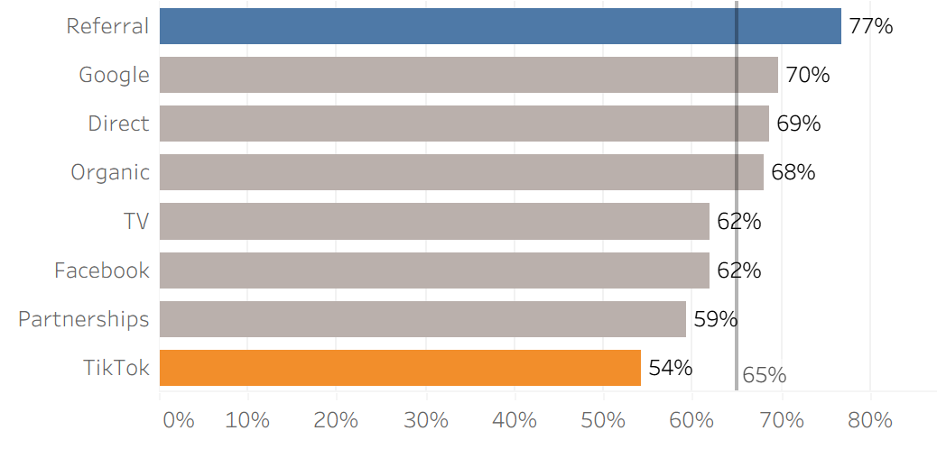
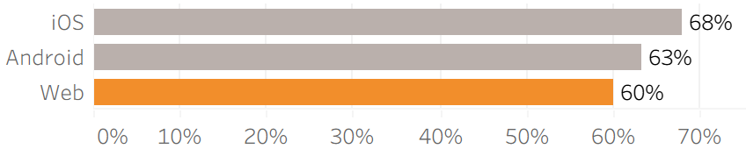
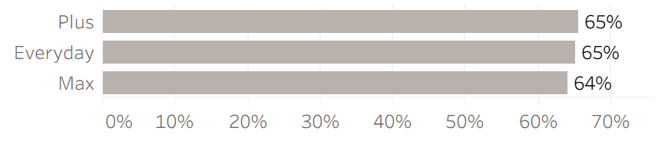
Channel and platform matter; plan tier does not
SEGMENTS
Fee rate by acquisition channel
Fee rate by platform
Fee rate by plan tier
no real difference
Activated customers; average 65%. Channel and platform gaps remain after accounting for behaviour (TikTok −14pp and Referral +8pp vs Organic; Web −8pp vs iOS).
Notes:
Question 2. Where a customer comes from matters: referral customers pay 77% of the time, TikTok customers 54%. Platform matters too: Web users trail iOS by 8 points. The important check is that these gaps are not just because these groups behave differently: customers from every channel set up allowances at about the same rate, and the regression shows the gaps remain after accounting for behaviour. So this is about who the customers are, likely intent, not what they do in the app. Plan tier makes no difference, which tells us non-payment is not about price tier. If asked: activation rates are about the same in every segment, so the gaps are in paying, not activating.

Slide 7
Three changes to test
RECOMMENDATIONS
1 · ACTIVATION
2 · ONBOARDING
3 · DECLINED PAYMENTS
Nudge customers to activate their card
Build allowance and family
login into onboarding
Prompt a top-up after a
declined payment
Why: 34% of non-payers never activated, and nobody pays without activating.
Why: the two strongest habits (+25pp, +20pp); 94% pay with both.
Why: the main warning sign (−12pp); 1 in 5 activated customers has a decline.
Test: card-arrived reminders and step-by-step activation help in the app.
Test: a pre-filled weekly allowance step and a prompt for the child's first login.
Test: a real-time alert to the parent with the reason and a one-tap top-up.
+1.8pp
+1.1pp
+0.4pp
of all signups paying (range +1.0 to +3.3pp)
of all signups paying (range +0.3 to +2.4pp)
of all signups paying (range +0.1 to +0.8pp)
Impact = extra first-fee payers as a share of all signups, central scenario. Assumes only part of each link is causal.
Notes:
Three recommendations, each tied to a finding. One: activation, the biggest lever because a third of non-payers never activate. Two: build the two strongest habits, allowance and family login, into onboarding. Three: when a child's card is declined, alert the parent with the reason and a one-tap top-up; a decline is the clearest warning sign. The impact numbers are deliberately cautious: I assume only part of each link is causal, because engaged parents tend to do everything. That's exactly why each one should be tested before rollout, which is the next slide. Also worth sharing with Marketing: channel quality, Referral vs TikTok.

Slide 8
Each change runs as an A/B test on first-fee collection
MEASURING SUCCESS
Element | What we measure
Primary metric | Share of all signups who pay their first fee (55% today)
Leading signals | Activation within 14 days · allowance set up within 7 days · top-up within 24h of a decline
Guardrails | Time to activate · support contacts · cancellations · second-month fee
Design | New signups split 50/50 at random; success rule agreed before launch
Customers needed per group
To detect +2pp
9,700
To detect +3pp
4,300
To detect +5pp
1,500
Baseline 55%, 95% confidence, 80% power.
Caveats: associations, not proven causes · fee timing and reasons for failed fees to confirm · dummy data. Next: an early-warning score at day 7 to target these interventions.
Notes:
How we'd know it worked. The primary metric is the share of ALL signups who pay their first fee, not just activated customers, so that a change which affects activation is still counted. Leading signals tell us early whether the change is doing what we expect. Guardrails make sure we're not just moving the problem, for example people paying month one but cancelling in month two. Sample size: to detect a 3 point uplift we need about 4,300 customers per group. Caveats: these are associations, which is why we test; I've asked about fee timing and why fees fail. Next step: an early-warning score at day 7 so we can target the nudges at the customers most at risk.

