Slide 1


Slide 2
Integration and Authentication
“
”
Mark Lassau
Team Lead, JIRA Engine Room

Slide 3
Engine Room Team
  Work on JIRA's core
  DB, performance, Business Logic…
  Maintain the JIRA Service API
  Build the JIRA REST API

Slide 4
Integration and Authentication
“
”
Talking to external applications from your plugin
Dealing with OAuth
Non-Atlassian applications
Custom Authentication schemes

Slide 5
Introduction to Application Links
“
”

Slide 6
Introduction to Application Links
  What is “Application Links”?
    a.k.a “App Links”, APL, UAL (Unified App Links)
    By itself – nothing – just an enabling library
    Helps you write plugins that can talk to external systems

Slide 7
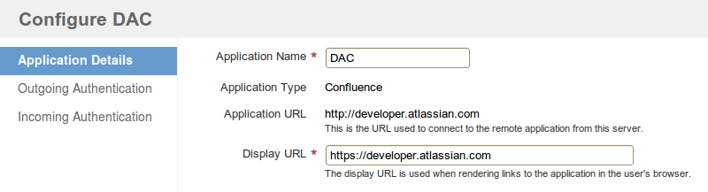
Introduction to Application Links
  Common configuration UI
    Consistent look and feel
    Shared configuration makes administration easier
    One less thing for plugin devs to write

Slide 8
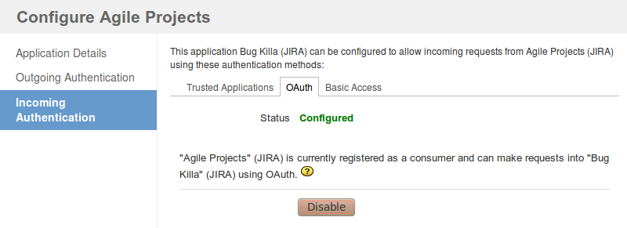
Introduction to Application Links
  What else do we get?
    Out of the box Authentication providers
    Factories to help plugins make authenticated remote requests
    Modular and extendable

Slide 9
Using Application Links in a plugin
“
”

Slide 10
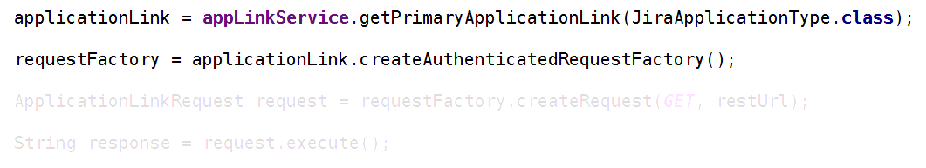
Using App Links in a Plugin
Show me the code!
    Use the ApplicationLinkService to get an ApplicationLink
    Get a RequestFactory that will add appropriate authentication data

Slide 11
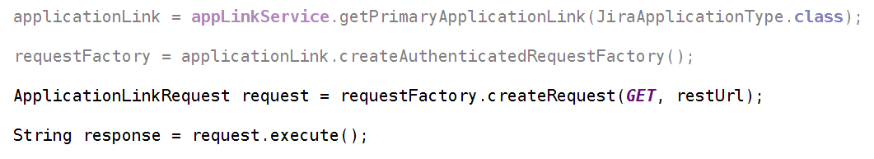
Using App Links in a Plugin
How easy is this?
    Create your HTTP request
    Execute it and parse the results!

Slide 12
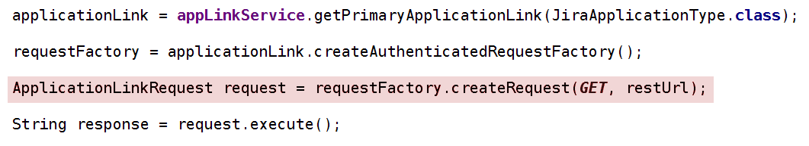
Using App Links in a Plugin
Except …
… the CredentialsRequiredException
    If we are not able to authenticate yet
    This is mostly about OAuth

Slide 13
Authentication in App Links
“
”

Slide 14
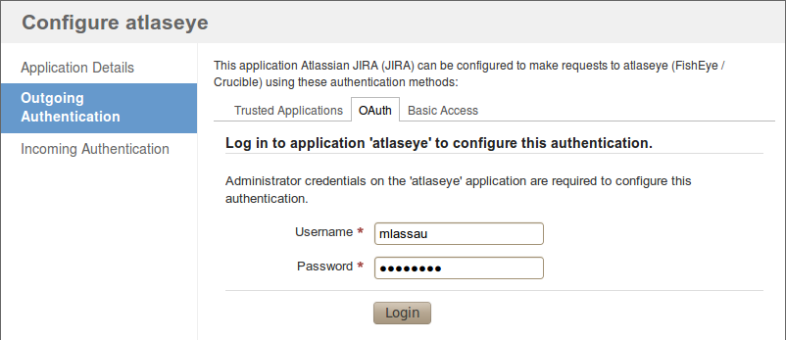
Authentication in App Links
  Configuring Authentication methods
    The admin sets up zero or more authentication providers
    Plugins usually accept “preferred” method, but can request a specific one

Slide 15
Authentication in App Links
  Available Authentication providers
    Basic Authentication
    Trusted Applications
    OAuth
    (+ Custom Authentication Providers)

Slide 16
Authentication in App Links
  Basic Authentication
    Basic Auth sends a weakly encoded user/pass with every request
    Single credentials shared with all users
    Send every request over HTTPS to secure it

Slide 17
Authentication in App Links
  Basic Auth – the Good
    Simple to configure
    You may want to use shared credentials?

Slide 18
Authentication in App Links
  Basic Auth – the Bad
    Shared credentials
    Storing passwords is bad, mkay?

Slide 19
Authentication in App Links
  Trusted Applications
    Atlassian proprietary protocol
    Provides “impersonating” authentication
    Assumes the user bases are exactly the same in both apps

Slide 20
Authentication in App Links
  Trusted Apps – the Good
    Respects users privileges on external app
    Doesn't require a shared password
    No further authorisation required by users
    No special code required by plugins

Slide 21
Authentication in App Links
  Trusted Apps – the Bad
    Will only connect to other Atlassian applications
    Only works for shared userbases

Slide 22
Authentication in App Links
  OAuth
    Standards-based authorisation protocol
    Provides “impersonating” authentication
    Allows a user to grant third party access to external resources without sharing their password

Slide 23
Authentication in App Links
  OAuth - the Good
    Standard protocol used by many 3rd party systems
    No storing of foreign passwords
    Allows disparate user bases
    User can grant and revoke access to their resources

Slide 24
Authentication in App Links
  OAuth - the Bad
    User must explicitly grant access to their resources
    Plugins must implement the UI logic to gain access

Slide 25
A bit about OAuth
“
”

Slide 26
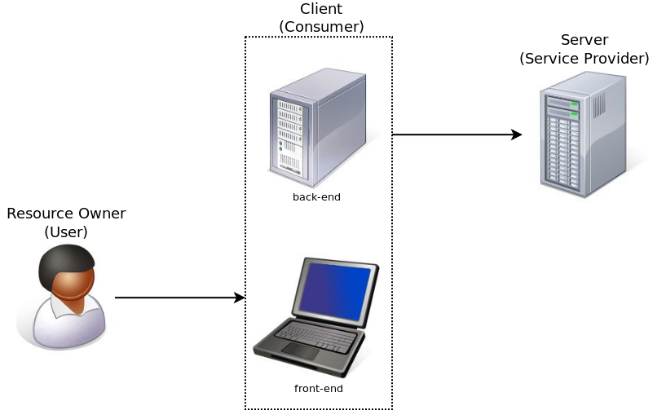
A bit about OAuth
  Three-Legged OAuth
  (the “OAuth Love Triangle”)

Slide 27
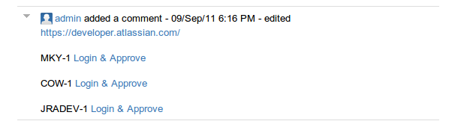
A bit about OAuth
  The OAuth Dance
  User has not approved access yet

Slide 28
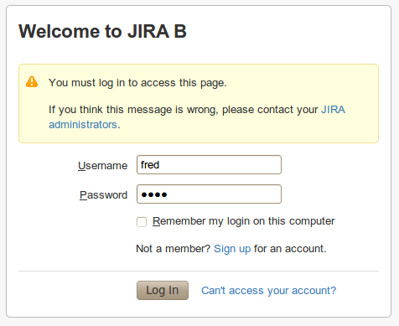
A bit about OAuth
  The OAuth Dance
  User must authenticate with the remote application

Slide 29
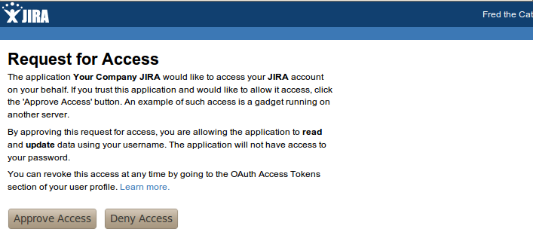
A bit about OAuth
  The OAuth Dance
  User grants the “client” access to her resources on the remote application.

Slide 30
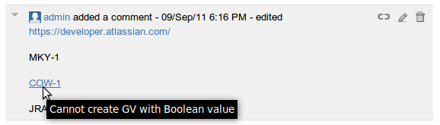
A bit about OAuth
  The OAuth Dance
  The first application can now access data from the remote application.

Slide 31
A bit about OAuth
  The OAuth Dance – behind the scenes
    Client gets temporary request token from Server
    Client redirects User to the Server with the request token
    User authenticates with Server
    Users grants access to resources and is redirected back to Client
    Client exchanges request token for Access Token
    Client can now access resources on Server on behalf of User!

Slide 32
Doing the OAuth Dance
“
”
  Back to writing our plugin

Slide 33
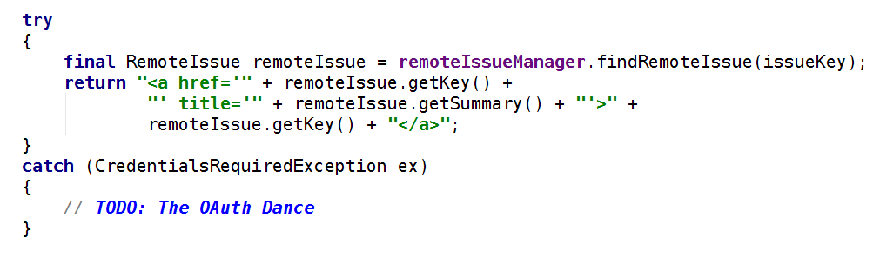
Doing the OAuth Dance
  The happy path
    Retrieve remote data and display to user

Slide 34
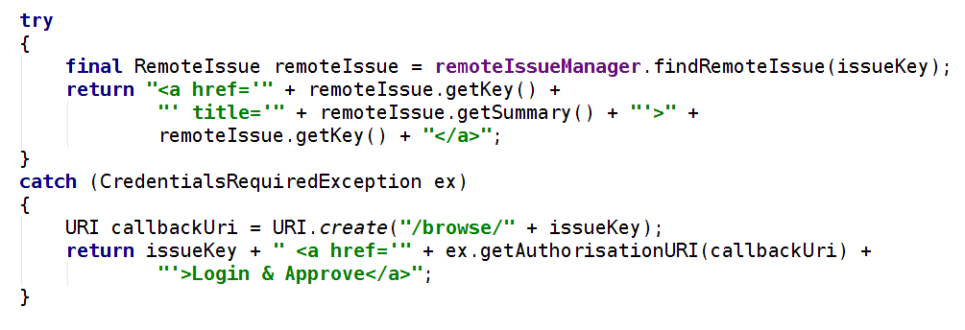
Doing the OAuth Dance
  Dealing with CredentialsRequired
    We need to send the user to the remote server
    We supply a callback URL to come back to us when they are finished

Slide 35
“
Custom Application Types
”
  Connecting to non-Atlassian Apps

Slide 36
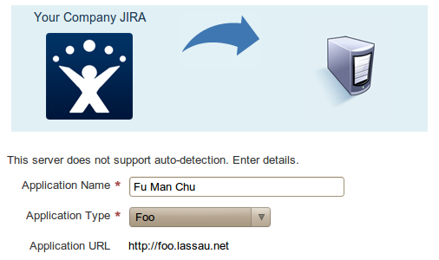
Creating a custom Application Type
  Why Create a Custom Application Type?
    Simpler more professional configuration

Slide 37
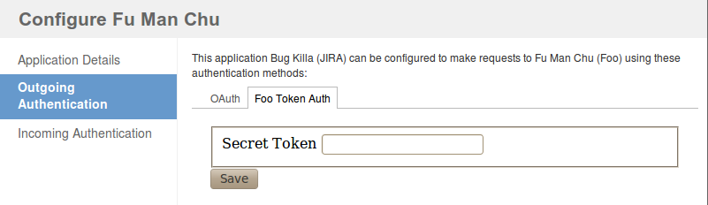
Creating a custom Application Type
  Why Create a Custom Application Type?
    Control the available Authentication Providers
    Can use custom Authentication Providers

Slide 38
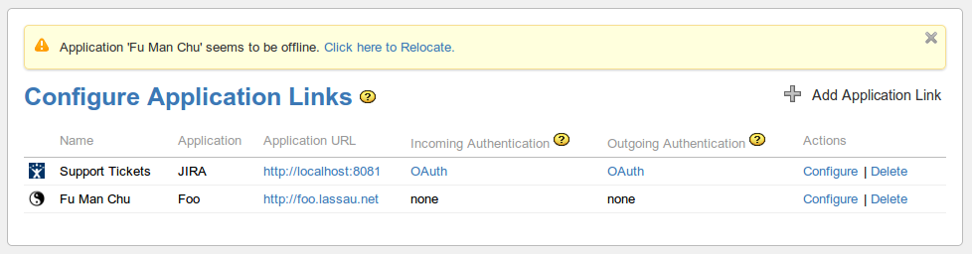
Creating a custom Application Type
  Why Create a Custom Application Type?
    More professional look
    Implement the heartbeat ping

Slide 39
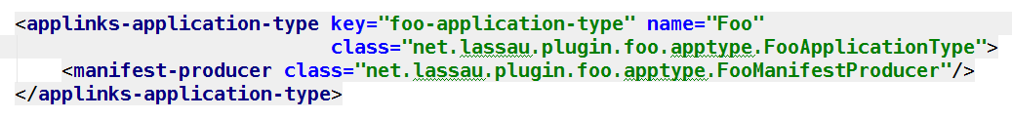
Creating a custom Application Type
  atlassian-plugin.xml

Slide 40
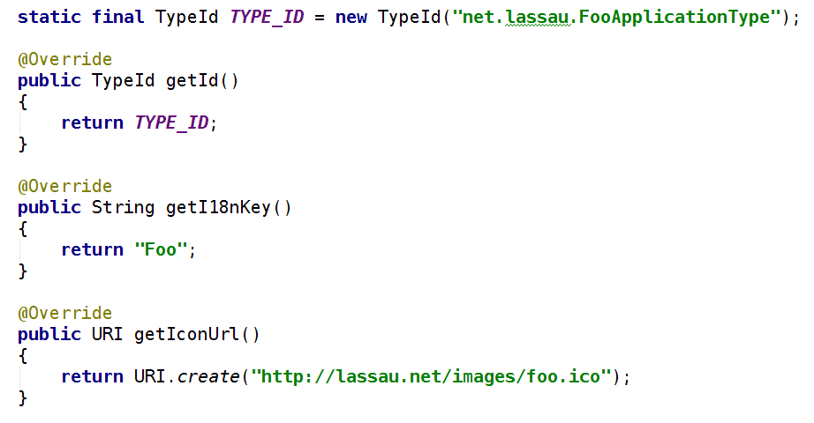
Creating a custom Application Type
  Implement ApplicationType

Slide 41
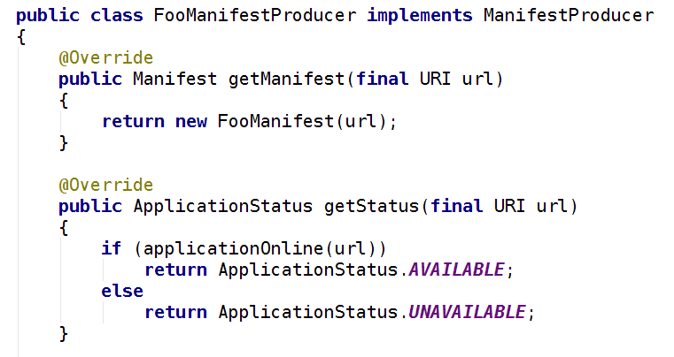
Creating a custom Application Type
  Implement ManifestProducer...

Slide 42
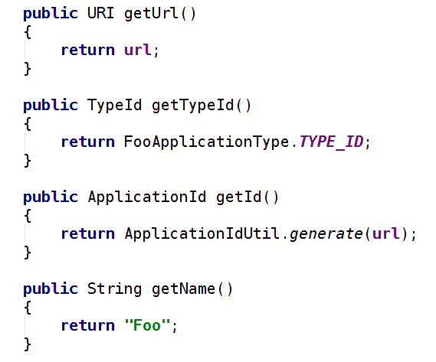
Creating a custom Application Type
Implement Manifest …

Slide 43
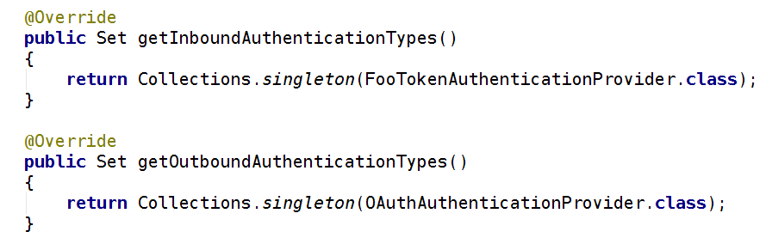
Creating a custom Application Type
Implement Manifest … authentication types

Slide 44
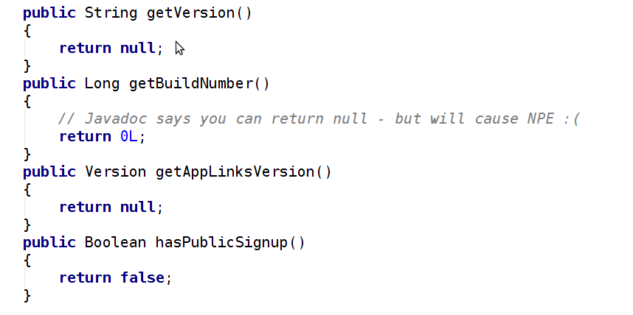
Creating a custom Application Type
Implement Manifest … mostly boilerplate

Slide 45
“
”
Custom Authentication Providers

Slide 46
Creating a custom Authentication Provider
  atlassian-plugin.xml

Slide 47
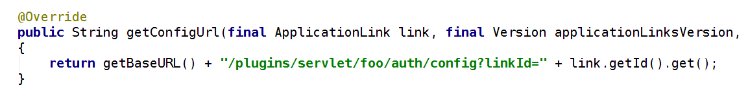
Creating a custom Authentication Provider
AuthenticationProviderPluginModule - Custom UI

Slide 48
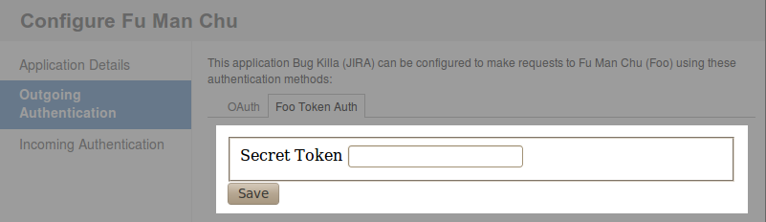
Creating a custom Authentication Provider
  Custom config is inserted as an iframe

Slide 49
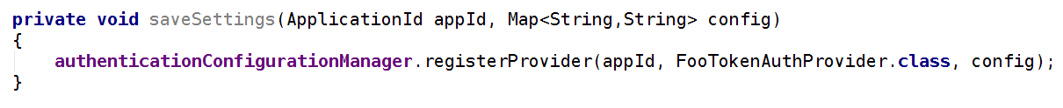
Creating a custom Authentication Provider
  Storing the configuration settings
    AuthenticationConfigurationManager is provided for you
    Stores and retrieves arbitrary configuration

Slide 50
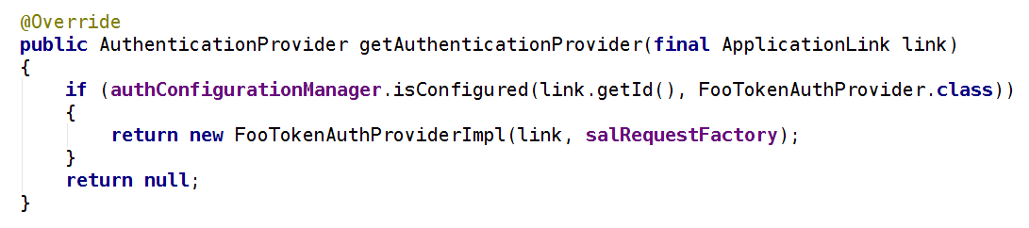
Creating a custom Authentication Provider
AuthenticationProviderPluginModule
    Creating an authentication provider
    We are going to use the SAL RequestFactory as a helper

Slide 51
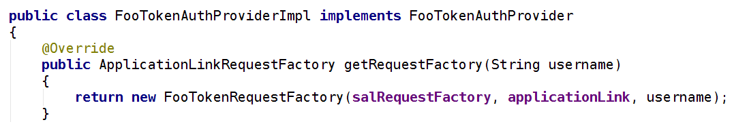
Creating a custom Authentication Provider
AuthenticationProvider
    Returns a RequestFactory that will add authentication data
    Can be “impersonating” or “non-impersonating”
    Wrapping the SAL RequestFactory makes life easy

Slide 52
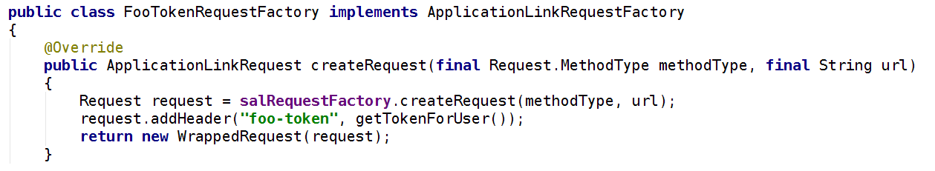
Creating a custom Authentication Provider
ApplicationLinkRequestFactory
    Use SAL RequestFactory to create a vanilla request
    Add headers (or whatever) in order to add authentication info

Slide 53
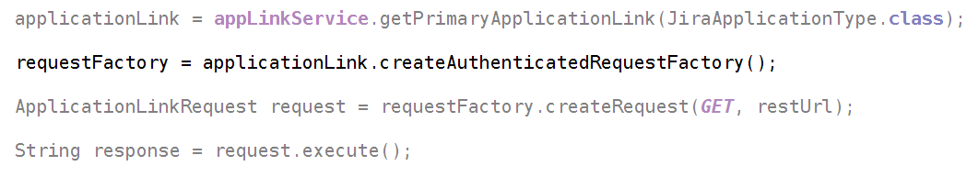
Creating a custom Authentication Provider
  The circle is complete!
    Remember the old “authenticated request factory”?

Slide 54

App Links makes talking to external servers easy
OAuth is not as scary as it sounds
Specialist Application Types can be created
We can handle any authentication scheme
”

Slide 55
Thank you!

Slide 56
More Reading
Application Links Documentation
http://confluence.atlassian.com/display/APPLINKS/
App Links Developer docs
https://developer.atlassian.com/display/APPLINKS/
Example Twitter App Link
http://blogs.atlassian.com/developer/2011/06/unified_applinks_integration_without_the_hassle_-_part_1.html
OAuth 1.0 Guide
http://hueniverse.com/oauth/

