Slide 1
CAPSTONE PROJECT
Presentation For Capstone
“App quản lý công ty BĐS”
Team 3: Hello World
Mentor: Đặng Đình Hòa

Slide 2
1.
Team introduction
Agenda
Agenda
2.
Project overview.
3.
Monitoring & control.
4.
Architectural.
5.
Summary test report.
6.
Problem project
7.
Lesson learned & Demo.

Slide 3
1. TEAM INTRODUCTION
LOGO TEAM
STAKEHOLDERS
Name | Role
Mr. Trần Minh Châu | Customer
Mr. Nguyễn Hữu Nhật | Customer

Slide 4
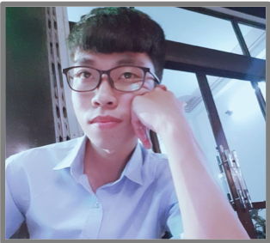
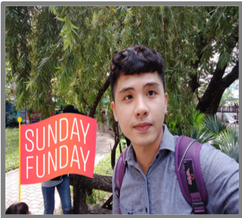
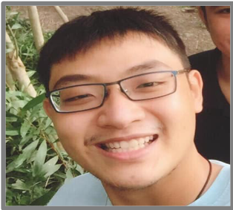

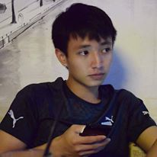
TEAM MEMBER
Huỳnh Tuấn Đạt
Trương Quang Vương
Phạm Quốc Nhân
Trịnh Nhu Phương
Nguyễn Anh Minh
CODER
CODER
DESIGNER
TESTER
CODER
4

Slide 5
2. Project overview
Project introduction
Currently, housing demand is a big problem for people across the country, so homeowners are looking to provide housing through real estate applications.
Real Estate App, built for internal users to manage projects, manage statistics, reports and many other functions.
The App also helps employees know more about essential information about the real estate industry such as real estate projects, employee sales, group and room sales.
5

Slide 6
2. Project overview
Number of people in the company
Stakeholders | Number of people
Director | 1 people
Department Heads | ~10 people
Administrator | ~1 people
Employees | ~150 people
Deputy department | ~5 people
6

Slide 7
2. Project overview
Business constraints
# | Business Rules | Business Rules
1 | BR1 | When employees leave, the account will be hidden.
2 | BR2 | Staff only view and register applications
3 | BR3 | Only the administrator can update the information
4 | BR4 | Only director can approve employee applications
5 | BR5 | Unapproved applications will be canceled and not saved in history
6 | BR6 | Admin to update information continuously or when there is information from leaders and departments
7 | BR7 | Admin cannot use App Mobile to import files, etc.
7

Slide 8
2. Project overview
Technical constraints
System: | Programming language App: | Programming language Website: | Database:
Website (browser: Firefox, Chrome, Cốc cốc,..) | Code: Javascript | Code: javascript | Database: Firebase
App (platform: Ios & Android). | Framework: React native | Framework: Vuejs | Document: github
 |  |  | Communication: zalo and facebook
8

Slide 9
2. Project overview
Technical constraints
System: | Programming language App: | Programming language Website: | Database:
Website (browser: Firefox, Chrome, Cốc cốc,..) | Code: Javascript | Code: javascript | Database: Firebase
App (platform: Ios & Android). | Framework: React native | Framework: Vuejs | Document: github
 |  |  | Communication: zalo and facebook
9

Slide 10
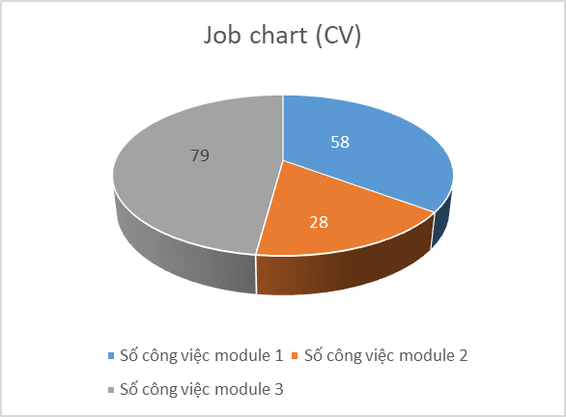
3. Monitoring & control
Job chart
Total work for module 1 | 58
Total work for module 2 | 28
Total work for module 3 | 79
10

Slide 11
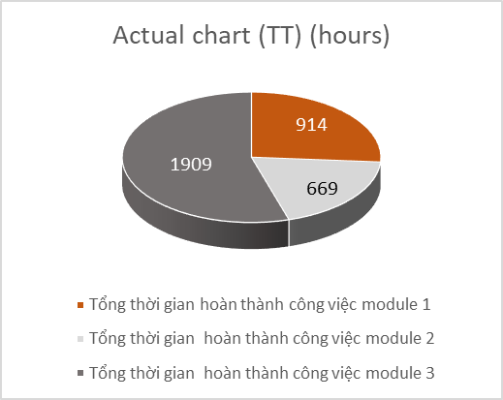
3. Monitoring & control
Actual chart (TT) (hours)
Total actual time of module completion 1 | 914 hours
Total actual time of module completion 2 | 669 hours
Total actual time of module completion 3 | 1909 hours
11

Slide 12
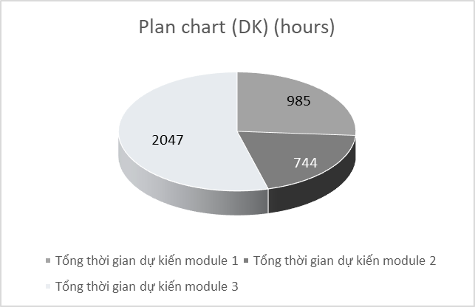
3. Monitoring & control
Plan chart (DK) (hours)
Total actual time of module completion 1 | 985 hours
Total actual time of module completion 2 | 744 hours
Total actual time of module completion 3 | 2047 hours
12

Slide 13
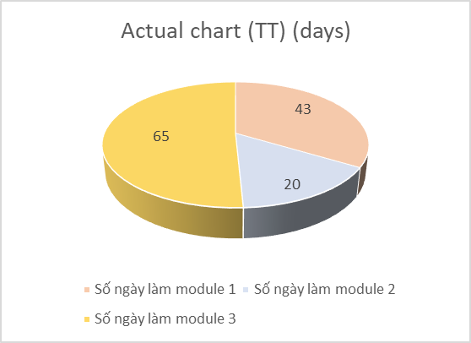
3. Monitoring & control
Actual chart (TT) (days)
Total actual time of module completion 1 | 43 day
Total actual time of module completion 2 | 20 day
Total actual time of module completion 3 | 65 day
Deducted 3 weeks for Tet holidays and 2 weeks for epidemic breaks
13

Slide 14
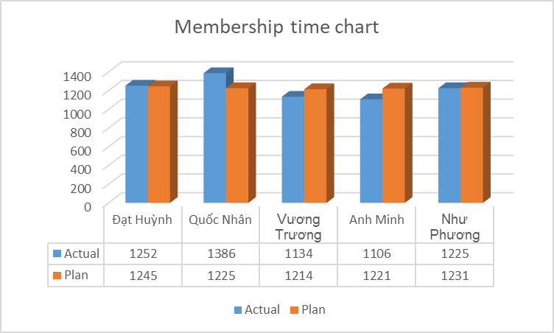
3. Monitoring & control
Membership time chart
Total time each member worked in 32 weeks
14

Slide 15
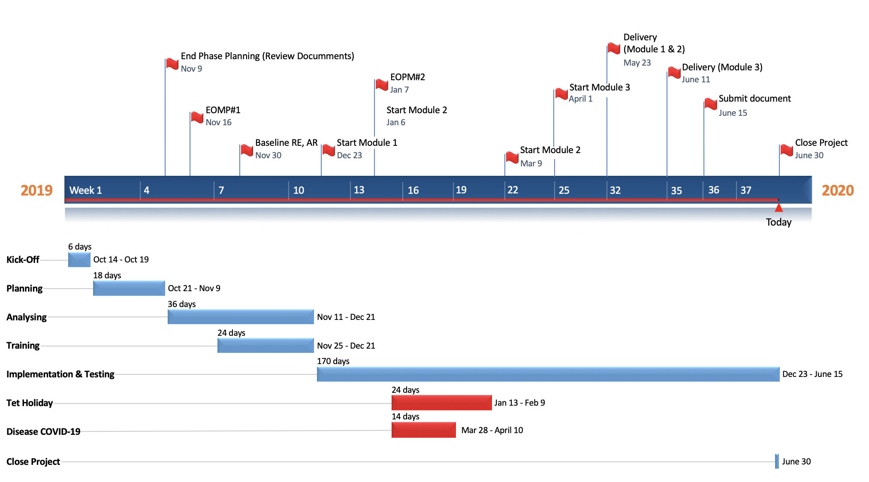
3. Monitoring & control
15

Slide 16
4. Architectural
# | ID | Quality Attributes | Priority
Usability
1 | QA1 | Users use the app to easier | High
Portability
2 | QA2 | Users can use the application on two platforms | High
16

Slide 17
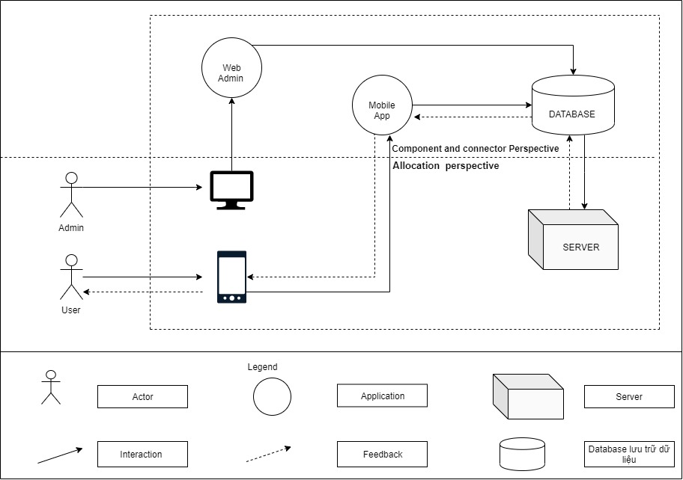
4. Architectural
Context diagram
17

Slide 18
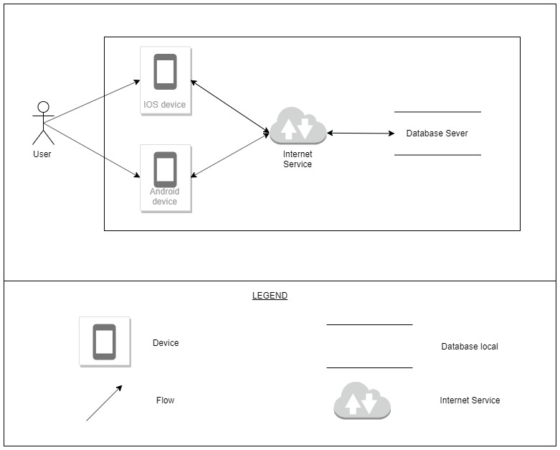
4. Architectural
Protability (physics)
18

Slide 19
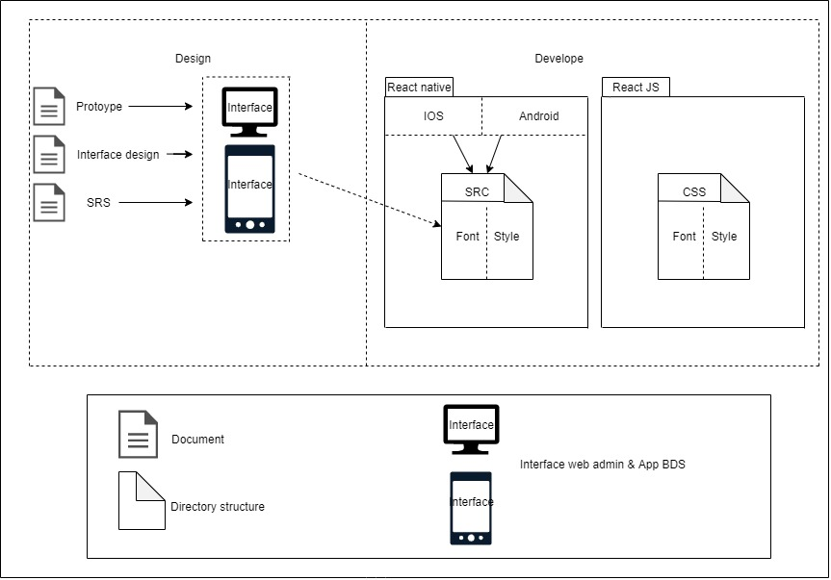
4. Architectural
Usability (static)
19

Slide 20
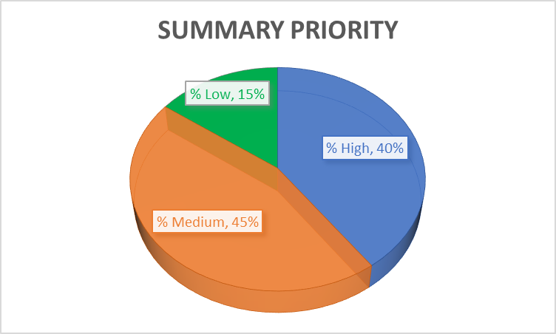
5. Summary test report.
Summary priority
20

Slide 21
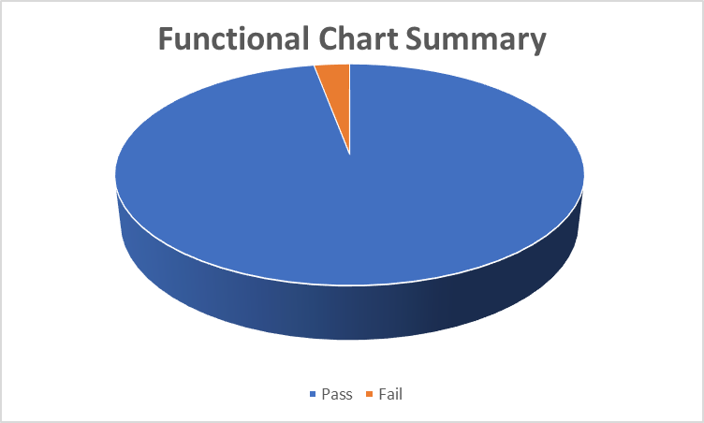
5. Summary test report.
Summary priority
Summary
Pass | 364
Fail | 11
Number of test cases | 375
21

Slide 22
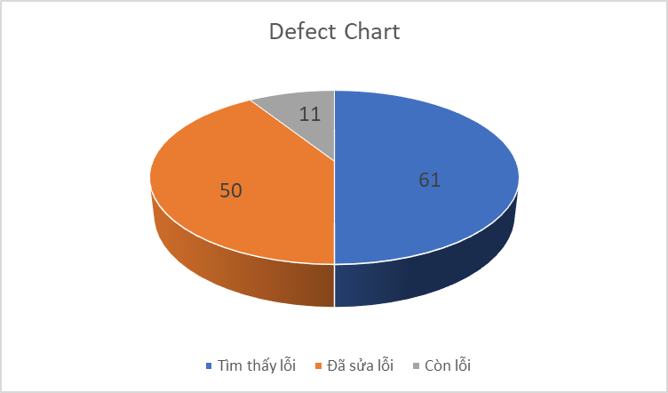
5. Summary test report.
Summary priority
Summary
Enforcement | 100%
Error found | 61
Corrected the error | 50
Error still | 11
22

Slide 23
6. Problem project
Number | Problem name | Possibility | Impact | Impact factor | How to fix
1 | Language code | High (occurred) | High | Objective | Spend much time for search (Forum, youtube, google, group facebook, question mentor, …)
2 | Database (firebase) | High (occurred) | High | Objective | Spend much time for search (Forum, youtube, google, group facebook, question mentor, …)
3 | Change requirement | Medium (occurred) | Medium | Objective | Contract signed (increased time)
4 | Disease cov19 | High (occurred) | High | Objective | Meeting online
23

Slide 24
8. Lesson learned & Demo.
Lesson learned
Kiến thức – kĩ năng
1 | Design - Hiểu biết sâu hơn về design. Có kiến thức thêm về làm dự án thực tế
2 | Code - Có thêm kiến thức mới về ngôn ngữ lập trình và kinh nghiệm làm dự án thực tế
3 | Test - Hiểu được tầm quan trọng của tester và cũng có được trải nghiệm thực tế
Teamwork
1 | Nhóm làm teamwork rất tốt không có gặp khó khăn.
2 | Mỗi người đều có trách nhiệm và ý thức không đun đẩy công việc
3 | Có những hoạt động xa đọa để nâng cao tinh thần đồng đội
24

Slide 25
8. Lesson learned & Demo.
25

Slide 26
THANK YOU

