Slide 1

Cellular Automata and Sequential Forward Search: A Frontier in Image Analysis Damian Rozpedowski

Slide 2
Abstract
This presentation delves into the innovative use of Cellular Automata (CA) for enhancing image processing tasks, focusing on noise reduction, thinning, and convex hull computation. It emphasizes the integration of the Sequential Floating Forward Search (SFFS) method, which automates rule generation for CA, significantly improving efficiency and reducing manual labor. By modifying the traditional CA with new rule classes and a dual-cycle operational mode, the study achieves refined performance in image analysis. It also explores the use of genetic algorithms and co-evolutionary strategies, which optimize the CA's functionality further, demonstrating their potential in handling complex image processing scenarios more effectively than conventional methods. The research findings suggest that these advanced techniques allow for a high degree of adaptability and precision, making them suitable for a broad spectrum of applications in digital image processing.

Slide 3
Introduction
Cellular Automata
This paper explores training cellular automata (CA) to handle various image processing tasks. Think of CA as grids where each cell follows rules based on its neighbors, like a game board. This technique has been used to study complex behaviors like chaos and pattern formation.
Cellular Automata (CA) are discrete dynamical systems consisting of a grid of cells. (Rosin, 2006)
Each cell has a finite number of possible states and updates synchronously based on its neighborhood's previous states. (Rosin, 2006)
CA are often represented by rule tables that determine cell states based on neighborhood configurations. (Rosin, 2006)
Widely used in modeling phenomena like ordering, chaos, and symmetry-breaking across various fields like physics, biology, and sociology. (Rosin, 2006)
Image Processing Overview
Vital for enhancing, analyzing, and manipulating digital images.
Widely used in medical diagnostics, entertainment, and various applications.
Understanding Image Noise
Noise: Random pixel variations distorting image clarity.
Types: Salt and pepper noise and gaussian noise.
Importance of Noise Reduction
Crucial for accurate analysis and interpretation of visual data.
Ensures image quality and facilitates subsequent processing tasks.

Slide 4
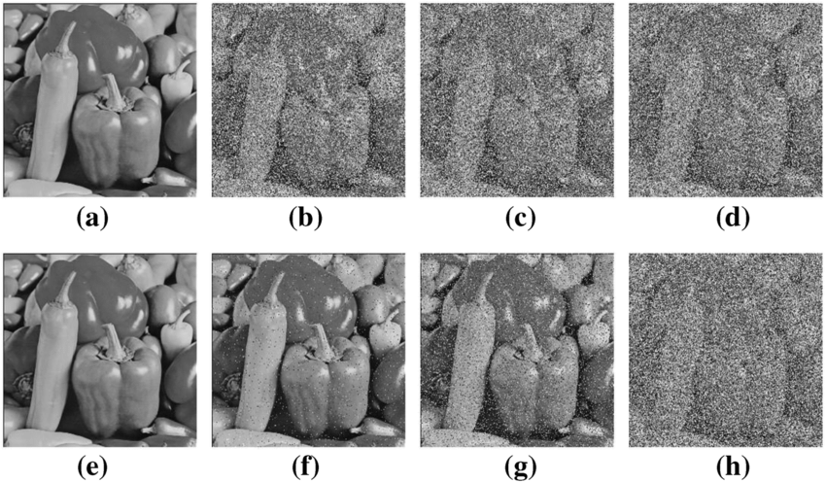
INTRODUCTION
Image Noise Types
Salt and Pepper Noise: Characterized by randomly occurring white and black pixels, simulating "salt" and "pepper" sprinkled on an image.
Gaussian Noise: Represents a random distribution of pixel intensity values, commonly encountered in digital imaging.
Challenges in Image Processing
Preserving Image Details: Traditional noise reduction methods like median filtering may blur or distort fine image features.
Thinning: Thinning algorithms reduce object thickness in binary images.
Convex Hulls: Identifying the smallest convex shape encapsulating a set of points aids in shape analysis, object recognition, and computer vision tasks.
Gaussian noise (a–d), salt and pepper noise (e–f) results. a No Gaussian noise; b Variance is 0.0001; c Variance is 0.003; d Variance is 0.0005; e No salt and pepper noise; f Density is 0.01; g Density is 0.05; h Density is 0.25. (Zheng, Luo, and Qingxia, 2020).

Slide 5
BACKGROUND
Filtering salt and pepper noise in images has been approached using methods like median filtering, which replaces pixel values with the median value of neighboring pixels. Cellular Automata (CA) present a unique approach by using rule sets to process images. This offers potential improvements in noise reduction.
The standard CA formulation involves rules that determine the state of a cell based on its neighbors.
The B-rule modification refines standard CA behavior by introducing additional conditions for determining cell states based on neighboring cells' states. This improves accuracy.
The 2-cycle CAs modification updates between iterations. This enhances noise reduction and image quality.
Advantages of Cellular Automata (CAs):
Simple rules at the cell level.
Local interactions lead to sophisticated global behavior.
Enables complex patterns and dynamics to emerge. Disadvantages of CA Systems:
Manual effort needed to generate rules.
Tedious and impractical for larger and more complex problems. (Rosin, 2006)
Recent developments for automating rule generation was done by using evolutionary algorithms by iteratively refining rule sets based on predefined objectives. Additionally, advancements in machine learning have also contributed to the development of training methods for Cellular Automata.

Slide 6
BACKGROUND
Manual Rule Specification: This involves the creation of rules for the automaton (CA) by hand. It is a kind of write-up giving instructions on how changes of the cells in the automaton should be carried out over time. This is, however, delicate because there are so very many ways that the rules combine, making it impracticable for the complex CAs. Usually, this kind of method gets used in simple cases where a small number of rules lead to the goal.
Evolutionary Methods: These work better in the issue of figuring out how to automatically create the rules in CAs. These methods mimic how evolution works in nature. It basically starts from a population of potential rule sets and then does selection, recombination, and mutation on it. This could thus make them good candidates for jobs like sorting the various patterns of CAs according to the density with which they get filled out, but also problems of similar patterns and dealing with large data.
Sequential Floating Forward Search (SFFS): This is a simpler method for learning rules in CAs. It's known for being easy to use and quick at picking out the right rules. SFFS works by trying out rules one by one and seeing if they make things better. If a rule helps, it stays; if not, it's taken out. This process repeats until adding more rules doesn't improve things anymore. SFFS is popular because it's straightforward and good at figuring out which rules matter most in a CA.

Slide 7
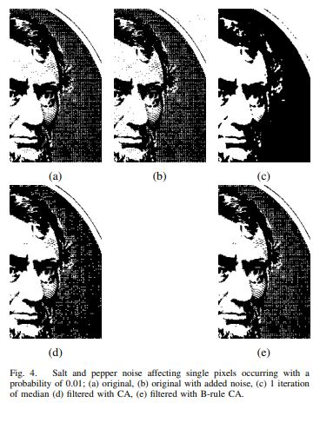
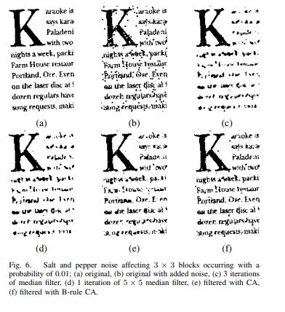
Defining the problem – Manual Rule Generation for Cellular Automata
This problem involves very important tasks in the realm of feature extraction and shape analysis for applications related to image processing: noise reduction, thinning, and convex hull computation in digital images. Traditional methods applied to these tasks can suffer from accuracy or computational efficiency shortcomings. This fact is leading us to explore alternative approaches like Cellular Automata (CA). One key challenge in this area is the human labor involved in creating the rules for CA systems. Very often, such rules are very tedious and don't scale well to larger problems or to more complex image processing tasks.
The figures on the right are taken from (Rosin, 2006)

Slide 8
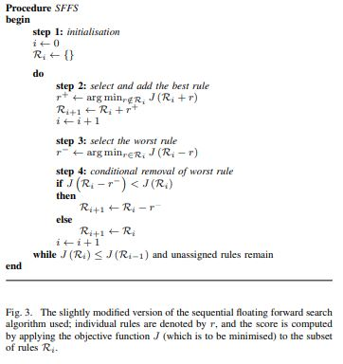
Defining the problem – Manual Rule Generation for Cellular Automata
There are a variety of ways to reduce manual effort in image processing, one such instance being the use of Sequential Forward Floating Selection (SFFS). This method is highly valued for its simplicity and efficiency. SFFS is straightforward to implement and offers a good balance between speed and effectiveness, making it a preferred choice over more complex evolutionary methods (Rosin, 2006).
The implementation of SFFS requires an objective function that essentially acts as a hill-climbing algorithm to minimize discrepancies between the input and target images. Error measurement is crucial in this context. The primary metric used is the Root Mean Square (RMS) error, which assesses the overall error rate (Rosin, 2006).
The basic mechanism of Cellular Automata (CA) used in SFFS has been extended in this study through two significant modifications. B-rule class for one-dimensional CAs, the first modification involves testing additional pixel values from previous iterations. The second extension employs a 2-cycle approach, where rules are alternately applied in even and odd numbered iterations, enhancing the refinement process. These rule sets are developed and optimized using SFFS, demonstrating the adaptability and potential of our approach in complex image processing scenarios.
The figure on the right is taken from (Rosin, 2006)

Slide 9
Literature Review
Genetic Algorithms (GAs) have proved their ability to find good solutions to complex optimization problems in image processing since they provide one of the most adaptive, flexible, and powerful feature selection and image classification approaches. These include algorithms that have done very well in mimicking the process of natural selection and work well in searching large spaces to get solutions that are optimal or nearly optimal in image analysis. Further improvements on GA methodologies through co-evolutionary strategies have allowed for more advanced adaptation to the search process. Coevolutionary learning, for example, brings to play a dynamic interaction between competing elements in the algorithm to enhance the evolutionary process by continuously refining the quality of the solution over time (Juillé & Pollack, 1994). These adaptations reflect mostly improvements related to the discovery of rules for the classification tasks of cellular automata applied to problems of image processing.
Recent studies, including those by Hao, Liu, and Sako (2003), have investigated various methods for classifier subset selection, which is important for enhancing the efficiency of multiple classifier systems. Their findings suggest that no single method consistently outperforms others across all scenarios, but methods like the Sequential Floating Forward Search (SFFS) often yield a better balance between speed and accuracy, especially for complex tasks of pattern recognition. This shows the usefulness of efficient searching methods, such as SFFS, for searching in the wide combinatorial space in pursuit of the optimal configuration for properly simulating complex behaviors, such as those implied by chaos and pattern formation.

Slide 10
Literature Review
In other comparison evaluations, however, SFFS was always providing better performance. Notably, Jain and Zongker (1997) had previously surveyed many strategies of feature selection, among them genetic algorithms, and found that SFFS was providing the best overall effectiveness. This underscores the flexibility and capability of the method, rendering it an esteemed choice to match its desirability with respect to a plethora of high-dimensional data challenges, among them being image processing and pattern recognition.
The recent advancement in feature selection has called for a methodology that strikes a balance between optimality and computational feasibility. This substantially increased computational efficiency has been due to the introduction of floating search methods, for example, Sequential Forward Floating Selection (SFFS) or Sequential Backward Floating Selection (SBFS), compared to the traditional Branch and Bound method (Pudil, Novovičová, & Kittler, 1994). The two were progressively adding or removing a number of features at each step, subsequently making them fast and more efficient in handling high-dimensional data. Techniques like these are of very high value to cellular automata applications, since they could be exploited to get the optimal configurations that would increase the accuracy and efficiency by orders of magnitude.

Slide 11
Literature Review
Rosin (2006) went into further detail on the use of cellular automata (CA) for different image processing operations, particularly using the SFFS method to optimize the rule sets for some operations, including noise thinning and convex hull detection. This introduces changes from traditional CA models and promising results have been witnessed for these tasks under the B-rule. Rosin also compares various objective functions that guide the selection of good rule sets and hence enhance the CA's ability to adapt to various image processing problems. Rosin (2006) elaborates more on the capabilities of CA in binary image processing, and the SFFS method has high effectiveness in refining rule sets.
Furthermore, Rosin (2006) presents a detailed exploration of the CA's capabilities in binary image processing, where the SFFS method proved particularly effective in refining CA rule sets. The research found that these optimized CAs could outperform traditional image processing techniques. The results underscore the potential of CAs, optimized via SFFS, to achieve high-level performance across a variety of standard image processing functions. By automating the rule generation process and enhancing CA functionalities through strategic modifications and objective function optimization, this research contributes valuable insights into the development of more efficient image processing technologies.

Slide 12
Experimentation – Materials and Methods
Materials
Cellular Automata (CA): Used for image processing tasks.
B-Rule CA: Modified CA formulation for improved performance.
2-Cycle CA: Modification for enhanced functionality.
Binary Input Images: Employed binary images with white and black pixel states.
Neighborhood Considerations: Utilized eight-way connected immediate neighbors (Moore neighborhood).
Boundary Conditions: Applied fixed value boundary conditions for non-boundary cells.
Methods
Sequential Floating Forward Search (SFFS): A training algorithm used to select optimal rule sets for cellular automata.
Root Mean Square (RMS): An objective function for evaluating the quality of CA output compared to target images.
Median Filter: Used as a reference method for comparison in image filtering tasks.
Morphological Filters: Employed for image processing and noise reduction.
Mathematical Morphology: Utilized for structuring element-based image transformations.

Slide 13
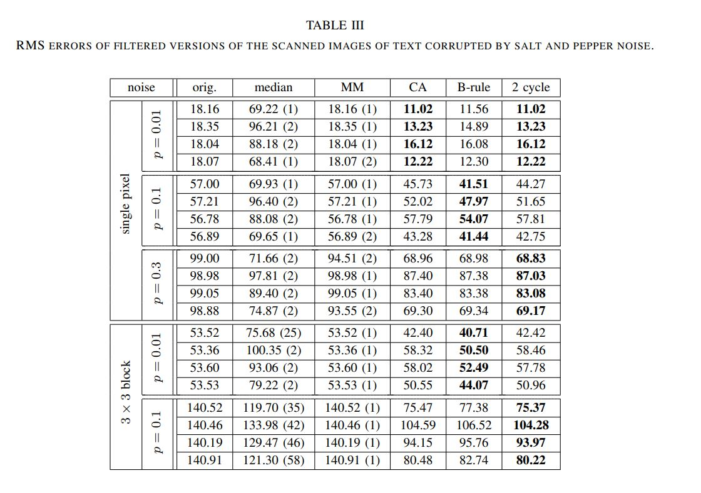
Experimentation - Results
In Experiment 3 / Table III (Rosin, 2006), the study delved into noise reduction specifically for text fragments within digital images. This experiment aimed to simulate real-world scenarios where text readability is paramount, necessitating effective noise reduction strategies.
The "p" values represent the probability of salt and pepper noise corruption in the scanned images of text. These values indicate the level of noise corruption, with lower "p" values representing lower levels of noise. The numbers represent the RMS errors of filtered versions of scanned images of text corrupted by salt and pepper noise. These RMS error values indicate the level of distortion. Lower RMS error values generally indicate better performance in terms of noise reduction or image quality restoration.
As seen from the table, CA/B-Rule/2-Cycle consistently performs better than median filtering and mathematical morphology and at times B-Rule and 2-Cycle, the variations of CA, end up performing better than CA. No matter if it’s a single pixel or 3x3 block with any of the provided noise levels, CA /B-Rule/2 Cycle will have lower RMS error values indicating better performance in noise reduction/image restoration.

Slide 14
Discussion of results
The results from Table III (Rosin, 2006) showcased the superior performance of CA in reducing noise while maintaining text clarity. Across different noise levels CA consistently outperformed traditional median filters and morphological operations. This demonstrates its robustness in handling complex noise patterns inherent in text fragments.
CA's adaptive nature allowed it to adaptively filter noise without compromising text details, making it highly suitable for text-intensive image processing tasks.
The experiment highlighted CA's superiority over conventional filters, especially when dealing with fine text details and intricate noise patterns.
The findings underscored the potential of CA as a versatile and effective tool for noise reduction in text-rich images, paving the way for enhanced readability and improved analysis accuracy.
Previous experiments had already highlighted CA's adaptive nature, allowing it to filter noise effectively without compromising details, making it suitable for image processing tasks. The experiment reaffirmed CA's superiority over conventional filters, particularly in addressing fine text details and intricate noise patterns, as observed in earlier studies. These cumulative findings emphasize the potential of CA as a versatile and effective tool for noise reduction in text-rich images, paving the way for enhanced readability and improved analysis accuracy.

Slide 15
Conclusion
This paper demonstrates significant progress in the realm of Cellular Automata for image processing tasks, showcasing the ability to learn effective rule sets through various methods. Particularly notable is the introduction of modified CA formulations like the B-rule and 2-cycle CAs, which exhibit improved performance, especially in tasks such as filtering salt and pepper noise, outperforming traditional median filtering methods.
There are several things that stand out in this paper, first, the flexibility of trained CA systems, enabling their application to diverse image processing tasks. This adaptability paves the way for exploring specialized feature detection and addressing specific types of noise with efficiency.
Moreover, the paper's focus on the Sequential Floating Forward Search algorithm highlights a key aspect of its methodology. By employing SFFS, the research showcases a strategic approach to rule set optimization within Cellular Automata systems. This methodological choice not only demonstrates a practical and effective means of enhancing CA performance but also opens avenues for further refining and fine-tuning rule sets for specific image processing tasks.
The research presented also encourages exploration into more effective solutions for image processing tasks. The emphasis on optimizing rule sets using methods like Sequential Floating Forward Search or evolutionary programming indicates a proactive approach towards improving CA performance. Furthermore, with the development of machine learning and artificial intelligence there is a potential to integrate techniques to further enhance CA's adaptability and efficiency in handling image processing challenges.
Overall, this paper emphasizes the significant potential of Cellular Automata as a versatile and effective solution for various image processing problems, paving the way for more sophisticated and efficient image analysis technologies.

Slide 16
Future research/directions
I intend to continue exploring further the capabilities and applications of cellular automata models in the field of image processing through the recent areas of development, notably evolutionary algorithms, artificial intelligence (AI), machine learning (ML), and how quantum computing could be pivotal for cellular automata to carry out more intricate computations. Such improvements would enable the systems of cellular automata with a much greater ability to optimize, learn, and adapt, and hence give much better performance in handling complex image processing tasks. The following subsections provide possible directions of interest for study and research…
Investigate the integration of reinforcement learning algorithms to enhance the adaptability and learning capabilities of cellular automata systems.
Explore the application of deep learning techniques in conjunction with cellular automata for more complex image processing tasks.
Explore the use of hybrid approaches combining cellular automata with other computational models such as neural networks or evolutionary algorithms for synergistic effects in image processing.
Explore recent advancements in evolutionary algorithms, such as genetic algorithms (GAs) to enhance the optimization and learning capabilities of cellular automata models for image processing tasks.
Investigate modern developments in computational techniques such as quantum computing or neuromorphic computing and their potential applications in advancing cellular automata.

Slide 17
acknowledgements
I am profoundly influenced by the comprehensive insights and results from Dr. Paul L. Rosin's work on training cellular automata for image processing, which have fundamentally shaped the entire scope and detail of the discussions presented in this paper. Utilizing his research helped develop this paper's focus on cellular automata, enhancing our understanding and application of these systems.

Slide 18
References
[1] Rosin, P. L. (2006). Training cellular automata for image processing. IEEE Transactions on Image Processing, 15(7), 2076-2087.
[2] Zheng, J., Luo, Z., & Qingxia, Z. (2020). An efficient image encryption algorithm based on multi chaotic system and random DAN coding. Multimedia Tools and Applications, 79.
[3] Juillé, H., & Pollack, J. B. (1994). Coevolving the "Ideal" Trainer: Application to the Discovery of Cellular Automata Rules. Computer Science Department, Brandeis University.
[4] Pudil, P., Novovičová, J., & Kittler, J. (1994). Floating search methods in feature selection. Pattern Recognition Letters, 15(11), 1119-1125.
[5] Jain, A., & Zongker, D. (1997). Feature Selection: Evaluation, application, and small sample performance. IEEE Transactions on Pattern Analysis and Machine Intelligence, 19(2).
[6] Hao, H., Liu, C., & Sako, H. (2003). Comparison of genetic algorithm and sequential search methods for classifier subset selection. In Proceedings of the 7th International Conference on Document Analysis and Recognition (pp. 765-769).

