Slide 1

The effect of acquiescence bias on measurement invariance testing
E. Damiano D’Urso Dr. Jesper Tijmstra
Prof. Dr. Jeroen K. Vermunt
Dr. Kim De Roover

Slide 2






Measuring Academic Engagement
Let us imagine that we use four items to measure academic engagement:
“I am proud to be an employee at my university”;
“I would refer to a friend or family member to this university”;
“I believe that generally, my workload is reasonable for my role”;
“I feel recognized for my hard work”.
With the following response options:
Strongly disagree
Disagree
Neutral
Agree
Strongly agree
1
2
3
4
5
Notes:
And I would like to start with an example.

Slide 3






Academic Engagement Scale (AES)
Notes:
What is commonly done in order to obtain an indicator for engagement is to sum the four item scores across participants, or take the mean, and look at this sum-score by comparing it to norms or other groups. However, it is important to keep in mind that the number itself is not interesting since it is only a proxy for whatever we are interested in, that is the actual level of engagement. In fact, the reason why we use items is that we cannot directly observe engagement but we assume that the person level of engagement will affect the item responses.

Slide 4
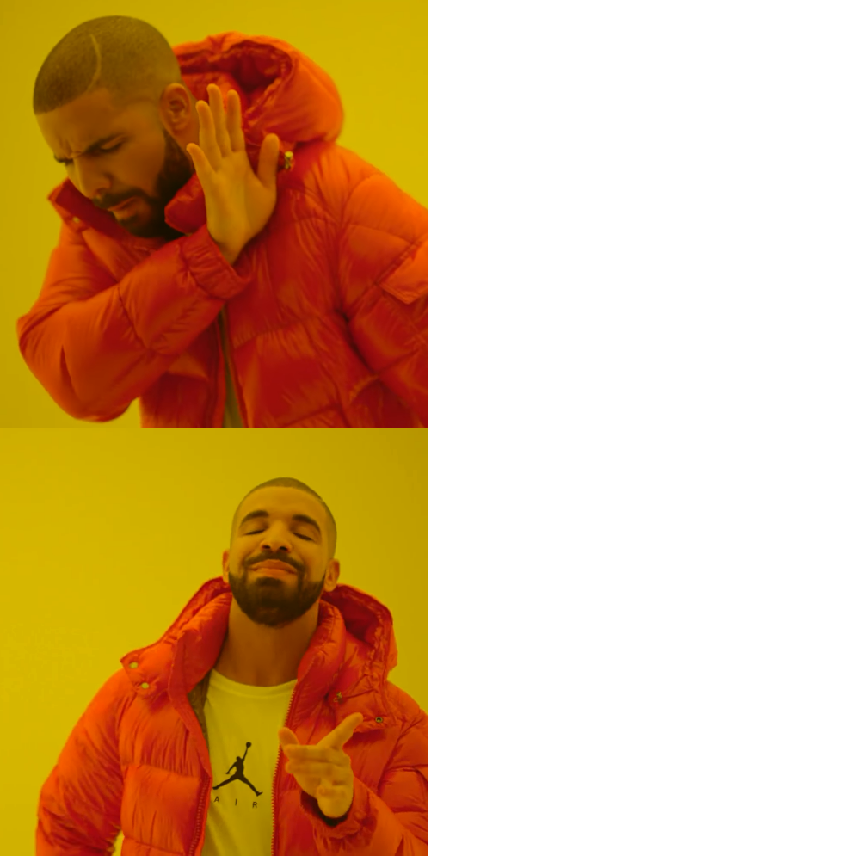
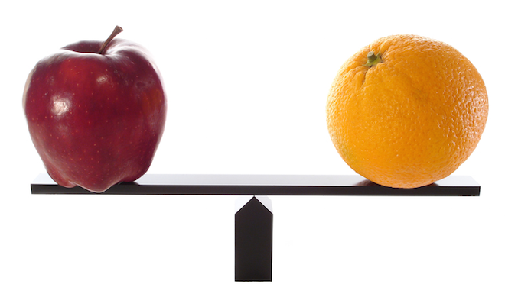

Measurement Invariance

Slide 5


























Multiple Group Categorical Confirmatory Factor Analysis (MG-CCFA)
$$η$$
$$η$$
$$λ_{4}$$
$$λ_{4}$$
$τ_{1}$…$τ_{k}$
$τ_{2}$…$τ_{k}$
$τ_{3}$…$τ_{k}$
$τ_{4}$…$τ_{k}$
$τ_{1}$…$τ_{k}$
$τ_{2}$…$τ_{k}$
$τ_{3}$…$τ_{k}$
$τ_{4}$…$τ_{k}$
$$ν_{1}$$
$$ν_{2}$$
$$ν_{3}$$
$$ν_{4}$$
$$ν_{1}$$
$$ν_{2}$$
$$ν_{3}$$
$$ν_{4}$$

Slide 6



















Multiple Group Categorical Confirmatory Factor Analysis (MG-CCFA)
$$η$$
$$η$$
$$λ_{4}$$
$$λ_{4}$$
$τ_{1}$…$τ_{k}$
$τ_{2}$…$τ_{k}$
$τ_{3}$…$τ_{k}$
$τ_{4}$…$τ_{k}$
$τ_{1}$…$τ_{k}$
$τ_{2}$…$τ_{k}$
$τ_{3}$…$τ_{k}$
$τ_{4}$…$τ_{k}$
Configural
$$ν_{1}$$
$$ν_{2}$$
$$ν_{3}$$
$$ν_{4}$$
$$ν_{1}$$
$$ν_{2}$$
$$ν_{3}$$
$$ν_{4}$$

Slide 7









Multiple Group Categorical Confirmatory Factor Analysis (MG-CCFA)
$$η$$
$$η$$
$$λ_{4}$$
$τ_{1}$…$τ_{k}$
$τ_{2}$…$τ_{k}$
$τ_{3}$…$τ_{k}$
$τ_{4}$…$τ_{k}$
$τ_{1}$…$τ_{k}$
$τ_{2}$…$τ_{k}$
$τ_{3}$…$τ_{k}$
$τ_{4}$…$τ_{k}$
Configural
$$ν_{1}$$
$$ν_{2}$$
$$ν_{3}$$
$$ν_{4}$$
$$ν_{1}$$
$$ν_{2}$$
$$ν_{3}$$
$$ν_{4}$$

Slide 8












Multiple Group Categorical Confirmatory Factor Analysis (MG-CCFA)
$$η$$
$$η$$
$$λ_{4}$$
$$λ_{4}$$
Thresholds
$τ_{1}$…$τ_{k}$
$τ_{2}$…$τ_{k}$
$τ_{3}$…$τ_{k}$
$τ_{4}$…$τ_{k}$
$τ_{1}$…$τ_{k}$
$τ_{2}$…$τ_{k}$
$τ_{3}$…$τ_{k}$
$τ_{4}$…$τ_{k}$
Configural
$$ν_{1}$$
$$ν_{2}$$
$$ν_{3}$$
$$ν_{4}$$
$$ν_{1}$$
$$ν_{2}$$
$$ν_{3}$$
$$ν_{4}$$

Slide 9
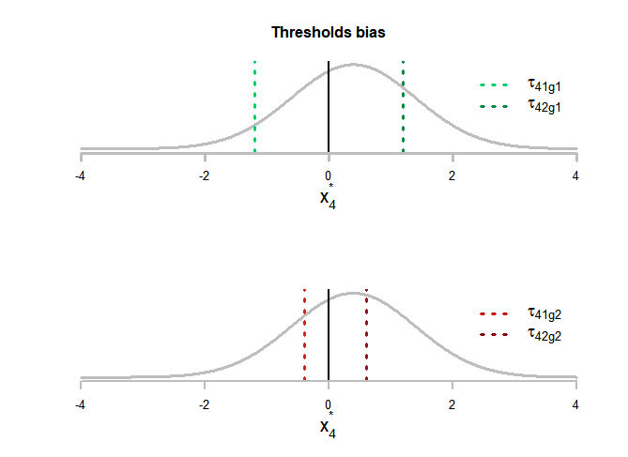



Multiple Group Categorical Confirmatory Factor Analysis (MG-CCFA)
$$η$$
$$η$$
$$λ_{4}$$
$$λ_{4}$$
Thresholds
$τ_{1}$…$τ_{k}$
$τ_{2}$…$τ_{k}$
$τ_{3}$…$τ_{k}$
$τ_{4}$…$τ_{k}$
$τ_{1}$…$τ_{k}$
$τ_{2}$…$τ_{k}$
$τ_{3}$…$τ_{k}$
$τ_{4}$…$τ_{k}$
Configural
$$ν_{1}$$
$$ν_{2}$$
$$ν_{3}$$
$$ν_{4}$$
$$ν_{1}$$
$$ν_{2}$$
$$ν_{3}$$
$$ν_{4}$$

Slide 10








Multiple Group Categorical Confirmatory Factor Analysis (MG-CCFA)
$$η$$
$$η$$
$$λ_{1}$$
$$λ_{2}$$
$$λ_{3}$$
$$λ_{4}$$
$$λ_{1}$$
$$λ_{2}$$
$$λ_{3}$$
$$λ_{4}$$
Loadings
Thresholds
$τ_{1}$…$τ_{k}$
$τ_{2}$…$τ_{k}$
$τ_{3}$…$τ_{k}$
$τ_{4}$…$τ_{k}$
$τ_{1}$…$τ_{k}$
$τ_{2}$…$τ_{k}$
$τ_{3}$…$τ_{k}$
$τ_{4}$…$τ_{k}$
Configural
$$ν_{1}$$
$$ν_{2}$$
$$ν_{3}$$
$$ν_{4}$$
$$ν_{1}$$
$$ν_{2}$$
$$ν_{3}$$
$$ν_{4}$$

Slide 11
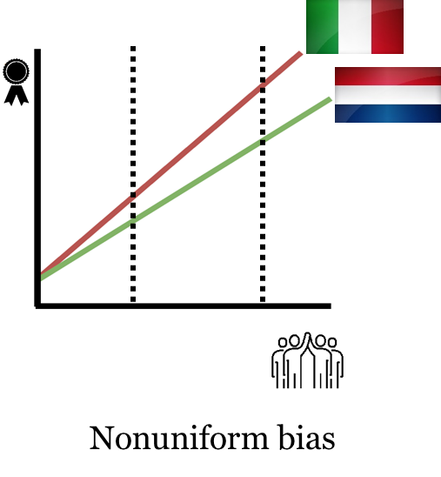

Multiple Group Categorical Confirmatory Factor Analysis (MG-CCFA)
$$η$$
$$η$$
$$λ_{1}$$
$$λ_{2}$$
$$λ_{3}$$
$$λ_{4}$$
$$λ_{1}$$
$$λ_{2}$$
$$λ_{3}$$
$$λ_{4}$$
Loadings
Thresholds
$τ_{1}$…$τ_{k}$
$τ_{2}$…$τ_{k}$
$τ_{3}$…$τ_{k}$
$τ_{4}$…$τ_{k}$
$τ_{1}$…$τ_{k}$
$τ_{2}$…$τ_{k}$
$τ_{3}$…$τ_{k}$
$τ_{4}$…$τ_{k}$
Configural
$$ν_{1}$$
$$ν_{2}$$
$$ν_{3}$$
$$ν_{4}$$
$$ν_{1}$$
$$ν_{2}$$
$$ν_{3}$$
$$ν_{4}$$

Slide 12








Multiple Group Categorical Confirmatory Factor Analysis (MG-CCFA)
$$η$$
$$η$$
Intercepts
$$λ_{1}$$
$$λ_{2}$$
$$λ_{3}$$
$$λ_{4}$$
$$λ_{1}$$
$$λ_{2}$$
$$λ_{3}$$
$$λ_{4}$$
Loadings
Thresholds
$τ_{1}$…$τ_{k}$
$τ_{2}$…$τ_{k}$
$τ_{3}$…$τ_{k}$
$τ_{4}$…$τ_{k}$
$τ_{1}$…$τ_{k}$
$τ_{2}$…$τ_{k}$
$τ_{3}$…$τ_{k}$
$τ_{4}$…$τ_{k}$
Configural
$$ν_{1}$$
$$ν_{2}$$
$$ν_{3}$$
$$ν_{4}$$
$$ν_{1}$$
$$ν_{2}$$
$$ν_{3}$$
$$ν_{4}$$

Slide 13
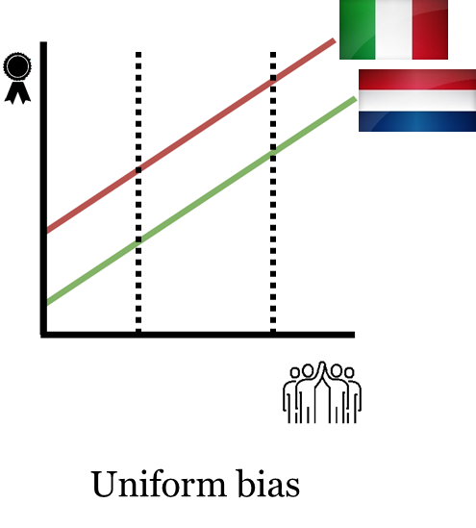

Multiple Group Categorical Confirmatory Factor Analysis (MG-CCFA)
$$η$$
$$η$$
Intercepts
$$λ_{1}$$
$$λ_{2}$$
$$λ_{3}$$
$$λ_{4}$$
$$λ_{1}$$
$$λ_{2}$$
$$λ_{3}$$
$$λ_{4}$$
Loadings
Thresholds
$τ_{1}$…$τ_{k}$
$τ_{2}$…$τ_{k}$
$τ_{3}$…$τ_{k}$
$τ_{4}$…$τ_{k}$
$τ_{1}$…$τ_{k}$
$τ_{2}$…$τ_{k}$
$τ_{3}$…$τ_{k}$
$τ_{4}$…$τ_{k}$
Configural
$$ν_{1}$$
$$ν_{2}$$
$$ν_{3}$$
$$ν_{4}$$
$$ν_{1}$$
$$ν_{2}$$
$$ν_{3}$$
$$ν_{4}$$

Slide 14




Multiple Group Categorical Confirmatory Factor Analysis (MG-CCFA)
$$η$$
$$η$$
Intercepts
Partial invariance
$$λ_{1}$$
$$λ_{2}$$
$$λ_{3}$$
$$λ_{4}$$
$$λ_{1}$$
$$λ_{2}$$
$$λ_{3}$$
$$λ_{4}$$
≈
Loadings
≈
Thresholds
$τ_{1}$…$τ_{k}$
$τ_{2}$…$τ_{k}$
$τ_{3}$…$τ_{k}$
$τ_{4}$…$τ_{k}$
$τ_{1}$…$τ_{k}$
$τ_{2}$…$τ_{k}$
$τ_{3}$…$τ_{k}$
$τ_{4}$…$τ_{k}$
Configural
$$ν_{1}$$
$$ν_{2}$$
$$ν_{3}$$
$$ν_{4}$$
$$ν_{1}$$
$$ν_{2}$$
$$ν_{3}$$
$$ν_{4}$$

Slide 15

What could cause measurement bias?

Slide 16
Response styles
Notes:
Now, all this was a short and hopefully intuitive introduction about how systematic bias, such as the one coming from differences in measurement may affect group comparisons. However, systematic differences in measurement may not only arise from differences in item interpretations but also from differences in way of responding to items.

Slide 17

Agreeing Response Style (Yay-saying)
Agreeing (or acquiescence) response style (ARS) is a tendency to agree with items regardless of their content (Paulhus, 1991).

Slide 18
Potential effects of ARS
ARS can harm the assessment of a scale’s psychometric properties in many ways:
Inflate observed means and correlations (Van Vaerenbergh & Thomas, 2013);
Increase or decrease factor loadings (Ferrando & Lorenzo-Seva, 2010);
Result in an additional factor (Billiet & McClendon, 2000; D’Urso et al., 2022).

Slide 19









A simple way to deal with ARS (Billiet & McClendon, 2000)
Using both positively and negatively phrased items can help correcting for ARS.
For example:
Unbalanced scale:
“I am proud to be an employee at my university”
“I feel recognized for my hard work”.
Balanced scale:
“I am proud to be an employee at my university”
“I feel unappreciated for my hard work”.
ARS
$$η$$
1
1
1
1
$$λ_{4}$$
$τ_{1}$…$τ_{k}$
$τ_{2}$…$τ_{k}$
$τ_{3}$…$τ_{k}$
$τ_{4}$…$τ_{k}$
$$ν_{1}$$
$$ν_{2}$$
$$ν_{3}$$
$$ν_{4}$$

Slide 20

Literature gaps
ARS correction for:
MG analyses
Ordinal data
ARS as a weak factor
Types of scales (e.g., semi-balanced)

Slide 21
Does acquiescence affect measurement invariance?

Slide 22
Does acquiescence affect measurement invariance?
By means of a simulation study we investigated the effect of ARS on measurement invariance testing when:
Accounting for ARS;
Ignoring ARS;

Slide 23

Simulation study
Design factors:
Number of subjects N per group: 250, 1000;
Type of scale: balanced, semi-balanced, unbalanced;
Number of content factors Q: 1, 2;
Number of items J: 12, 24;
Strength of the ARS factor: small and large.
For each condition, 100 replications were generated.

Slide 24
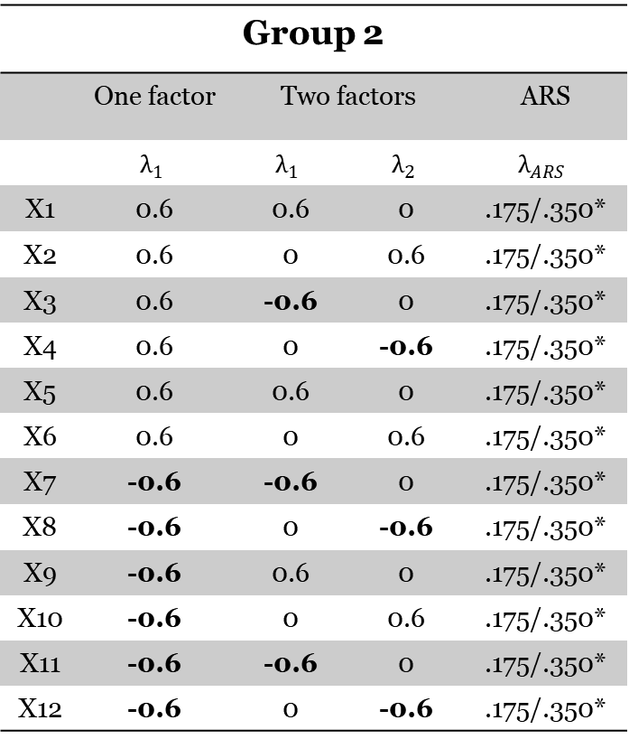
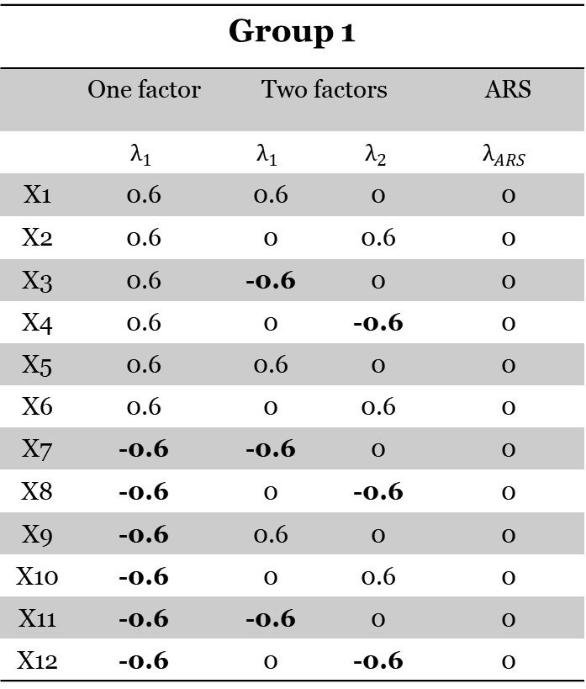
Balanced scales
Group 1
 | One factor | Two factors |  | ARS
 | $$λ_{1}$$ | $$λ_{1}$$ | $$λ_{2}$$ | $$λ_{ARS}$$
X1 | 0.6 | 0.6 | 0 | 0
X2 | 0.6 | 0 | 0.6 | 0
X3 | 0.6 | -0.6 | 0 | 0
X4 | 0.6 | 0 | -0.6 | 0
X5 | 0.6 | 0.6 | 0 | 0
X6 | 0.6 | 0 | 0.6 | 0
X7 | -0.6 | -0.6 | 0 | 0
X8 | -0.6 | 0 | -0.6 | 0
X9 | -0.6 | 0.6 | 0 | 0
X10 | -0.6 | 0 | 0.6 | 0
X11 | -0.6 | -0.6 | 0 | 0
X12 | -0.6 | 0 | -0.6 | 0
Group 2
 | One factor | Two factors |  | ARS
 | $$λ_{1}$$ | $$λ_{1}$$ | $$λ_{2}$$ | $$λ_{ARS}$$
X1 | 0.6 | 0.6 | 0 | .175/.350*
X2 | 0.6 | 0 | 0.6 | .175/.350*
X3 | 0.6 | -0.6 | 0 | .175/.350*
X4 | 0.6 | 0 | -0.6 | .175/.350*
X5 | 0.6 | 0.6 | 0 | .175/.350*
X6 | 0.6 | 0 | 0.6 | .175/.350*
X7 | -0.6 | -0.6 | 0 | .175/.350*
X8 | -0.6 | 0 | -0.6 | .175/.350*
X9 | -0.6 | 0.6 | 0 | .175/.350*
X10 | -0.6 | 0 | 0.6 | .175/.350*
X11 | -0.6 | -0.6 | 0 | .175/.350*
X12 | -0.6 | 0 | -0.6 | .175/.350*
*ARS loadings are rescaled based on the variance of a right-censored normal distribution. Original loadings were .3 and .6.

Slide 25
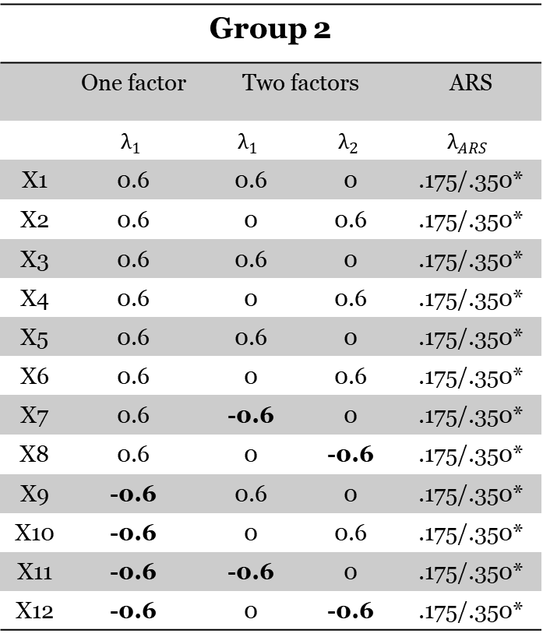
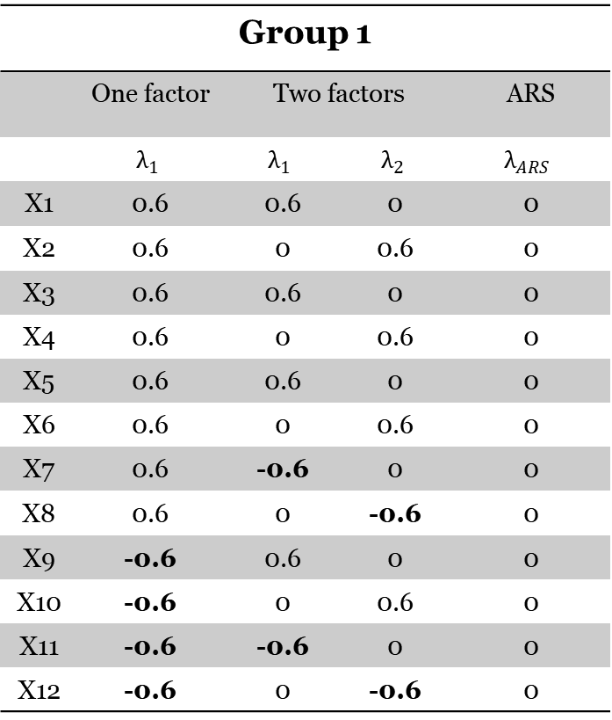
Semi-balanced scales
Group 1
 | One factor | Two factors |  | ARS
 | $$λ_{1}$$ | $$λ_{1}$$ | $$λ_{2}$$ | $$λ_{ARS}$$
X1 | 0.6 | 0.6 | 0 | 0
X2 | 0.6 | 0 | 0.6 | 0
X3 | 0.6 | 0.6 | 0 | 0
X4 | 0.6 | 0 | 0.6 | 0
X5 | 0.6 | 0.6 | 0 | 0
X6 | 0.6 | 0 | 0.6 | 0
X7 | 0.6 | -0.6 | 0 | 0
X8 | 0.6 | 0 | -0.6 | 0
X9 | -0.6 | 0.6 | 0 | 0
X10 | -0.6 | 0 | 0.6 | 0
X11 | -0.6 | -0.6 | 0 | 0
X12 | -0.6 | 0 | -0.6 | 0
Group 2
 | One factor | Two factors |  | ARS
 | $$λ_{1}$$ | $$λ_{1}$$ | $$λ_{2}$$ | $$λ_{ARS}$$
X1 | 0.6 | 0.6 | 0 | .175/.350*
X2 | 0.6 | 0 | 0.6 | .175/.350*
X3 | 0.6 | 0.6 | 0 | .175/.350*
X4 | 0.6 | 0 | 0.6 | .175/.350*
X5 | 0.6 | 0.6 | 0 | .175/.350*
X6 | 0.6 | 0 | 0.6 | .175/.350*
X7 | 0.6 | -0.6 | 0 | .175/.350*
X8 | 0.6 | 0 | -0.6 | .175/.350*
X9 | -0.6 | 0.6 | 0 | .175/.350*
X10 | -0.6 | 0 | 0.6 | .175/.350*
X11 | -0.6 | -0.6 | 0 | .175/.350*
X12 | -0.6 | 0 | -0.6 | .175/.350*
*ARS loadings are rescaled based on the variance of a right-censored normal distribution. Original loadings were .3 and .6.

Slide 26
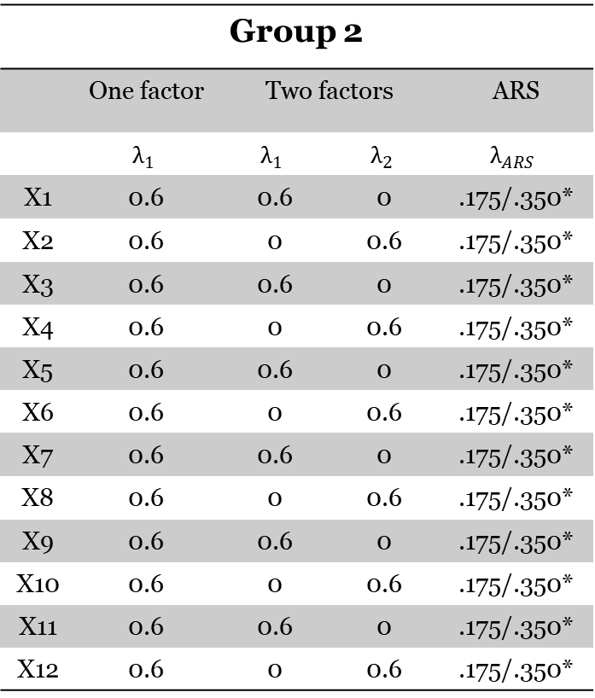
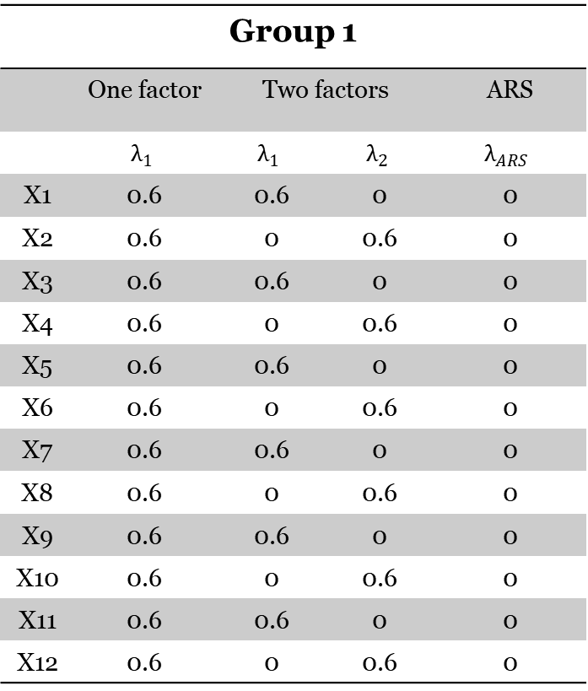
Unbalanced scales
Group 1
 | One factor | Two factors |  | ARS
 | $$λ_{1}$$ | $$λ_{1}$$ | $$λ_{2}$$ | $$λ_{ARS}$$
X1 | 0.6 | 0.6 | 0 | 0
X2 | 0.6 | 0 | 0.6 | 0
X3 | 0.6 | 0.6 | 0 | 0
X4 | 0.6 | 0 | 0.6 | 0
X5 | 0.6 | 0.6 | 0 | 0
X6 | 0.6 | 0 | 0.6 | 0
X7 | 0.6 | 0.6 | 0 | 0
X8 | 0.6 | 0 | 0.6 | 0
X9 | 0.6 | 0.6 | 0 | 0
X10 | 0.6 | 0 | 0.6 | 0
X11 | 0.6 | 0.6 | 0 | 0
X12 | 0.6 | 0 | 0.6 | 0
Group 2
 | One factor | Two factors |  | ARS
 | $$λ_{1}$$ | $$λ_{1}$$ | $$λ_{2}$$ | $$λ_{ARS}$$
X1 | 0.6 | 0.6 | 0 | .175/.350*
X2 | 0.6 | 0 | 0.6 | .175/.350*
X3 | 0.6 | 0.6 | 0 | .175/.350*
X4 | 0.6 | 0 | 0.6 | .175/.350*
X5 | 0.6 | 0.6 | 0 | .175/.350*
X6 | 0.6 | 0 | 0.6 | .175/.350*
X7 | 0.6 | 0.6 | 0 | .175/.350*
X8 | 0.6 | 0 | 0.6 | .175/.350*
X9 | 0.6 | 0.6 | 0 | .175/.350*
X10 | 0.6 | 0 | 0.6 | .175/.350*
X11 | 0.6 | 0.6 | 0 | .175/.350*
X12 | 0.6 | 0 | 0.6 | .175/.350*
*ARS loadings are rescaled based on the variance of a right-censored normal distribution. Original loadings were .3 and .6.

Slide 27
Model estimation
For each data set, we estimated (using DWLS):
MG-CCFA model with an additional ARS factor;
MG-CCFA model without an additional ARS factor;
Measurement invariance was tested following Wu and Estabrook (2016) guidelines:
Configural invariance;
Thresholds invariance;
Loadings invariance;
Intercept invariance.

Slide 28
Outcome measures
We evaluated the fit of the model (with and without ARS) to the data using:
Exact fit (chi-squared test) (α = 0.05);
Misfit (RMSEA ≥ 0.08);
Comparative fit (CFI ≤ 0.95).

Slide 29
Key results

Slide 30






The impact of ARS on MI testing
 |  | Without ARS | With ARS
Small ARS | Balanced
 | Semi
 | Unbalanced
Large ARS | Balanced
 | Semi
 | Unbalanced
= measurement invariant
= measurement non-invariant
= convergence issues

Slide 31
Key results
Ignoring a large agreeing bias (ARS) resulted in measurement non-invariance;
Accounting for ARS allowed to accurately assess measurement invariance;
Unbalanced scales often did not allow to correct for ARS.

Slide 32



Three practical tips
To avoid agreeing bias when comparing groups using surveys:
Use surveys with a (semi-)balanced set of items;
Use models that can correct for agreeing tendencies (ARS);
Test for measurement invariance;
e.d.durso@tilburguniversity.edu
@Damiano_Durso
Damiano D’Urso

Slide 33
References
Measurement invariance
Putnick, Diane L., and Marc H. Bornstein. "Measurement invariance conventions and reporting: The state of the art and future directions for psychological research." Developmental review 41 (2016): 71-90.
Wu, H., & Estabrook, R. (2016). Identification of confirmatory factor analysis models of different levels of invariance for ordered categorical outcomes. Psychometrika, 81(4), 1014-1045.
Response styles
Billiet, J. B., & McClendon, M. J. (2000). Modeling acquiescence in measurement models for two balanced sets of items. Structural equation modeling, 7(4), 608-628.
D’Urso, E. D., Tijmstra, J., Vermunt, J. K., & De Roover, K. (2022). Awareness is bliss: How acquiescence affects exploratory factor analysis. Educational and Psychological Measurement, 00131644221089857.
Ferrando, P. J., & Lorenzo‐Seva, U. (2010). Acquiescence as a source of bias and model and person misfit: A theoretical and empirical analysis. British Journal of Mathematical and Statistical Psychology, 63(2), 427-448.
Paulhus, D. L. (1991). Measurement and control of response bias.
Van Vaerenbergh, Y., & Thomas, T. D. (2013). Response styles in survey research: A literature review of antecedents, consequences, and remedies. International Journal of Public Opinion Research, 25(2), 195-217.

Slide 34


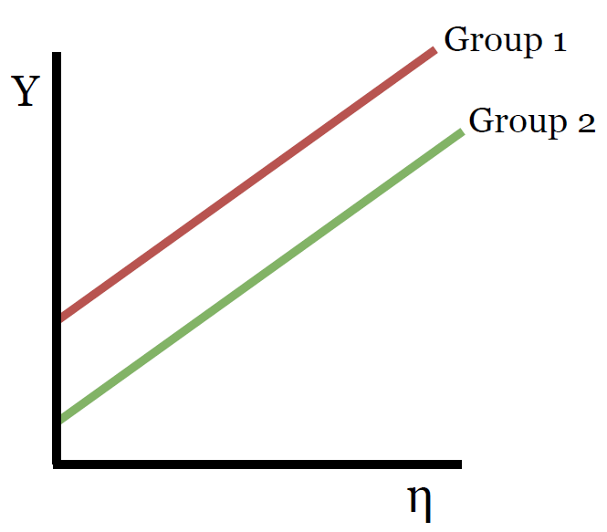
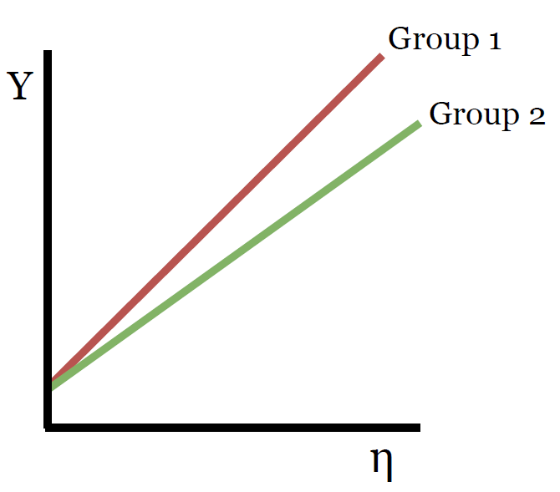
Types of measurement bias
No bias
Uniform bias
Nonuniform bias

Slide 35
A simple way to deal with ARS (Billiet & McClendon, 2000)
Using both positively and negatively phrased items can help correcting for ARS.
For example:
Unbalanced scale:
“I am proud to be an employee at my university”
“I would refer to a friend or family member to this university”;
“I believe that generally, my workload is reasonable for my role”;
“I feel recognized for my hard work”.
Balanced scale:
“I am proud to be an employee at my university”
“I would not refer to a friend or family member to this university”;
“I believe that generally, my workload is reasonable for my role”;
“I feel unappreciated for my hard work”.
ARS
$$η$$
1
1
1
1
$$λ_{4}$$
$τ_{1}$…$τ_{k}$
$τ_{2}$…$τ_{k}$
$τ_{3}$…$τ_{k}$
$τ_{4}$…$τ_{k}$
$$ν_{1}$$
$$ν_{2}$$
$$ν_{3}$$
$$ν_{4}$$

Slide 36
The impact of ARS on MI testing
 |  | Without ARS |  |  | With ARS
 |  | Configural | Thresholds | Loadings | Configural | Thresholds | Loadings
Small | Balanced
 | Semi
 | Unbalanced
Large | Balanced
 | Semi
 | Unbalanced

Slide 37
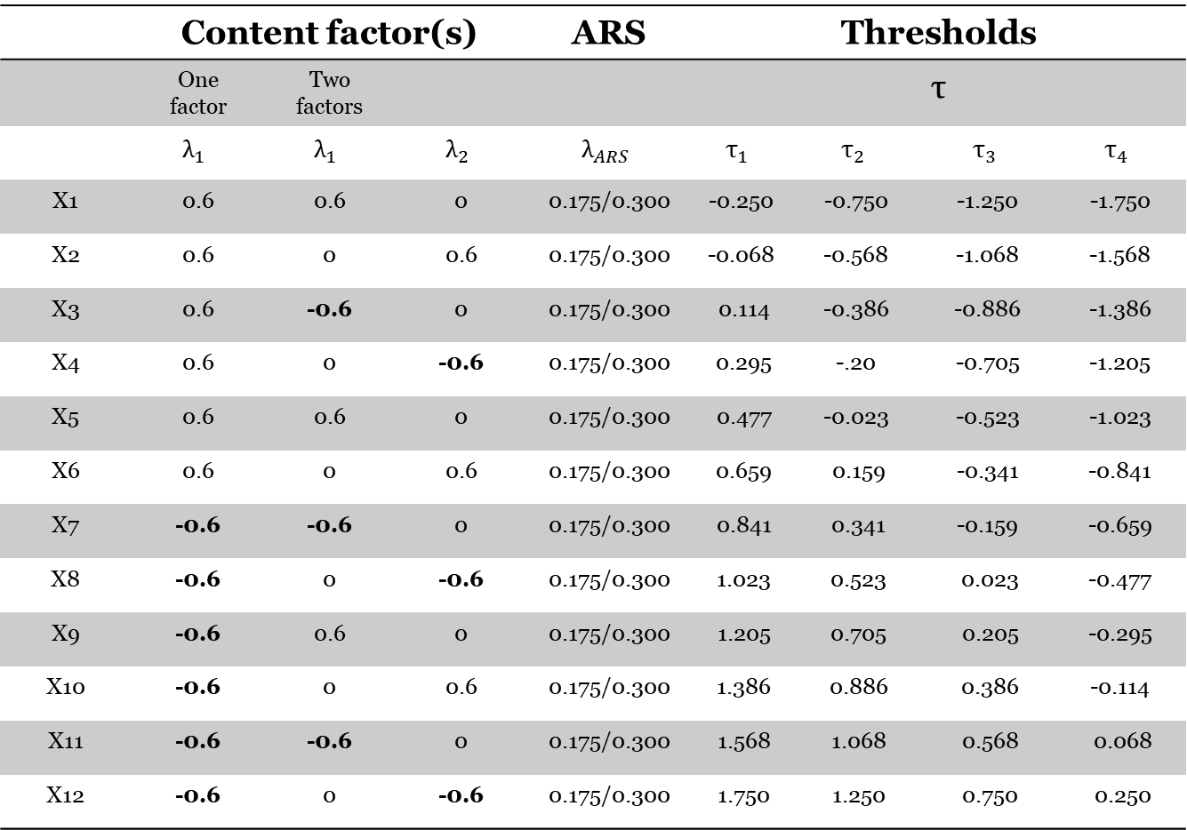
Data generation (balanced)
 | Content factor(s) |  |  | ARS | Thresholds
 | One factor | Two factors |  |  | τ
 | $$λ_{1}$$ | $$λ_{1}$$ | $$λ_{2}$$ | $$λ_{ARS}$$ | $$τ_{1}$$ | $$τ_{2}$$ | $$τ_{3}$$ | $$τ_{4}$$
X1 | 0.6 | 0.6 | 0 | 0.175/0.300 | -0.250 | -0.750 | -1.250 | -1.750
X2 | 0.6 | 0 | 0.6 | 0.175/0.300 | -0.068 | -0.568 | -1.068 | -1.568
X3 | 0.6 | -0.6 | 0 | 0.175/0.300 | 0.114 | -0.386 | -0.886 | -1.386
X4 | 0.6 | 0 | -0.6 | 0.175/0.300 | 0.295 | -.20 | -0.705 | -1.205
X5 | 0.6 | 0.6 | 0 | 0.175/0.300 | 0.477 | -0.023 | -0.523 | -1.023
X6 | 0.6 | 0 | 0.6 | 0.175/0.300 | 0.659 | 0.159 | -0.341 | -0.841
X7 | -0.6 | -0.6 | 0 | 0.175/0.300 | 0.841 | 0.341 | -0.159 | -0.659
X8 | -0.6 | 0 | -0.6 | 0.175/0.300 | 1.023 | 0.523 | 0.023 | -0.477
X9 | -0.6 | 0.6 | 0 | 0.175/0.300 | 1.205 | 0.705 | 0.205 | -0.295
X10 | -0.6 | 0 | 0.6 | 0.175/0.300 | 1.386 | 0.886 | 0.386 | -0.114
X11 | -0.6 | -0.6 | 0 | 0.175/0.300 | 1.568 | 1.068 | 0.568 | 0.068
X12 | -0.6 | 0 | -0.6 | 0.175/0.300 | 1.750 | 1.250 | 0.750 | 0.250

Slide 38
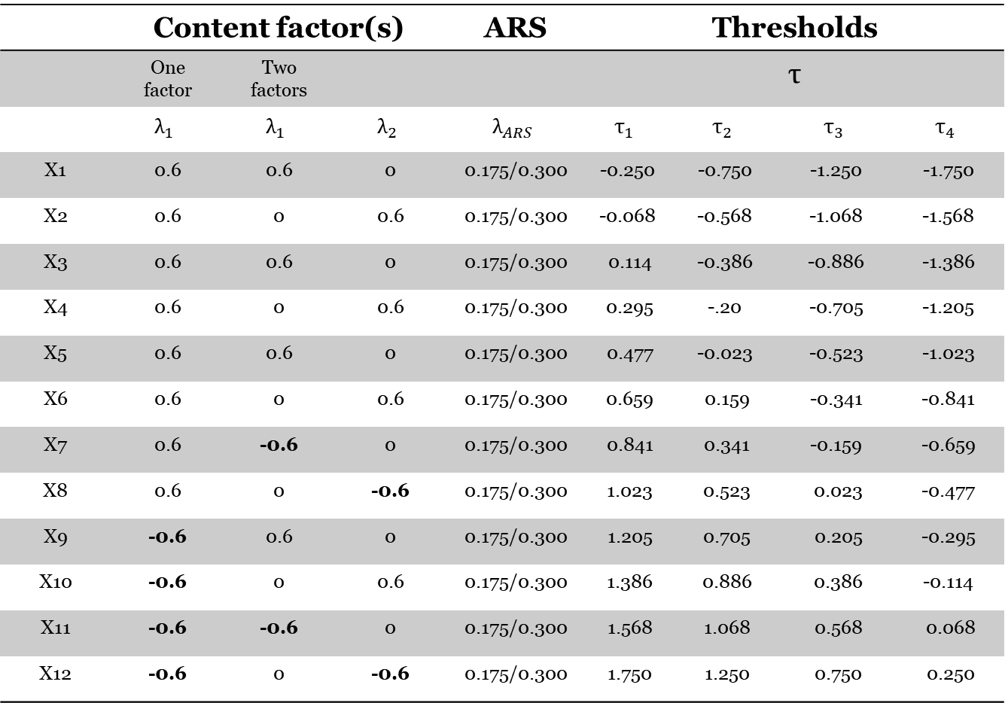
Data generation (semi-balanced)
 | Content factor(s) |  |  | ARS | Thresholds
 | One factor | Two factors |  |  | τ
 | $$λ_{1}$$ | $$λ_{1}$$ | $$λ_{2}$$ | $$λ_{ARS}$$ | $$τ_{1}$$ | $$τ_{2}$$ | $$τ_{3}$$ | $$τ_{4}$$
X1 | 0.6 | 0.6 | 0 | 0.175/0.300 | -0.250 | -0.750 | -1.250 | -1.750
X2 | 0.6 | 0 | 0.6 | 0.175/0.300 | -0.068 | -0.568 | -1.068 | -1.568
X3 | 0.6 | 0.6 | 0 | 0.175/0.300 | 0.114 | -0.386 | -0.886 | -1.386
X4 | 0.6 | 0 | 0.6 | 0.175/0.300 | 0.295 | -.20 | -0.705 | -1.205
X5 | 0.6 | 0.6 | 0 | 0.175/0.300 | 0.477 | -0.023 | -0.523 | -1.023
X6 | 0.6 | 0 | 0.6 | 0.175/0.300 | 0.659 | 0.159 | -0.341 | -0.841
X7 | 0.6 | -0.6 | 0 | 0.175/0.300 | 0.841 | 0.341 | -0.159 | -0.659
X8 | 0.6 | 0 | -0.6 | 0.175/0.300 | 1.023 | 0.523 | 0.023 | -0.477
X9 | -0.6 | 0.6 | 0 | 0.175/0.300 | 1.205 | 0.705 | 0.205 | -0.295
X10 | -0.6 | 0 | 0.6 | 0.175/0.300 | 1.386 | 0.886 | 0.386 | -0.114
X11 | -0.6 | -0.6 | 0 | 0.175/0.300 | 1.568 | 1.068 | 0.568 | 0.068
X12 | -0.6 | 0 | -0.6 | 0.175/0.300 | 1.750 | 1.250 | 0.750 | 0.250

Slide 39
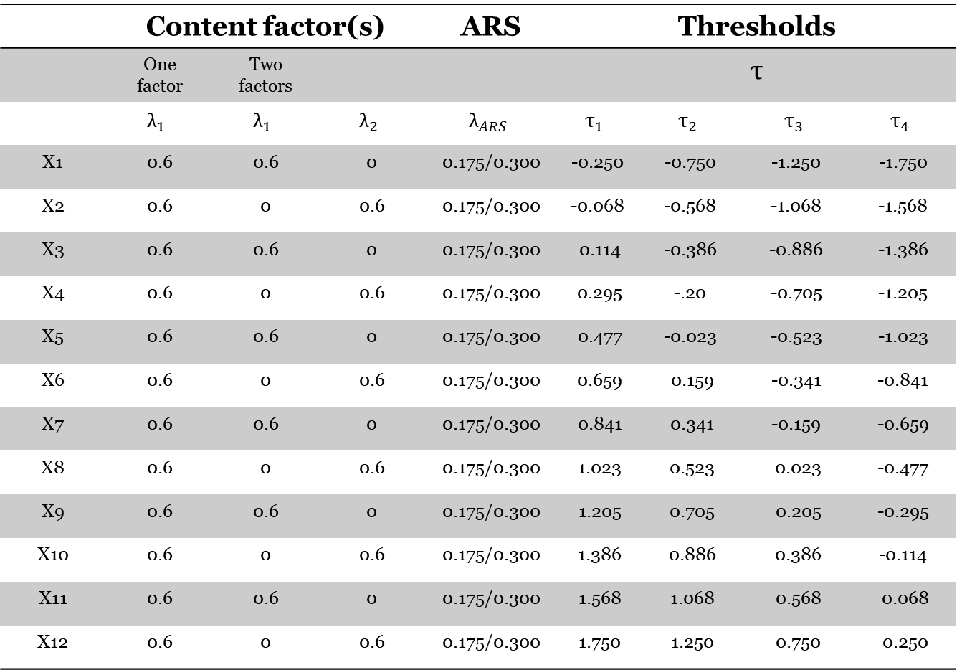
Data generation (unbalanced)
 | Content factor(s) |  |  | ARS | Thresholds
 | One factor | Two factors |  |  | τ
 | $$λ_{1}$$ | $$λ_{1}$$ | $$λ_{2}$$ | $$λ_{ARS}$$ | $$τ_{1}$$ | $$τ_{2}$$ | $$τ_{3}$$ | $$τ_{4}$$
X1 | 0.6 | 0.6 | 0 | 0.175/0.300 | -0.250 | -0.750 | -1.250 | -1.750
X2 | 0.6 | 0 | 0.6 | 0.175/0.300 | -0.068 | -0.568 | -1.068 | -1.568
X3 | 0.6 | 0.6 | 0 | 0.175/0.300 | 0.114 | -0.386 | -0.886 | -1.386
X4 | 0.6 | 0 | 0.6 | 0.175/0.300 | 0.295 | -.20 | -0.705 | -1.205
X5 | 0.6 | 0.6 | 0 | 0.175/0.300 | 0.477 | -0.023 | -0.523 | -1.023
X6 | 0.6 | 0 | 0.6 | 0.175/0.300 | 0.659 | 0.159 | -0.341 | -0.841
X7 | 0.6 | 0.6 | 0 | 0.175/0.300 | 0.841 | 0.341 | -0.159 | -0.659
X8 | 0.6 | 0 | 0.6 | 0.175/0.300 | 1.023 | 0.523 | 0.023 | -0.477
X9 | 0.6 | 0.6 | 0 | 0.175/0.300 | 1.205 | 0.705 | 0.205 | -0.295
X10 | 0.6 | 0 | 0.6 | 0.175/0.300 | 1.386 | 0.886 | 0.386 | -0.114
X11 | 0.6 | 0.6 | 0 | 0.175/0.300 | 1.568 | 1.068 | 0.568 | 0.068
X12 | 0.6 | 0 | 0.6 | 0.175/0.300 | 1.750 | 1.250 | 0.750 | 0.250

Slide 40
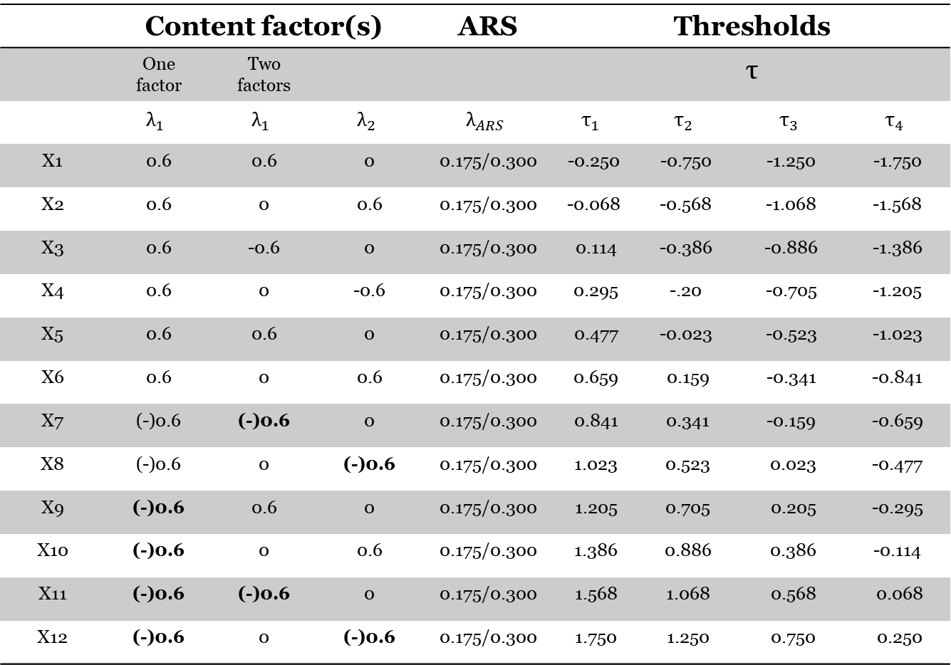
Data generation
 | Content factor(s) |  |  | ARS | Thresholds
 | One factor | Two factors |  |  | τ
 | $$λ_{1}$$ | $$λ_{1}$$ | $$λ_{2}$$ | $$λ_{ARS}$$ | $$τ_{1}$$ | $$τ_{2}$$ | $$τ_{3}$$ | $$τ_{4}$$
X1 | 0.6 | 0.6 | 0 | 0.175/0.300 | -0.250 | -0.750 | -1.250 | -1.750
X2 | 0.6 | 0 | 0.6 | 0.175/0.300 | -0.068 | -0.568 | -1.068 | -1.568
X3 | 0.6 | -0.6 | 0 | 0.175/0.300 | 0.114 | -0.386 | -0.886 | -1.386
X4 | 0.6 | 0 | -0.6 | 0.175/0.300 | 0.295 | -.20 | -0.705 | -1.205
X5 | 0.6 | 0.6 | 0 | 0.175/0.300 | 0.477 | -0.023 | -0.523 | -1.023
X6 | 0.6 | 0 | 0.6 | 0.175/0.300 | 0.659 | 0.159 | -0.341 | -0.841
X7 | (-)0.6 | (-)0.6 | 0 | 0.175/0.300 | 0.841 | 0.341 | -0.159 | -0.659
X8 | (-)0.6 | 0 | (-)0.6 | 0.175/0.300 | 1.023 | 0.523 | 0.023 | -0.477
X9 | (-)0.6 | 0.6 | 0 | 0.175/0.300 | 1.205 | 0.705 | 0.205 | -0.295
X10 | (-)0.6 | 0 | 0.6 | 0.175/0.300 | 1.386 | 0.886 | 0.386 | -0.114
X11 | (-)0.6 | (-)0.6 | 0 | 0.175/0.300 | 1.568 | 1.068 | 0.568 | 0.068
X12 | (-)0.6 | 0 | (-)0.6 | 0.175/0.300 | 1.750 | 1.250 | 0.750 | 0.250

Slide 41
Types of measurement bias
Uniform bias
Nonuniform bias

Slide 42
How can we assess measurement bias ?

Slide 43
The impact of ARS on MI testing
 |  | Without ARS | With ARS
Small ARS | Balanced
 | Semi
 | Unbalanced
Large ARS | Balanced
 | Semi
 | Unbalanced

Slide 44
Response styles
In some groups, responses to survey items can be systematically biased due to:
Desire to impress;
Fatigue;
Environmental factors;
Cultural differences;
Etc.
This may cause measurement non-invariance (or bias)
Notes:
Now, all this was a short and hopefully intuitive introduction about how systematic bias, such as the one coming from differences in measurement may affect

Slide 45
An omniscient example
 |  |  |  | Academic Engagement Scale Items |  |  |  |  |  | Academic Satisfaction Scale Items |  |  |  |  | Valid Responses
Respondent | Country |  | ARS | 1 |  | 2 | 3 | 4 | Tot | 1 | 2 | 3 | 4 | Tot | JS | PP
1 |  |  | Yes | 5 |  | 4 | 5 | 5 | 19 | 4 | 4 | 5 | 5 | 18 | - | -
2 |  |  | No | 3 |  | 5 | 5 | 4 | 17 | 1 | 2 | 3 | 2 | 8 | 17 | 8
3 |  |  | Yes | 5 |  | 5 | 4 | 5 | 19 | 5 | 5 | 5 | 5 | 20 | - | -
4 |  |  | No | 3 |  | 2 | 5 | 3 | 13 | 2 | 1 | 1 | 1 | 5 | 13 | 5
5 |  |  | No | 1 |  | 3 | 4 | 5 | 13 | 3 | 2 | 1 | 3 | 10 | 13 | 10
6 |  |  | Yes | 5 |  | 5 | 4 | 5 | 19 | 4 | 5 | 5 | 4 | 18 | - | -
Correlation between EES and JSS = 0.84 |  |  |  |  |  |  |  |  |  | Correlation valid responses = 0.11
Mean |  |  |  |  |  |  |  |  | 20 |  |  |  |  | 15.8 | 14.3 | 7.6
EES = Employee Engagement Scale; JSS = Job Satisfaction Scale
Notes:
Here we have an omniscient example, where we assume to know whether a person has an acquiescent response style, as indicated by the ARS column, and how this affects means and correlations

Slide 46














Different levels of invariance:
Configural
Metric
Scalar
$$η$$
$$η$$
$$λ_{4}$$
$$λ_{4}$$
e
e
$$ν_{4}$$
e
e
$$ν_{4}$$
e
e
e
e
$$ε_{1}$$
$$ε_{2}$$
$$ε_{3}$$
$$ε_{4}$$
$$ε_{1}$$
$$ε_{2}$$
$$ε_{3}$$
$$ε_{4}$$
Notes:
Okay, so, the first step when testing for MI is to ensure that configural invariance holds, or, in other words, ensuring that the form of the construct that we are studying is equivalent across groups by, for example, investigating whether the construct is measured by the same items across groups. In order to do that, we would estimate such factor model imposing the constraint that this factor is measured by these three items in both groups. In the example here we can see that, in both samples, compliance to covid-19 guidelines is measured by the same three items and, therefore, configural invariance holds.

Slide 47
A simple way to deal with ARS
I believe that generally, my workload is reasonable for my role.
I believe that generally, my workload is excessive for my role.
Strongly disagree
Disagree
Neutral
Agree
Strongly agree
1
2
3
4
5
Strongly disagree
Disagree
Neutral
Agree
Strongly agree
1
2
3
4
5

Slide 48

A simple way to deal with ARS
Using balanced surveys has multiple limitations:
Reducing sample size;
Not allowing to obtain an engagement score while correcting for ARS.

Slide 49


Correct for ARS using MG-CFA
$$η$$
$$η$$
$$λ_{4}$$
$$λ_{4}$$
$$ν_{4}$$
$$ν_{4}$$
1
1
1
1
1
1
1
1
ARS
ARS
Variances omitted for visual clarity*

Slide 50










ARS
ARS
$$η$$
$$η$$
1
1
1
1
1
1
1
1
$$λ_{4}$$
$$λ_{4}$$
$τ_{1}$…$τ_{k}$
$τ_{2}$…$τ_{k}$
$τ_{3}$…$τ_{k}$
$τ_{4}$…$τ_{k}$
$τ_{1}$…$τ_{k}$
$τ_{2}$…$τ_{k}$
$τ_{3}$…$τ_{k}$
$τ_{4}$…$τ_{k}$

Slide 51
ARS
ARS
$$η$$
$$η$$
1
1
1
1
1
1
1
1
$$λ_{4}$$
$$λ_{4}$$
$τ_{1}$…$τ_{k}$
$τ_{2}$…$τ_{k}$
$τ_{3}$…$τ_{k}$
$τ_{4}$…$τ_{k}$
$τ_{1}$…$τ_{k}$
$τ_{2}$…$τ_{k}$
$τ_{3}$…$τ_{k}$
$τ_{4}$…$τ_{k}$

Slide 52





Psychometric correction for ARS (Billiet & McClendon, 2000)
ARS
$$η$$
1
1
1
1
$$λ_{4}$$
$τ_{1}$…$τ_{k}$
$τ_{2}$…$τ_{k}$
$τ_{3}$…$τ_{k}$
$τ_{4}$…$τ_{k}$

