Slide 1

Awareness is bliss: how acquiescence affects exploratory factor analysis
E. Damiano D’Urso
Dr. Jesper Tijmstra
Prof. Dr. Jeroen K. Vermunt
Dr. Kim De Roover

Slide 2

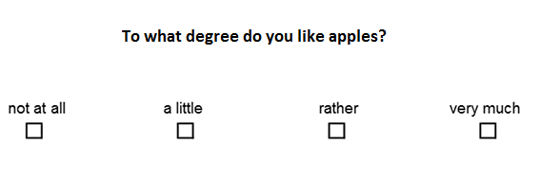
Self-report scales
Notes:
Okay, so the focus on this project was on self-report scales, which are often used in psychology to assess individuals with regard to their latent constructs (e.g., self-esteem). These scales are commonly composed of various items, such as the one we see here, where individuals are asked to rate how much they agree with a certain statement by selecting a response option on a likert scales. so, in this case....

Slide 3

Psychometric properties
Essential to assess their psychometric properties, which entails, among other things, evaluating the measurement model (MM):
The number of latent psychological constructs (i.e., factors);
Which factor is measured by which item (i.e., factor structure);
Whether items are good measurements of factors (i.e., loading size);
Items that measure more than one factor at the same time (i.e., cross-loading).
Notes:
Evaluating the psychometric properties of these questionnaires is crucial for the validity of the assessment of the psychological trait being measures. This assessement mostly entails, evaluating the MM. Meaning (read points).

Slide 4
Exploratory Factor Analysis (EFA)
Step 1: Determining the number of factors;
Step 2: Solve rotational freedom.
Notes:
There are various tools to evaluate the psychometric properties of such scales but one of the most commonly used ones, in the case of newly developed scales (i.e., scales where the MM has not yet been assessed) is EFA, where, without imposing an assumed structure on the MM, we can identify the relations between the items forming the questionnaires and the latent constructs, or factors. EFA normally comprises two primary steps. In the first step the number of factors (i.e., latent constructs) must be determined. These factors, however, have rotational freedom (meaning that rotating them does not affect the fit of the model), and to obtain an interpretable solution we must resolve rotational freedom. I will quickly go through these two steps now

Slide 5
Step 1: Model selection
Objective criteria:
Bayesian Information Criterion (BIC; Schwarz et al., 1978);
Parallel analysis (PA; Horn, 1965);
Convex Hull procedure (Chull; Ceulemans & Kiers, 2006; Lorenzo-Seva, Timmerman, & Kiers, 2011);
Subjective criteria (i.e., interpretability).
Notes:
so, first, as I just said, we must select the number of factors, and this decision relies both on objective and subjective criteria. Some of the most commonly objective criteria are the Bayesian information criterion (which is a function of how well the model fits the data and the model's complexity), Parallel analysis, which takes sampling variablity into account when selecting the number of factors ( we compared the distribution of eigen fctors estimated from a number of randomly generated polychoric/correlation matrices and, afterwards, we retain a factor if its eigenvalue is larger than a given cut-off) and, finally, the convex hull procedure, which can be see as a generalization of the scree test, where a goodness-of-fit measure (e.g., explained variance) is plotted against the degree of freedom and, then, the solution which is on or close the elbow of the higher boundary of the convex hull plot is selected.
Finally, these objective criteria are normally weighed in by subjective interpretation of the researchers to make sure that the extracted number of factors can be actually interpreted.

Slide 6

Step 2: Rotational freedom
Extracted (i.e., retained) latent factors have rotational freedom, which should be resolved to obtain an interpretable solution.
Commonly, the goal is to strive for simple structure (i.e., each item is a pure measurement of a single factor) and with correlated factors (i.e., oblique).
This can be achieved by means of:
Uninformed rotation approaches: without applying any user-specified expectations regarding the MM (e.g., oblimin, varimax).
Informed rotation approaches: with expectations regarding the MM via a user-specified target loading matrix (e.g., target rotation).
Notes:
After the number of factors is determined the next goal is to solve rotational freedom for the extracted factors. Commonly the goal is to strive for simple structure, meaning that the rotation algorithm uses certain criteria to miminze the variable complexity. In addition, it is commonly prefered to allow the extracted factors to be correlated since purely orthogonal factors (factor that do not correlate at all) are considered to be theoretically less likely than oblique factors (correlated) in psychology. When rotating these factors different algorith exist for simple structure and oblique factors and they mostly differ with regard to the possibility of specifying expectations with regard to the measurement model by the researcher. Therefore, we might have uninformed rotation approaches (oblimin) or informed rotation approaches. The latter allows the researchers to specify expectations regarding the measurement model via a user-specified target loading matrix.

Slide 7

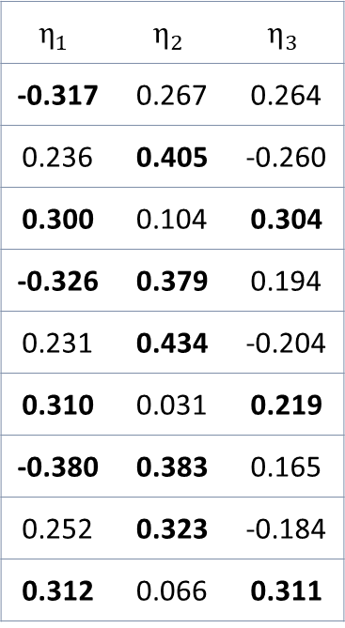

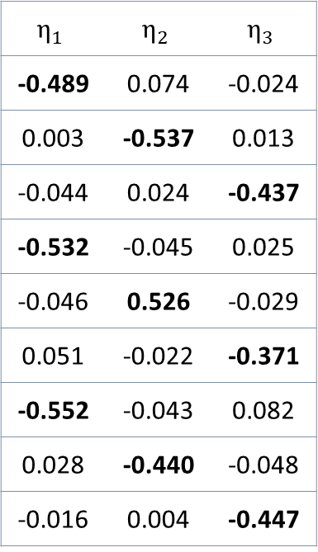
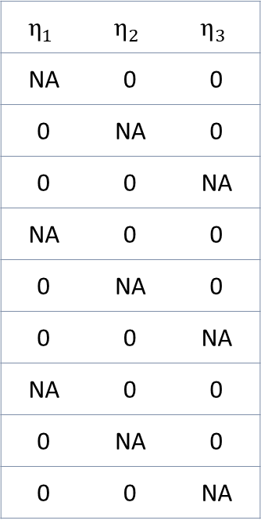
Informed rotation
Unrotated loadings
Semi-specified target
Target-rotated loadings
$$η_{1}$$ | $$η_{2}$$ | $$η_{3}$$
-0.317 | 0.267 | 0.264
0.236 | 0.405 | -0.260
0.300 | 0.104 | 0.304
-0.326 | 0.379 | 0.194
0.231 | 0.434 | -0.204
0.310 | 0.031 | 0.219
-0.380 | 0.383 | 0.165
0.252 | 0.323 | -0.184
0.312 | 0.066 | 0.311
$$η_{1}$$ | $$η_{2}$$ | $$η_{3}$$
NA | 0 | 0
0 | NA | 0
0 | 0 | NA
NA | 0 | 0
0 | NA | 0
0 | 0 | NA
NA | 0 | 0
0 | NA | 0
0 | 0 | NA
$$η_{1}$$ | $$η_{2}$$ | $$η_{3}$$
-0.489 | 0.074 | -0.024
0.003 | -0.537 | 0.013
-0.044 | 0.024 | -0.437
-0.532 | -0.045 | 0.025
-0.046 | 0.526 | -0.029
0.051 | -0.022 | -0.371
-0.552 | -0.043 | 0.082
0.028 | -0.440 | -0.048
-0.016 | 0.004 | -0.447
$Λ$ =
B =
$Λ^{∗}$ =
Notes:
To make this more clear here is an example of target rotation. On the left we can see the loadings extracted from a three factor solution.
When using target-rotation we can rotate these unrotated loadings towards a target-loading matrix, where we can use zero or any non-zero value for the target elements, but commonly researcher only indicate the 0 loadings because values for the non-zero loadings are rarely known prior to estimating the model.
These loadings might not be easy to interpret and, in order to solve rotational freedom, we might specify a target loading matrix B (middle)where, based on specific assumption or expectations, we specify whether a certain item is expected to load on one of these three factors. In many practical applications it is recommended to specify only the zero loadings since precise values for the non-zero loadings are rarely if ever known prior to estimating the model. The right-most matrix displays the results of the rotated loadings and I marked in bold all those items that were indicated as 0 which turned out to have a close-to-zero value.

Slide 8
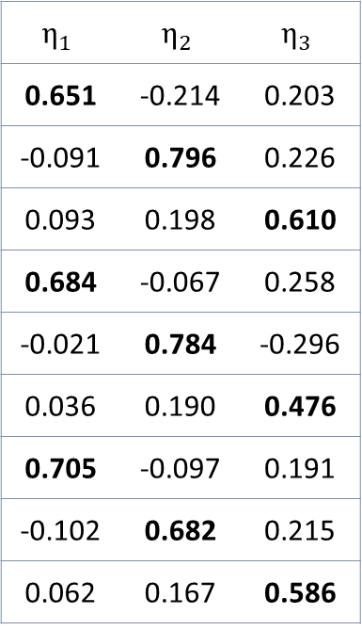
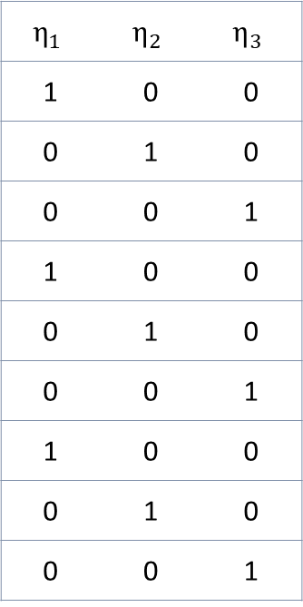
Informed rotation
Unrotated loadings
Fully-specified target
Target-rotated loadings
$$η_{1}$$ | $$η_{2}$$ | $$η_{3}$$
-0.317 | 0.267 | 0.264
0.236 | 0.405 | -0.260
0.300 | 0.104 | 0.304
-0.326 | 0.379 | 0.194
0.231 | 0.434 | -0.204
0.310 | 0.031 | 0.219
-0.380 | 0.383 | 0.165
0.252 | 0.323 | -0.184
0.312 | 0.066 | 0.311
$$η_{1}$$ | $$η_{2}$$ | $$η_{3}$$
1 | 0 | 0
0 | 1 | 0
0 | 0 | 1
1 | 0 | 0
0 | 1 | 0
0 | 0 | 1
1 | 0 | 0
0 | 1 | 0
0 | 0 | 1
$$η_{1}$$ | $$η_{2}$$ | $$η_{3}$$
0.651 | -0.214 | 0.203
-0.091 | 0.796 | 0.226
0.093 | 0.198 | 0.610
0.684 | -0.067 | 0.258
-0.021 | 0.784 | -0.296
0.036 | 0.190 | 0.476
0.705 | -0.097 | 0.191
-0.102 | 0.682 | 0.215
0.062 | 0.167 | 0.586
$Λ$ =
B =
$Λ^{∗}$ =
Notes:
To make this more clear here is an example of target rotation. On the left we can see the loadings extracted from a three factor solution. These loadings might not be easy to interpret and, in order to solve rotational freedom, we might specify a target loading matrix B (middle)where, based on specific assumption or expectations, we specify whether a certain item is expected to load on one of these three factors. In many practical applications it is recommended to specify only the zero loadings since precise values for the non-zero loadings are rarely if ever known prior to estimating the model. The right-most matrix displays the results of the rotated loadings and I marked in bold all those items that were indicated as 0 which turned out to have a close-to-zero value.

Slide 9

Acquiescence Response Style
Subject’s responses not always consistent with the measured psychological construct.
These inconsistencies, defined as response styles (RSs), are stylistic tendencies in the manner individuals respond to items (Paulhus, 1991).
Acquiescence (or agreeing) response style (ARS) is a tendency to agree with items regardless of their content.
Notes:
Now, so far, this seems all okay. Subject responses on self report scales, however, are not always consistent with the measured psychological construct. In fact, subject responses often show stylistic tendencies in the way they use a self-report scale. One of the most studied and common response sytle is the acquiescent one where subjects tend to agree with items regardless of their content. (In the next slide we can see an example of two subjects, one showing a normal response patter and one showing an acquiescent response pattern). When not taken into account such tendency can be extremely harmful. In fact, previous research indicated how an ARS can ARS can harm the assessment of a scale’s psychometric properties in many ways:
Inflate observed means and correlations (Van Vaerenbergh & Thomas, 2013);
Increase or decrease factor loadings (Ferrando & Lorenzo-Seva, 2010);
Result in an additional factor (Billiet & McClendon, 2000).

Slide 10
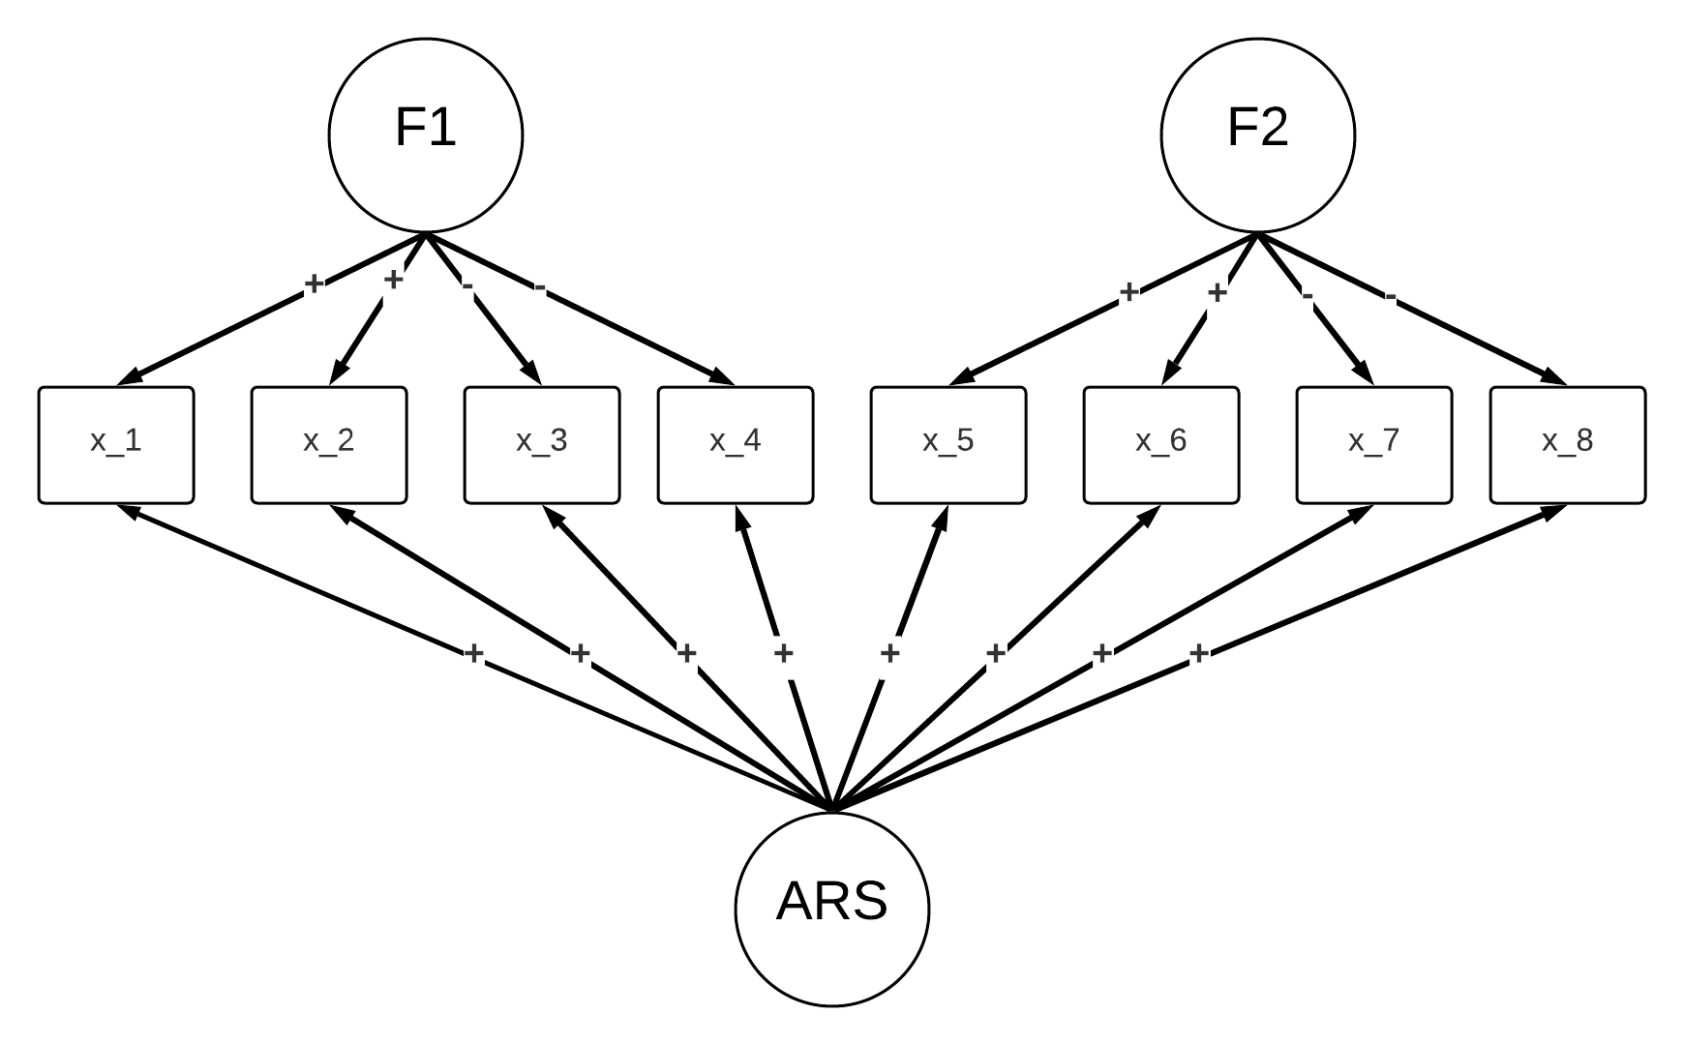
Correcting for ARS
Counting the number of agreements;
Counting double agreements on reversed items;
Specify an additional ARS factor (see Billiet & McClendon, 2000).
Notes:
In the literature there is a multitude of methods that have been proposed to correct for ARS. Some of them include....
However, in this project we focused purely on a latent variable approach, where ARS is specified as an additional factor. To use the example that we have been discussing so far, this means that an additional factor is included, which is considered to be measuring ARS. Note that this factor loads on all items since ARS is assumed to be a person-specific characteristics and not necessarily item-specific. Also, ARS is considered to be correlated with the content traits and there is some literature that indicates why this might be the case for some psychological traits (e.g., conscientiousness).

Slide 11
Correcting for ARS
If the scale has been validated:
Number of content factors is known a priori;
MM is (assumed to be) known;
ARS can be explicitly included as an additional factor.
If the scale has not been validated:
Number of content factors may not be (entirely) known a priori;
Structure of the MM is not (entirely) known.
ARS may be hard to detect
Notes:
This method might be easy to implement in the case of confirmatory approaches where the number of factors and the structure of the MM is known a-priori. However, in the case of EFA, specifying an additional ARS factor might not be easy because both the number of factors and the MM is not known.

Slide 12
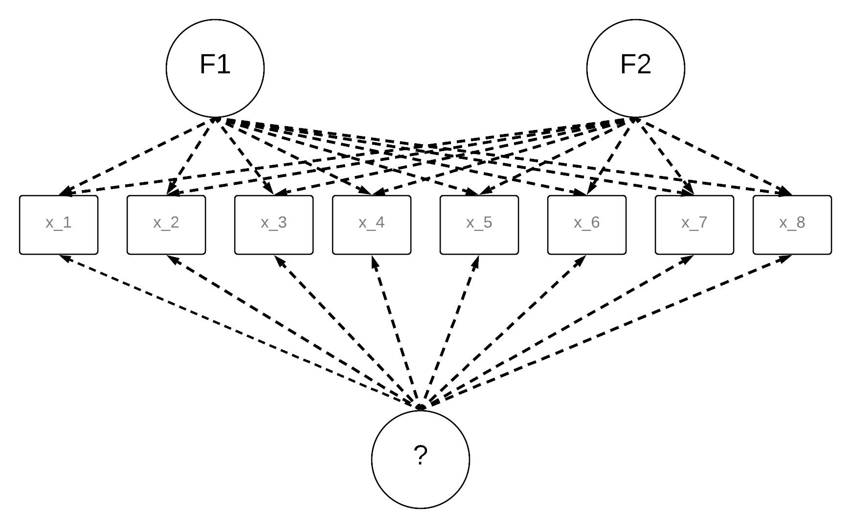
Potential effects of ARS on EFA
In the model selection step an additional factor could be selected that may be the ARS factor
Notes:
Therefore, in the model selection step, if one naively ignores the risk of an ARS such factor may be erroneously interpreted as an additional content factor. Moreover, not beware that an additional factor measures ARS might also be problematic because it could lead the researcher to conclude that items load on multiple factors or that they are a poor measurement of a factor.

Slide 13
Potential effects of ARS on EFA
When ARS is not taken into account in the rotation step (i.e., simple structure is assumed), items may seem to malfunction because they:
Load on multiple factors (i.e., cross-loading)
Poorly measure a factor (i.e., small loadings)
Notes:
Therefore, in the model selection step, if one naively ignores the risk of an ARS such factor may be erroneously interpreted as an additional content factor. Moreover, not beware that an additional factor measures ARS might also be problematic because it could lead the researcher to conclude that items load on multiple factors or that they are a poor measurement of a factor.

Slide 14

How harmful is it to ignore ARS
Notes:
To summarize, ARS can be especially problematic when evaluating the psychometric properties of newly developed scales but, in the literature, it is not yet clear to what extent can ARS actually be. this was the starting point of our investigation, and to answer this research question we conducted a simulation study to investigate..

Slide 15
How harmful is it to ignore ARS
We conducted a simulation study to evaluate the impact of an ARS on the assessment of the psychometric properties of unidimensional and multidimensional scales using EFA.
We investigated the effect of ARS on:
The suggested number of factors;
The recovery of factor loadings and correlations when an additional ARS factor was extracted;
The recovery of factor loadings and correlations when an additional ARS factor was not extracted.

Slide 16

Simulation study
Number of subjects N at 2 levels: 250, 500;
Number of item categories C at 3 levels: 3, 5, 7;
Type of scale at 2 levels: balanced, unbalanced;
Number of content factors Q at 2 levels: 1, 2;
Number of items J per factor at 2 levels: 12, 24;
Strength of the ARS factor at 3 levels: small, medium and large.
For each condition, 100 replications were generated.

Slide 17
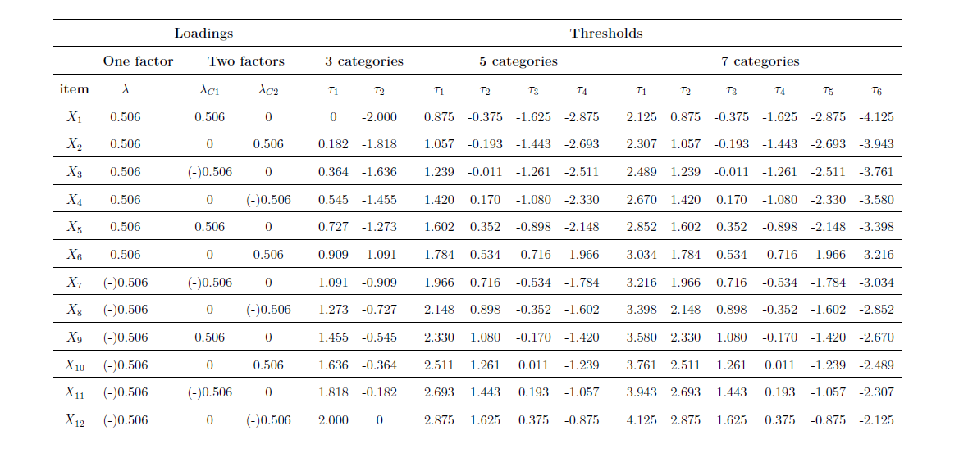
Data generation and analyses
1
Data were generated under a Q-dimensional normal ogive graded response model using the R-package mirt (Chalmers, 2012)

Slide 18
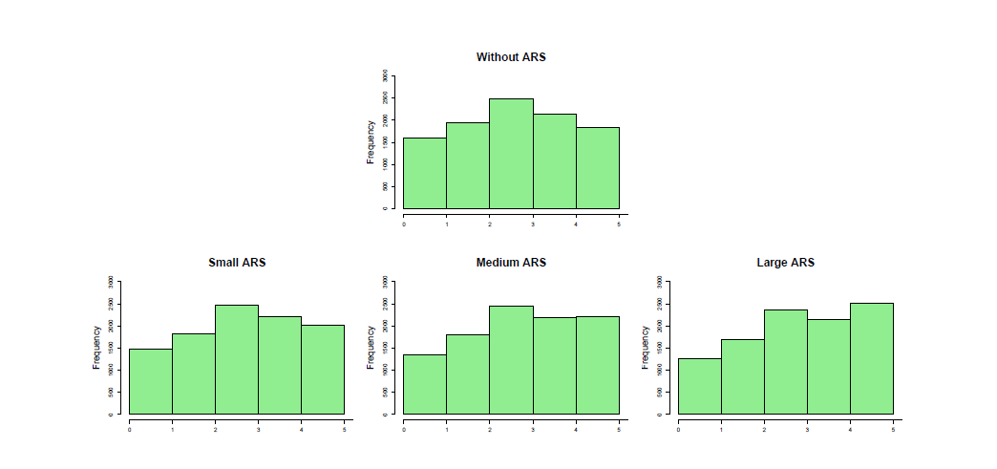
Data generation and analyses
1
ARS scores were sampled from a right-censored normal distribution to simulate subjects who either did or did not show an ARS, without allowing for scores representing a negative ARS (i.e., disagreeing).
Value of loadings for small medium and large ARS were .218, .343 and . 506, respectively.
Effects of the ARS manipulation on a 5 categories item
Notes:
You can see the effect of the different levels of this manipulation on a single item

Slide 19
Data generation and analyses
1
Data were generated under a Q-dimensional normal ogive graded response model using the R-package mirt (Chalmers, 2012)
2
EFA models were estimated with up to three factors (i.e., unidimensional scales) and up to four factors (i.e., multidimensional scales)
3
Three model selection criteria were considered to evaluate the number of dimensions:
4
For all data sets, we estimated the EFA models using both Pearson correlation and polychoric correlation
Irrespective of the model selection results, the loadings for the model with and without the ARS factor were rotated using:
Oblimin (i.e., uninformed rotation approach);
Fully specified target rotation (informed rotation approach);
Semi-specified target rotation (informed rotation approach).
ARS scores were sampled from a right-censored normal distribution to simulate subjects who either did or did not show an ARS, without allowing for scores representing negative ARS (i.e., disagreeing).
Value of loadings for small medium and large ARS were .218, .343 and . 506, respectively.*
Bayesian Information Criterion (BIC; Schwarz et al., 1978);
Paralell Analysis (PA; Horn, 1965);
Convex-hull procedure (Ceulemas & Kiers, 2006) using the CAF index (Lorenzo-Seva et al., 2011).
*Rescaling the generating values of the ARS loadings based on a right-censored normal distribution resulted in in loading of .128, .200 and .299 for the small, medium and large ARS conditions,
Notes:
The CAF index expresses the degree to which the extracted factor(s) capture the common variance in the data. To calculate the CAF, first the Kaiser-Meyer-Olkin (KMO; Kaiser, 1970; Kaiser & Rice, 1974) index is calculated on the estimated residual correlation matrix q 258 of a factor model with q factors. Then, the CAF for a model with q factors is obtained as CAFq = 1-KMO. The values of the CAF index range from 0 to 1, where values close to 1 indicate that no substantial amount of common variance is left in the residual matrix after extracting q factors.
Kaiser-Meyer-Olkin (KMO) Test is a measure of how suited your data is for Factor Analysis. The test measures sampling adequacy for each variable in the model and for the complete model. The statistic is a measure of the proportion of variance among variables that might be common variance.

Slide 20
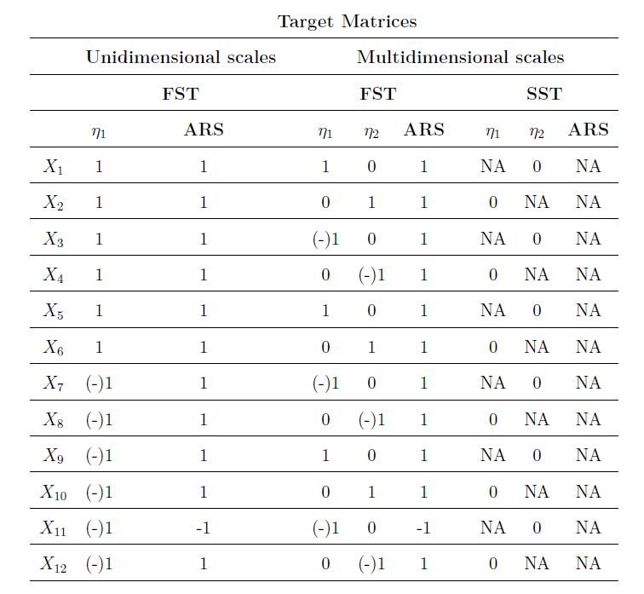
Data generation and analyses
4
Irrespective of the model selection procedures, the loadings for the model with and without the ARS factor were rotated using:
Oblimin (i.e., uninformed rotation approach);
Target rotation (informed rotation approach);
Semi-specified target rotation (informed rotation approach).

Slide 21


Slide 22
How many factors were suggested?
The true positive rate (TPR), for each of the model selection criteria, was calculated (i.e., proportion of selecting the model with an additional ARS factor)
The results showed that, both for unidimensional and multidimensional scales, the most impactful design factors were:
The type of scale, i.e., the additional ARS factor was almost never captured in unbalanced scales;
The strength of the ARS, i.e., the additional ARS factor was often selected when its strength was medium or large, and especially by Pearson-based PA.
Notes:
TPR represents the proportion of selecting a two-or three- factor model for unidimensional and multidimensional scales, respectively

Slide 23



How well were the parameters recovered?
 |  | Uninformed Rotation approaches |  |  | Informed rotation approaches
 |  | Loadings (RMSE) | Cross-loadings (MMAB) | Factor correlations (RMSE) | Loadings (RMSE) | Cross-loadings (MMAB) | Factor correlations (RMSE)
ARS factor extracted | Balanced Scales
 | Unbalanced Scales
ARS factor not extracted | Balanced Scales
 | Unbalanced Scales
RMSE = root mean square error; MMAB = mean maximum absolute bias for the zero loadings;

Slide 24
Conclusions
For balanced scales:
Especially large ARS resulted in selecting an additional factor;
When an additional factor is retained, beware that this may be an ARS factor and use informed rotation approaches;
Not retaining an additional ARS factor results in large cross-loadings (irrespective of the rotation);
For unbalanced scales:
ARS is hard to disentangle from the content factor(s);
Not extracting ARS as an additional factor did not impact the factor loadings and correlation much.
Notes:
This may be due to the use of EFA, where the cross-loadings between the factors allow for a lot of flexibility so that the additional ARS factor is easily “absorbed” by the content ones;
naively rotating towards simple structure (i.e., assuming that each item measures only one factor) resulted in biased loadings as well as “non-ignorable” cross-loadings.

Slide 25
Limitations
Semi-balanced scales were not investigated;
Data were generated from a MM without cross-loadings;
Effect of ARS on factor scores was not evaluated (but can be crucial for unbalanced scales).

Slide 26
References
Billiet, J. B., & McClendon, M. J. (2000). Modeling acquiescence in measurement models for two balanced sets of items. Structural equation modeling, 7(4), 608-628.
Ceulemans, E., & Kiers, H. A. (2006). Selecting among three‐mode principal component models of different types and complexities: A numerical convex hull based method. British journal of mathematical and statistical psychology, 59(1), 133-150.
Chalmers, R. P. (2012). mirt: A multidimensional item response theory package for the R environment. Journal of statistical Software, 48(1), 1-29.
Ferrando, P. J., & Lorenzo‐Seva, U. (2010). Acquiescence as a source of bias and model and person misfit: A theoretical and empirical analysis. British Journal of Mathematical and Statistical Psychology, 63(2), 427-448.
Horn, J. L. (1965). A rationale and test for the number of factors in factor analysis. Psychometrika, 30(2), 179-185.
Lorenzo-Seva, U., Timmerman, M. E., & Kiers, H. A. (2011). The Hull method for selecting the number of common factors. Multivariate behavioral research, 46(2), 340-364.
Paulhus, D. L. (1991). Measurement and control of response bias.
Schwarz, G. (1978). Estimating the dimension of a model. The annals of statistics, 461-464.
Van Vaerenbergh, Y., & Thomas, T. D. (2013). Response styles in survey research: A literature review of antecedents, consequences, and remedies. International journal of public opinion research, 25(2), 195-217.

Slide 27
Thank you for your attention!
E. Damiano D’Urso
E.D.Durso@tilburguniversity.edu

Slide 28
For empirical practice (balanced scales)…
Do | Don’t
Extract an additional factor. | Ignore an additional factor if suggested in the model selection step.
Rotate using informed rotation approaches. In particular, for multidimensional scales, we recommend using semi-specified target rotation | If an additional factor is suggested, do not rotate using uninformed rotation approaches.
Compare this solution to one without an additional factor

Slide 29








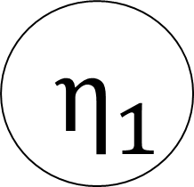


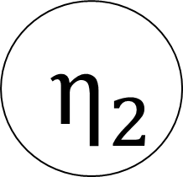


Number of factors
$${ η}_{1}$$
$${ η}_{2}$$
${X_1}^{+}$
$${X_3}^{−}$$
$${X_5}^{+}$$
$${X_7}^{−}$$
$${X_9}^{+}$$
$${X_11}^{−}$$
$${X_2}^{+}$$
$${X_4}^{−}$$
$${X_6}^{+}$$
$${X_8}^{+}$$
$${X_10}^{+}$$
$${X_12}^{+}$$
Notes:
Let us have a look here at this scenario where we have 12 items (mention + and -)
The goal, in the first step of EFA, is determining how many factors are measured by these items.
For example, in this case, we have two latent factors.
- Note that EFA is extremely flexibile, and thus it is not necessary to pre-specify anything with regard to the structure of the model.

Slide 30
Rotational freedom
$${ η}_{1}$$
$${ η}_{2}$$
${X_1}^{+}$
$${X_3}^{−}$$
$${X_5}^{+}$$
$${X_7}^{−}$$
$${X_9}^{+}$$
$${X_11}^{−}$$
$${X_2}^{+}$$
$${X_4}^{−}$$
$${X_6}^{+}$$
$${X_8}^{+}$$
$${X_10}^{+}$$
$${X_12}^{+}$$
Notes:
Again, what we are graphically doing is basically starting from the model here where all items load on both factors to a more parsimonious solution where items primary load on only factor.

Slide 31
Rotational freedom
$${ η}_{1}$$
$${ η}_{2}$$
${X_1}^{+}$
$${X_3}^{−}$$
$${X_5}^{+}$$
$${X_7}^{−}$$
$${X_9}^{+}$$
$${X_11}^{−}$$
$${X_2}^{+}$$
$${X_4}^{−}$$
$${X_6}^{+}$$
$${X_8}^{+}$$
$${X_10}^{+}$$
$${X_12}^{+}$$

Slide 32
Potential effects of ARS
ARS can harm the assessment of a scale’s psychometric properties in many ways:
Inflate observed means and correlations (Van Vaerenbergh & Thomas, 2013);
Increase or decrease factor loadings (Ferrando & Lorenzo-Seva, 2010);
Result in an additional factor (Billiet & McClendon, 2000).
Notes:
Now, so far, this seems all okay. Subject responses on self report scales, however, are not always consistent with the measured psychological construct. In fact, subject responses often show stylistic tendencies in the way they use a self-report scale. One of the most studied and common response sytle is the acquiescent one where subjects tend to agree with items regardless of their content. (In the next slide we can see an example of two subjects, one showing a normal response patter and one showing an acquiescent response pattern). When not taken into account such tendency can be extremely harmful. In fact, previous research indicated how an ARS can (read points).

Slide 33

Potential effects of ARS on EFA:

Slide 34














Potential effects of ARS on EFA The data generating model
$${ η}_{1}$$
$${ η}_{2}$$
${X_1}^{+}$
${X_3}^{−}$
$${X_5}^{+}$$
${X_7}^{−}$
${X_9}^{+}$
${X_11}^{−}$
${X_2}^{+}$
${X_4}^{−}$
${X_6}^{+}$
${X_8}^{−}$
${X_10}^{+}$
${X_12}^{−}$
ARS

Slide 35
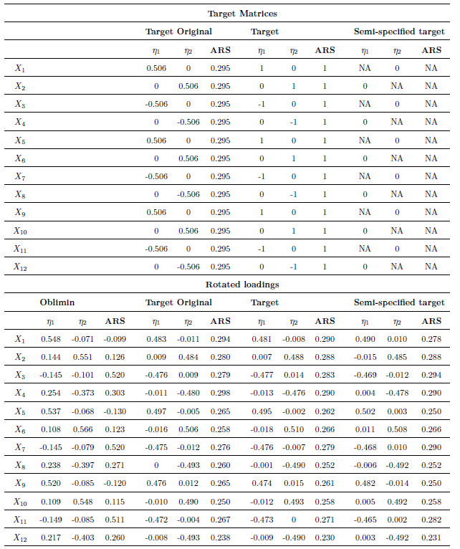
Potential effects of ARS on EFA:
Factor rotation
Ignoring (i.e., not taking into account) ARS when rotating:
Splits the positive and negative pole of one content factor;
Results in cross-loadings.
Therefore, in empirical practice, researchers might:
Interpret this additional ARS factor as substantial (e.g., good and bad factor);
Erroneously exclude items from a scale.
Notes:
And, to give you an example of how ARS can affect EFA I would like to guide you throw an example. On the top part of the table under the heading target original you can see the values of the model that we used to generate some artificial data. As you can see we have two content factors (eta1 and eta2), which are the factors that we are interested in measuring. Additionally, we also have an ARS factor with loadings of .295 on all items. After generating some data for 10,000 subjects we estimate a factor model and we rotate using an informed rotation approach. In other words, as one would normally do when unaware of the risk of an ARS, we would rotate the factor solution assuming that each item is a pure measurement of a single factor. As you can see from the obtained rotated loading below, rotating the obtained solution using an informed rotation approach can be quite problematic. For example, the oblimin rotated loadings seem to split the negative pole of one content factor and, additionally, showed some cross-loadings. Therefore, based on these rotated loadings one would conclude that...

Slide 36
Potential effects of ARS on EFA:
Factor rotation
Taking ARS into account when rotating (i.e., target rotation) results in well-recovered factor loadings.
In addition, semi-specified target rotation performs as well as fully-specified target rotation.
Notes:
Differently, when ARS is take into account by means of informed rotation approaches, the factor loadings seem to be more accurately recovered both when the loadings are partly or fully specified.

Slide 37

















Potential effects of ARS on EFA:
Model selection
Different factors might play a role in retaining (i.e., selecting) ARS as an additional factor, such as:
Amount of variance explained by the ARS factor. Various studies suggest that ARS is a weak factor (i.e., items showing weak to moderate loadings);
Type of scale:
Balanced (i.e., half positively worded and half negatively worded items);
Partially balanced (i.e., a few negatively worded items);
Unbalanced (i.e., only positively worded items);
?
$${ η}_{1}$$
$${ η}_{2}$$
${X_1}^{+}$
${X_3}^{−}$
${X_5}^{+}$
${X_7}^{−}$
${X_9}^{+}$
${X_11}^{−}$
${X_2}^{+}$
${X_4}^{−}$
${X_6}^{+}$
${X_8}^{−}$
${X_10}^{+}$
${X_12}^{−}$
Notes:
So far I have only discussed the issues that might arise when not taking into account an ARS when rotationg the extracted factor but, of course, ARS might also affect model selection. That is, the ARS factor might not be always easy to capture when determining the number of factors because (read points).

Slide 38




Potential effects of ARS on EFA:
Model selection
Failure to select the ARS factor could result in:
Biased content factors’ loadings;
Biased factor correlations.
$${ η}_{1}$$
$${ η}_{2}$$
${X_1}^{+}$
${X_3}^{−}$
$${X_5}^{+}$$
${X_7}^{−}$
${X_9}^{+}$
${X_11}^{−}$
${X_2}^{+}$
${X_4}^{−}$
${X_6}^{+}$
${X_8}^{−}$
${X_10}^{+}$
${X_12}^{−}$
ARS
38
Notes:
Failing to select the ARS factor could be especially problematic when assessing the factor loadings, because it could for example (read points)

Slide 39
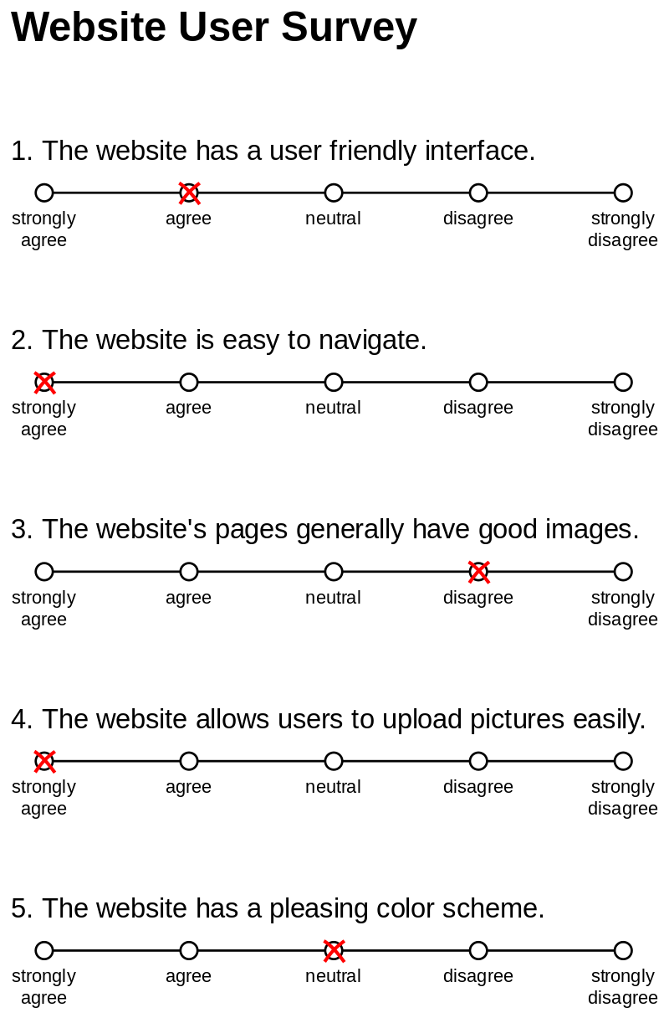
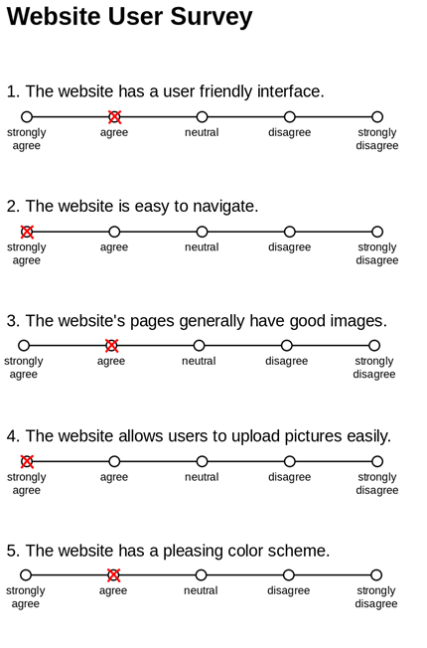

Slide 40
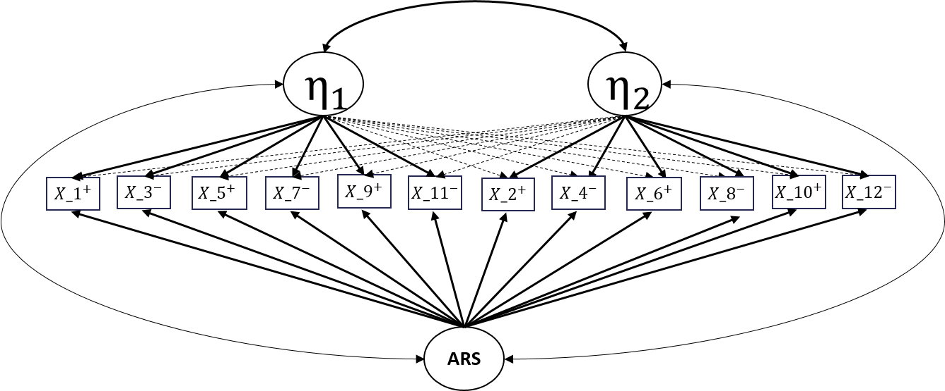
Correcting for ARS
Counting the number of agreements;
Counting double agreements on reversed items;
Specify an additional ARS factor.
Notes:
In the literature there is a multitude of methods that have been proposed to correct for ARS. Some of them include....
However, in this project we focused purely on a latent variable approach, where ARS is specified as an additional factor. To use the example that we have been discussing so far, this means that an additional factor is included, which is considered to be measuring ARS. Note that this factor loads on all items since ARS is assumed to be a person-specific characteristics and not necessarily item-specific. Also, ARS is considered to be correlated with the content traits and there is some literature that indicates why this might be the case for some psychological traits (e.g., conscientiousness).

Slide 41
Potential effects of ARS on EFA
When ARS is not taken into account in the rotation step (i.e., simple structure is assumed), items may seem to malfunction because they:
Load on multiple factors (i.e., cross-loading)
Poorly measure a factor (i.e., small loadings)
Notes:
Therefore, in the model selection step, if one naively ignores the risk of an ARS such factor may be erroneously interpreted as an additional content factor. Moreover, not beware that an additional factor measures ARS might also be problematic because it could lead the researcher to conclude that items load on multiple factors or that they are a poor measurement of a factor.

Slide 42
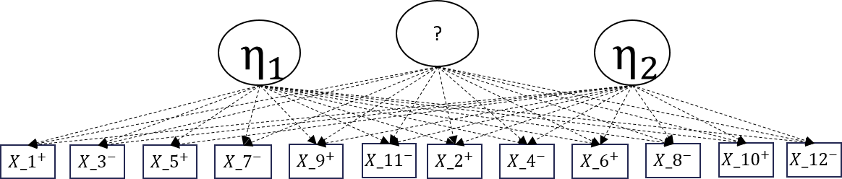
Potential effects of ARS on EFA
In the model selection step ARS could be erroneously interpreted as an additional content factor.
Notes:
Therefore, in the model selection step, if one naively ignores the risk of an ARS such factor may be erroneously interpreted as an additional content factor. Moreover, not beware that an additional factor measures ARS might also be problematic because it could lead the researcher to conclude that items load on multiple factors or that they are a poor measurement of a factor.

