Slide 1

SENTIMENT ANALYSIS

Slide 2
PROBLEM FORMULATION
Background
Based on Risk Management, Reputational Risk is one of risks that can potentially lead a company to have bad image amidst the public.
The cause and trigger of the Reputational Risk may be varied. It can be from customers’ complaints, public’s review, hoax, false information about products/service/job vacancy and the likes.
It becomes Reputational Risk if those conversation/information is published/blew up/disclosed in public forums which are mostly on online platform such as online news portal, online forum or social media.
If it happens this eventually triggers to bigger problem such as customer’s distrust, internal conflicts, litigation and also business activities decrease (business loss).
Reputational Risk is the responsibility of all Company’s elements from management to employment. In daily business, this specifically becomes the responsibility of a cross-departments task force consisting of Corp.Comm Unit, Legal Unit, Customer Relation Unit, Risk Management Unit, and BCM Unit.
Risks cannot be omitted but it can be reduced in terms of adverse impacts to the Company. One of the effective ways is by anticipating the root cause/trigger as early as possible so the task force has an opportunity to prepare the mitigation and strategy to overcome the adverse impacts that may arise.
Online Sentiment Detector is present to provide the solution to early detection of Reputational Risks’ cause/trigger, particularly in online media.
Why?
The amount conversations on online platform are very vast and mostly in the form of text. The related team may analyze those texts, but mostly they lack time and resources to check and review each conversation’s sentiment one by one.
Therefore, Online Sentiment Detector is needed to help the team classifying those vast data more quickly and efficiently so they can focus on the quality of strategy to handle the risks. In addition, if the classification process is done manually, each team member’s subjectivity in labelling the sentiment may rise information bias and affect the decision-making process.
Human’s subjectivity may be affected by individual’s background, education, perspective/point and also body stamina.
In this case machine learning model (sentiment prediction) helps the manual classification process that is done by human.
Users
It is usually under the supervision of Corporate Communications team
The task force can also access to get faster update
Positive Impacts
The automation of process to identify and detect negative conversations and what topics are discussed
The team can focus on handling and follow up negative conversations (customers’ complaint, hoax, negative campaign, and the likes)
Reducing the potential business loss since the root cause can be mitigated earlier (compared to real cases -> an insurance agent publish a content that attacks an association, this leads the insurance company to spend budget for resolution process including negotiation and compensation to the association)
Company can save budget for hiring agency that provide this service since now the company can set up its own system ( save up to Rp 500 M per year)

Slide 3
Limitation
Limited to 7 days backward
Still only cover twitter post, reply and comments
Future Works
Customers’ Email Sentiment analysis that can be used by
Customer Service: to follow up complaints as immediately as possible
Sales Business: to identify bad-feeling customers and decide what the best treatment should be done to retain them
Early Warning System for Top 5 Negative Contents
Image detection for fraud analysis (fake information, fake job vacancy) or brand misuse (use of logo that does not align with Company’s guideline)

Slide 4
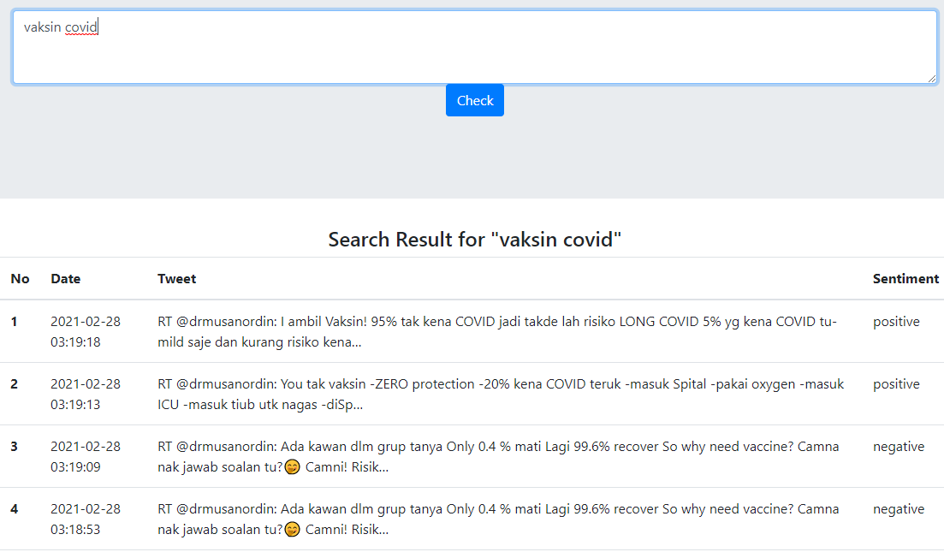
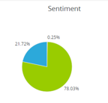
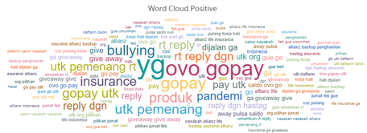
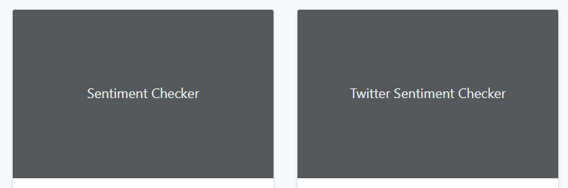
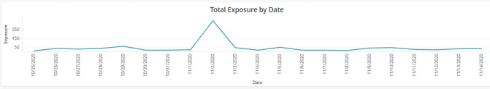
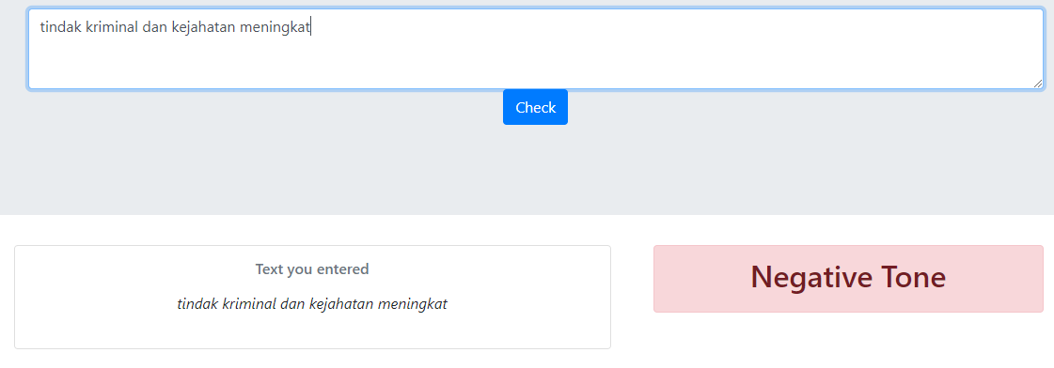
PROTOTYPE
Social Media Sentiment Analysis (Twitter)
Filter:
- Date
- Sentiment
Text Sentiment Checker

Slide 5
DATA
Data for sentiment prediction training
Github
IndoNLU
Others
Github – rizalespe (https://github.com/rizalespe/Dataset-Sentimen-Analisis-Bahasa-Indonesia )
- Dataset sentimen Twitter Pilkada DKI 2017
- Dataset sentimen Twitter layanan telekomunikasi Indonesia
- Dataset sentimen komentar Instagram Cyberbullying
- Dataset sentimen Twitter tayangan televisi
- Dataset sentimen Twitter opini film
- Dataset emoji
Github – indobenchmark (https://github.com/indobenchmark/indonlu/tree/master/dataset/smsa_doc-sentiment-prosa)
Meltwater

Slide 6
INPUT & OUTPUT
Sentiment Analysis Model
Single words
Phrases
Sentences
Emoticon
File Input
Sentiment Result

Slide 7
MAIN FEATURES
Feature 1: Sentiment Prediction
From whose perspective?
What industry/topic?
What are the channels from?
What data will be collected?
Accuracy & confusion matrix?
Every content’s sentiment is labelled/predicted automatically
The accuracy and confusion matrix should be better than previous projects
Dataset should be legally collected and public
Provide benchmark score from popular classification algorithms (KNN, SVM, SGD, Random Forest, Naïve Bayes, Logistics Regression, Gradient Boosting) and deep learning algorithms (see Samuel Cahya & PyData slides)
Feature 2: Weekly text summary
Text summarization
Trend insight/keywords insight
Feature 3: Translation (English – Indonesian)
This feature is nice to have
It becomes added value for the project and also a distinguished factor from the previous project.
This works very simply, it is translating English to Indonesian.
Future Works
Early Warning System for Top 5 Negative Contents
Image detection for fraud analysis or brand misuse
Recommendation based on contents and sentiment

Slide 8
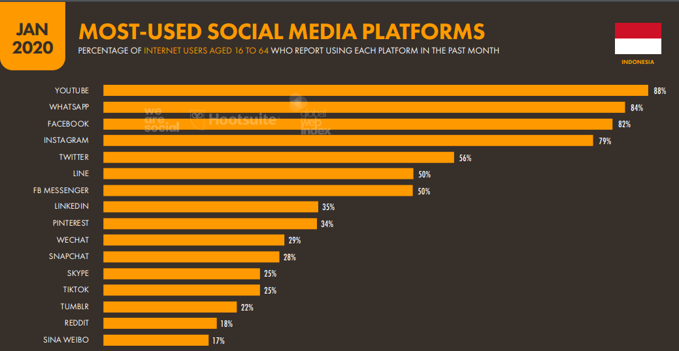
BACKGROUND
Based on Hootsuite Digital Report January 2020, Indonesia internet users are 175.4 million people
160 million of them are social media users
95% are actively engaged with social media where each of them spend averagely 3H 26M per day using social media
Continuing the trend from last years, digital behaviour of Indonesian people tend to grow higher moreover with the existence of pandemic. They are more actively engaged in digital in terms of accessing information, buying something, sharing insight or opinions.
On the other hand, brands/companies are also challenged to adapt in this condition. With more limited physical activities, they give more focus on optimizing all digital channels in providing services/distributing products as well as collecting data/listening to customers‘ voice.
Listening customers‘ or people‘s voice is really significant. One of key factors in capturing what customers‘/people want is through understanding their intention based on sentiment categorization.

Slide 9
THEORY
Sentiment analytics use techniques such as part of speech tagging, lemmatization, prior polarity, negations, ampliﬁers & other grammatical constructs, and semantic clustering to assign sentiment scores to social media posts, research survey questions and documents such as -1 (true negative) and 1 (true positive). A score of 0 or very close to 0 (±0.05) can be interpreted as being neutral; either there was no sentiment expressed or it was ambiguous – Repustate.com (https://www.repustate.com/sentiment-analysis/)
Industry benefited from sentiment analysis → e-commerce, banking & finance, healthcare, hospitality, market research, government & automobile manufacturing
The larger the corpus, and more importantly, the more varied the corpus, the better the results in creating the Indonesian part-of-speech tagger (https://www.repustate.com/indonesian-sentiment-analysis/)
Using NER to increase the quality of sentiment analysis (https://www.repustate.com/named-entity-recognition/)

Slide 10
LEARNING CYCLE
Streamed contents
Predicted sentiment
Storing the streamed contents and their sentiment
Taking them to be included in the training data
Updating the model and accuracy

