Slide 1
LogoType
Social Sentiment Detector
FINAL PROJECT
PURWADHIKA – JOB CONNECTOR DATA SCIENCE PROGRAM

Slide 2
Table of Contents
01
Background
Background, problem formulation, goal, impacts
02
Data Source & Preprocessing
Data integration, special elements handling, text preprocessing, twitter API
03
Modelling, Modelling Evaluation, Dashboard & Insight
Model development & evaluation, integration into dashboard, and insight
04
Business Impact Calculation & Future Improvements
Calculation of Return of Investment and some possible improvement in the future

Slide 3
Background
Background, problem formulation, goal, impacts

Slide 4
Risk Management
Credit Risk
Reputational Risk
Reputational Risk is one of 8 corporate risks that can potentially lead to a company bad image or reputation amidst the public.
This is cross-functions responsibility (Corporate Comm, Legal, BCM, Risk Management, and other related teams
Liquidity Risk
Market Risk
Operating Risk
Strategic Risk
Trigger
Legal Risk
Customer’s complaints, negative product/service review, hoax, false information, etc.
Compliance Risk
Domino Effect
Amidst the widespread use of online platform, a small trigger may be easily exposed to wider audience through media social, blog, online news or national TV.
In many cases it ultimately become national issue and government’s concern
Reputational Risk
Notes:
Standard Issue:
Use of copyright content
Not convenient service to certain public figure
National issue:
Jouska
Eiger
Garuda Indonesia
Reputational Risk is the responsibility of all Company’s elements from management to employment. In daily business, this specifically becomes the responsibility of a cross-departments task force consisting of Corp.Comm Unit, Legal Unit, Customer Relation Unit, Risk Management Unit, and BCM Unit.

Slide 5
Further Impacts
Reputational Risks can cause more adverse impacts to the company
Delayed Business Activities
Internal Conflict
Public Distrust
Litigation
Business Shutdown
Notes:
National issue:
Jouska → delayed and shut down
Eiger → negative sentiment
Garuda Indonesia → public distrust to management, change of BOD
National Police → not to publish the police action, but managed to be handled earlier

Slide 6
Reputational Risk Journey
1
2
3
4
Trigger
Consumed by specific audience
Getting viral
Public Attention / National Issue
Notes:
Journey of reputational risk

Slide 7
Reputational Risk Journey
Crucial Period
1
2
3
4
Trigger
Consumed by specific audience
Getting viral online forum, social media or online news
Public Attention / National Issue
Golden Times
01
There is a chance to mitigate as earlier as possible before getting worse and become crisis condition
Online Sentiment Detector
Different Action, Different Result
02
Early warning system and early mitigation may result in better output in the crisis management
Notes:
Although finally become national issue, at least public sees that the company did an effort to solve the root problem rather than considered ignoring the problem
The resolution is a combined coordination with other related parties (CEO, Legal Team, Business Risk Team, Corporate Communication, etc)

Slide 8
Why Online Sentiment Detector?
Efficient Supervision
Text data is vast and big. There should be a system that helps the team to analyze the content in an efficient way
24-Hour Monitoring
Preventing Human Subjectivity
The system can get the data by certain keywords and classify them into defined sentiment (good, bad, neutral).
With appropriate data, the system can learn and classify the data without any human bias (system evaluation continuously applied)
Focus & Productivity
More-Directed Follow-up Action
The related team can improve their focus on analyzing and mitigating any negative/bad sentiment.
Follow up action can be adjusted to what happens in the public.
Notes:
The amount of conversations on online platform are very vast and mostly in the form of text.
The related team may analyze those texts, but mostly they lack time and resources to check and review each conversation’s sentiment one by one.
Therefore, Online Sentiment Detector is needed to help the team classifying those vast data more quickly and efficiently so they can focus on the quality of strategy to handle the risks.
In addition, if the classification process is done manually, each team member’s subjectivity in labelling the sentiment may rise information bias and affect the decision-making process.
Human’s subjectivity may be affected by individual’s background, education, perspective/point and also body stamina.
In this case machine learning model (sentiment prediction) helps the manual classification process that is done by human.

Slide 9
Data Source & Preprocessing
Data integration, special elements handling, text preprocessing, twitter API

Slide 10
Data
 | Data Source
 | All data sources are taken from the following Github repositories: Rizalespe Louis Owen IndoNLU
 | Data Compilation
 | 12 datasets are combined into one This data is the combination of topics about general election, product/service review, emoji description and Indonesian’s single words dictionary
 | Final Data
 | The combination of all data results in 36,032 data. Cleaning process generate 27,617 data

Slide 11
Data Preprocessing
Text Preprocessing
Case
Lowering
Number
Removal
Punctuation
Removal
White Space
Removal
Slang/
Abbreviated
Words
Conversion
DATA IS
READY!!
Word
Stemming
Emoji
Conversion
Notes:
Standard text preprocessing: lowering all letters, removing numbers, removing punctuation, removing white space (non-standard white space such as tab space)
Step point 5 to 8 are specially designed to handle Indonesian text.
slang words converter
Indonesian people often shorten the standard words or use slang words when texting or posting something in the social media such as bkn (bukan), sm (sama), ngebully (intimadasi), au ah (tidak tahu) and the likes. In this step we will replace all the slang and abbreviated words into its standard form
emoji converter
by using this converter, the idea is to replace all emojis into its description. For example, 🙇 converted into Person_Bowing or 😮 converted into Face_With_Open_Mouth
stopwords removal we use nltk stopwords that is modified by omitting the negation words (tidak, bukan, jangan and belum) and adding some other forms found in the data such as nya and yg)
stemming since we are treating Indonesian text, so we will use Sastrawi library for stemming process (Sastrawi only provides stemming). NLTK and other NLP Libraries do not yet have the Indonesian-based stemming.
however, it should be noted that according to INDIRA SYAWANODYA in her Post-Graduate Thesis, Sastrawi's running time is slow and it impacts to its low performance.
we will see later that it will impact also to the model performance. We can see this illustration
running the stemming process to 27,617 data needs more than 1 hour
running hyperparameter tuning to create model for 19,000 training data needs more than 24 hours
running the hyperparameter tuning model for 100 new data needs approximately 30 seconds to 1 minute

Slide 12
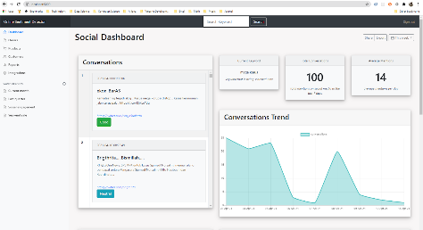
Data to be Predicted
In this context, the data still only cover Tweet data that is generated in real time by typing certain keywords
01
02
Tweet API
Text to DataFrame
Dashboard
Text data is generated by typing a keyword
The generated text is converted into dataframe and displayed in the dashboard
the new data and the prediction are displayed in several information and plot

Slide 13
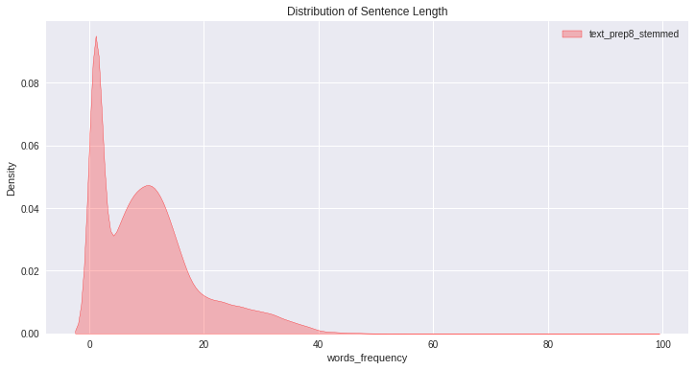
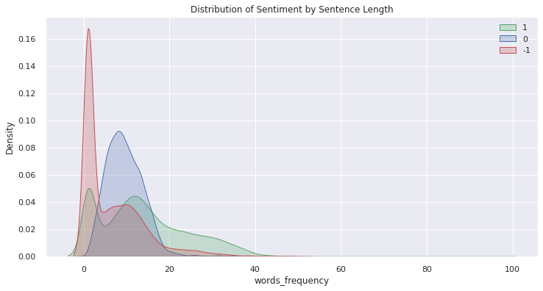
Data Insight – Words Length
Words Length
Data
Insight
the words length is in the range of 1 to 100 where most data is in the range of 1 to 15 words
good sentiment data is quite distributed in the range of 1 to 40
neutral sentiment data is normally distributed in the range of 1 to 20
bad sentiment data is mostly distributed in the range of 1 to 5

Slide 14
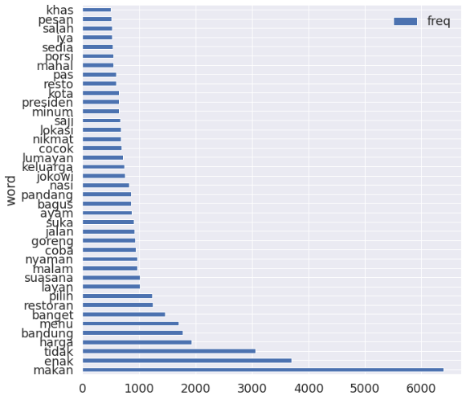
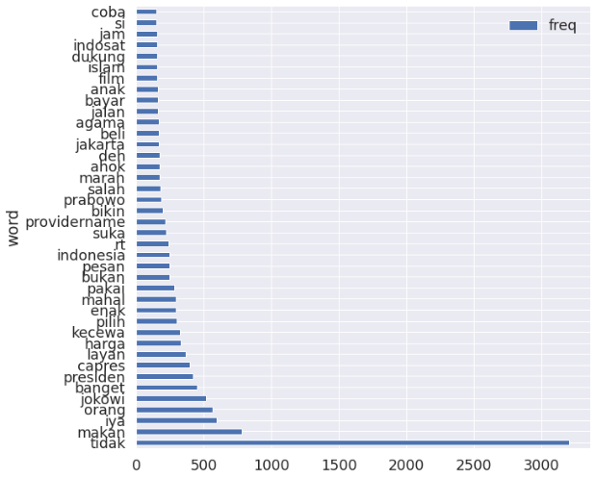
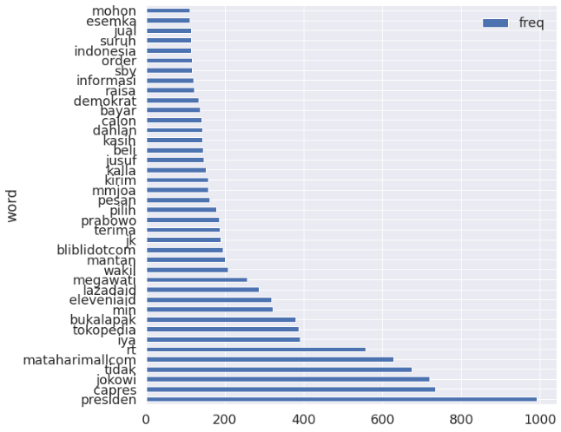
Data Insight – Word Frequency
Good
(1)
Bad
(-1)
Neutral
(0)
Words Frequency
Data
Insight
The word tidak doesn’t absolutely means negative or bad. It functions as the negation that can be assumed to negate something bad which in turn change the meaning into positive/neutral sentiment ('tidak jelek' or 'tidak apa-apa’)
tidak becomes the top words in bad sentiment. However, the frequency is lesser than those in good sentiment.

Slide 15
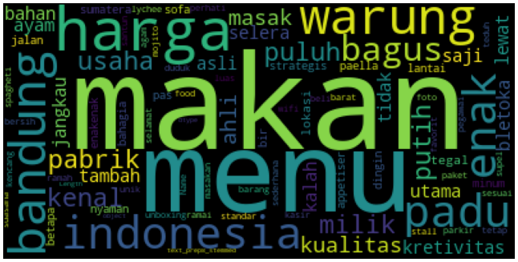
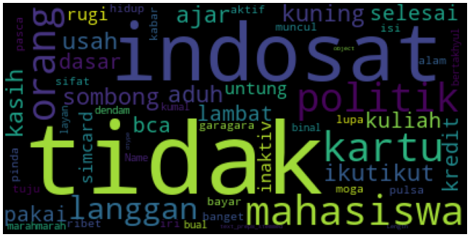
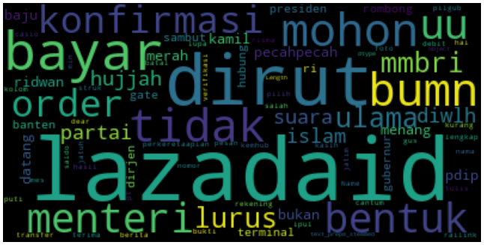
Data Insight – Word Cloud
Good
(1)
Bad
(-1)
Neutral
(0)

Slide 16
Modelling, Modelling Evaluation, Dashboard & Insight
Model development & evaluation, integration into dashboard, and insight

Slide 17
Modelling – Scoring
Good | Neutral | Bad
Predicted ------------- Actual | 0 | 0 | 1
0 | TN | TN | FP
0 | TN | TN | FP
1 | FN | FN | TP
Recall Positive (Recall_Micro)
Focus
Reducing False Negative
Reducing the bad sentiment that is predicted as good sentiment
The teams would like to anticipate any bad sentiment as early as possible
recall_micro ➔ multiclass classification & imbalance data
Good
Neutral
Bad

Slide 18
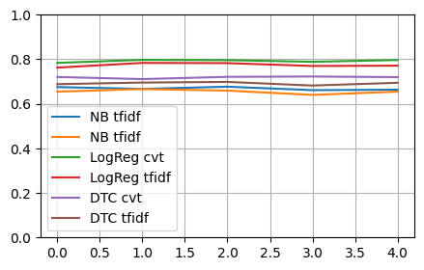
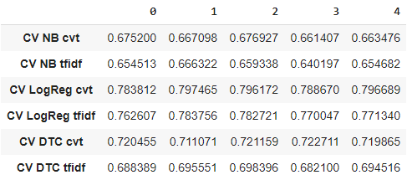
Modelling – Initial Benchmark
Logistic Regression with TF-IDF
Best
Model
Logistic Regression
CV 5 Folds
Solver ➔ ‘lbfgs’
Class Weight ➔ ‘balanced’
TF-IDF is chosen since this method can indicate a meaningful word in a context

Slide 19
Modelling – Hyperparameter Tuning
Training Duration
Best Score
Best Parameters
1,349 minutes
* + 22 hours
0,82
max_iter: 300
C: 10
Model Performance
Notes
The model performance is affected by the stemming process by Sastrawi
INDIRA SYAWANODYA in her Post-Graduate Thesis stated that Sastrawi's running time is slow and it impacts to its performance

Slide 20
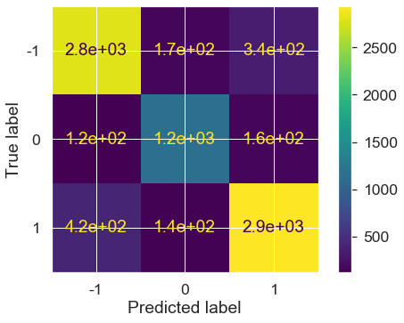
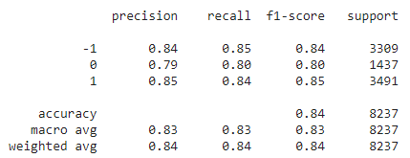
Modelling – Evaluation
Recall Score
Score
Recall Score is 0.85
Of 3309 data of bad sentiment, the model successfully classify 2800 data .

Slide 21
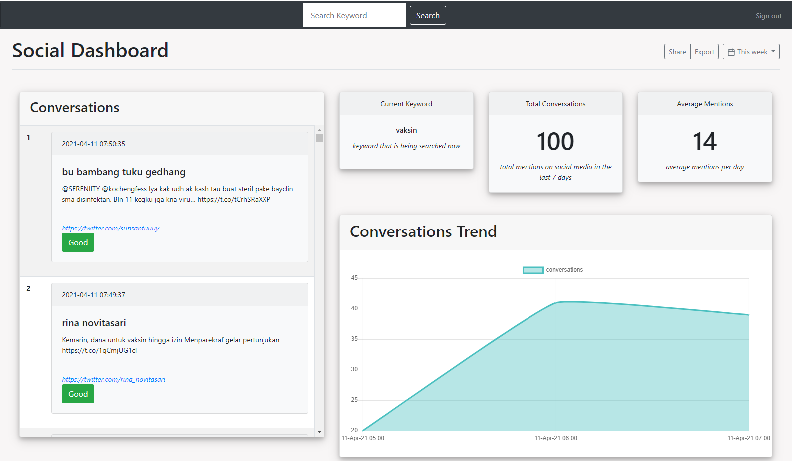
Dashboard
Prediction Result
Result
Model can successfully predict new data from Twitter
Disclaimer
Model used in Dashboard Deployment still uses the model without preprocessor due to technical issue (custom preprocessor function cannot be read as part of the pipeline).
However, in the notebook the model with preprocessor keep running successfully in predicting new data
Notes:
Recall Score of model with preprocessor: 0.85
Recall Score of model without preprocessor: 0.85

Slide 22
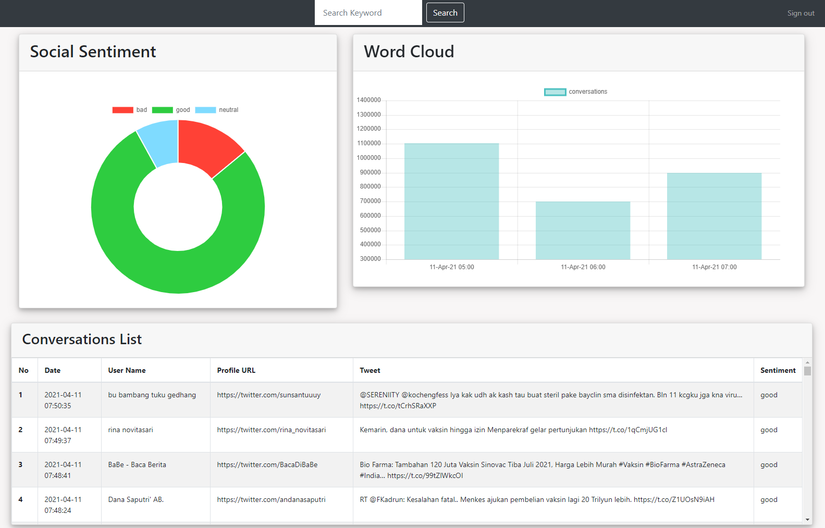
Dashboard

Slide 23
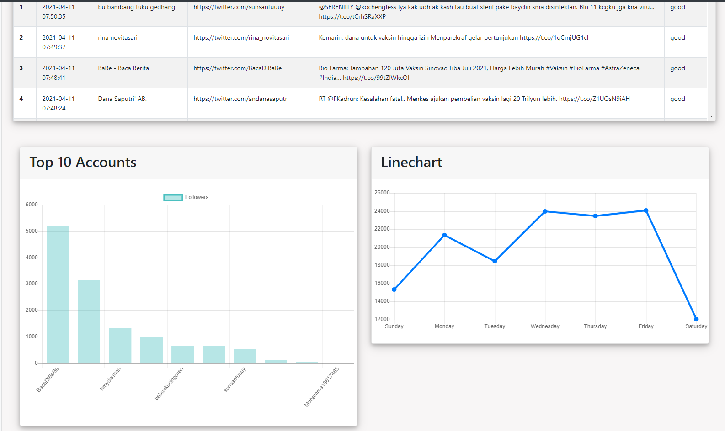
Dashboard

Slide 24
Business Impact Calculation & Future Improvements
Return of Investment and Future Improvement

Slide 25
Business Impact
Automated Process
01
Automated Sentiment Analysis ➔ Help the Tem to Focus on the Solution
Budget Savy
02
Building own system can save up annual vendor service fee by IDR 400 M
Prevent Bigger Loss
03
Reputational Risk can lead loss due to cost of compensation & litigation where the amount can be higher than 1 B in a year
Benefit Achieved

Slide 26
Future Improvement
Customers’ Email/Phone Sentiment Analysis
01
Customer Service: to follow up complaints as immediately as possible
Sales Business: to identify bad-feeling customers and decide what the best treatment should be done to retain them
Early Warning System
02
Push Notification via SMS/email for any Negative Contents
Image detection
03
Fraud analysis (fake information, fake job vacancy) or brand misuse (use of logo that does not align with Company’s guideline) that involve image contents
Improvement for Better Output

Slide 27
Model & Dashboard Improvement
Dashboard
01
More friendly UI & UX
More customized feature for filtering or report download
Cover specific searching and more data in terms of amount and time period
Model
02
Applying Name Entity Recognition
Using Deep Learning Model
Using Pretrained Model (Transfer Learning)
Improvement for Better Output

Slide 28
Thank You!!
Damianus Deni Kurnianto
Job Connector Data Science After Hour
November 2020 – April 2021

Slide 29
Fully Editable Icon Sets : A
You can Resize without losing quality
You can Change Fill Color &
Line Color
FREE
PPT TEMPLATES
www.allppt.com

Slide 30
Fully Editable Icon Sets : B
You can Resize without losing quality
You can Change Fill Color &
Line Color
FREE
PPT TEMPLATES
www.allppt.com

Slide 31
Fully Editable Icon Sets : C
You can Resize without losing quality
You can Change Fill Color &
Line Color
FREE
PPT TEMPLATES
www.allppt.com

