Slide 1

SENTIMENT ANALYSIS

Slide 2
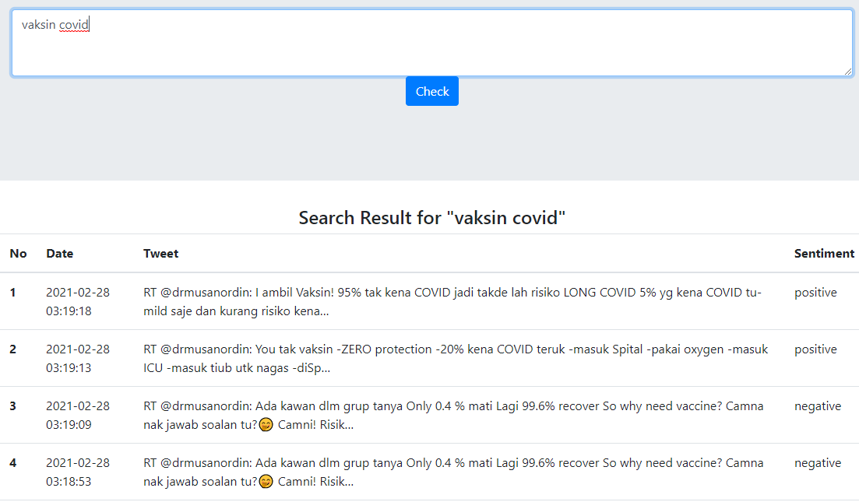
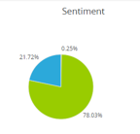
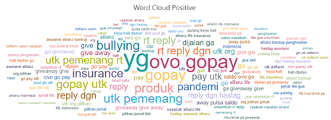
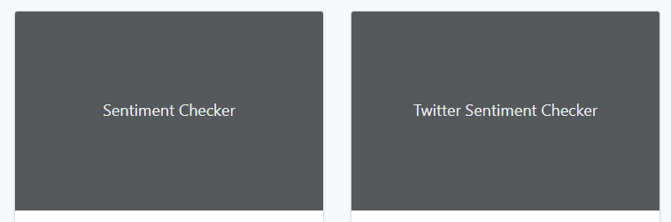
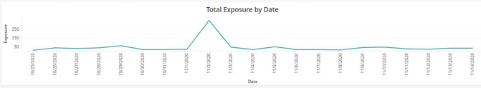
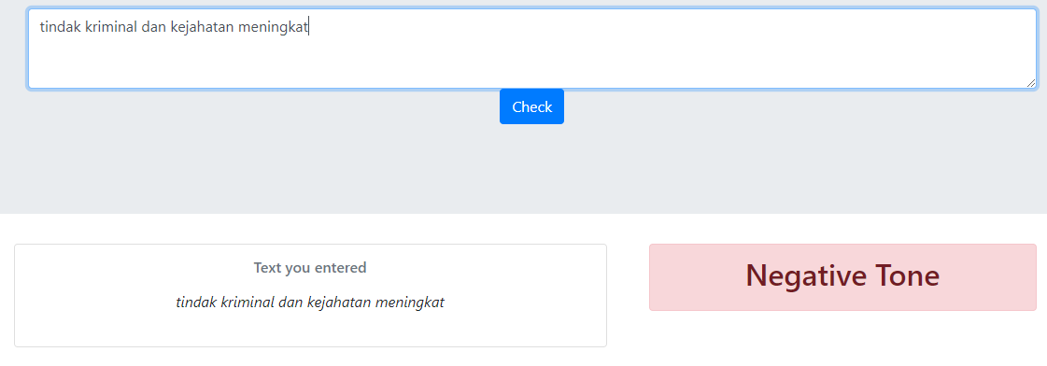
PROTOTYPE
Social Media Sentiment Analysis (Twitter)
Filter:
- Date
- Sentiment
Text Sentiment Checker

Slide 3
DATA
Data for sentiment prediction training
Github
IndoNLU
Others
Github – rizalespe (https://github.com/rizalespe/Dataset-Sentimen-Analisis-Bahasa-Indonesia )
- Dataset sentimen Twitter Pilkada DKI 2017
- Dataset sentimen Twitter layanan telekomunikasi Indonesia
- Dataset sentimen komentar Instagram Cyberbullying
- Dataset sentimen Twitter tayangan televisi
- Dataset sentimen Twitter opini film
- Dataset emoji
Github – indobenchmark (https://github.com/indobenchmark/indonlu/tree/master/dataset/smsa_doc-sentiment-prosa)
Meltwater

Slide 4
INPUT & OUTPUT
Sentiment Analysis Model
Single words
Phrases
Sentences
Emoticon
File Input
Sentiment Result

Slide 5
MAIN FEATURES
Feature 1: Sentiment Prediction
From whose perspective?
What industry/topic?
What are the channels from?
What data will be collected?
Accuracy & confusion matrix?
Every content’s sentiment is labelled/predicted automatically
The accuracy and confusion matrix should be better than previous projects
Dataset should be legally collected and public
Provide benchmark score from popular classification algorithms (KNN, SVM, SGD, Random Forest, Naïve Bayes, Logistics Regression, Gradient Boosting) and deep learning algorithms (see Samuel Cahya & PyData slides)
Feature 2: Weekly text summary
Text summarization
Trend insight/keywords insight
Feature 3: Translation (English – Indonesian)
This feature is nice to have
It becomes added value for the project and also a distinguished factor from the previous project.
This works very simply, it is translating English to Indonesian.
Future Works
Early Warning System for Top 5 Negative Contents
Image detection for fraud analysis or brand misuse
Recommendation based on contents and sentiment

Slide 6
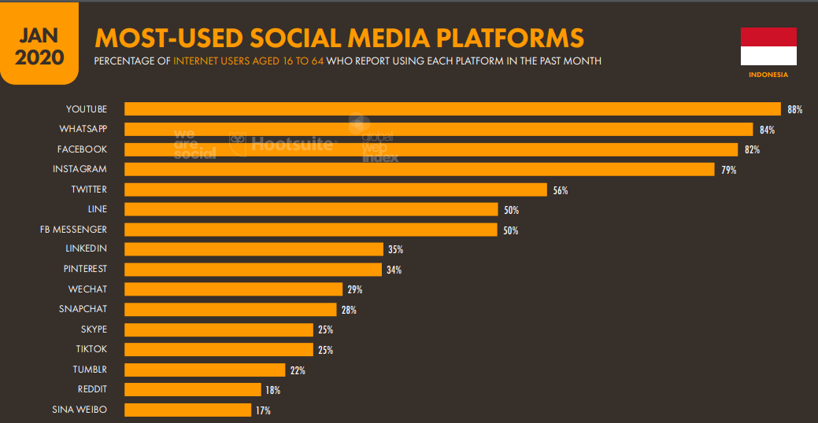
BACKGROUND
Based on Hootsuite Digital Report January 2020, Indonesia internet users are 175.4 million people
160 million of them are social media users
95% are actively engaged with social media where each of them spend averagely 3H 26M per day using social media
Continuing the trend from last years, digital behaviour of Indonesian people tend to grow higher moreover with the existence of pandemic. They are more actively engaged in digital in terms of accessing information, buying something, sharing insight or opinions.
On the other hand, brands/companies are also challenged to adapt in this condition. With more limited physical activities, they give more focus on optimizing all digital channels in providing services/distributing products as well as collecting data/listening to customers‘ voice.
Listening customers‘ or people‘s voice is really significant. One of key factors in capturing what customers‘/people want is through understanding their intention based on sentiment categorization.

Slide 7
THEORY
Sentiment analytics use techniques such as part of speech tagging, lemmatization, prior polarity, negations, ampliﬁers & other grammatical constructs, and semantic clustering to assign sentiment scores to social media posts, research survey questions and documents such as -1 (true negative) and 1 (true positive). A score of 0 or very close to 0 (±0.05) can be interpreted as being neutral; either there was no sentiment expressed or it was ambiguous – Repustate.com (https://www.repustate.com/sentiment-analysis/)
Industry benefited from sentiment analysis → e-commerce, banking & finance, healthcare, hospitality, market research, government & automobile manufacturing
The larger the corpus, and more importantly, the more varied the corpus, the better the results in creating the Indonesian part-of-speech tagger (https://www.repustate.com/indonesian-sentiment-analysis/)
Using NER to increase the quality of sentiment analysis (https://www.repustate.com/named-entity-recognition/)

Slide 8
LEARNING CYCLE
Streamed contents
Predicted sentiment
Storing the streamed contents and their sentiment
Taking them to be included in the training data
Updating the model and accuracy

